Slide 1
Performance

Slide 2
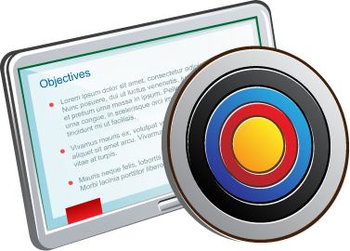
Objectives
After completing this lesson, you should be able to:
Monitor performance in a CDB and PDBs
Manage SGA and PGA limits at the PDB level
Manage AWR snapshots at the CDB and PDB levels
Run ADDM tasks for CDB and PDB recommendations
Manage application shared object statistics
Control query DOP involving the containers() construct
Manage Heat Map and ADO policy declaration in a PDB
Manage a CDB fleet
Describe use cases for Consolidated Database Replay
Notes:
For a complete understanding of the CDB and PDB performance and monitoring, refer to the following guide in the Oracle documentation:
“Monitoring CDBs and PDBs“ in Oracle Multitenant Administrator’s Guide 19c
Oracle Database Performance Tuning Guide, 19c
Oracle Database Testing Guide 19c
Refer to other sources of information available under Oracle Learning Library:
Oracle By Example (OBE): Learning Path: 19c New Features for Multitenant
managing_cdb_fleets

Slide 3
Tuning a CDB
Basic rules:
The PDB appears to applications exactly the same as a non-CDB.
Some initialization parameters can be set at the PDB level.
SQL statements are tuned on a per PDB basis.
Common objects statistics are gathered in the application root of the common object.
Local objects statistics are gathered in the PDB of the local object.
AWR tools run at the CDB and PDB level: ASH / ADDM
AWR snapshots can be taken at CDB or PDB level.
The cursors in the shared pool are identified by PDB.
Instance-wide information is kept in the CDB root container.
Notes:
The tuning methodology for a multitenant container database (CDB) with many pluggable databases is basically the same as for a single instance non-CDB. Oracle Corporation has developed a tuning methodology based on years of experience. The methodology presented in this course is also presented in the Oracle Database Performance Tuning Guide. This methodology is applied independent of the tools that you use. The ADDM tool follows this methodology automatically.
The rules relating to the behavior of the PDB are fairly simple, but have some complex implications.
The first rule is that in a PDB servicing an application behaves in exactly the same way a non-CDB with the same data would with regard to the SQL and PL/SQL issued by the application. The implications of this statement with regard to tuning include that some initialization parameters can be set at the PDB level, and some of these parameters affect SQL performance.
SQL statements are tuned at the PDB level. The SQL Tuning Advisor runs in a specific PDB. SQL Profiles are applied at the PDB level. These require that cursors are identified by PDB in the shared pool. The objects statistics are collected with the DBMS_STATS package in the PDB where the object resides.
The Automatic Workload Repository (AWR) snapshots and Active Session History (ASH) data are kept in the CDB root container when created in the CDB root. This information is used to provide instance-wide tuning advice using the Automatic Database Diagnostic Monitor (ADDM), AWR, and ASH tools.
Oracle Database 12c introduces PDB level snapshots—collection of statistics that matters at the PDB level, created when connected to the PDB. PDB level automatic snapshot is off by default. A PDB has the ability to take its PDB-specific AWR data when it unplugs from a CDB. The AWR data captured at the PDB level is stored in the SYSAUX tablespace of the PDB.

Slide 4
Sizing the CDB
Areas of concern:
Memory (SGA and PGA)
Buffer Cache
Shared Pool
Program Global Area
CPU over allocation
SQL Tuning
Notes:
When considering non-CDBs’ consolidation into a single CDB, several questions arise:
How much memory will I need?
How much CPU will I need for peak loads?
Can I tune the applications independently?
An estimate of memory and CPU requirements can be obtained by gathering statistics as in an AWR report over a period of time for each non-CDB instance to estimate and then take a sum of non-CDBs’ buffer cache, shared pool, and PGA in the current instances. These estimates should also include period of peak usage and the times of peak usage for each non-CDB to be consolidated.
Reducing the CPU resources allocated to non-CDBs, which are usually based on peak usage, is one of the main reasons for consolidation. But a strategy for handling peak usage should be determined. Do multiple non-CDBs experience peak usage at the same time? Can the loads be time-shifted? Can the applications tolerate being throttled by Resource Manager?
Application tuning is often the most effective tuning. If the application is well tuned on a non-CDB, it behaves well on a PDB. Determining which PDB is handling the poorly behaving SQL is clear. SQL statements flagged at the CDB level have a tag that identifies the PDB of origin.

Slide 5
Testing the Estimates
Consolidated Database Replay tests:
Consolidation of servers
Scale-up
Peak load capacity
Notes:
After performing the initial sizing estimates for the multitenant container database, you can use Consolidated Database Replay to test the estimates by combining captured workloads from each of the individual non-CDB databases into a scheduled replay in a single CDB. This replay schedule can be modified to adjust peak loads and test scenarios where additional workloads are expected to be added. Details on Consolidated Database Replay are covered in "Appendix C: Consolidated Database Replay Procedures."

Slide 6
Managing SGA for PDBs
CDB Instance
SGA_TARGET set at the PDB level enforces a hard limit for the PDB’s SGA.
SGA_TARGET at the PDB level provides more SGA for other containers.
SGA_MIN_SIZE set for a PDB guarantees SGA space for the PDB.
Parameters at PDB level are:
DB_CACHE_SIZE
SHARED_POOL_SIZE
(PDB minimums) cannot be > 50 percent of memory.
SGA_TARGET=10TB
SGA_TARGET=10TB
CDB Root SGA
CDB Root SGA
Support PDB SGA
SGA_TARGET
Support
PDB SGA
Should the SUPPORT PDB use most of the SGA?
Marketing PDB SGA
Sales
PDB SGA
SGA_MIN_SIZE
Marketing PDB SGA
Sales PDB SGA
Notes:
In a CDB, there is one SGA allocation for the instance, which is shared by all containers, the CDB root, and all PDBs. Most of the SGA is a cache that favors frequently accessed objects in the buffer cache, the shared pool, and the In-Memory column store.
Active PDBs may dominate the space in the SGA cache. In the example in the slide on the left side, the SUPPORT PDB has an active, memory-intensive workload. It monopolizes the SGA. In the example, the MARKETING PDB needs very little SGA. The performance of the SALES PDB depends on critical buffer cache data and parsed cursors. The SUPPORT PDB is more active and is evicting its data.
In the example in the slide on the right side, SGA and PGA memory management is configured at the PDB level.
Setting an SGA_TARGET for a PDB enforces a hard limit for the PDB’s SGA and provides more SGA for the other containers within the CDB. The sum of all PDBs’ SGA_TARGET does not necessarily need to be less than the instance SGA_TARGET, but each PDB SGA_TARGET cannot exceed the instance SGA_TARGET or SGA_MAX_SIZE. SGA_TARGET for PDBs works only if the CDB’s SGA_TARGET is set.
Setting DB_CACHE_SIZE and SHARED_POOL_SIZE guarantees minimum sizes for the PDB.
Setting SGA_MIN_SIZE for a PDB guarantees the SGA space for the PDB.
SGA_TARGET, DB_CACHE_SIZE, and SHARED_POOL_SIZE do not work if the CDB’s MEMORY_TARGET is set.
No more than 50 percent of the memory can be set aside for the PDB minimums: SGA_MIN_SIZE, DB_CACHE_SIZE, and SHARED_POOL_SIZE.

Slide 7
Managing PGA for PDBs
CDB Instance
PGA_AGGREGATE_LIMIT=1TB
PGA_AGGREGATE_TARGET=500GB
Actual PGA Usage
CDB Root PGA
Instance PGA_AGGREGATE_LIMIT
No more PGA can be allocated.
Call or session of the largest PGA users is terminated.
Instance PGA_AGGREGATE_TARGET
All sessions must use TEMP rather than PGA.
PDB PGA_AGGREGATE_LIMIT
PDB PGA_AGGREGATE_TARGET
These parameters set the same behavior at the PDB level.
Support PDB SGA
PGA_AGGREGATE_LIMIT=300M
PGA_AGGREGATE_TARGET=150M
Sales PDB SGA
PGA_AGGREGATE_LIMIT=200M
PGA_AGGREGATE_TARGET=100M
Notes:
PGA_AGGREGATE_TARGET specifies the target aggregate PGA memory that is available to all server processes attached to the instance. To set a hard limit for aggregate PGA memory, use the PGA_AGGREGATE_LIMIT parameter. PGA_AGGREGATE_LIMIT is set by default to the greater of 2 GB, 200 percent of PGA_AGGREGATE_TARGET, and 3 MB times the PROCESSES parameter. It is set below 200 percent of PGA_AGGREGATE_TARGET if it is larger than 90 percent of the physical memory size minus the total SGA size, but not below 100 percent of PGA_AGGREGATE_TARGET.
The parameters can be configured at the PDB level.

Slide 8
Monitoring PDB Memory Usage
Monitor memory usage before and after configuring PDB memory parameters.
Monitor per PDB history statistics.
V$RSRCPDBMETRIC / V$RSRCPDBMETRIC_HISTORY /
V$RSRC_PDB
SGA_BYTES
PGA_BYTES
SHARED_POOL_BYTES
BUFFER_CACHE_BYTES
V$RSRC_PDB_HISTORY
Notes:
Several views have been added to allow you to monitor the memory and Resource Manager operations at the PDB level.
Statistics are collected every minute into V$RSRCPDBMETRIC and V$RSRCPDBMETRIC_HISTORY, showing PDB memory and Resource Manager statistics rolled up to the PDB level. This is different from the V$RSRCMGRMETRIC view that shows statistics at the consumer group level.
All these views include information that allows you to monitor different aspects of SGA and PGA memory allocations by PDB.

Slide 9
AWR and ADDM Behavior
AWR snapshots are created to collect statistics:
Collects statistics at the PDB level
Collects statistics for each PDB opened
ADDM runs at the CDB level only:
Recommendations at the CDB level and PDB level
SQL> CONNECT / as sysdba
SQL> exec DBMS_WORKLOAD_REPOSITORY.CREATE_SNAPSHOT (FLUSH_LEVEL => 'TYPICAL', DBID => 594859305)
AWR_ROOT_PDB_IN_SNAP
snap_ID = 120 … DBID = 594859305
con_DBID = 65473892
con_ID = 5
SQL> CONNECT / AS SYSDBA SQL> var task_name VARCHAR2(60)
SQL> DECLARE
taskid NUMBER;
BEGIN
dbms_advisor.create_task('ADDM',taskid,:task_name);
dbms_advisor.set_task_parameter(:task_name, 'START_SNAPSHOT', 97);
dbms_advisor.set_task_parameter(:task_name, 'END_SNAPSHOT', 119);
dbms_advisor.set_task_parameter(:task_name, 'DB_ID', 594859305);
dbms_advisor.execute_task(:task_name);
END;
/
Notes:
PDB-level snapshots—collection of statistics that matter at the PDB level are created when the PDB is opened. Even if the snapshot is created while being connected to the CDB root, the snapshot contains statistics that are collected for each opened PDB. A PDB-level report contains information that is specific only to a PDB.
A new view, AWR_ROOT_PDB_IN_SNAP, captures the list of opened PDBs at the time of the Automatic Workload Repository (AWR) snapshot creation. The CON_ID column displays the ID of the PDB to which the data pertains. The same information is kept in the DBA_HIST_PDB_IN_SNAP view.
SQL> select * from AWR_ROOT_PDB_IN_SNAP;
SNAP_ID DBID INSTANCE_NUMBER CON_DBID FLAG CON_ID
---------- ---------- --------------- ---------- ---------- ------
120 594859305 1 216956870 0 4
120 594859305 1 65473892 0 5
121 594859305 1 216956870 0 4
121 594859305 1 65473892 0 5
Thus, ADDM tasks can provide recommendations for the CDB and for PDBs as well.

Slide 10
PDB-Level Snapshot Views
CDB-level AWR views
PDB-level AWR views
List of all PDB-level AWR views
AWR_ROOT_PDB_IN_SNAP
snap_ID = 120 … DBID = 594859305
con_DBID = 65473892
con_ID = 5
AWR_ROOT_RSRC_PDB_METRIC snap_ID = 120 … DBID = 594859305
con_DBID = 65473892
con_ID = 5
AWR_PDB_PARAMETER snap_ID = 120 DBID = 594859305
parameter_name = db_performance_profile
value = PROF_HIGH
con_DBID = 65473892
con_ID = 5
AWR_PDB_RSRC_PDB_METRIC snap_ID = 120 DBID = 594859305
pga_used = 491030
cpu_consumed_time = 58018
con_DBID = 65473892
con_ID = 5
AWR_PDB_SQL_SUMMARY
snap_ID = 120 DBID = 594859305
total_sql= 419
total_sql_mem = 15252584
Single_use_sql_mem = 473848
con_DBID = 65473892
con_ID = 5
SQL> SELECT view_name FROM dba_views WHERE view_name LIKE '%AWR%_PDB%';
Notes:
The AWR data that is captured at the PDB level is stored in the SYSAUX tablespace of the CDB root.
You can view AWR CDB-level data in AWR_ROOT_xxx views.
You can view AWR PDB-level data for all opened PDBs at the time of snapshot capture in AWR_PDB_xxx views.
A PDB has the ability to take its AWR PDB-specific data when it unplugs from a CDB. The target CDB differentiates between the old AWR data that is carried along with the PDB and the new AWR data that is captured after the plugging. The AWR report will not be different from a report that would have been generated in the source CDB.

Slide 11
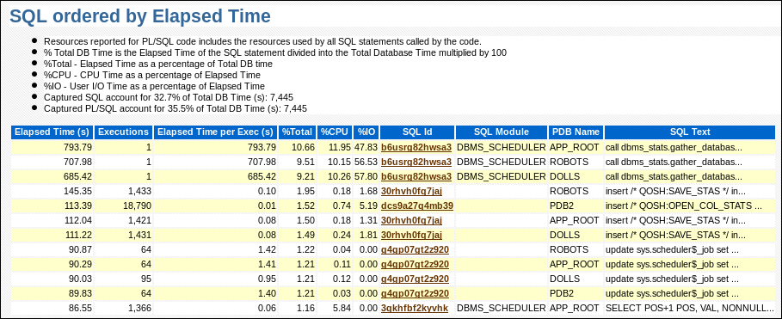
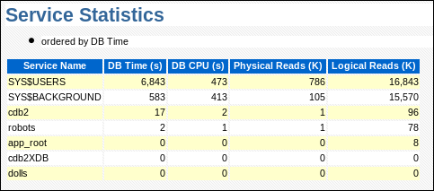
AWR Report
Statistics for each container:
CDB root
PDBs opened
Statistics for each container:
CDB root
PDBs opened
Application root
Application PDBs
Notes:
AWR reporting is performed at the CDB level.
However, an AWR report contains the following AWR data:
AWR CDB-level data
AWR PDB-level data for all opened PDBs at the time of snapshot capture, including application roots and application PDBs

Slide 12
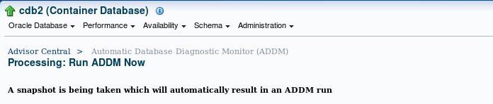
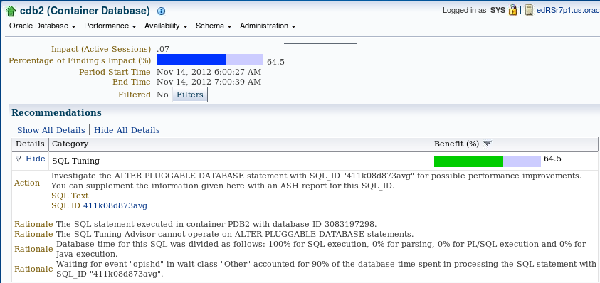
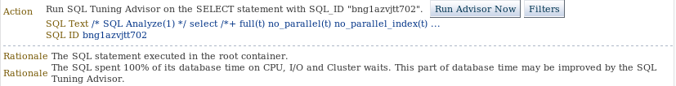
ADDM Tasks: At the CDB Level Only
SQL statements executed in PDB and CDB root
Notes:
All ADDM runs must be performed in the CDB root, and all ADDM results are stored in the CDB root.
However, ADDM tasks provide recommendations on statements executed in any container—in the CDB root, in application roots, in regular PDBs, and in application PDBs. However, ADDM results cannot be viewed when the current container is a PDB.
ADDM analyzes activity in a PDB within the context of the current analysis target, but ADDM does not analyze only one PDB at a time.
ADDM results related to a PDB are not included if the PDB is unplugged.

Slide 13
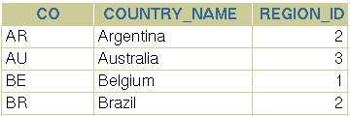
Basic Rules: Statistics for Common Objects
Statistics for common data-linked objects are gathered in the application root.
Statistics for common metadata-linked objects are gathered in the application PDB.
Statistics for common extended data-linked objects are gathered both in the application root and application PDB.
Statistics for local objects are gathered in the application PDB.
App. Container PDB_APP
Application root
Table APP.CODE
Table
APP.COUNTRIES
LABEL | VALUE
Table APP.C
CODE
C1
C2
PDB_APP1
Application
PDB
Table
SYS.OBJ$
NAME
AUDIT_ACTIONS
APP.COUNTRIES
Table APP.C
Table APP.CODE
CODE
C4
LABEL | VALUE
CODE1 | C_PDB_APP1
PDB_APP2
Application
PDB
Table APP.C
Table APP.CODE
Table
SYS.OBJ$
NAME
AUDIT_ACTIONS
APP.COUNTRIES
CODE
C5
LABEL | VALUE
CODE2 | C_PDB_APP2
Notes:
The rules relating to the behavior of a PDB are fairly simple, but have some complex implications.
The first rule is that a PDB that services an application behaves in exactly the same way that a non-CDB with the same data would with regard to the SQL and PL/SQL issued by the application. The implications of a statement with regard to tuning include that some initialization parameters can be set at the PDB level, some of these parameters affecting SQL performance.
SQL statements are tuned at the PDB level. The SQL Tuning Advisor runs in a specific PDB. A container database (CDB) administrator can tune the same query in many PDBs at the same time, whereas a PDB administrator can only tune a single PDB. SQL Profiles are applied at the PDB level. Object statistics are collected with the DBMS_STATS package in the PDB where the object resides.
Statistics for user-defined application common objects are gathered in the application root and/or the application PDB depending on the type of common object, whereas those for local objects in an application PDB are gathered in the application PDB.

Slide 14


Controlling the Degree of Parallelism of Queries
SQL> CONNECT toys_app@toys_root
➔ Queries using the containers() construct execute in parallel by default.
➔The query DOP used is 4: sum (app. root + opened application PDBs).
The query DOP that is used for each statement by using the containers() construct is now 12.
The query DOP that is used for the statement is now 8.
SQL> SELECT sum(revenue), year
FROM CONTAINERS(sales_data)
WHERE year = 2014 GROUP BY year;
TOYS_
root
PDB1
PDB2
PDB3
SQL> ALTER SESSION SET containers_parallel_degree = 12;
SQL> SELECT sum(revenue), year FROM CONTAINERS(sales_data)
WHERE year = 2014 GROUP BY year;
SQL> SELECT /*+ CONTAINERS(DEFAULT_PDB_HINT=PARALLEL 8*/ sum(revenue), year
FROM CONTAINERS(sales_data)
WHERE year = 2014 GROUP BY year;
Notes:
The CONTAINERS_PARALLEL_DEGREE instance parameter controls the Degree of Parallelism of queries, which involves a containers() construct.
By default, a query involving a containers() construct uses a DOP that is equal to the following value:
In the case of a query in the CDB root, the value is (1 + number of open PDBs).
In the case of a query in an application root, the value is (1 + number of open application PDBs).
If the value of this parameter is less than 65535, the value is used as the DOP for all queries involving containers():
In the session if the value was set at the session level
In the instance if the value was set at the system level

Slide 15
Heat Map and ADO Support
Oracle Database CDBs support ADO and Heat Map statistics.
ADO policies automatically compress data in objects in PDBs.
ADO policies automatically move segments in PDBs to other tablespaces in the same PDB when necessary.
ADO is dependent on Heat Map statistics collection and does not work unless Heat Map is enabled.
HEAT_MAP = ON
Notes:
Automatic Data Optimization (ADO) policies automatically execute actions under predefined conditions:
Compress data only
Move segments to other storage tiers under space pressure
ADO can execute compression and data movement only if Heat Map is enabled. After being enabled, Heat Map automatically collects statistics to execute ADO actions after the statistics evaluation is completed.
Automatic Data Optimization requires the Advanced Compression option.
Since Oracle Database 12.2, ADO, and Heat Map statistics are supported in CDBs and more precisely on objects in PDBs.

Slide 16

Managing Heat Map and ADO Policies in PDB
1
2
Enable Heat Map in PDB
HEAT_MAP=ON
Heat Map statistics collected on segments in PDB
Real
Time
Memory
V$HEAT_MAP_SEGMENT
select * from EMP;
update DEPT…;
DBA_HEAT_MAP_SEG_HISTOGRAM view
HEAT_MAP_STAT$ table
MMON
3
4
Window
5
Create ADO Policy on table
ADO Policy evaluated
ADO action executed
EMP
If no access during 3 days
➔ COMPRESS (pol1)
If tablespace TBSEMP FULL
Move EMP to another tablespace (pol2)
No access since 3 days
COMPRESS (pol1)
TBSEMP not FULL yet
➔ No movement (pol2)
EMP compressed
6
View ADO results
COMPRESSION_STAT$ table
Notes:
The slide shows how to set up the different steps between Heat Map and ADO to automate the movement of a segment to another tablespace and/or the compression of blocks or a segment depending on certain conditions defined in ADO policies, in a PDB.
The first operation for the DBA is to enable Heat Map at the PDB level, tracking activity on blocks and segments. Heat Map activates system-generated statistics collection, such as segment access and row and segment modification.
Real-time statistics are collected in memory (V$HEAT_MAP_SEGMENT view) and regularly flushed by scheduled DBMS_SCHEDULER jobs to the persistent table HEAT_MAP_STAT$. Persistent data is visible by using the DBA_HEAT_MAP_SEG_HISTOGRAM view.
The next step is to create ADO policies in the PDB on segments or groups of segments or as default ADO behavior on tablespaces.
The next step is to schedule when ADO policy evaluation must happen if the default scheduling does not match business requirements. ADO policy evaluation relies on Heat Map statistics. MMON evaluates row-level policies periodically and starts jobs to compress whichever blocks qualify. Segment-level policies are evaluated and executed only during the maintenance window.
The DBA can then view ADO execution results by using the DBA_ILMEVALUATIONDETAILS and DBA_ILMRESULTS views in the PDB.
Finally, the DBA can verify if the segment in the PDB is moved and stored on the tablespace that is defined in the ADO policy and/or if blocks or the segment was compressed, by viewing the COMPRESSION_STAT$ table.

Slide 17

CDB Fleet
19c
A CDB fleet is a collection of different CDBs that can be managed as one logical CDB:
To provide the underlying infrastructure for massive scalability and centralized management of many CDBs
To provision more than the maximum number of PDBs for an application
To manage appropriate server resources for PDBs, such as CPU, memory, I/O rate, and storage systems
CDB Fleet High_Speed
CDB Fleet Low_Speed
cdb1
PDB1
cdb2
cdb4
cdb3
cdb5
PDB2
PDB4
PDB3
PDB5
PDB22
PDB44
PDB55
PDB33
PDB333
PDB555
Notes:
Oracle Database 19c introduces the CDB Fleet feature. CDB Fleet aims to provide the underlying infrastructure for massive scalability and centralized management of many CDBs.
The maximum number of PDBs in a CDB is 4096 PDBs. A CDB fleet can hold more than 4096 PDBs.
Different PDBs in a single configuration require different types of servers to function optimally. Some PDBs might process a large transaction load, whereas other PDBs are used mainly for monitoring. You want the appropriate server resources for these PDBs, such as CPU, memory, I/O rate, and storage systems.
Each CDB can use all the usual database features for high availability, scalability, and recovery of the PDBs in the CDB, such as Real Application Clusters (RAC), Data Guard, RMAN, PITR, and Flashback.
PDB names must be unique across all CDBs in the fleet. PDBs can be created in any CDB in the fleet, but can be opened only in the CDB where they physically exist.

Slide 18
CDB Lead and CDB Members
The CDB lead in a fleet is the CDB from which you perform operations across the fleet.
The CDB members of the fleet link to the CDB lead through a database link.
CDB Fleet High_Speed
CDB Lead
cdb3
cdb1
cdb2
PDB2
PDB3
CDB root
PDB33
PDB22
PDB333
1
CONNECT / AS SYSDBA
ALTER DATABASE SET lead_cdb = TRUE;
CDB member
CDB member
3
4
CONNECT / AS SYSDBA
CREATE PUBLIC DATABASE LINK lcdb1
CONNECT TO system
IDENTIFIED BY pass
USING 'cdb1';
ALTER DATABASE SET lead_cdb_uri='dblink:lcdb1';
Same sequence
of statements
2
GRANT sysoper, … TO system
CONTAINER = ALL;
Notes:
A CDB fleet contains a CDB lead and CDB members. PDB information from the individual CDBs is synchronized with the CDB lead.
The CDB lead is, from the CDB root, able to:
Monitor all PDBs of all CDBs in the fleet.
Report information and collect diagnostic information from all PDBs of all CDBs in the fleet through a cross-container query.
Query Oracle-supplied objects from all PDBs of all CDBs in the fleet.
To configure a CDB fleet, define the lead and then the members.
To define a CDB as the CDB lead in a CDB fleet, from the CDB root, set the LEAD_CDB database property to TRUE.
Still in the CDB root of the CDB lead, use a common user and grant appropriate privileges.
To define other CDBs as members of the CDB fleet:
Connect to the CDB root of another CDB.
Use a common user identical to the common user used in the lead CDB because you have to create a public database link using a fixed user.
Set the LEAD_CDB_URI database property to the name of the database link to the CDB lead.
It assumes that the network is configured so that the current CDB can connect to the CDB lead by using the connect descriptor defined in the link.

Slide 19


Use Cases
Monitoring and collecting diagnostic information across CDBs from the lead CDB
Querying Oracle-supplied objects, such as DBA views, in different PDBs across the CDB fleet
Serving as a central location where you can view information about and the status of all the PDBs across multiple CDBs
CDB Fleet High Speed
CDB Lead
Member in the fleet
Member in the fleet
cdb1
cdb2
cdb3
PDB1
PDB2
PDB3
PDB22
PDB33
PDB333
SELECT … FROM CONTAINERS (dba_users) GROUP BY …;
Notes:
The CDB lead in the CDB fleet can monitor PDBs across the CDBs in the CDB fleet. You can install a monitoring application in one container and use CDB views and GV$ views to monitor and process diagnostic data for the entire CDB fleet. A cross-container query issued in the lead CDB can automatically execute in all PDBs across the CDB fleet through the Oracle-supplied objects.
Using Oracle-supplied or even common application schema objects in different PDBs (or application PDBs) across the CDB fleet, you can use the CONTAINERS clause or CONTAINER_MAP to run queries across all of the PDBs of the multiple CDBs in the fleet. This enables the aggregation of data from PDBs in different CDBs across the fleet. The application can be installed in an application root, and each CDB in the fleet can have an application root clone to enable the common application schema across the CDBs.
The CDB lead can serve as a central location where you can view information about and the status of all the PDBs across multiple CDBs.

Slide 20
Consolidated Database Replay Use Cases
Perform realistic load testing for scenarios including:
Consolidation of servers
Workload scale-up
Test peak load capacity
Notes:
In many enterprises, mission-critical business functions rely on databases. The changing technology environment forces businesses to adopt the latest technology to stay competitive. The challenge is to keep the transition from disrupting business.
Several questions need to be answered to be assured of a smooth transition:
Can the new server handle all the projected consolidate databases?
How much additional workload can the new server handle?
What if the current workload increases?
Consolidated Database Replay allows you to test with real production workloads to answer these questions. With Consolidated Database Replay, multiple captured workloads can be replayed concurrently. A captured workload can be divided into subsets covering particular time periods, and multiple captured workloads can be scheduled to run at specified times.
Because a subset of a captured workload is a self-contained captured workload, a subset can be replicated, time-shifted, and replayed with other subsets.
These features allow you to test scenarios such as consolidation by capturing multiple workloads on different servers and replaying on one server, scale-up by replaying multiple subsets concurrently, and test peak load conditions by replaying captures together with varying schedules.

Slide 21
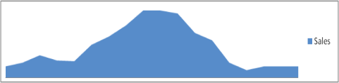
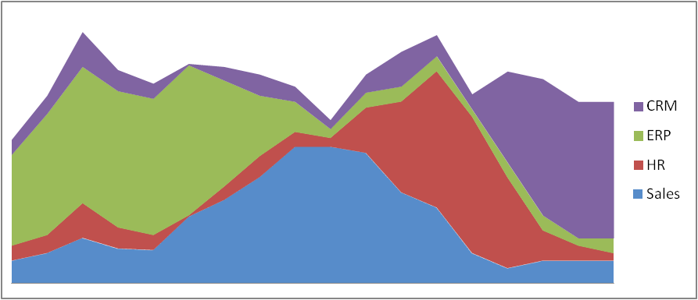
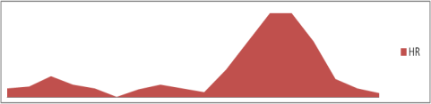
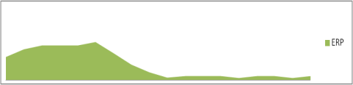
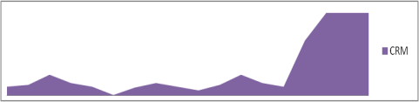
Use Cases: Source Workloads
Workload: Each application has distinct peaks at different times of the workday.
Each workload captured on different databases and being consolidated is independent of the other.
Allows multiple workloads captured from different non-CDBs or PDBs to be replayed concurrently in a single CDB.
SALES
HR
ERP
CRM
Notes:
The ability to capture workloads from more than one non-CDB and then replay all of the workloads as a single replay against a single CDB is a valuable tool for those wishing to do database consolidation. This assumes that a PDB exists in the CDB for each of the non-CDB capture workloads. It is a simple matter to then remap the connections to the PDB service names in the CDB.
The tool also offers the ability to capture workloads from more than one PDB of different CDBs and then replay all of the workloads as a single replay against a single CDB. This is a valuable tool for those wishing to merge dispersed PDBs into a single CDB.

Slide 22




The Big Picture
Prechange Production System
Postchange Test System
Clients
6
5
Processed
Captured Workloads
7
Replay
Clients
App Server
App Server
App Server
8
4
Process
Processes
DB1
backup
1
Capture Workloads
3
CDB1
DB2
backup
PDB1
restore
DB1
PDB2
restore
DB2
DB3
backup
PDB3
restore
DB3
Notes:
The following are the typical steps to perform Database Replay. Note that not all steps are shown in the slide.
1. Capture the workload on a database.
2. Optionally, export the AWR data.
3. Restore the replay database on a test system to match the capture database at the start of the workload capture. The DBA determines the details of this step. It depends on the backup strategy used to return the test system to the starting SCN of the capture recording. With Consolidated Database Replay in Oracle Database 19c, this may mean restoring multiple non-CDBs as PDBs (export / import) or PDBs (cloning) in a single CDB to the start conditions for each capture being replayed.
4. Make changes (such as performing an upgrade or simply testing performance when all non-CDBs are consolidated within a single CDB) to the test system as required.
5. Copy the generated workload files to the replay system.
6. Preprocess the captured workload on the test system or on a system with the same version of database that exists on the test system.
7. Configure the test system for the replay. (Calibrate the wrc processes.)
8. Replay the workload on the restored PDBs in the single CDB.

Slide 23
Step 1
Consolidate multiple non-CDBs or PDBs on a single CDB.
Capture a typical eight-hour workday in each non-DB or PDB.
Export performance data from each DB (AWR, SQL Tuning Sets).
Production
Test
Capture SALES
Capture HR
Capture ERP
Capture CRM
Setup Test system
Preprocess
Replay
Review Reports
Fix Regressions and Iterate
Notes:
The first step consists of capturing the workloads from the multiple non-CDBs that you consider as good candidates for consolidation into a single CDB and/or from PDBs of distinct CDBs that you also consider as good candidates for consolidation into another CDB.
The captured files are generated in separate directories.
You may export the AWR and SQL Tuning Sets to import into the CDB before replay.

Slide 24
Step 2
Move all capture files from production to staging system.
Restore non-CDBs as PDBs or PDBs to the start conditions for each capture being replayed on the single CDB.
Process each workload (needed once).
Replay each workload in isolation on new hardware to obtain baseline and verify suitability.
Flashback/restore.
Production
Test
Capture SALES
Capture HR
Capture ERP
Capture CRM
Setup Test system
Preprocess
Replay
Review Reports
Fix Regressions and Iterate
Notes:
Set a replay directory on the test system to place all capture workloads in the same directory.
Then into the CDB on the test system, import each non-CDB captured (if any) into its dedicated precreated PDB so that the data correspond to what they were at the capture start. Clone each PDB captured (if any) into the test CDB so that the data correspond to what they were at the capture start. Then process all capture workloads once. This preprocessing must be executed once. The same preprocessed files can then be reused for repetitive replays.
Think about replaying each capture separately on the new CDB to verify if on this new server, within a CDB, you’ve already got new performance results.
Then flashback the whole CDB to the time of the capture start.

Slide 25
Step 3
Production
Test
Configure the test system for the replay.
Add each workload by using ADD_CAPTURE().
Initialize consolidated replay and remap all connections.
Optionally, remap schema users.
Synchronize on “Object_ID”.
Calibrate the wrc processes.
Replay the workload on the restored database.
Two objects with the same name in different PDBs will be different Object IDs and will not collide during replay.
Capture SALES
Capture HR
Capture ERP
Capture CRM
Setup Test system
Preprocess
Replay
Review Reports
Fix Regressions and Iterate
Notes:
Before starting the replay itself, first create a replay schedule that sets a directory containing multiple workload captures as the current replay directory. Add all the capture workloads by capture directory name. The schedule is now saved and associated with the replay directory and can be used for a replay.
Then initialize the replay. This step reads the information from the workloads in the replay directory and populates the DBA_WORKLOAD_CONNECTION_MAP table. Query this table to find the connections that need to be remapped.
Each capture workload in a schedule can remap each connection in the workload to a different connect for replay. This allows each capture to be mapped to a different PDB in a CDB.
Then specify the parameters of synchronization during the replay process of multiple capture workloads. Object_id synchronization offers more finer grain synchronization and, therefore, more replay concurrency. The capture process tracks “object_ids” used by each user call, and, therefore, the replay process can minimize object collision. Two objects with the same name in different PDBs will be different Object IDs and will not collide during the replay.
Now the replay in the CDB is ready to accept workload replay client (WRC) connections to replay the multiple captures at the same time.

Slide 26
Step 4
Production
Test
Capture SALES
Capture HR
Capture ERP
Capture CRM
Setup Test system
Preprocess
Replay
Review Reports
Fix Regressions and Iterate
Verify:
Quality of service metrics as perceived by application user per workload
Overall capacity
Only replay can provide definitive answers.
Notes:
Enterprise Manager Cloud Control can provide UI to perform all steps and generate the final report. The report will provide a comparison of the performance before (after the capture) and after (after the replay).
For more detailed information about the set of steps for using Consolidated Replay, refer to Appendix C of the course.

Slide 27

Summary
In this lesson, you should have learned how to:
Monitor performance in a CDB and PDBs
Manage SGA and PGA limits at the PDB level
Manage AWR snapshots at the CDB and PDB levels
Run ADDM tasks for CDB and PDB recommendations
Manage application shared object statistics
Control query DOP involving the containers() construct
Manage Heat Map and ADO policy declaration in a PDB
Manage a CDB fleet
Describe use cases for Consolidated Database Replay

Slide 28
Practice 10: Overview
10-1: Monitoring performance at the CDB and PDB levels
10-2: Getting performance ADDM recommendations at CDB and PDB levels
10-3: Monitoring and tuning SQL executions at the PDB level
10-4: Configuring a CDB fleet with its CDB lead and CDB members

