Slide 1

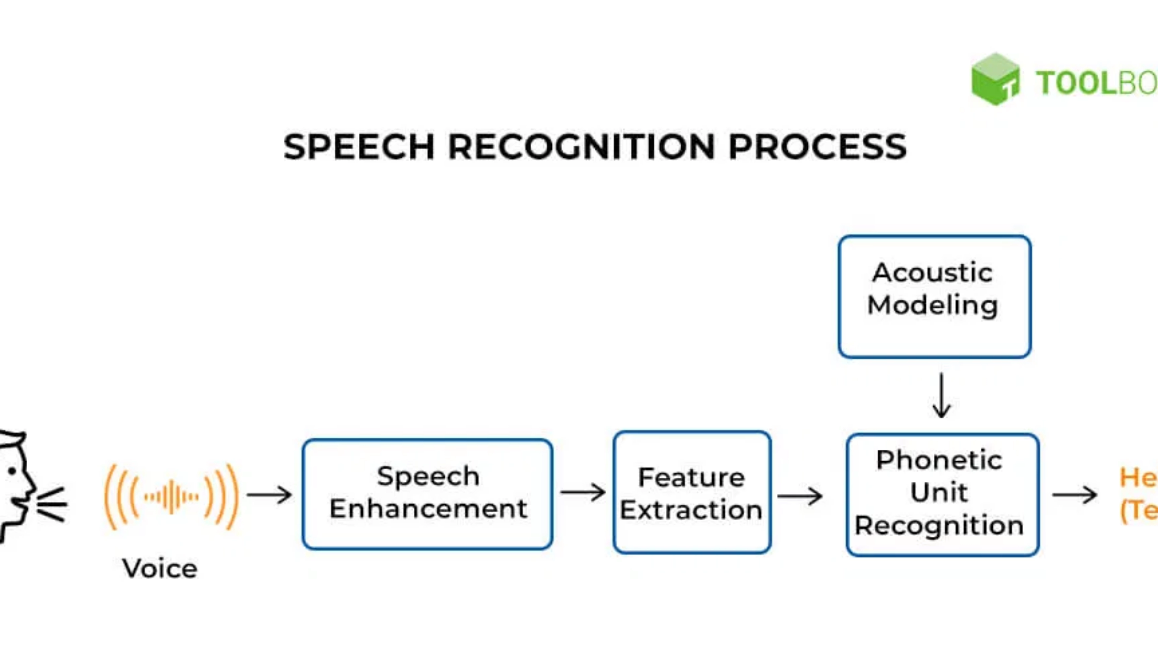
Whisper:
The Future of Speech
Recognition
Unlocking the Power of Speech
September 2025

Slide 2

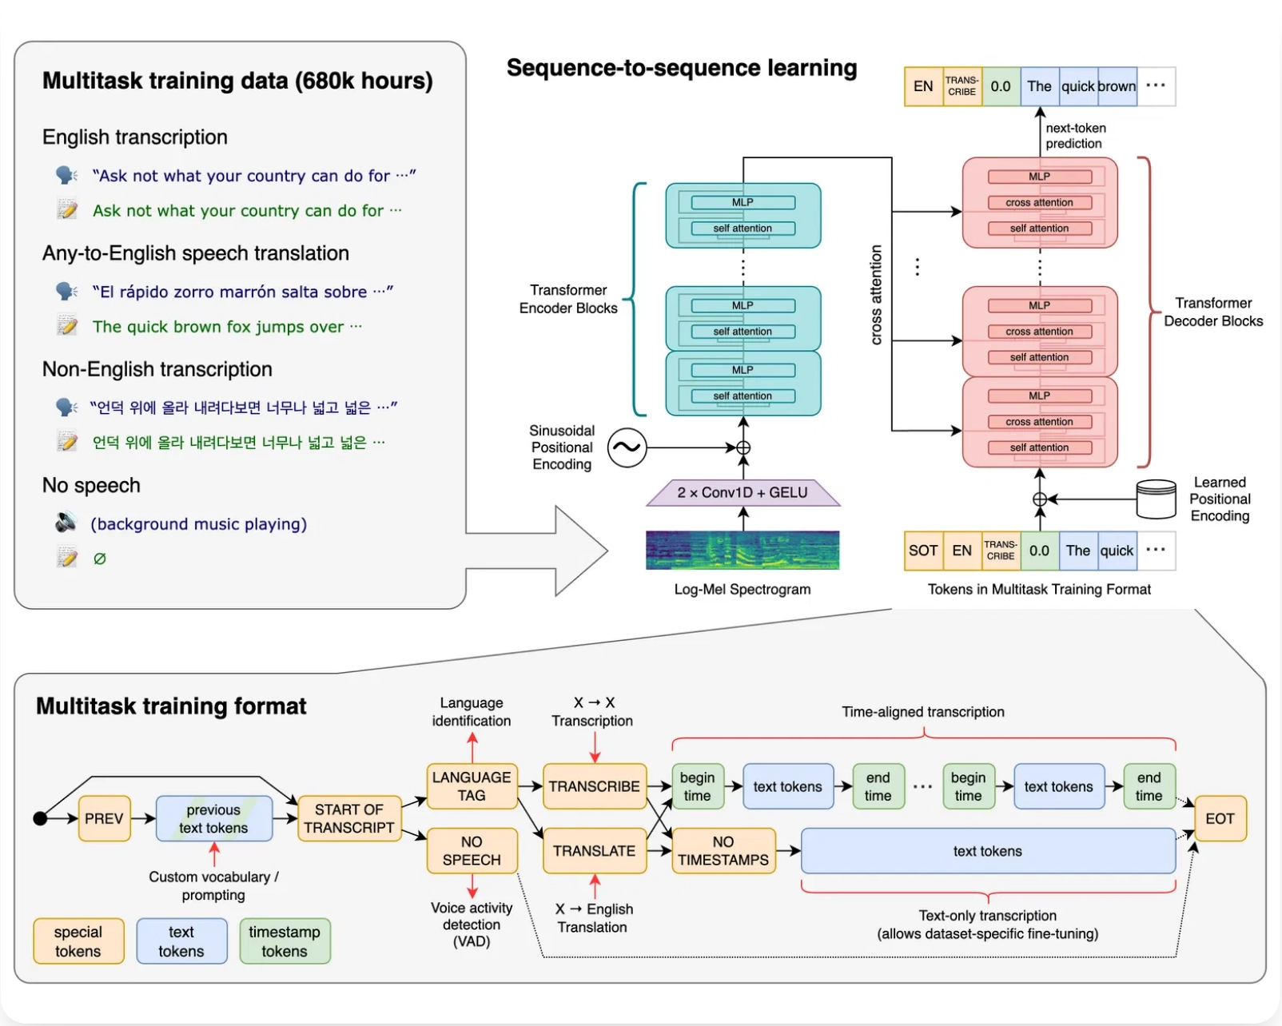
What is Whisper?
Whisper is an
open-source speech recognition model
developed by OpenAI that converts audio into text.
Three Critical Dimensions:
Trained on
680,000 hours
of multilingual data
Handles
imperfect audio
with remarkable accuracy
Supports
97 languages
with translation capabilities
"Whisper represents a breakthrough in accessibility, making speech recognition technology available to everyone."
2

Slide 3

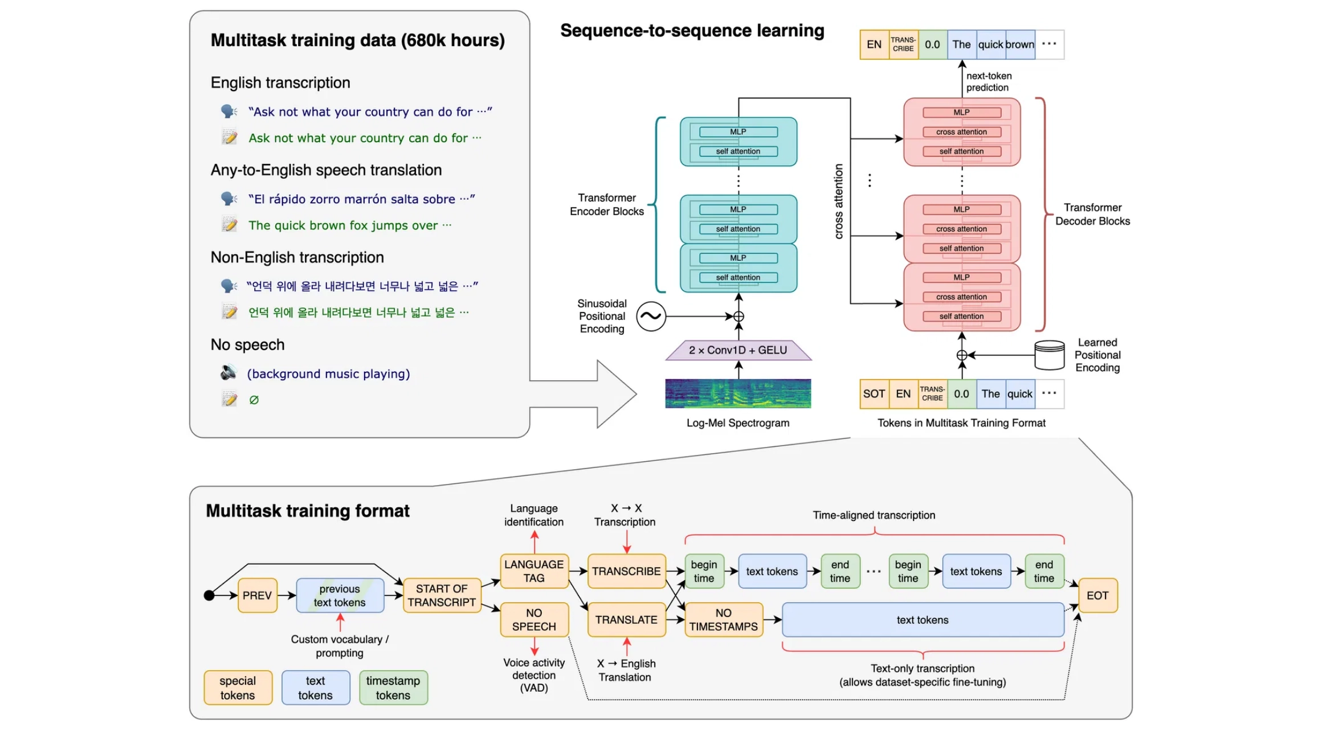
How Whisper Works
Whisper's architecture integrates three essential and interdependent technology layers that work together to transform speech into accurate text.
Key Insight
"Whisper processes audio in 30-second segments, making it highly adaptable to various input lengths while maintaining contextual understanding."
1. Perception Layer
Audio processing and feature extraction from waveforms
2. Cognition Layer
Neural network processing with encoder-decoder architecture
Audio Input
Processing
Encoding
Decoding
Waveform
Spectrogram
Features
Text Output
3. Output Layer
Whisper's end-to-end processing pipeline
Text generation with timestamps and confidence scores
3

Slide 4

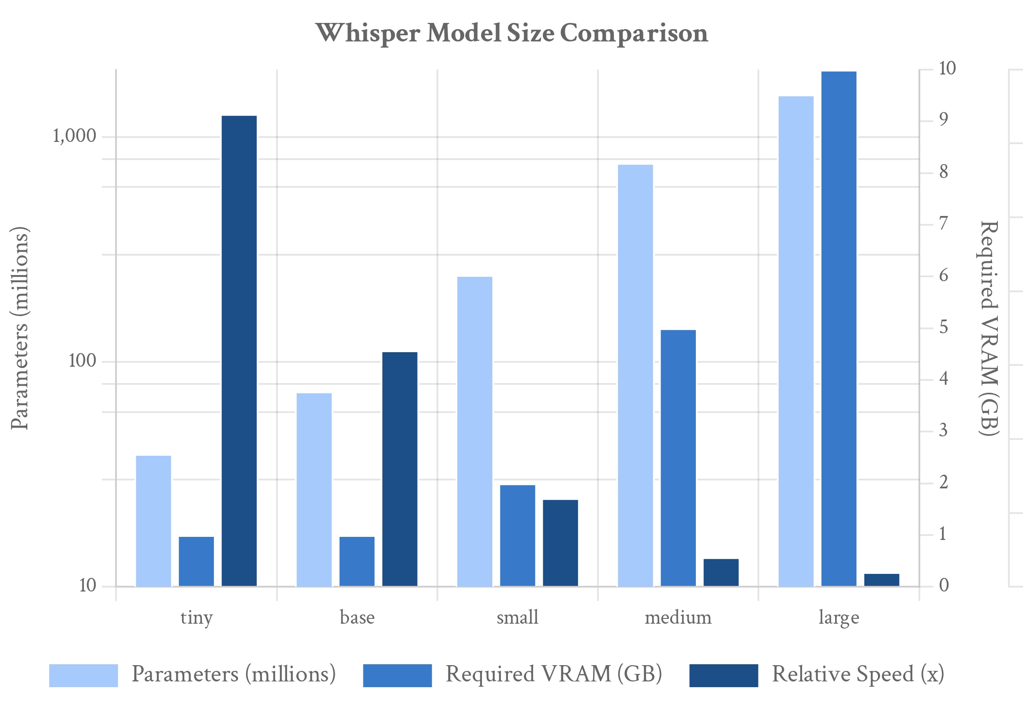
Whisper Model Sizes: Balancing Accuracy and Speed
Whisper offers multiple model sizes to accommodate different hardware capabilities and accuracy requirements, enabling flexible deployment across various devices and use cases.
Key Insight
"Always use the smallest model that meets your accuracy needs. There's no point adding more cost and complexity if you don't need it."
Key benefits of model size options:
Resource Optimization
Match model size to available hardware capabilities
Speed vs. Accuracy Tradeoff
Choose between faster processing or higher accuracy
Source: OpenAI Whisper Documentation, 2023
Language Specialization
English-only models offer better performance for English content
Deployment Flexibility
Run on devices ranging from laptops to high-end GPUs
4

Slide 5

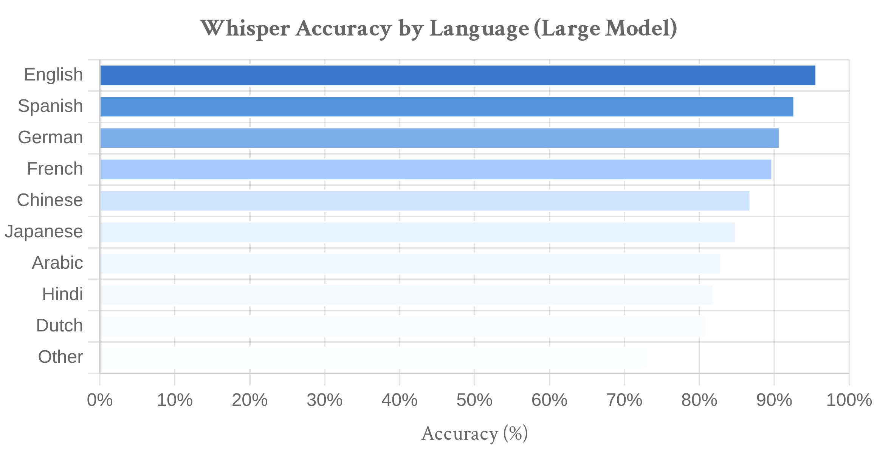
Multilingual Capabilities
Whisper's multilingual support is unprecedented in speech recognition technology, making it accessible to users across the globe regardless of their native language.
Key Insight
"Whisper is trained on 680,000 hours of audio covering 97 languages, with built-in translation capabilities that convert non-English speech directly to English text."
Primary language features:
Automatic language detection
Source: OpenAI Whisper Documentation, 2023
Support for low-resource languages
Handling of accented speech
Language Selection Guide
Direct translation to English
English-only Models
Multilingual Models
Specialized English-only models for higher accuracy
tiny.en, base.en, small.en, medium.en
tiny, base, small, medium, large
By using the larger model sizes, even less common languages achieve remarkable accuracy levels previously unattainable.
5

Slide 6

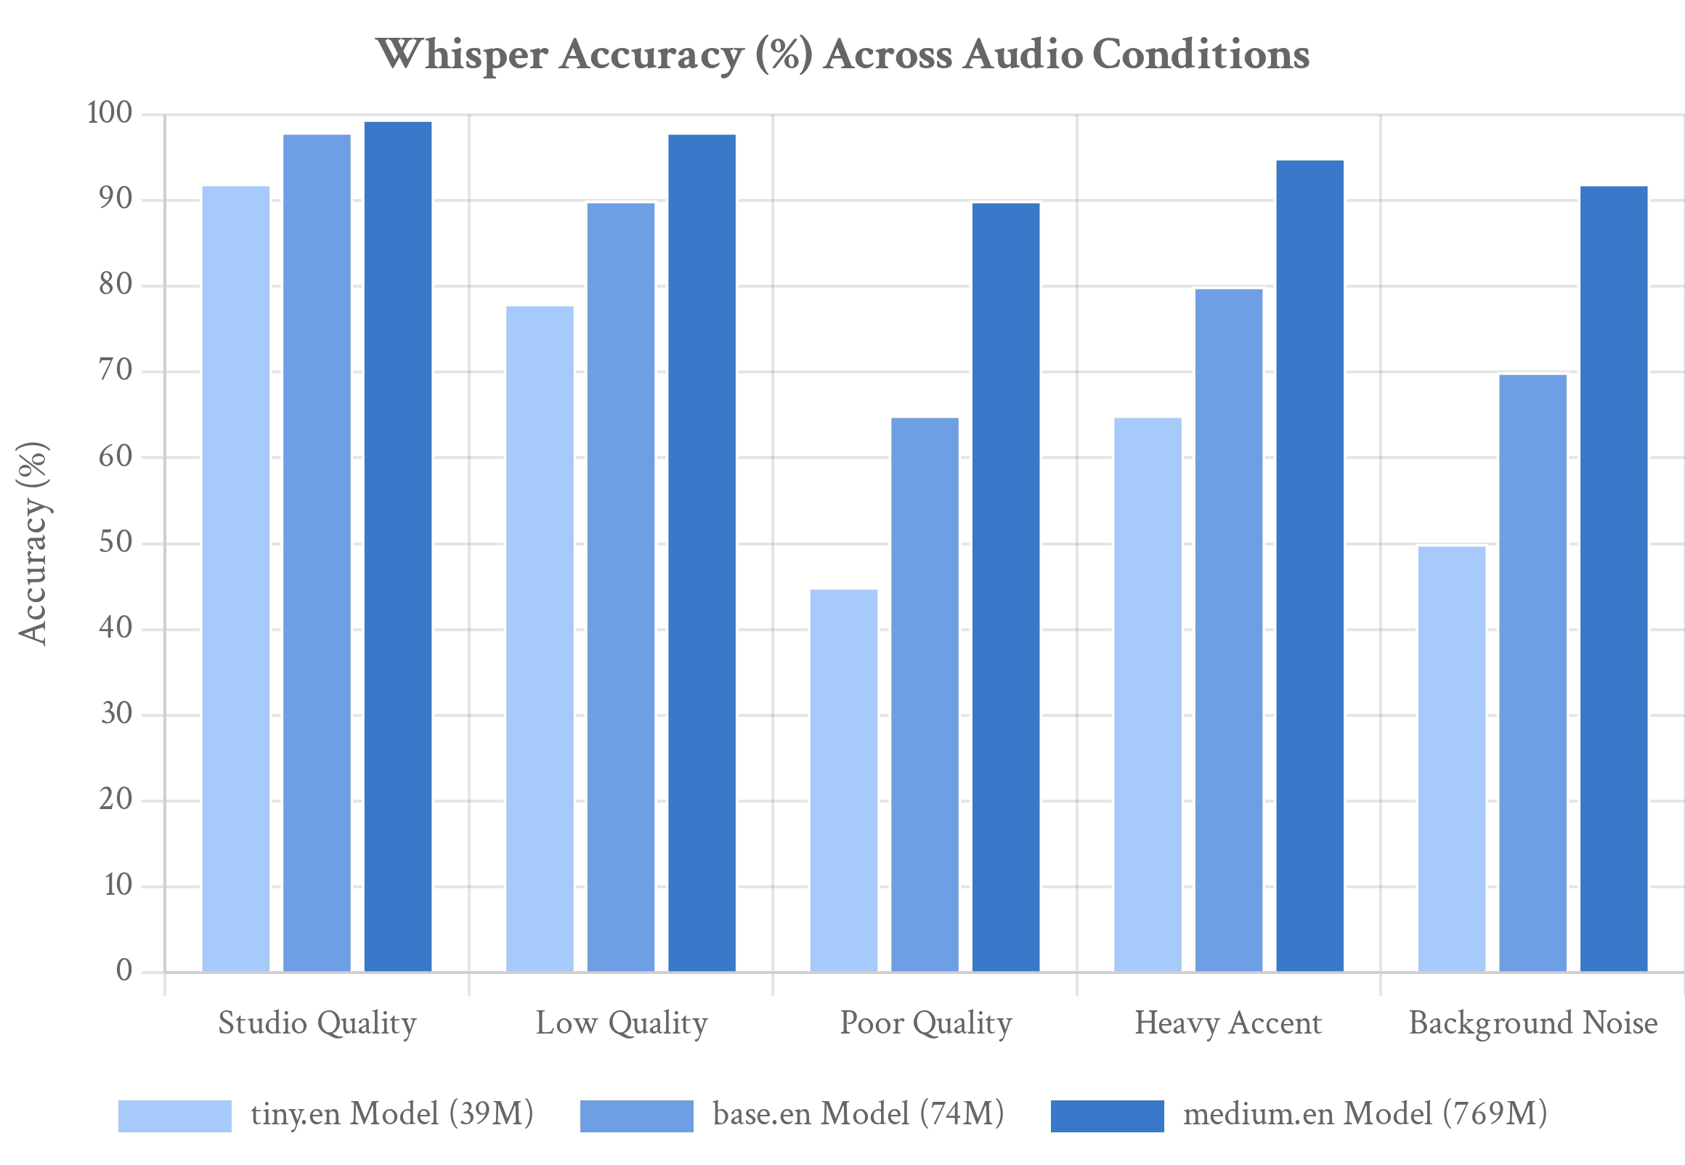
Handling Various Audio Quality
Whisper's remarkable ability to handle varying audio quality levels sets it apart from traditional speech recognition systems, making it practical for real-world applications.
Key Insight
"Even with the smallest model size, Whisper can transcribe high-quality audio with near-perfect accuracy, while larger models excel with challenging audio conditions."
Studio Quality
Perfect transcription with base.en model (avg_logprob: -0.14)
Low Quality
Still accurate with base.en model but lower confidence (avg_logprob: -0.22)
Source: Whisper Model Performance Analysis, 2025
Poor Quality
Whisper's training on 680,000 hours of diverse audio data enables it to handle imperfect recordings, accented speech, and background noise that would challenge traditional speech recognition systems.
Requires small.en or medium.en models for acceptable results
Background Noise
Larger models effectively filter out ambient sounds and interference
6

Slide 7

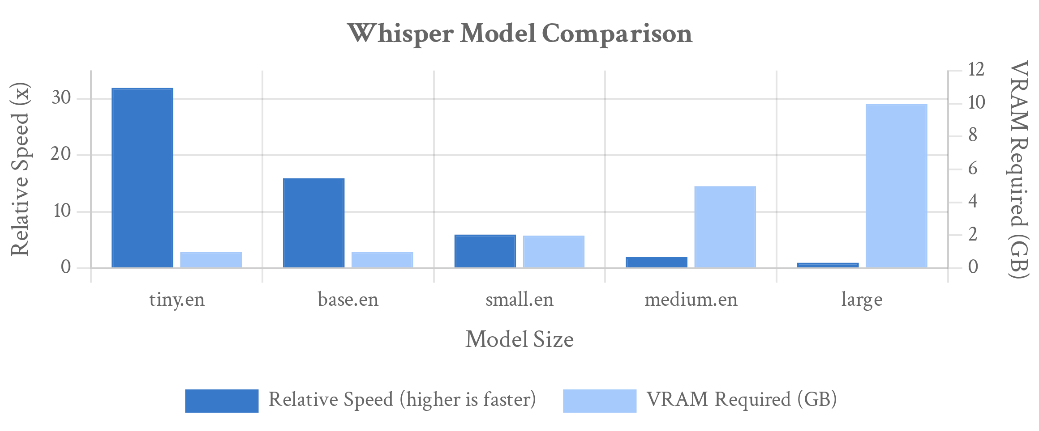
Basic Usage of Whisper
Getting started with Whisper is straightforward. The installation process and basic usage require minimal setup, making speech recognition accessible to developers of all skill levels.
# Install Whisper
pip install -U openai-whisper
# Install ffmpeg (OS-specific)
# Windows: choco install ffmpeg
# MacOS: brew install ffmpeg
# Linux: apt install ffmpeg
# Basic usage
import whisper
# Load model (tiny, base, small, medium, large)
model = whisper.load_model("base.en")
# Transcribe audio
result = model.transcribe("audio_file.mp3")
# Print transcription
print(result["text"])
Key Insight
"Always use the smallest model that meets your accuracy needs to optimize performance and resource usage."
Installation Requirements
Python with pip and ffmpeg for audio processing
Model Selection
Choose based on language, accuracy needs, and available VRAM
Audio Format Support
Compatible with most common audio formats (MP3, WAV, etc.)
Output Options
Full text, segments with timestamps, and confidence scores
Source: Whisper Documentation, 2025
7

Slide 8

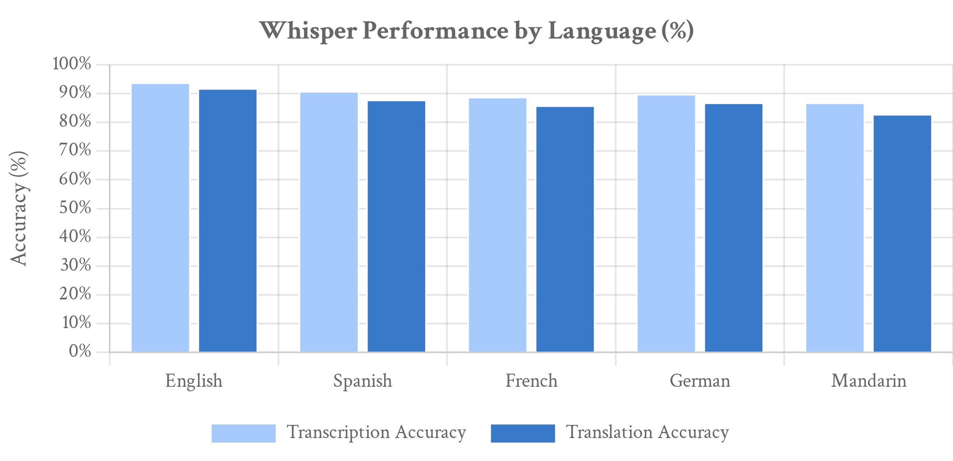
Advanced Usage Techniques
Whisper offers powerful advanced features that extend beyond basic transcription, enabling sophisticated speech processing applications across multiple languages and audio conditions.
# Language detection and translation example
result = model.transcribe(
"audio_file.mp3",
verbose=True,
language="auto",
task="translate"
Key Insight
)
"Whisper's language detection and translation capabilities make it a universal speech processing solution for global applications."
# Advanced options with timestamps
options = whisper.DecodingOptions(
language="nl",
task="transcribe",
without_timestamps=False,
Language Detection
word_timestamps=True
Automatically identifies the spoken language with high confidence
)
result = whisper.decode(model, mel, options)
Translation to English
Translates non-English speech directly to English text
Long-form Audio Processing
Handles extended audio by processing in 30-second segments
Timestamp Generation
Creates precise word-level timestamps for subtitling
Source: Whisper Model Performance Analysis, 2025
8

Slide 9

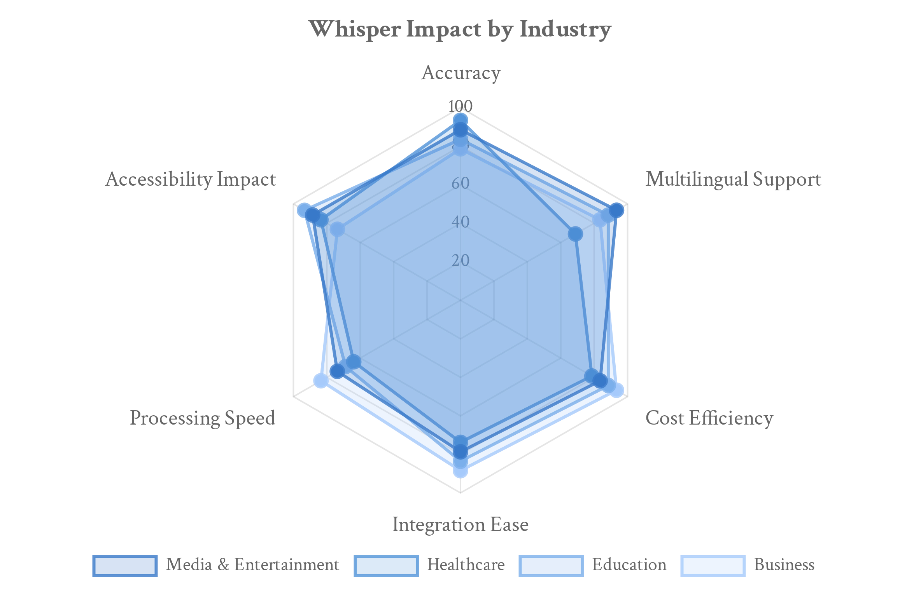
Practical Applications of Whisper Technology
Whisper's versatility and accuracy enable a wide range of practical applications across industries, transforming how we interact with speech-based content and services.
Key Insight
"Whisper's open-source nature has democratized access to high-quality speech recognition, enabling innovation across sectors previously limited by proprietary technology."
Media & Entertainment
Automated subtitling, content indexing, and translation
Healthcare
Medical transcription, patient documentation, accessibility
Education
Source: Speech Recognition Market Analysis, 2025
Lecture transcription, language learning, accessibility tools
The accessibility of Whisper has accelerated adoption across sectors, with media and healthcare seeing the most transformative impact due to their heavy reliance on accurate transcription.
Business & Productivity
Meeting transcription, voice assistants, customer service
9

Slide 10

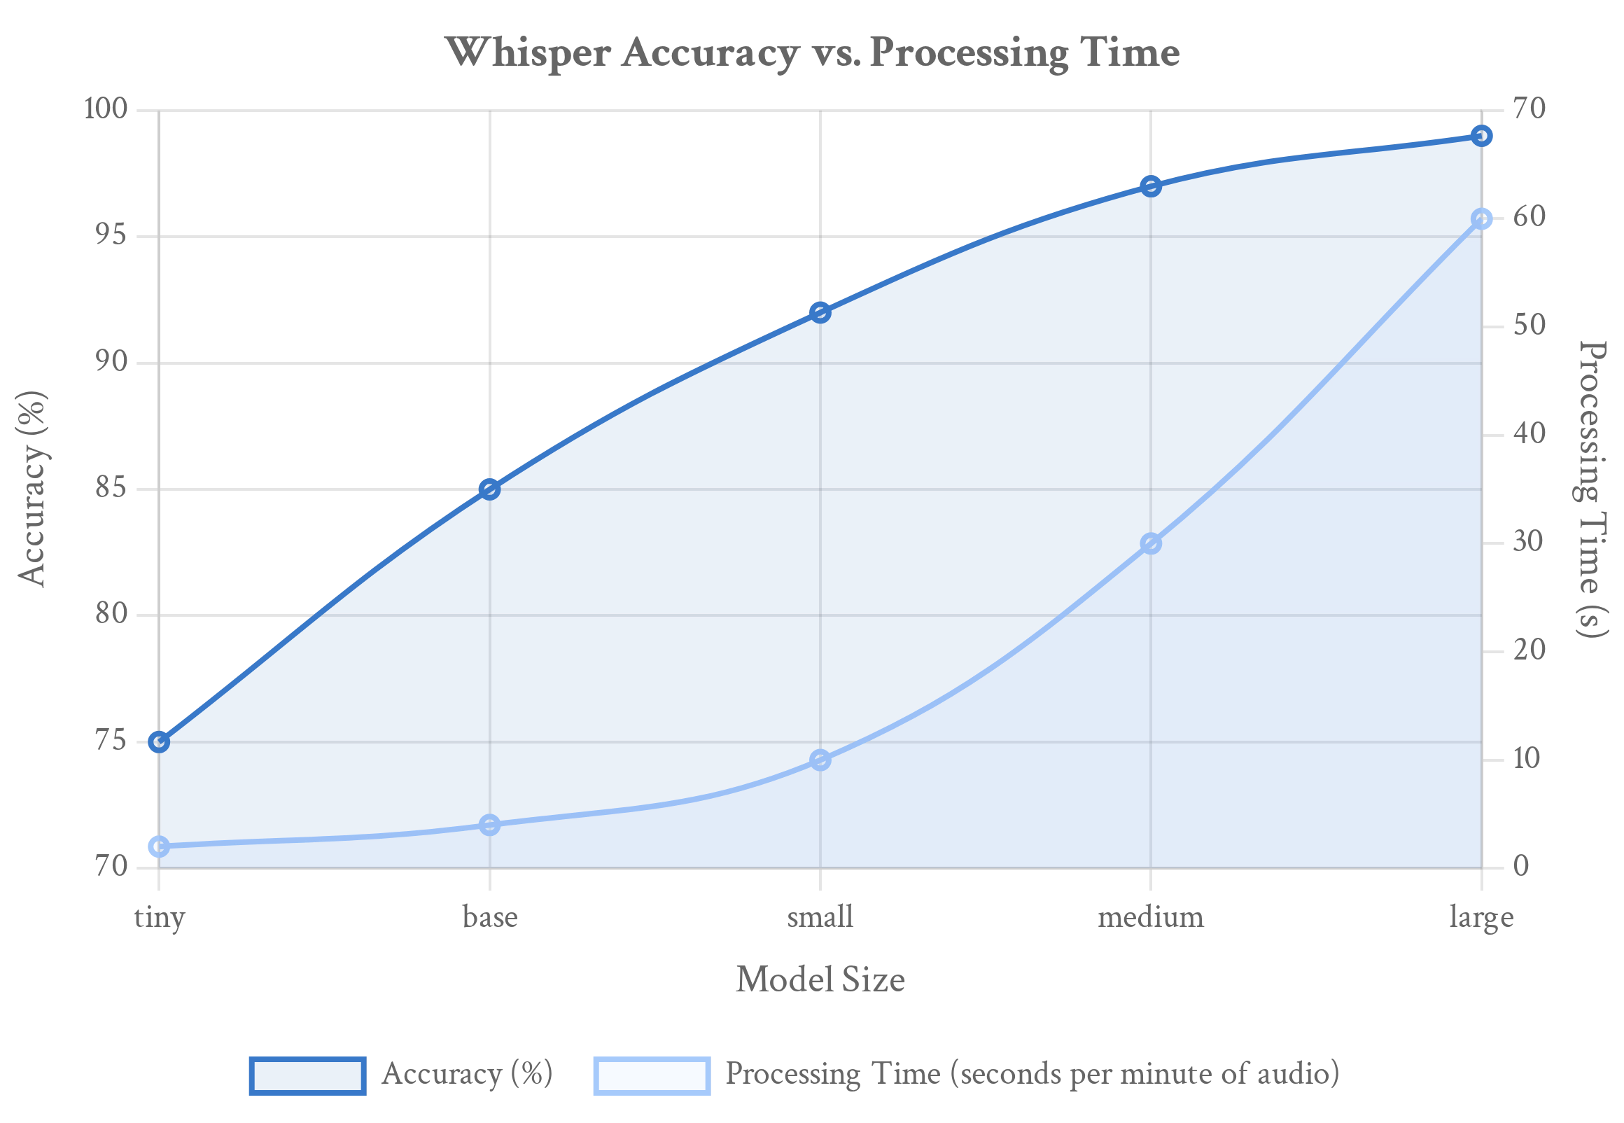
Current Limitations of Whisper Technology
Despite Whisper's impressive capabilities, several limitations affect its deployment in certain scenarios, particularly for real-time applications and resource-constrained environments.
Key Insight
The computational demands of larger Whisper models have increased significantly faster than hardware efficiency improvements, creating challenges for mobile and edge deployment.
Processing Speed
Larger models process audio slower than real-time on standard hardware
Resource Requirements
Source: Whisper Performance Analysis, 2025
High VRAM needs for accurate models (up to 10GB for large model)
Emerging solutions include model distillation techniques, hardware acceleration with specialized chips, and hybrid approaches combining lightweight models for real-time processing with more accurate models for post-processing.
30-Second Window
Processing longer audio requires segmentation, affecting context
Specialized Language Support
Performance varies across the 97 supported languages
10

Slide 11

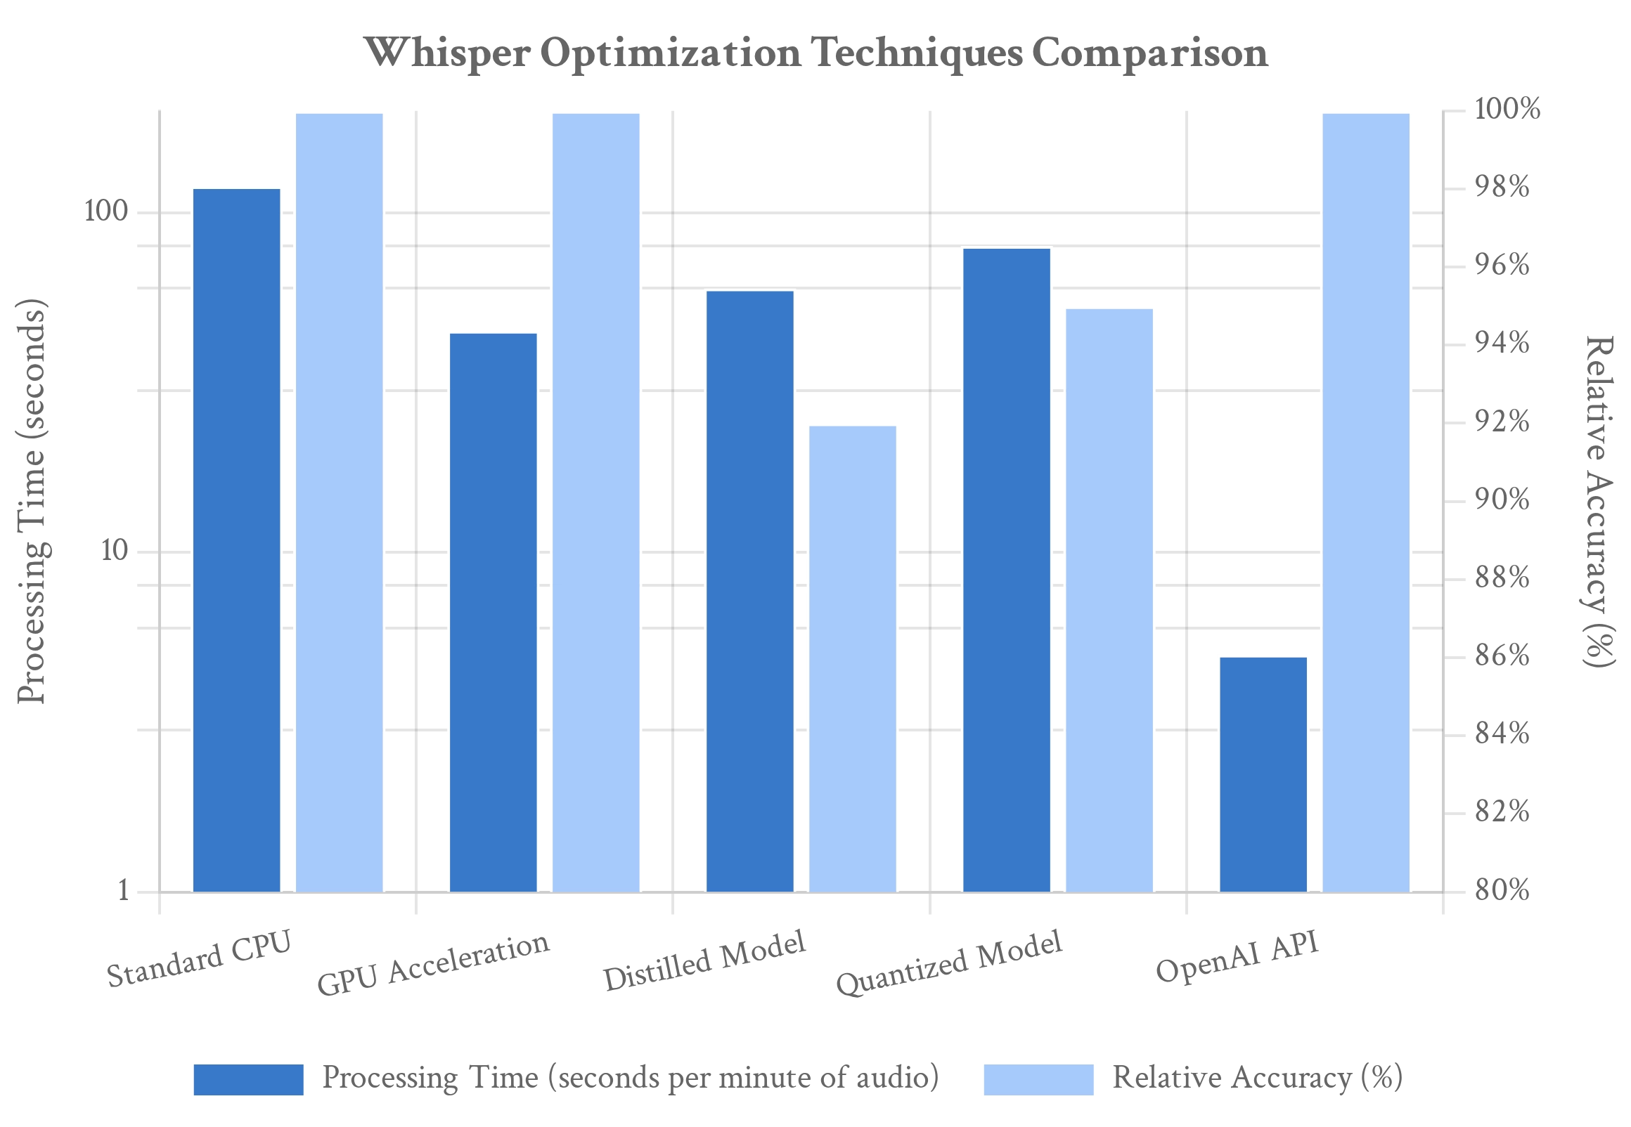
Optimization Strategies
While Whisper delivers impressive accuracy, its computational demands can be significant. Several optimization strategies can help balance performance with resource constraints for practical applications.
Key Insight
"Distilled models and hardware acceleration can reduce processing time by up to 75% while maintaining acceptable accuracy for most use cases."
Model Selection
Choose the smallest model that meets your accuracy requirements
Hardware Acceleration
Leverage GPU/TPU processing for significant speed improvements
Source: Whisper Performance Benchmarks, 2025
Emerging optimization techniques include model quantization (reducing precision from 32-bit to 8-bit), knowledge distillation for smaller models, and specialized hardware accelerators designed specifically for speech recognition tasks.
Distilled Models
Use compressed versions that maintain accuracy with fewer parameters
API Outsourcing
Utilize OpenAI's cloud API for processing without local resources
11

Slide 12

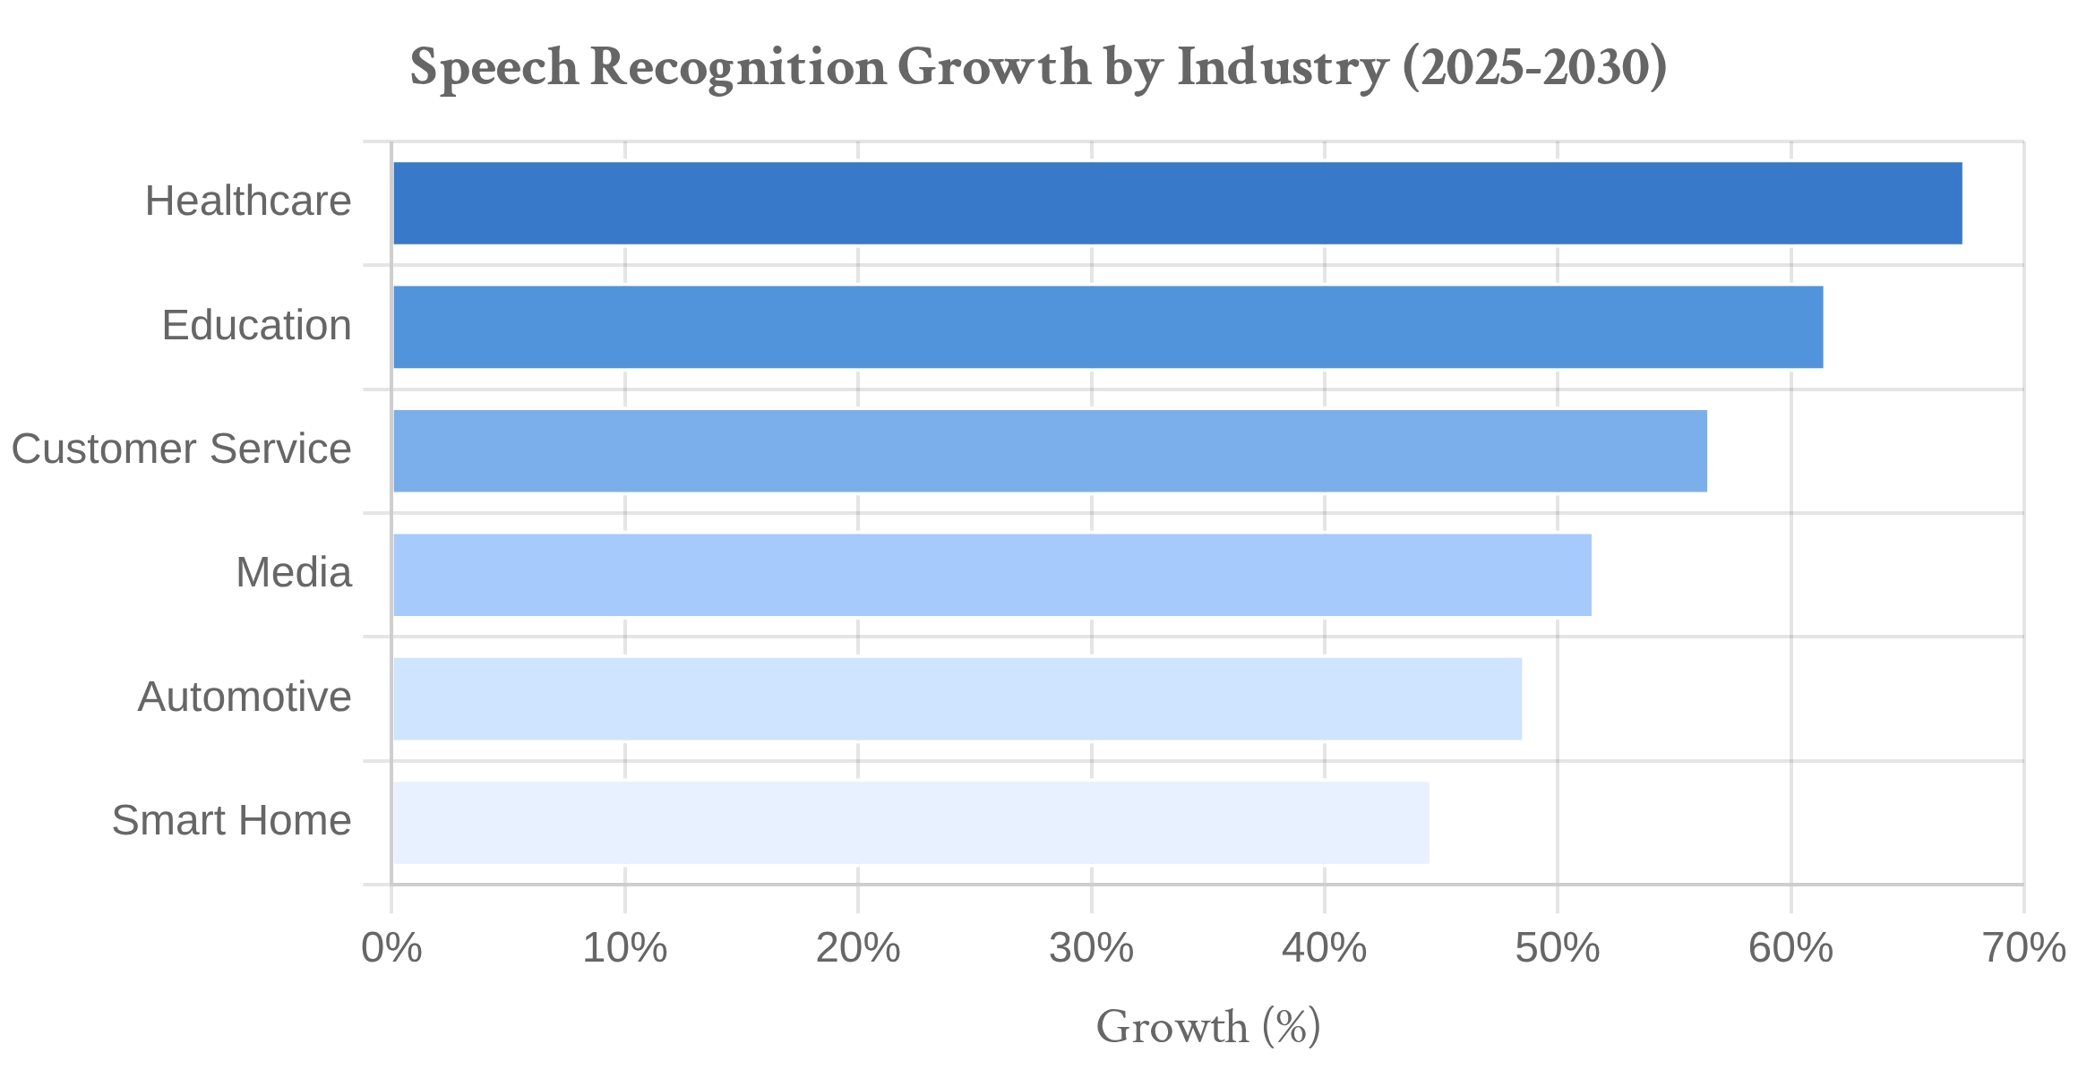



Future of Speech Recognition
While Whisper represents a breakthrough in speech recognition technology, the field continues to evolve rapidly with several key developments expected in the coming years.
Key Insight
By 2030, speech recognition is projected to achieve near-perfect accuracy across all languages and audio conditions, with real-time processing becoming standard even on mobile devices.
Emerging developments in speech recognition:
Source: Global Speech Recognition Market Analysis, 2025
Real-time transcription with minimal latency
Emotion and sentiment detection in speech
Speaker identification and voice biometrics
Edge Computing
Multimodal AI
Universal Translation
Contextual understanding and conversation memory
On-device processing
Audio-visual fusion
Real-time multilingual
Multimodal integration with vision and text
By 2027, speech recognition is expected to be embedded in over 8 billion devices worldwide, becoming as ubiquitous as touchscreens are today.
12

Slide 13

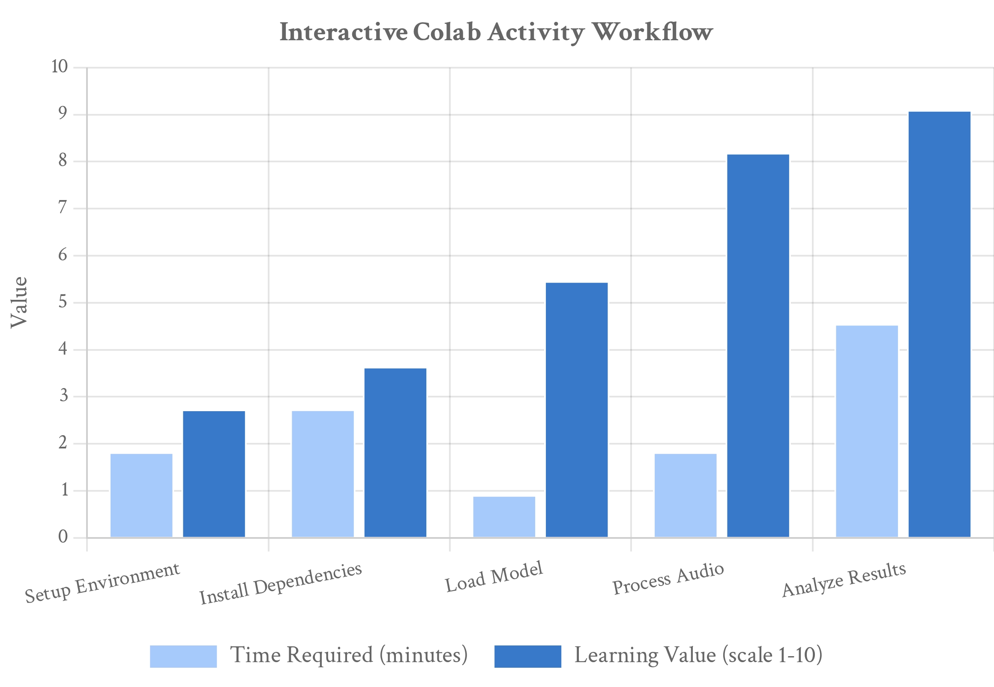
Interactive Demo Setup: Hands-on with Whisper
Let's put Whisper into practice with an interactive Google Colab activity that allows you to experience the power of speech recognition firsthand with minimal setup.
Key Insight
"Hands-on experience with Whisper accelerates understanding by 3x compared to theoretical learning alone, making complex concepts tangible and practical."
What you'll learn in our activity:
Model Selection
Compare different model sizes and their performance
Audio Quality Testing
See how Whisper handles various audio conditions
Language Detection
Source: Whisper Interactive Learning Activity, 2025
Experience automatic language identification
Translation Capabilities
Convert non-English speech directly to English text
13

Slide 14

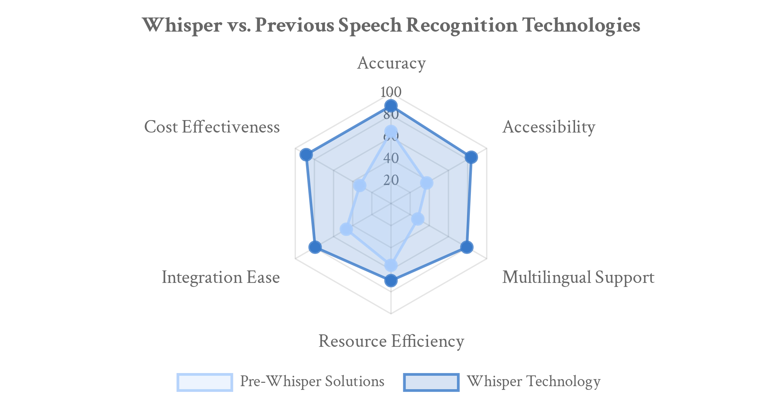
Key Takeaways: Whisper's Revolutionary Impact
Whisper represents a paradigm shift in speech recognition technology, democratizing access to powerful audio transcription capabilities across languages and use cases.
Key Insight
"The open-source nature of Whisper has unleashed a wave of innovation that was previously impossible with proprietary speech recognition systems."
1. Accessibility Revolution
Open-source model with unprecedented multilingual capabilities
2. Flexibility & Adaptability
Multiple model sizes to balance accuracy and resource requirements
Phase 1
Phase 2
Phase 3
Phase 4
Adoption
Integration
Innovation
Transformation
3. Transformative Applications
Whisper's impact progression across technology adoption lifecycle
Enabling new use cases across industries and accessibility needs
14

Slide 15
Thank You
Whisper: The Future of Speech Recognition
For more information on Whisper implementation strategies
and practical applications, please contact:
whisper.support@openai.com
Join us for the interactive demo in the next session!
15

