Slide 1
DeepBach a Steerable Model for Bach Chorales Generation
Proceedings of the 34th International Conference on Machine Learning, ICML
Gae ̈tan Hadjeres, Francois Pachet, Frank Nielsen

Slide 2
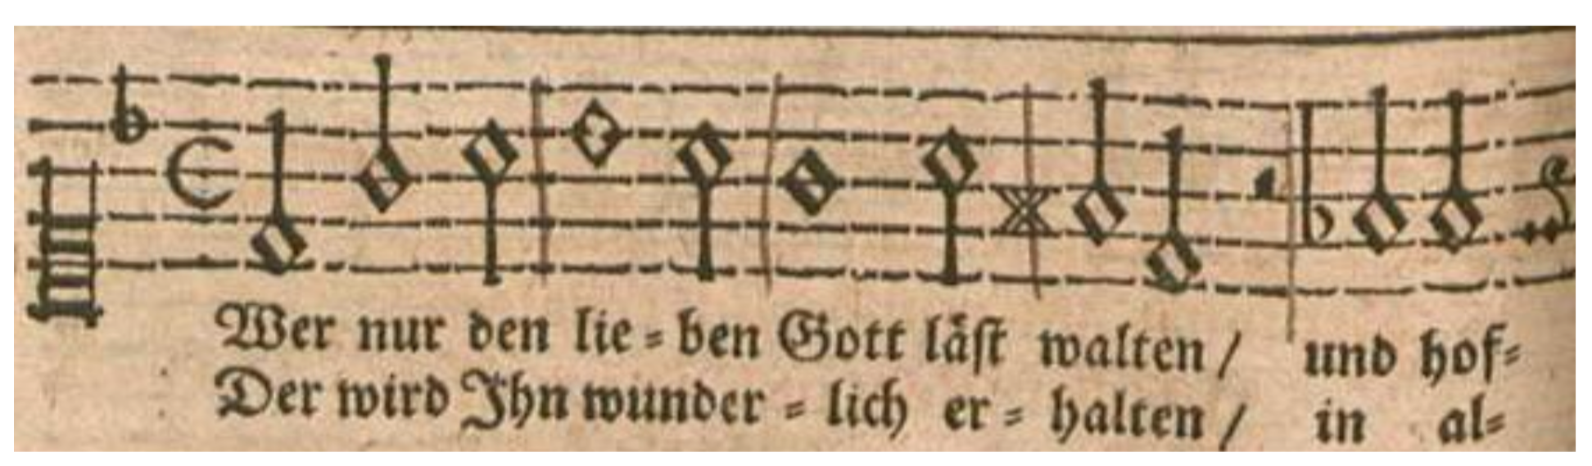
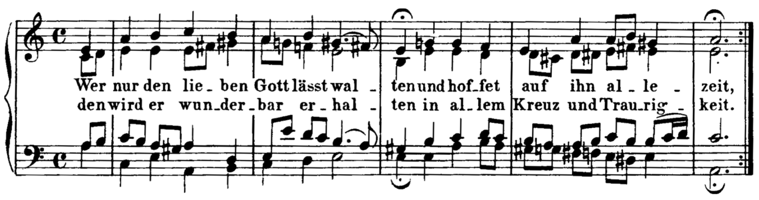
Intro
Original text and melody by Georg Neumark (1641)
Four-voice harmonization by Bach

Slide 3
Intro
rule-based expert system (1988)
rulebased expert system which contains no less than 300 rules and tries to reharmonize a given melody with a generate-and-test method and intelligent backtracking.
do not sound like Bach, except for occasional Bachian patterns and cadence formulas.
neural-network-based (1992 ~ 2016 , RBMs LSTM RNN GRUs)
these models which work on piano roll representations of the music are too general to capture the specificity of Bach chorales.
major drawback is their lack of flexibility
their invention capacity and non-plagiarism abilities are not demonstrated

Slide 4
Intro - BachBot model (Liang ,2016)
The BachBot Challenge - Test
This approach relies on little musical knowledge (all chorales are transposed in a common key) and able to produce high-quality chorale harmonizations
this model is less general (produced chorales are all in the C key for instance) and less flexible (only the soprano can be fixed)

Slide 5
Intro - DeepBach
RNN not only left to right
unary user-defined constraints
rhythm, notes, parts, chords and cadences
DeepBach is able to generate coherent musical phrases and provides, for instance, varied reharmonizations of melodies without plagiarism
Its core features are its speed, the possible interaction with users and the richness of harmonic ideas it proposes.
Notes:
第四點應該是跑的很快 可以讓使用者做很多種類的嘗試
for non experts in an interactive manner similarly to what is proposed in (Pa- padopoulos et al., 2016) for leadsheets. Leadsheet也有一篇能夠有快速且能互動的

Slide 6
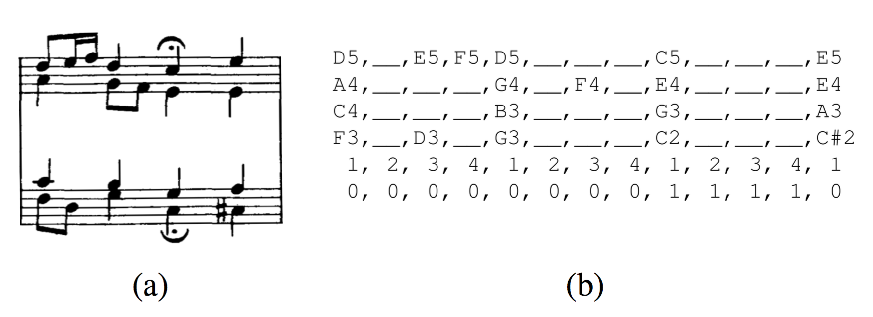
Data Representation
subdivision list S
the beat index,
an implicit metronome (on which subdivision of the beat the note is played)
the fermata symbols
current mode (major/minor/dorian).
current key,
current key signature,
the lyrics,
the key signature,
the time signature,
fermata list F
(V,M)
V is a list of 4 voices Vi
M a collection of (F,S)

Slide 7
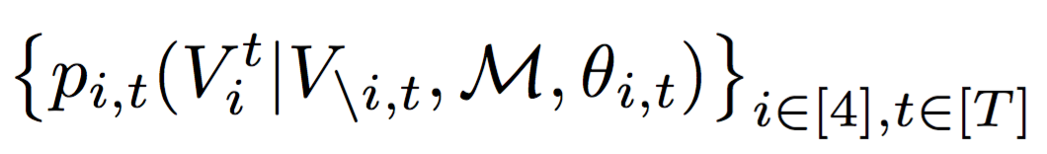
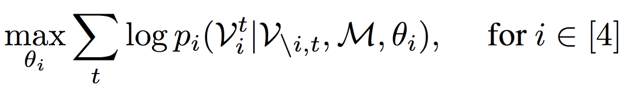
Model Architecture

