Slide 1

A Data Project
Ray Fendi
Gizem Yali-Pepper
Hernan Hernandez

Slide 2
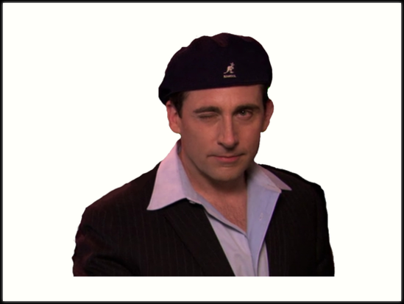
Why The Office?
We are all fans of the show and we wanted to pick a topic we were passionate about.
Our goal was to display the details about each episode like the percentage of lines spoken by the top characters, IMDb ratings and the synopsis.
We wanted to create a dashboard while having some fun with the elements from the show.
Finally, we wanted to introduce this great show to the class so they can start binging before it leaves Netflix in 2020.

Slide 3
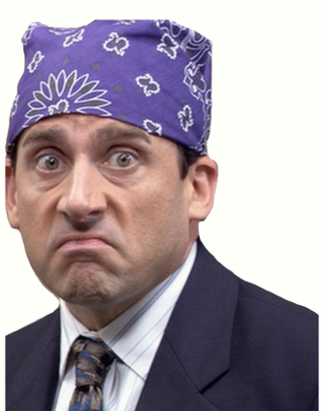
Insights
Michael’s presence on an episode created a higher rating when compared to episodes where he is not on.
The finale was the highest rated episode where Michael Scott made a cameo.
Highest number of lines are spoken by Michael, Dwight and Jim which made up 20.2%, 12.6% and 11.3% of the total lines, respectively.
Jim and Dwight are the only two characters that appeared in every episode of The Office.

Slide 4

Thank You!

