Slide 1
Numerical Methods and the Quantum Tunneling Effect
Jack Fenelon

Slide 2
Introduction
The Schrödinger Equation and its consequences:
Classically, an object with insufficient energy cannot overcome a potential barrier
Quantum Mechanics however allows a particle with insufficient energy to tunnel through a potential barrier
Questions of interest to answer from this project:
How does the tunneling effect behave as a function of barrier width?
Behavior as a function of particle energy relative to barrier width?

Slide 3
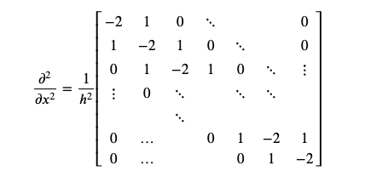
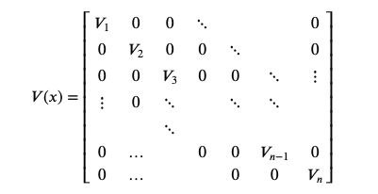
Methods
Numerical calculations will be done in Julia/Python and visualizations/plotting will be done in Python
Numerical approach to solving the Schrödinger Equation:
Discretize the second derivative operator
Construct diagonal potential matrix

Slide 4
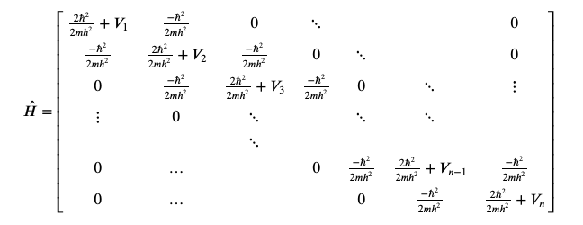
Methods cont.
Combining these two matrices we can get the Hamiltonian Operator
Next: Time-Dependence

Slide 5

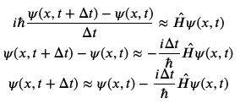

Methods cont.
Discretized time derivative operator:
Combining everything we get:
This alone however is not very stable, one step further:

Slide 6


Methods cont.
Adding both expressions and solving for the t+∆t case we get:
This final expression offers much better stability with larger ∆t values saving computational costs and time
The Crank-Nicholson Method

Slide 7
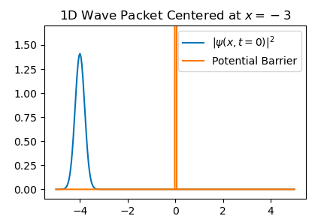
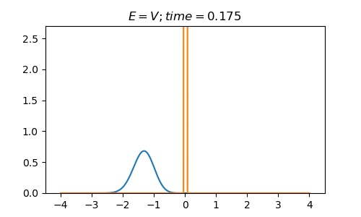
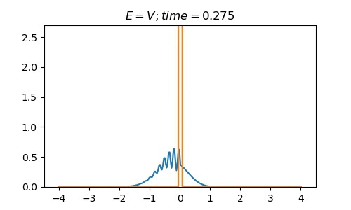
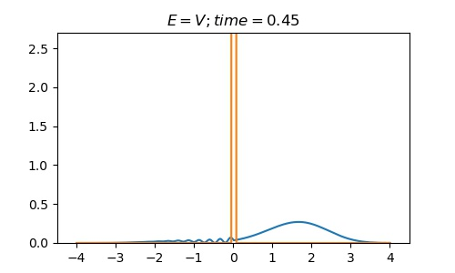
Results & Discussion

Slide 8
Results & Discussion
Width of the Barrier = 1Å
Reasonable Tunneling Probability
Width of the Barrier = 5Å
Next to 0 Tunneling Probability

Slide 9
Results & Discussion
Width of the Barrier = 1Å
Smaller Tunneling Probability
Width of the Barrier = 5Å
~ 0 Tunneling Probability

Slide 10
Conclusion
Tunneling probability decays exponentially as barrier width increases
At very small widths almost all energies can tunnel through
Applications:
Nuclear Physics e.g. Nuclear Fusion
Particle Refraction
Electronics e.g. the Tunnel Diode

