Slide 1
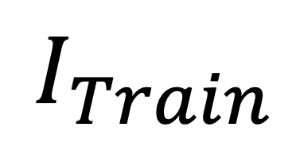

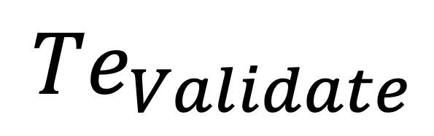
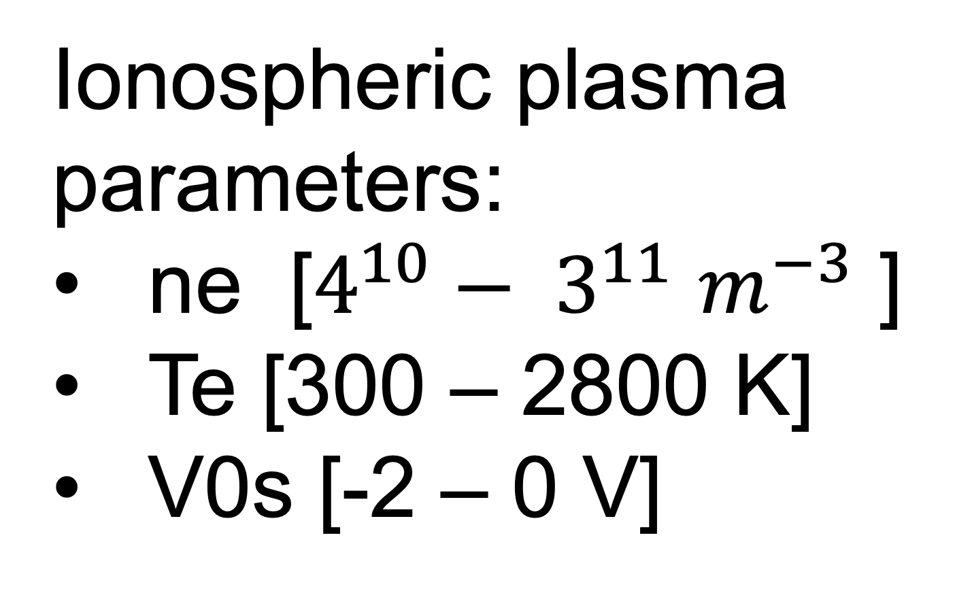
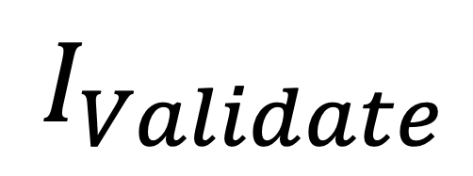
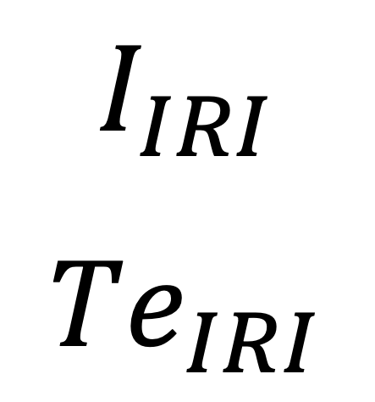
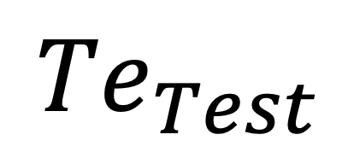

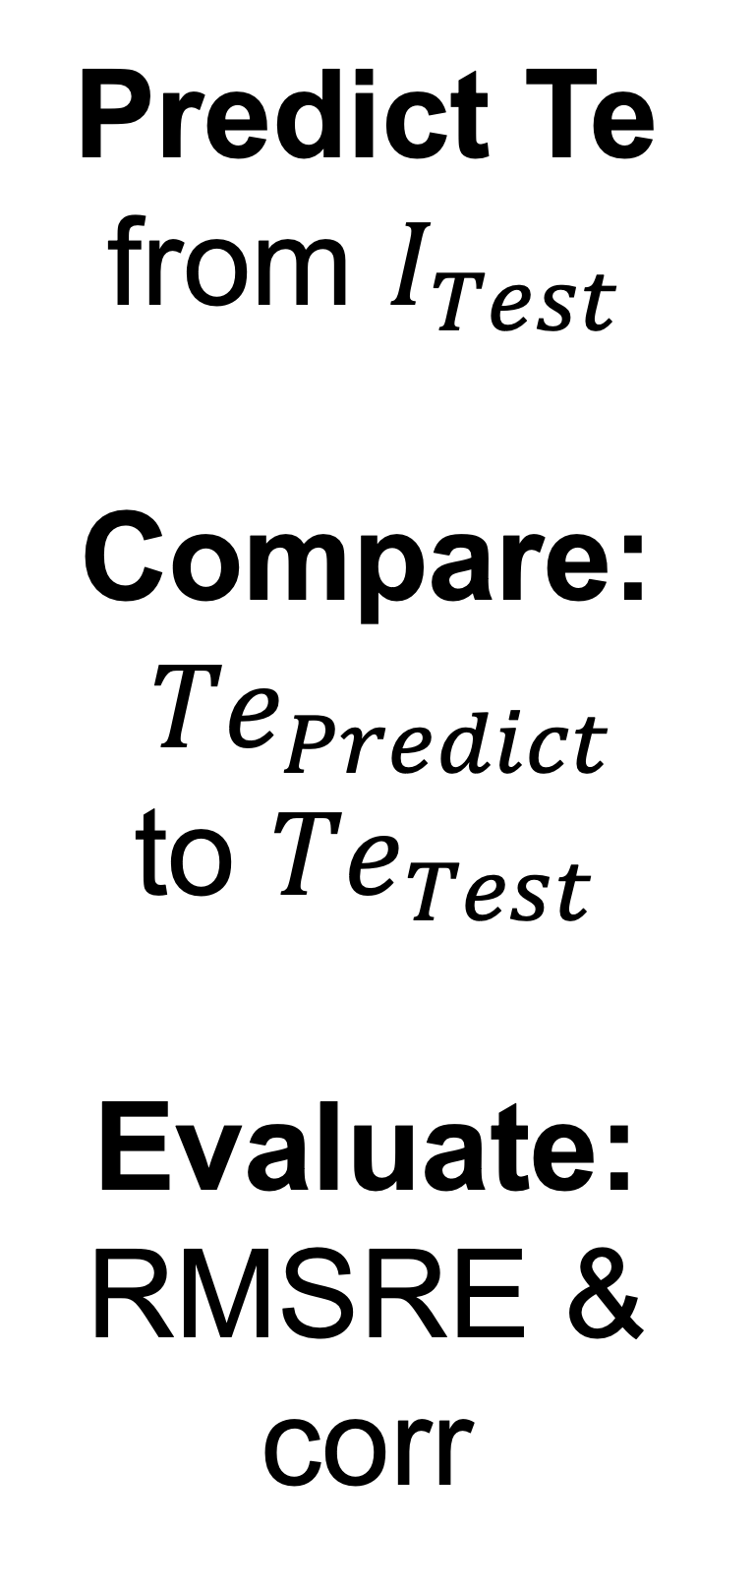
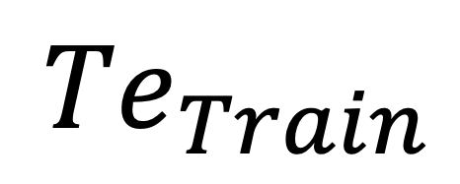
STEP 1:
Synthetic Data
I
Probe parameters:
Probe Geometries
Vb
70% Training
Langmuir Library:
Finite length model
Finite radius model
I & Te
derived currents
Ionospheric plasma parameters:
ne [$4^{10}− 3^{11}$ $m^{−3}$ ]
Te [300 – 2800 K]
V0s [-2 – 0 V]
10%
Validation
20% Test
STEP 2:
Synthetic Data:
Predict Te
from $I_{Test}$
Compare:
${Te}_{Predict}$
to ${Te}_{Test}$
Evaluate:
RMSRE & corr
DNN layers:
normalization,
RELU (80,Dense)
RELU (80,Dense)
RELU (1,Dense)
Machine Learning Model
$$I_{Train}$$
$${Te}_{Train}$$
$$I_{Validate}$$
$${Te}_{Validate}$$
$$I_{Test}$$
$${Te}_{Test}$$
STEP 3:
I
IRI Data:
Predict Te from $I_{IRI}$
Compare:
${Te}_{Predict}$
to ${Te}_{IRI}$
Evaluate:
RMSRE & corr
Ionospheric plasma parameters:
ne
Te
V0s
derived
currents
Langmuir Library:
Finite length model
Finite radius model
$$I_{IRI}$$
${Te}_{IRI}$
Test Robustness:
add noise (𝝈)
Probe parameters:
Probe Geometries
Vb
Machine Learning Model

