Slide 1
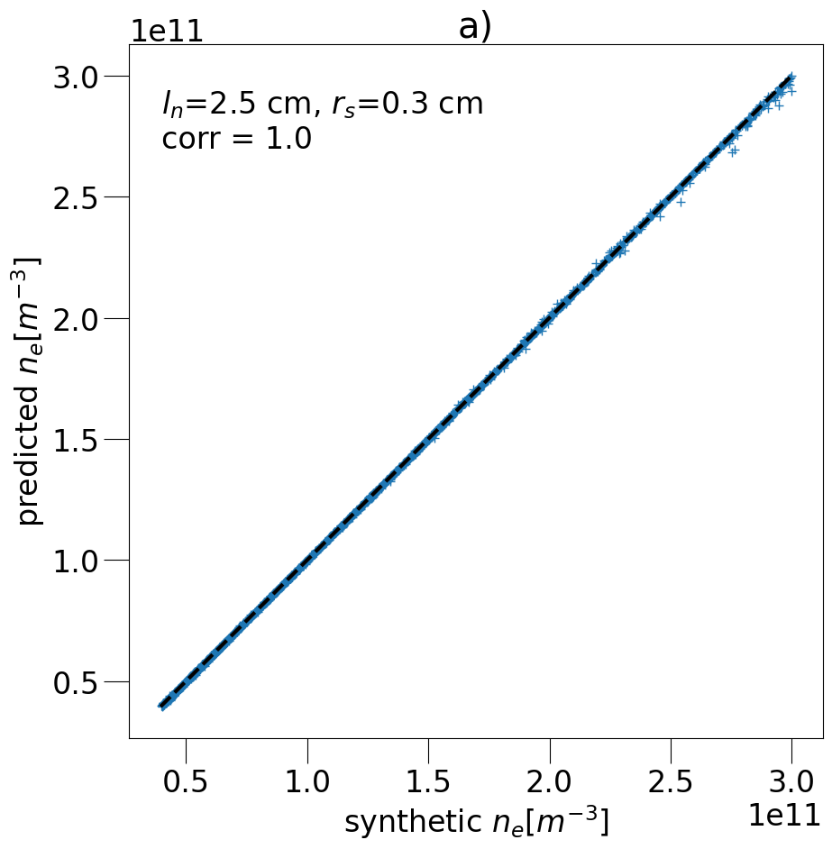
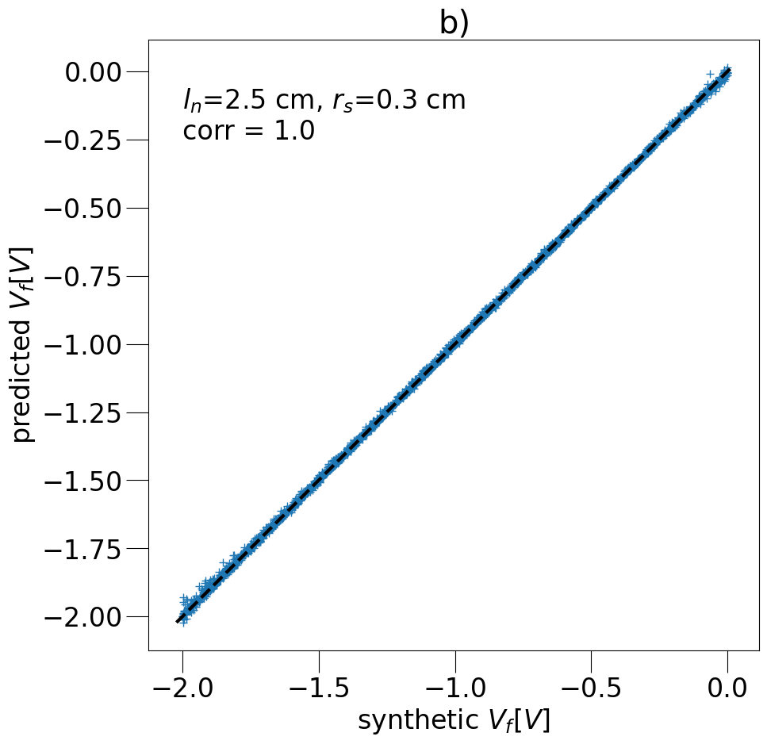
layers.Dense(80, activation='relu'),
layers.Dense(80, activation='relu'),

