Slide 1
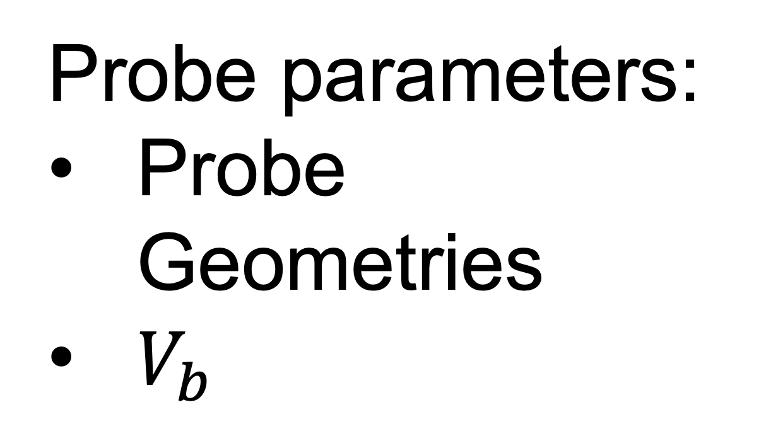
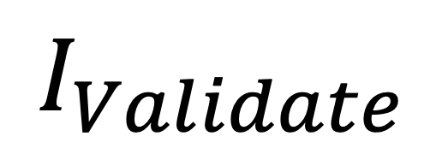
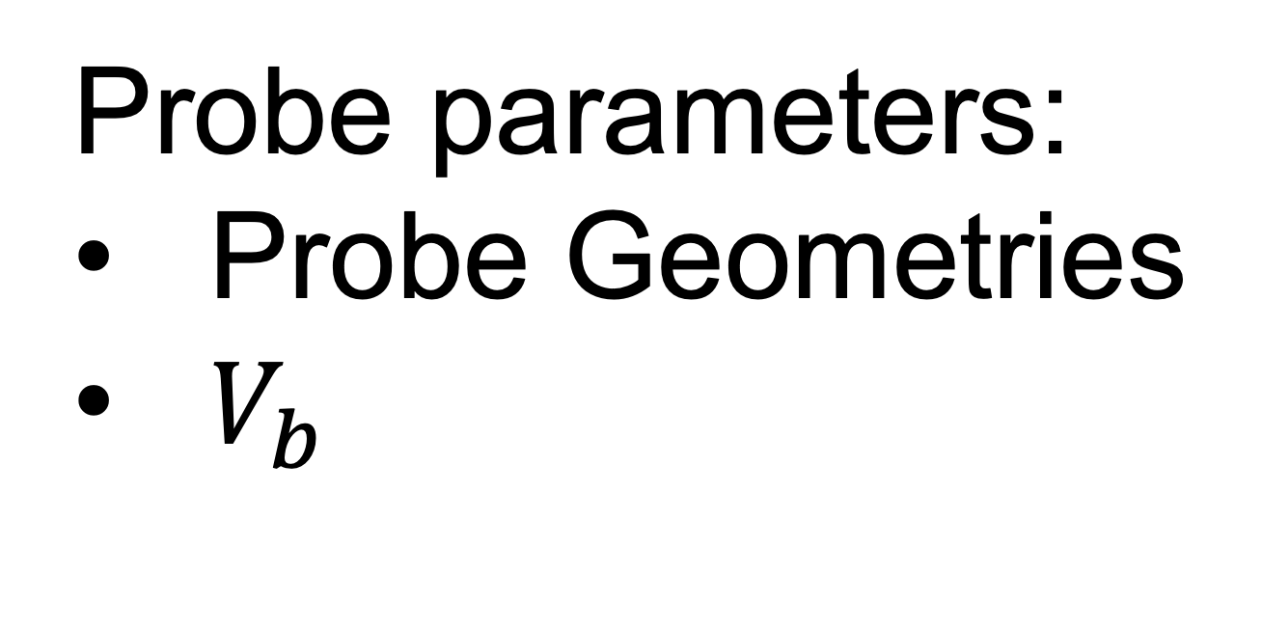


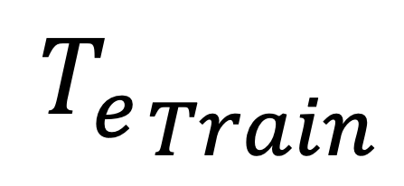
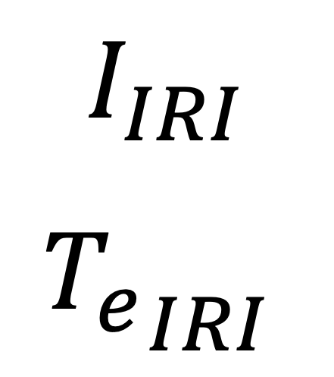
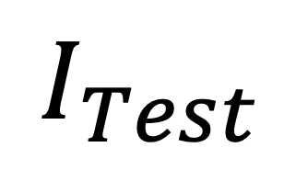


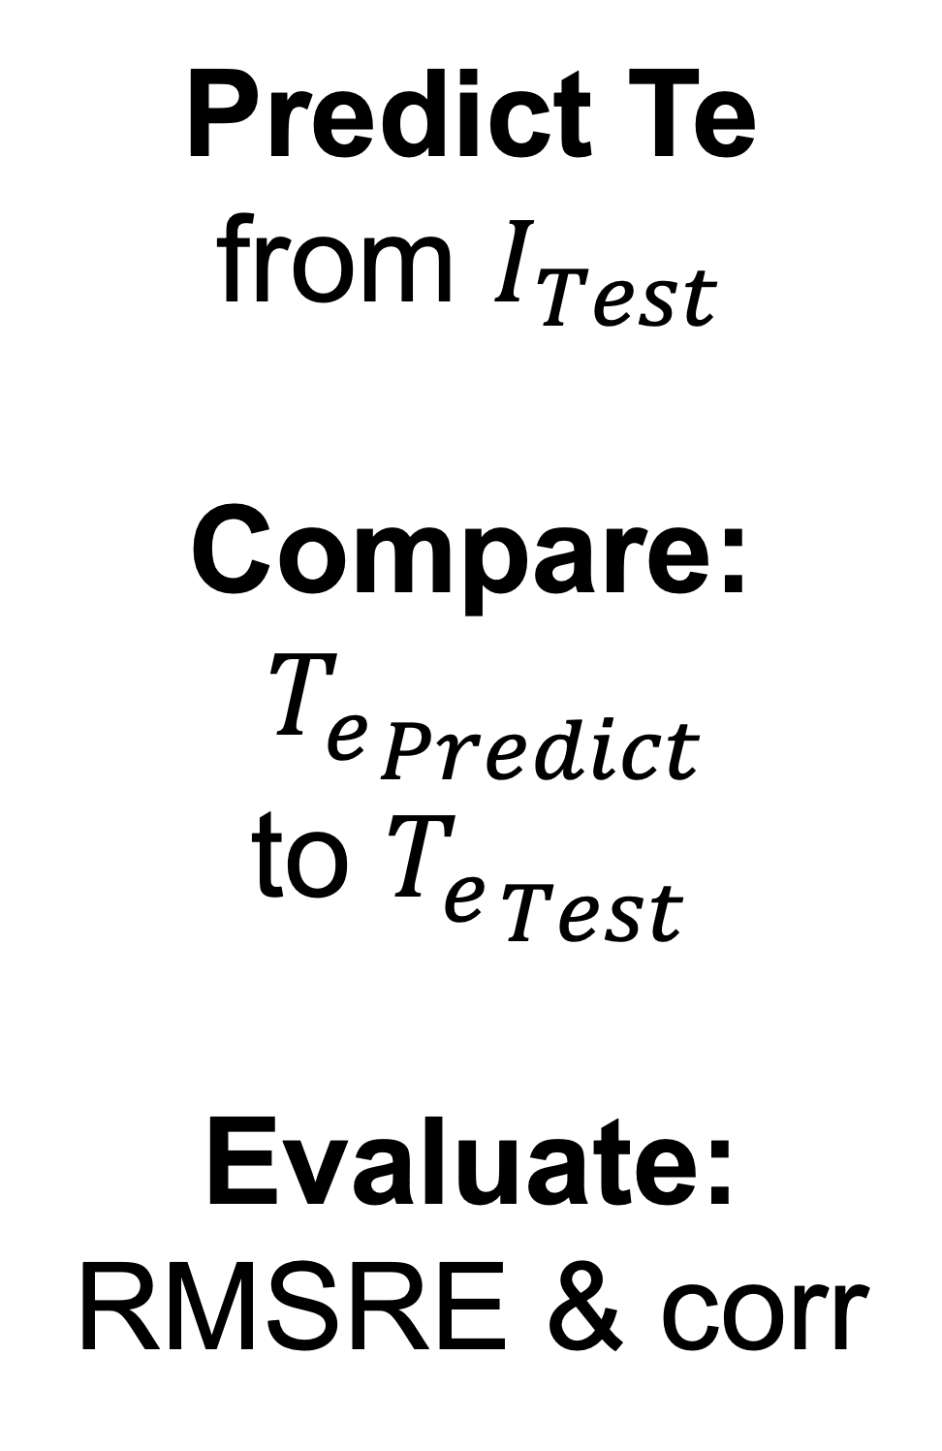
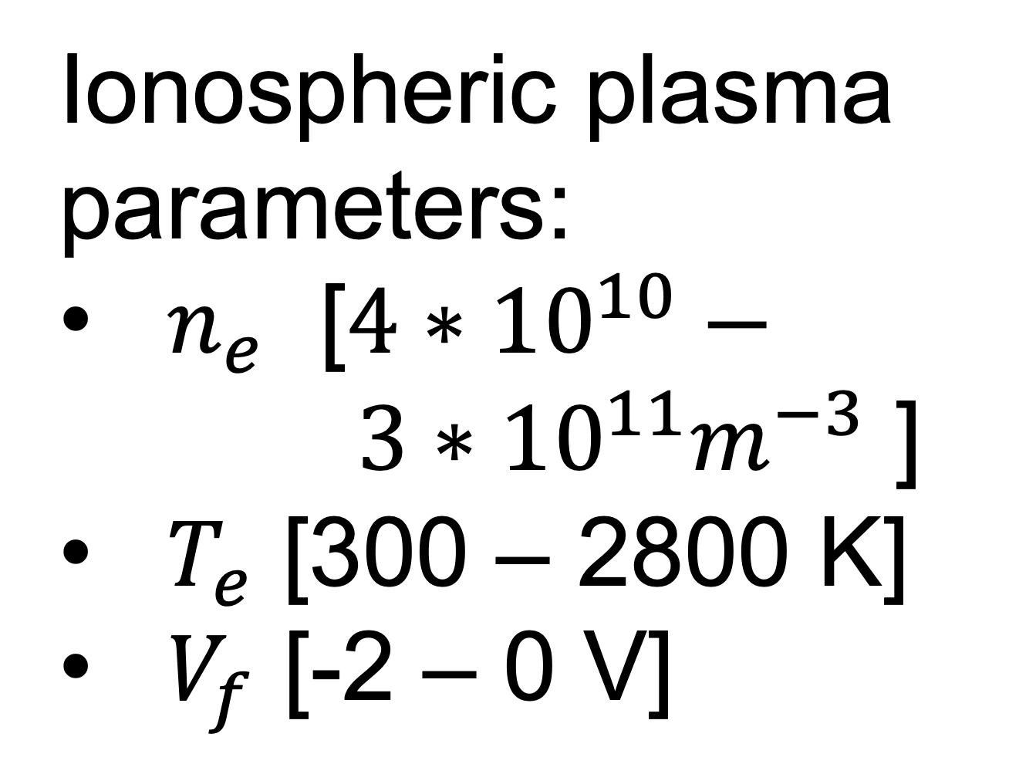

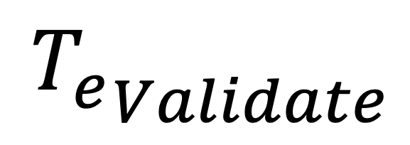
STEP 2:
Synthetic Data:
NN layers:
normalization,
RELU (80,Dense)
RELU (80,Dense)
RELU (1,Dense)
Predict Te
from $I_{Test}$
Compare:
${T_{e}}_{Predict}$
to ${T_{e}}_{Test}$
Evaluate:
RMSRE & corr
Machine Learning Model
$$I_{Train}$$
$${T_{e}}_{Train}$$
$$I_{Validate}$$
$${T_{e}}_{Validate}$$
$$I_{Test}$$
$${T_{e}}_{Test}$$
STEP 1:
Synthetic Data:
Synthetic Data:
Probe parameters:
Probe Geometries
$V_{b}$
Langmuir Library:
Finite length model
Finite radius model
I
70% Training
$I$ & $T_{e}$
Ionospheric plasma parameters:
$n_{e}$ [${4∗10}^{10}−$
${ 3∗10}^{11}m^{−3}$ ]
$T_{e}$ [300 – 2800 K]
$V_{f}$ [-2 – 0 V]
derived currents
10% Validation
20% Test
STEP 3:
Langmuir Library:
Finite length model
Finite radius model
I
IRI Data:
$$I_{IRI}$$
${T_{e}}_{IRI}$
Predict Te
from $I_{IRI}$
Compare:
${T_{e}}_{Predict}$
to ${T_{e}}_{IRI}$
Evaluate:
RMSRE & corr
Ionospheric plasma parameters:
$n_{e}$
$T_{e}$
derived currents
Test Robustness:
add noise (𝝈)
Probe parameters:
Probe Geometries
$V_{b}$
Machine Learning Model

