Slide 1
Inventory Management System
for CUSD Extension Dept. Theater Program
Nick Batista, Bill Feng, Wen Jin, Jaspreet Summan

Slide 2
Agenda
Initiating (Nick)
Background
Purpose
Stakeholders
Dependencies and Constraints
Planning (Wen) + Jaspreet
Plan of Action
Milestones
Project Requirements
Technical Approach
Workflow
Use Case
Risk Analysis (Jaspreet)
Executing (Jaspreet)
Time Success
Controlling (Bill)
Change Controls
Closing (Bill)
Documentation
Demonstration
Lessons Learned
1

Slide 3
Project Background
Sponsor:
Liz Gonzalez
Director of the Campbell Union School District (CUSD) Extensions Department
Problem Statement:
There is currently no inventory management system in place for the CUSD theater department.
Staff does not know what they have or where it is.
Nick Batista 2
Notes:
Project Sponsor → Liz Gonzalez, Director of CUSD Extensions Dept.
Problem? No inventory management system in place for the theater department.
Currently, all assets are kept unsorted in one room.
This means that the staff don’t know what they have or where it is, meaning they have a lot of redundant purchases.

Slide 4
Project Purpose
To develop and implement an Inventory Management System, allowing the extension department to:
Track the theater’s physical assets (costumes, equipment)
Reserve assets remotely and in bulk
Check assets out to specific people (typically parents)
Nick Batista 3
Notes:
Purpose of this project → to develop an IMS that let’s the theater staff:
Track the location, quantity, and state of the theater program’s assets
Reserve assets ahead of time, to prevent “double booking”
Check assets out to specific people, so that you always know who has what

Slide 5
Project Requirements
The completed project must:
Store asset information (costume size, location, etc.)
Be accessible online, to several people at once
Allow for asset reservations
Allow for bulk check-out of assets
Be searchable
Requirements were obtained through sponsor interview
Nick Batista 4
Notes:
We obtained our project requirements by interviewing our project sponsor as a group.
After discussing the theater department’s needs, we found that the project needed to:
Store different types of asset information, including storage room location
Be accessible online to several people at once
Allow for asset reservations, again to prevent “double booking”
Allow for several assets to be checked-out at once
Be searchable. If it weren’t, the number of assets would make the system infeasible

Slide 6
Project Stakeholders
Name | Position | Responsibilities
Nick Batista | Project Manager | Directed the team’s efforts and resources; acted as intermediary between team and project sponsor.
Wen Jin | Analyst | Created project schedule; worked with sponsor to establish project requirements
Bill Feng | Developer | Implemented our chosen technology to satisfy the system requirements
Jaspreet Summan | Researcher | Researched different technologies that would be useful in developing the inventory system
Liz Gonzalez | Project Sponsor, Director of CUSD Extensions Dept. | Worked with the team to establish project requirements; tested the system in development
Larry Gee | Project Champion, Professor | Provided the team with information & guidance throughout the project lifespan
Nick Batista 5
Notes:
Our project has several main stakeholders, and a handful of minor ones.
Nick Batista, PM, directed the team’s efforts, was the go between
Wen Jin, Analyst, created schedule, established project requirements
Bill Feng, Developer, worked on actually implementing the system
Jaspreet Summan, Researcher, found possible solutions to the problems posed by the project
Liz Gonzalez, Sponsor, worked with us to establish requirements and guide our implementation
Larry Gee, Champion, taught us what we needed to know to successfully execute this project
Not shown here: the CUSD theater department as a whole

Slide 7
Dependencies and Constraints
Scope: Must satisfy the given requirements, accomplishing the project’s purpose
Deliverables
a functional inventory management system
sufficient system documentation
Time: Project must be completed between February 4th and April 23rd (80 days)
Cost: Project has a minimal budget—every expenditure must be approved by sponsor
Nick Batista 6
Notes:
There were several constraints that our project absolutely must hold to.
Scope. If we don’t meet the project requirements and accomplish our project’s purpose, we’ve failed
That means delivering the system and a help doc
Time. The project must be completed by the 23rd of april.
Cost. Aprox. Budget of 0. All expenses have to be run by sponsor.

Slide 8
Milestones
Phase | Milestone | Dates
Initiating | Meet with Sponsor | 2/4/2019
Planning | Develop project charter | 2/13/2019
 | Develop Work Breakdown Structure | 2/15/2019
 | Completion of Project Schedule | 2/18/2019
Executing | Demo Prototype to Sponsor | 3/15/2019
 | Submit Documentation | 4/23/2019
Monitoring and Controlling | Change Controls | 2/18/2019 - 4/23/2019
Closing | Project Charter Sign off | 4/23/2019
Wen Jin 7 8
Notes:
We followed the waterfall methodology with 5 main phases.
Change control - since research had started, until we met all the requirements using Asset Tiger

Slide 9
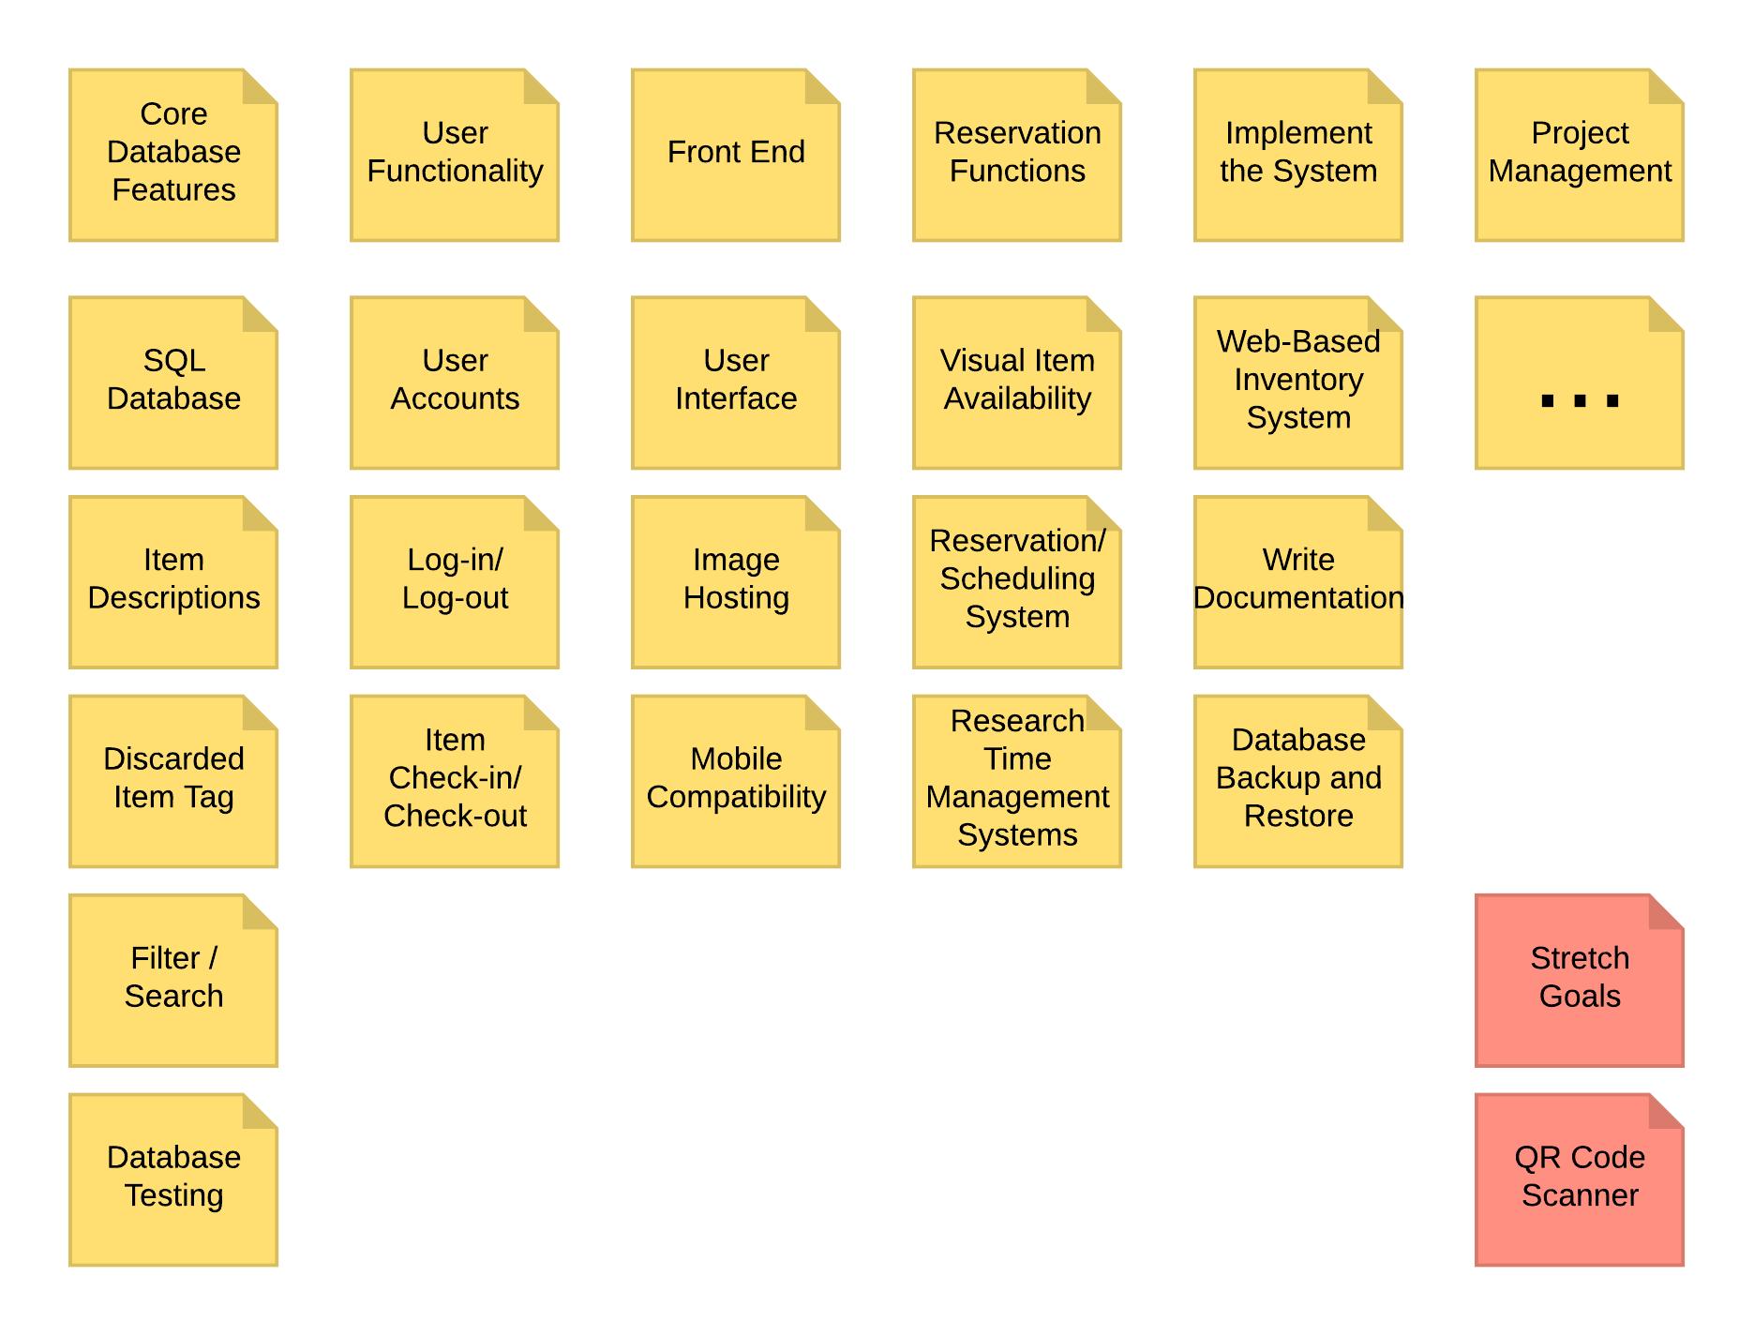
Plan of Action
Wen Jin 8
Notes:
From what we gather from our sponsor. We created a WBS to quickly break down the necessary functional part that will complete our project’s requirement.
Core Database Feature
User Functionality
Front End
…
We also have stretch goal. Such as QR code. As discussed in our conversation with our sponsor, she indicated that QR code is a good feature to have. She agree with us that it is not a key feature in technology feasibility. In the end the goal was achieved by an existing feature of AssetTiger.

Slide 10
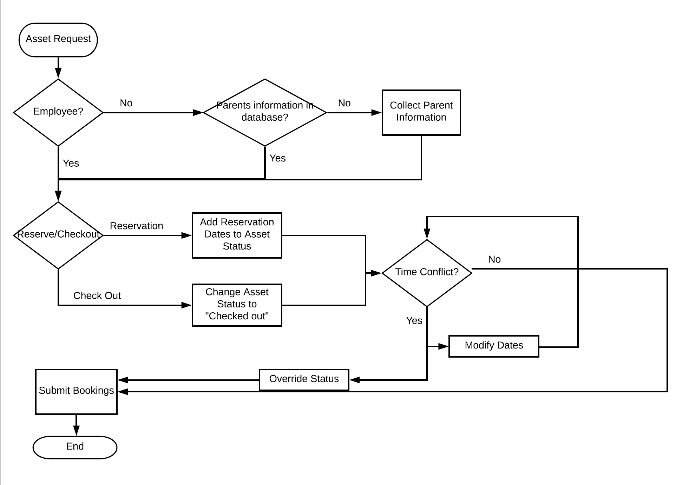
Asset Check Out / Reservation Workflow
Wen Jin 9
Notes:
The workflow of checking out or reserving an asset.
From requirement we had gathered, we designed a workflow as follow.
Workflow - planned
Use Case - actual

Slide 11
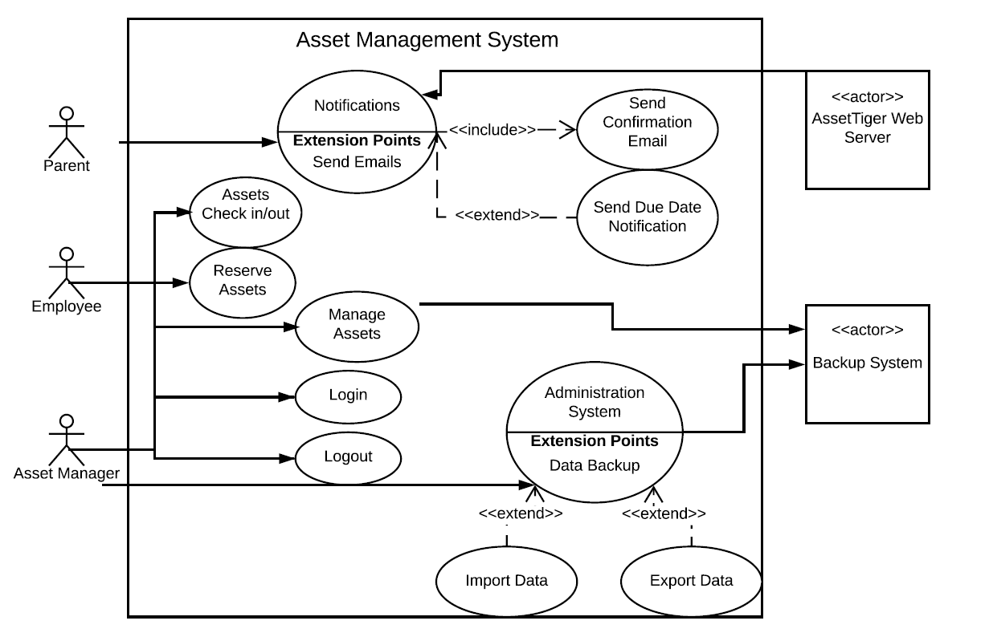
Wen Jin 10
Notes:
Use Case Diagram - Actual Use Case we developed in AssetTiger

Slide 12
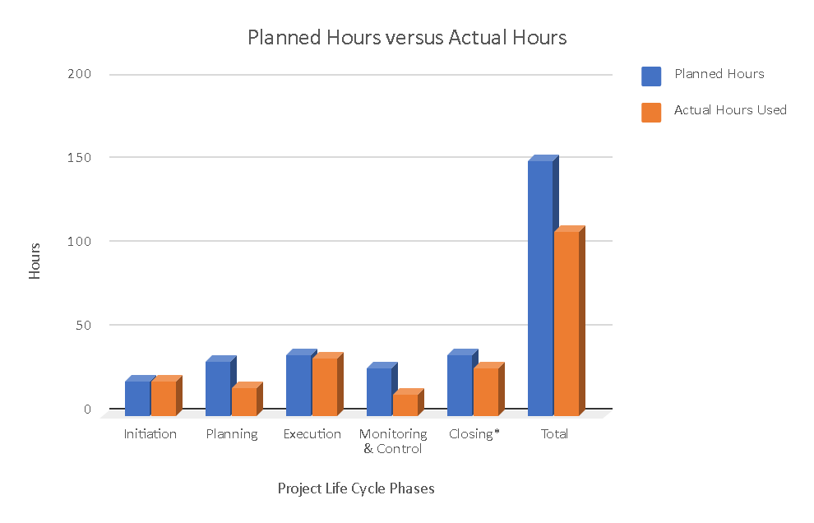
Time Success
Jaspreet Summan 11 8

Slide 13
Risk Analysis: Initiation
Risk/Problem | Expectation | Impact | Severity | Solution
Sponsor becomes disengaged | 2 | 9 | 18 | Contact project champion immediately (PM-Nick)
Scheduling errors | 3 | 6 | 18 | Contact project champion; revise project schedule. (PM - Nick)
Too many costs involved | 5 | 10 | 50 | Find alternative methods of funding or select another alternative.
Jaspreet Summan 12

Slide 14
Risk Analysis: Planning
Risk/Problem | Expectation | Impact | Severity | Solution
Poor estimates of effort required | 4 | 7 | 28 | Contact project champion; revise project schedule. (PM - Nick)
Technology not fit for task/project | 4 | 10 | 40 | Contact project sponsor and project champion immediately to discuss next steps; investigate alternative technologies. (Dev- Bill)
Sponsor's desires are misinterpreted | 3 | 10 | 30 | Immediate in-person meeting sponsor and champion for resolution. (All)
Jaspreet Summan 13

Slide 15
Risk Analysis: Execution
Risk/Problem | Expectation | Impact | Severity | Solution
Technology not fit for task/project | 4 | 10 | 40 | Contact project sponsor and project champion immediately to discuss next steps; investigate alternative technologies. (Dev- Bill)
Lack of communication between team and sponsor | 5 | 6 | 30 | Advise project champion, set up weekly communication assignment. (All)
Deadlines are not met on time | 4 | 7 | 28 | Meet with sponsor and project champion; revise project schedule. (PM - Nick)
Jaspreet Summan 14

Slide 16
Risk Analysis: Control
Risk/Problem | Expectation | Impact | Severity | Solution
Staff turnover | 1 | 10 | 10 | Contact project champion (PM - Nick)
Activities/tasks missing from scope | 2 | 7 | 14 | Notify project champion; have relevant party submit change request form. (PM - Nick)
Unclear authority | 2 | 5 | 10 | Advise project champion; schedule team meeting to establish clear authority. (PM - Nick)
Jaspreet Summan 15

Slide 17
Risk Analysis: Closing
Risk/Problem | Expectation | Impact | Severity | Solution
Platform hard to maintain | 4 | 8 | 32 | Inform project sponsor of the possible difficulties. Confirm that documentation is robust. (A - Wen)
Technology components aren't reliable | 6 | 9 | 54 | Restore database from back-up. (IT - Bill)
Lack of communication by PM and Team | 1 | 8 | 8 | Contact project champion. (APM - Jaspreet or PM-Nick)
Jaspreet Summan 16

Slide 18
Change Control
Build in-house
WordPress - WP Inventory Plugin
Snipe-IT
AssetTiger
Opportunity:
Cost -> little to none
Full-stack development project
Risk:
School district security disapproval for the use of server
Huge development time.
Opportunity:
Fixed monthly cost
Sponsor able to edit
Reduce development time
Risk:
Considerable development time.
Troublesome to maintain.
Not the most cost effective solution.
Opportunity:
Drastically reduced cost
Reduce development time
Risk:
Huge risk in developing software in a unknown
Opportunity:
Drastically reduced in development time.
Less time in development than previous
Risk:
Uncontrollable bug fix.
Bill Feng 17
Notes:
Coming into the project, we understood the troubling inventory management it was in place for the extended department. From our meeting, our sponsor also expressed her need in having a cost effective inventory solution. Considering it is a school district run department. Budget can propose a constraint.
Therefore, in our project research endeavor, we wanted a efficient solution that work Liz’s use-case for free or at least cost-effective. We were also fortunate to have full freedom in deciding what path we want to take that will best benefit the school program.
1. Our first solution is build from in-house. This would be the cheapest solution for our sponsor with customizable features.
Build in-house solution: The opportunity - is potentially Free of Cost with the cooperation with the school district’s IT department using their server resources benefiting our sponsor the most. At the same time, we are able to take this opportunity to build another full-stack website. Risk, however, these imposed opportunity also comes with risks. That is, 1. a long commitment with the IT department with unknown risk. 2. By building everything our-self, we risk coming into complications and not being able to deliver our product. It is also out of the scope of this class, where we want to focus on project managment, not development.
2. We decided it is not the best option for us, so we moved on to research third-party inventory solution.
WordPress using a third-party plug-in called WP inventory management. We have identify the opportunity of this software, first being fixed in month free. Second, our sponsor Liz is able to do content management by herself. Third, this solution will relatively lower our development time and thus reducing risk. Nevertheless, the risk we will have is the unknown development endeavor into a plug-in that we have no experience with considering there is no trial. Our second risk is content management after project hand off. Future maintenance can be difficult even with documentation. Our third risk is our development time is unknown when is lacking free trial feature to test out application.
3. We didn’t find the first two application is the best suit. So we moved on to another application Snipe-IT. Some opportunity we
have is it will drastically reduced our our development time as it already have a fully functional platform. It will also reduce our cost for our Liz. Risk was also introduced. One of the main request from Liz was to have the inventory system accessible from anywhere. However, Snipe-IT’s free version does not provide server space, and the risk in developing a server can get complicated earsily and it goes beyond the scope of our class. A paid version of Snipe-IT is still a relatively high cost for Liz. So we decided to move on, and leave it as a backup plan.
4. In our last iteration, we decided on using AssetTiger, as this solution will help deploy the software easier and reduce our development time and focus on project management.
development time. Furthermore, maintaining the inventory system is easier for Liz and future managers. Some of the risks are minor. RISK

Slide 19
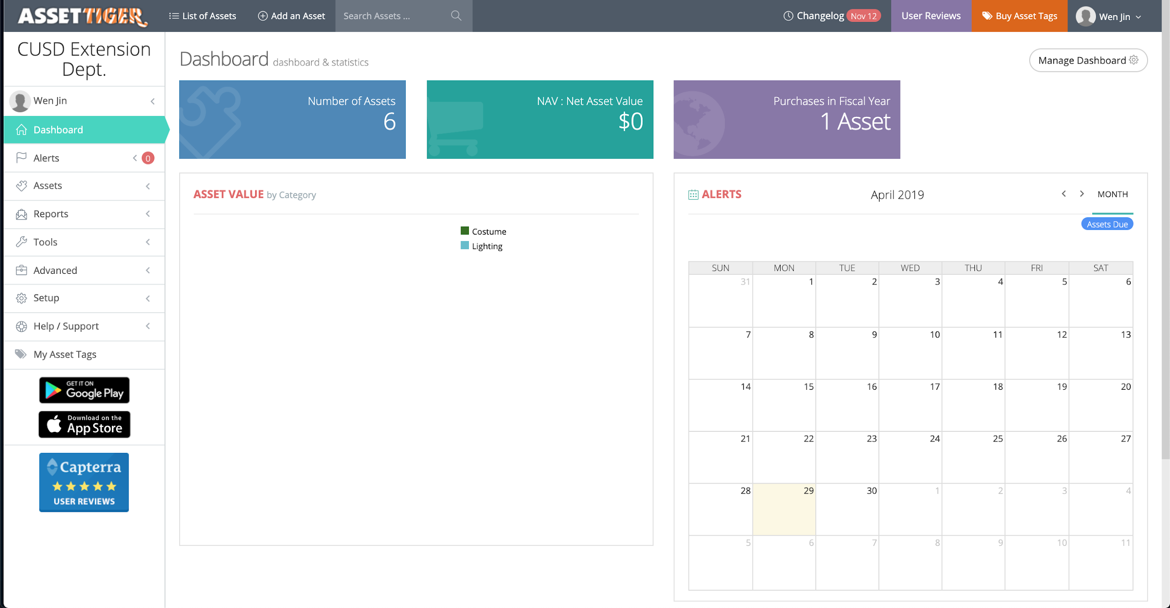
AssetTiger Demo Overview
Bill Feng 18
Notes:
Let’s go through an overview of how AssetTiger will look like.
Here is the dashboard. It contains all the features on the left column.
And a simple and clean view in the center.

Slide 20
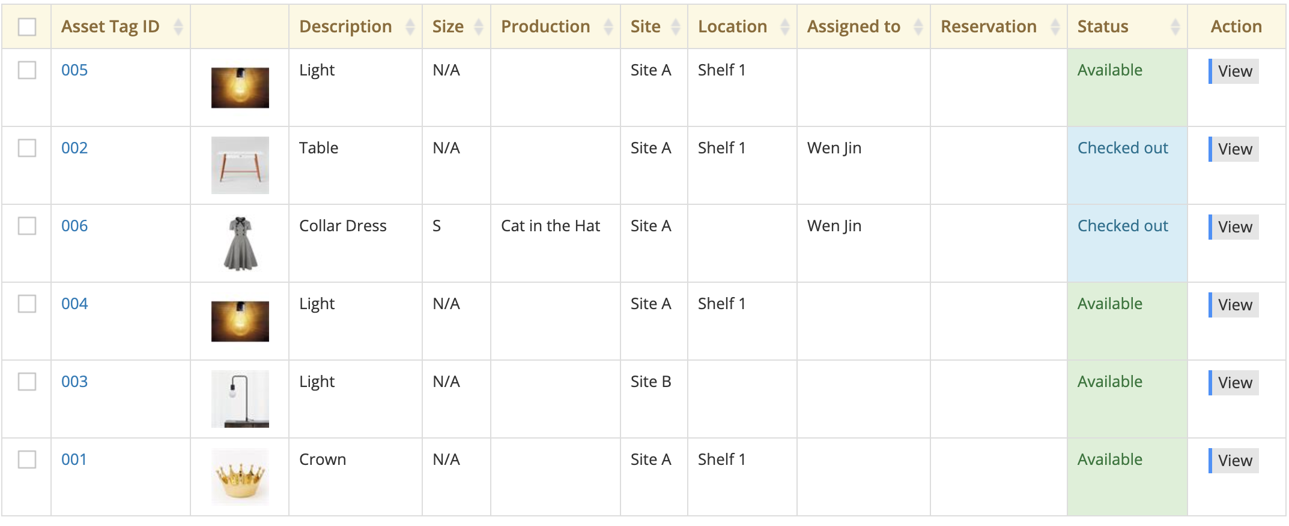
Assets View
Bill Feng 19
Notes:
This is the asset view. It contains the necessary information that was needed from our sponsor. Including…. List all of the column name. We can also use VIEW on the right side to take quick action on an item.

Slide 21
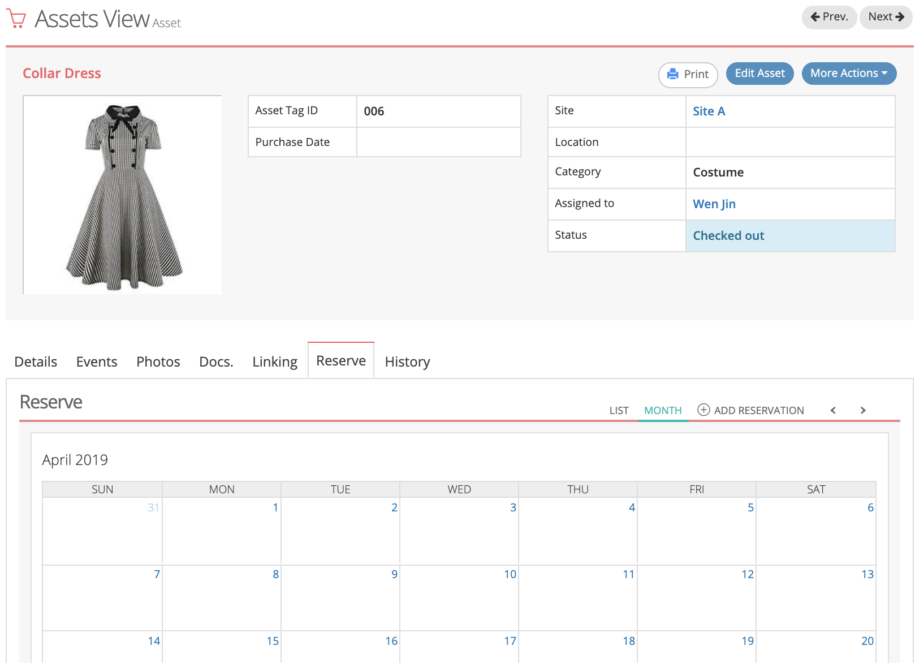
Detailed Asset View
Bill Feng 20
Notes:
This is a detailed asset view. It contains all of the information that was about the item. Including…. List all of the important tag name. We can also click on the tabs on the bottom to navigate to more details about an action to an item.

Slide 22
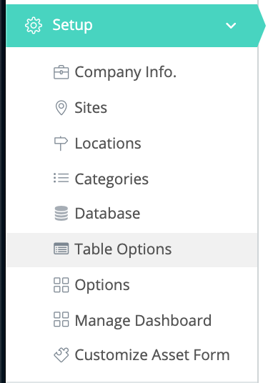
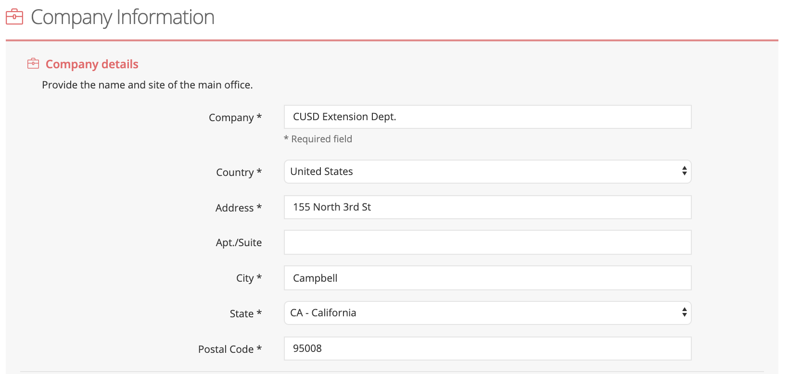
AssetTiger Setting/Customization
Bill Feng 21
Notes:
There are many setting and customization available for the user. Such as basic company information and database setup. See right figure

Slide 23
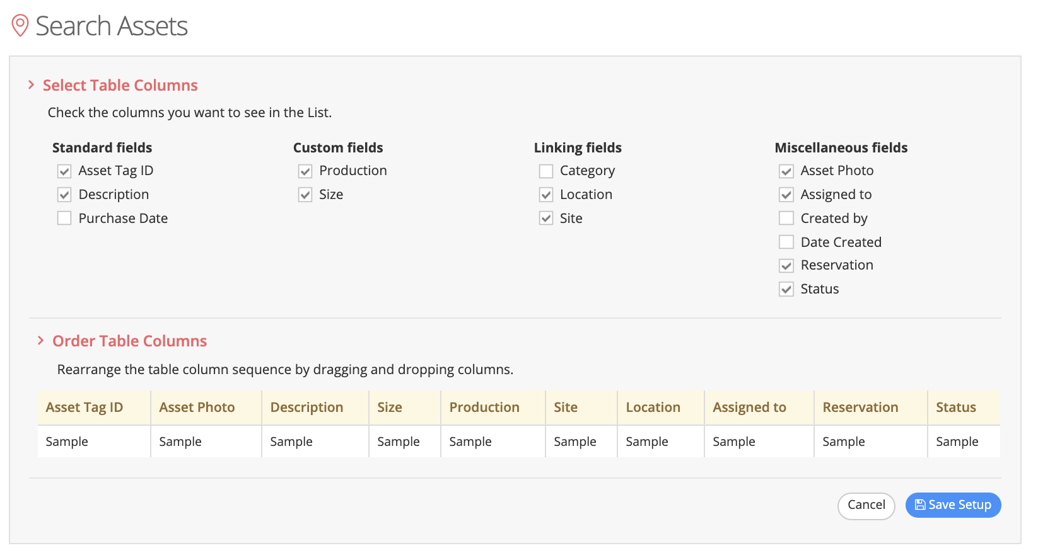
Asset column customization
Bill Feng 22
Notes:
Here we see the view to edit the visible column for an assets table view. From our previous setting, we can simply check box them to have which one be visible to us.

Slide 24
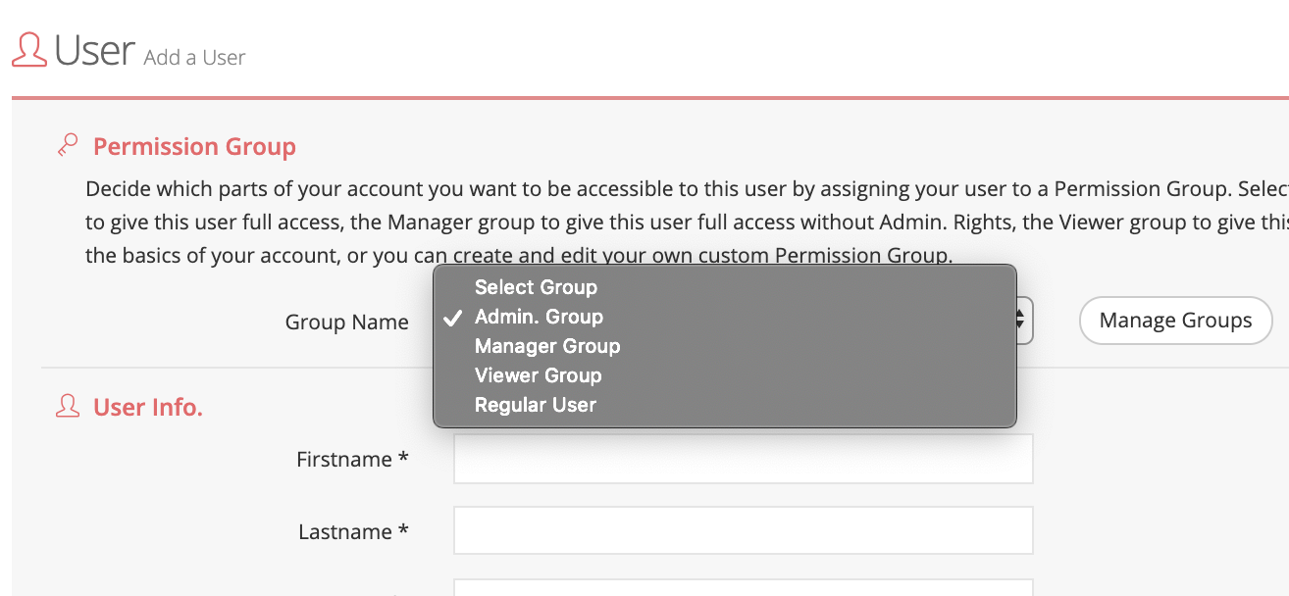
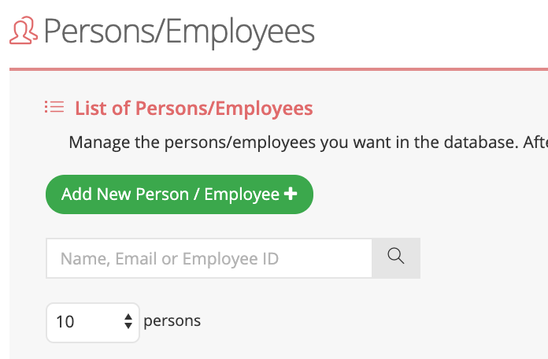
User Setting
Bill Feng 23
Notes:
We can also give out different permission group and also create many different user name with their information.

Slide 25
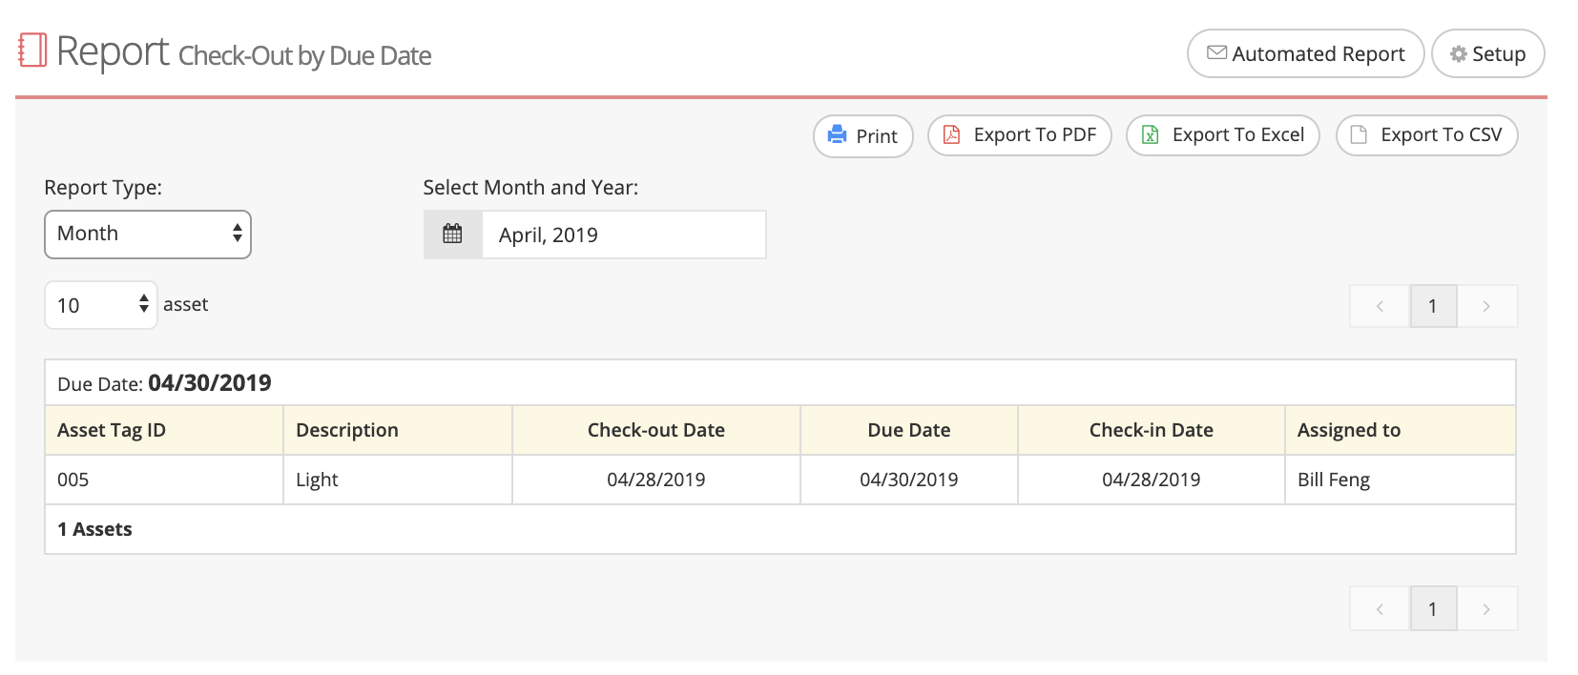
Report
Bill Feng 24
Notes:
There is also a reporting tool that can cater to the report need. Such as “Check-out by DUE DATE”

Slide 26
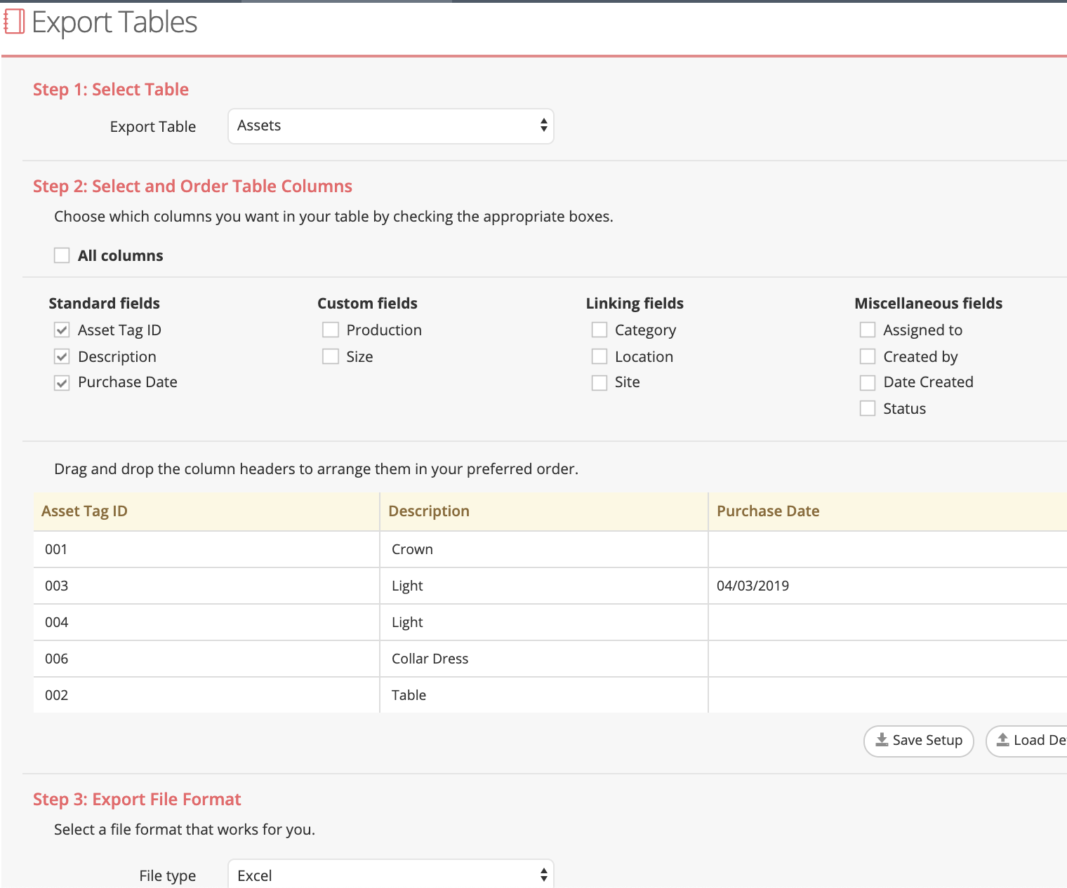
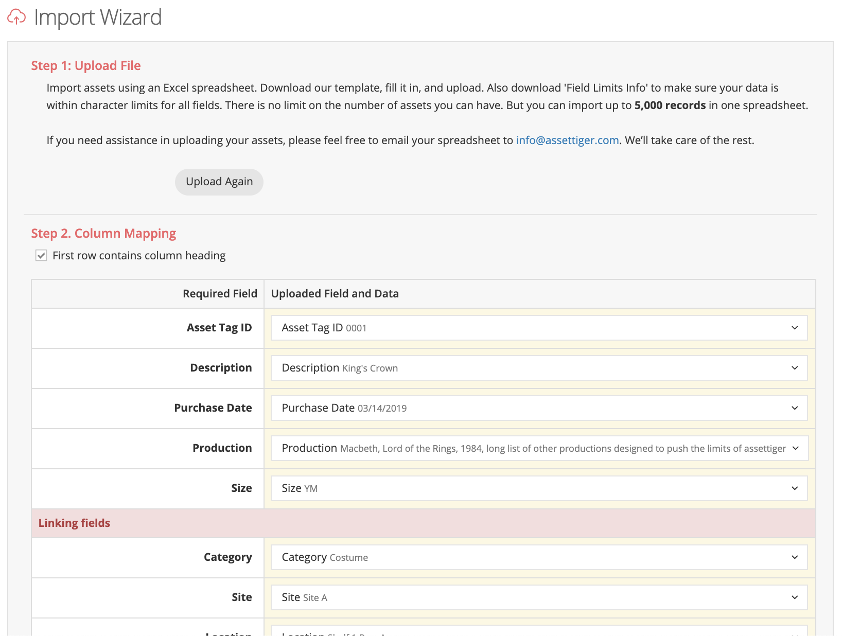
Import and Export
Bill Feng 25
Notes:
Mention about having import and export feature.

Slide 27
Documentation
https://docs.google.com/document/d/1EzevkQP_5L-zhBwB1niBoGt5FkZJeVuzRXN-3kXGXM8/edit?usp=sharing
Bill Feng 26
Notes:
Here we will show our style was asked by our sponsor and how we approach it.

Slide 28
Lessons Learned
Importance of weekly meeting.
Importance of effective communication with project sponsor.
Importance of document and consolidate all meeting note early.
Importance of scheduling more time on research for each person.
Importance of take advantage of the binder checklist.
Bill Feng 27
Notes:
1. It was good that we had weekly meeting. Because of this we were able to keep our team on track.
2. It was good for us to have effective communication with the project sponsor. When there is change or update for the sponsor we let her know, and she is really happy about it.
1. It is important to have documented everything early. Every single meeting, conversation, or simply any form of note.
2. It is important to have allocate more time for researching and planning for each person on the team. Might not be enough time.
3. It is important to take advantage of the binder checklist. Using the checklist through each phase of the PLC or SDLC can go a long way identifying what you are missing. Even better, less work at the end.

