Slide 1
面向对象编程（1）

Slide 2
什么是面向对象编程
对象：数据和操作的封装
  内部状态
    实例变量（instance variables）、字段（fields）、成员变量（member variables）、属性（attributes）…
    往往外部不可见，但有些语言中可以是public的
  外部可见操作
    方法（methods）、成员函数（member functions）
面向对象编程
  每个对象都是一个独立个体，对象间通过发送消息交互
    对象收到消息后，可以完成相应任务，修改自己的内部状态，并把结果返回给发送方，完成任务过程中也可能发送消息给其他对象
  “server-oriented”或者 “message-oriented”

Slide 3
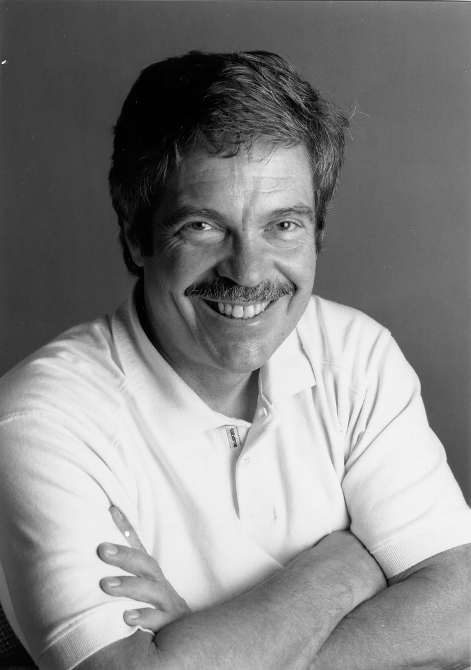
OOP to me means only messaging, local retention and protection and hiding of state-process, and extreme late-binding of all things. It can be done in Smalltalk and in LISP. There are possibly other systems in which this is possible, but I'm not aware of them.
Alan Kay
Smalltalk主要发明者
2003年图灵奖得主

Slide 4
面向对象的四个核心概念
动态派发（dynamic dispatch）
封装
多态（子类型）
继承（有较大争议）

Slide 5
OO编程的程序结构
类：对象的模板/类型/接口
  实例变量/方法，类（static）变量/方法
  实例方法调用：o.m(e1, …, en)
    向对象o发送消息m(e1, …, en)
    实际等同于过程式语言中的函数调用 m(o, e1, …, en)
    x.add(y) vs. add(x, y)
继承
  子类复用父类的方法，避免代码重复
  也可以重新实现父类的方法（override）
子类型
  子类型的对象天然也是父类型的对象
  提供多态能力

Slide 6
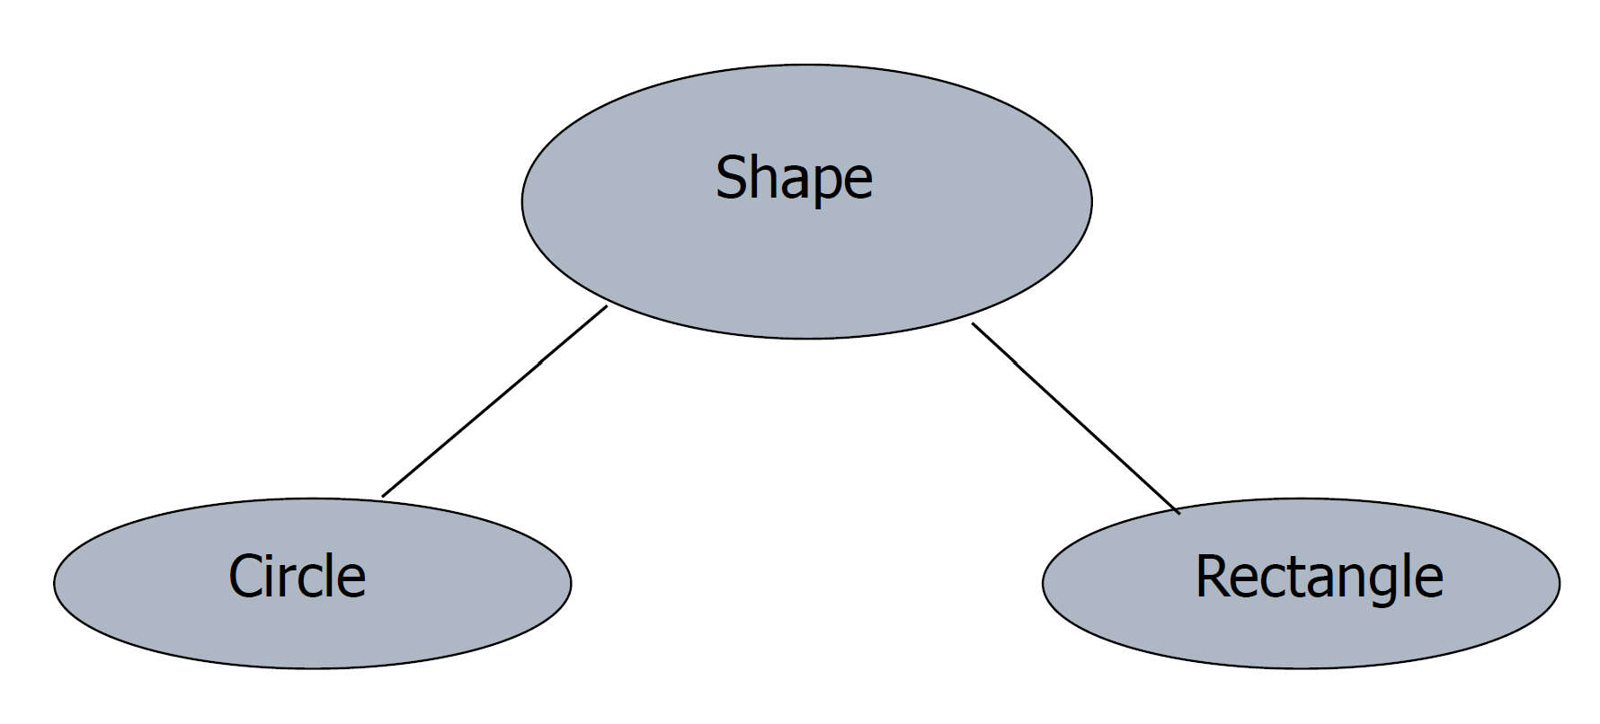
实例：几何图形库
通用概念：形状（Shape）
具体形状：矩形（Rectangle）和圆（Circle）
共性概念
  center、move、rotate、print
允许扩展
  具体形状（矩形和圆）中添加新的概念（成员变量或方法），
  或者重新定义上述共性概念
  添加新的具体形状
易扩展性是面向对象编程的一个重要理念

Slide 7
实例：几何图形库
open class Shape {
open func move(x: Int, y: Int): Unit {
print("Shape moved to ($x, $y)")
}
// Other common methods for shapes
}
class Circle <: Shape {
override func move(x: Int, y: Int): Unit {
print("Circle moved to ($x, $y)")
}
// Other common methods for circles
}
class Rectangle <: Shape {
override func move(x: Int, y: Int): Unit {
print("Rectangle moved to ($x, $y)")
}
// Other common methods for rectangles
}
let s1: Shape = Circle()
let s2: Shape = Rectangle()
s1.move(10, 20) // Should print "Circle moved to (10, 20)"
s2.move(30, 40) // Should print "Rectangle moved to (30, 40)"
继承和override
循环处理Shape队列中的每一个元素：
从队列中取出形状s
执行操作s.move(10, 20)
动态派遣
队列中实际存放的形状可以是Circle或Rectangle
根据实际形状，自动调用相应的move方法

Slide 8
面向对象语言发展历史 —— Simula
Simula 67: 第一个OO语言
最初用于仿真
  后扩展为通用编程语言
基于Algol 60扩展
1977年后标准化为Simula（不再带67）
影响了后续多种语言的设计
  Smalltalk
  C++
  Java
  C#
  …

Slide 9
面向对象语言发展历史 —— Simula
前身：Simula-1
  1962年发明与挪威计算中心（Norwegian Computing Center）
发明人
  Ole-Johan Dahl, Bjørn Myhrhaug, and Kristen Nygaard
最初设计
  受到Tony Hoare关于data type的想法的影响
  在Algol 60基础上引入类和前缀（prefix，实现子类型）
Nygaard
  运筹学专家、政治活动家
  希望语言能够描述社会和工业系统，希望普通人也能理解政治系统的变化
Myhrhaug 和 Nygaard
  计算机专家，关心通用编程

Slide 10
Simula中的面向对象设计
类：返回其活动记录指针的函数（过程）
对象
  每次调用类之后产生的活动记录
对象访问
  用“点运算符”（dot notation）访问对象的成员变量/函数
  o.var
内存管理
  采用垃圾收集来自动管理

Slide 11
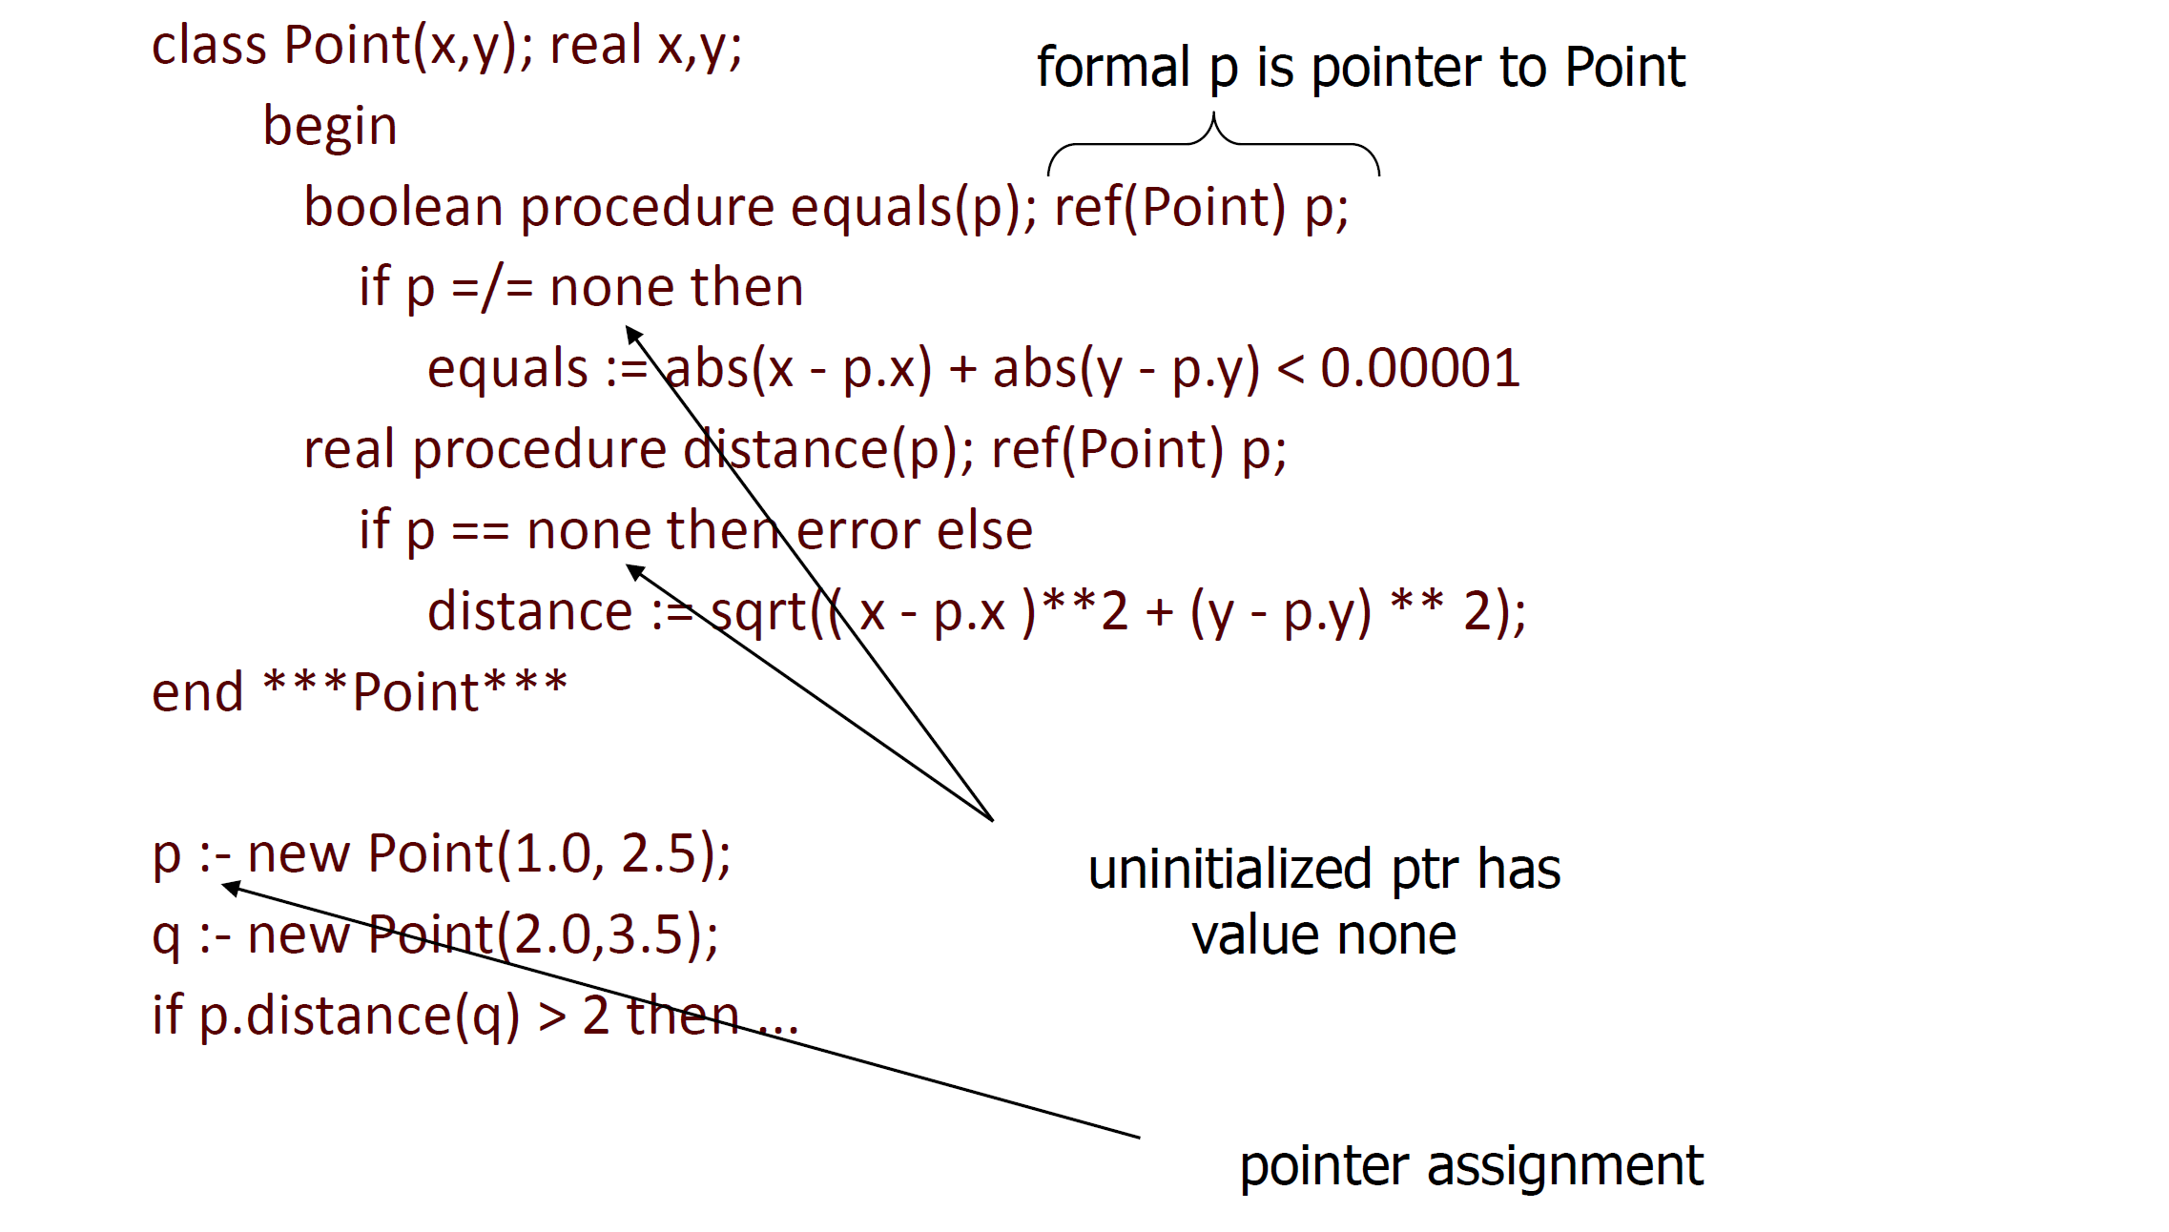
示例
func

Slide 12
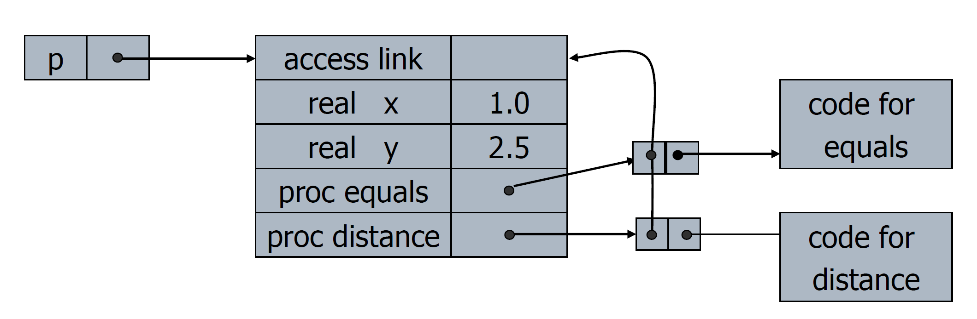
对象格式
对象 和 闭包 的关系
对象为活动记录
Access link用于访问全局变量

Slide 13
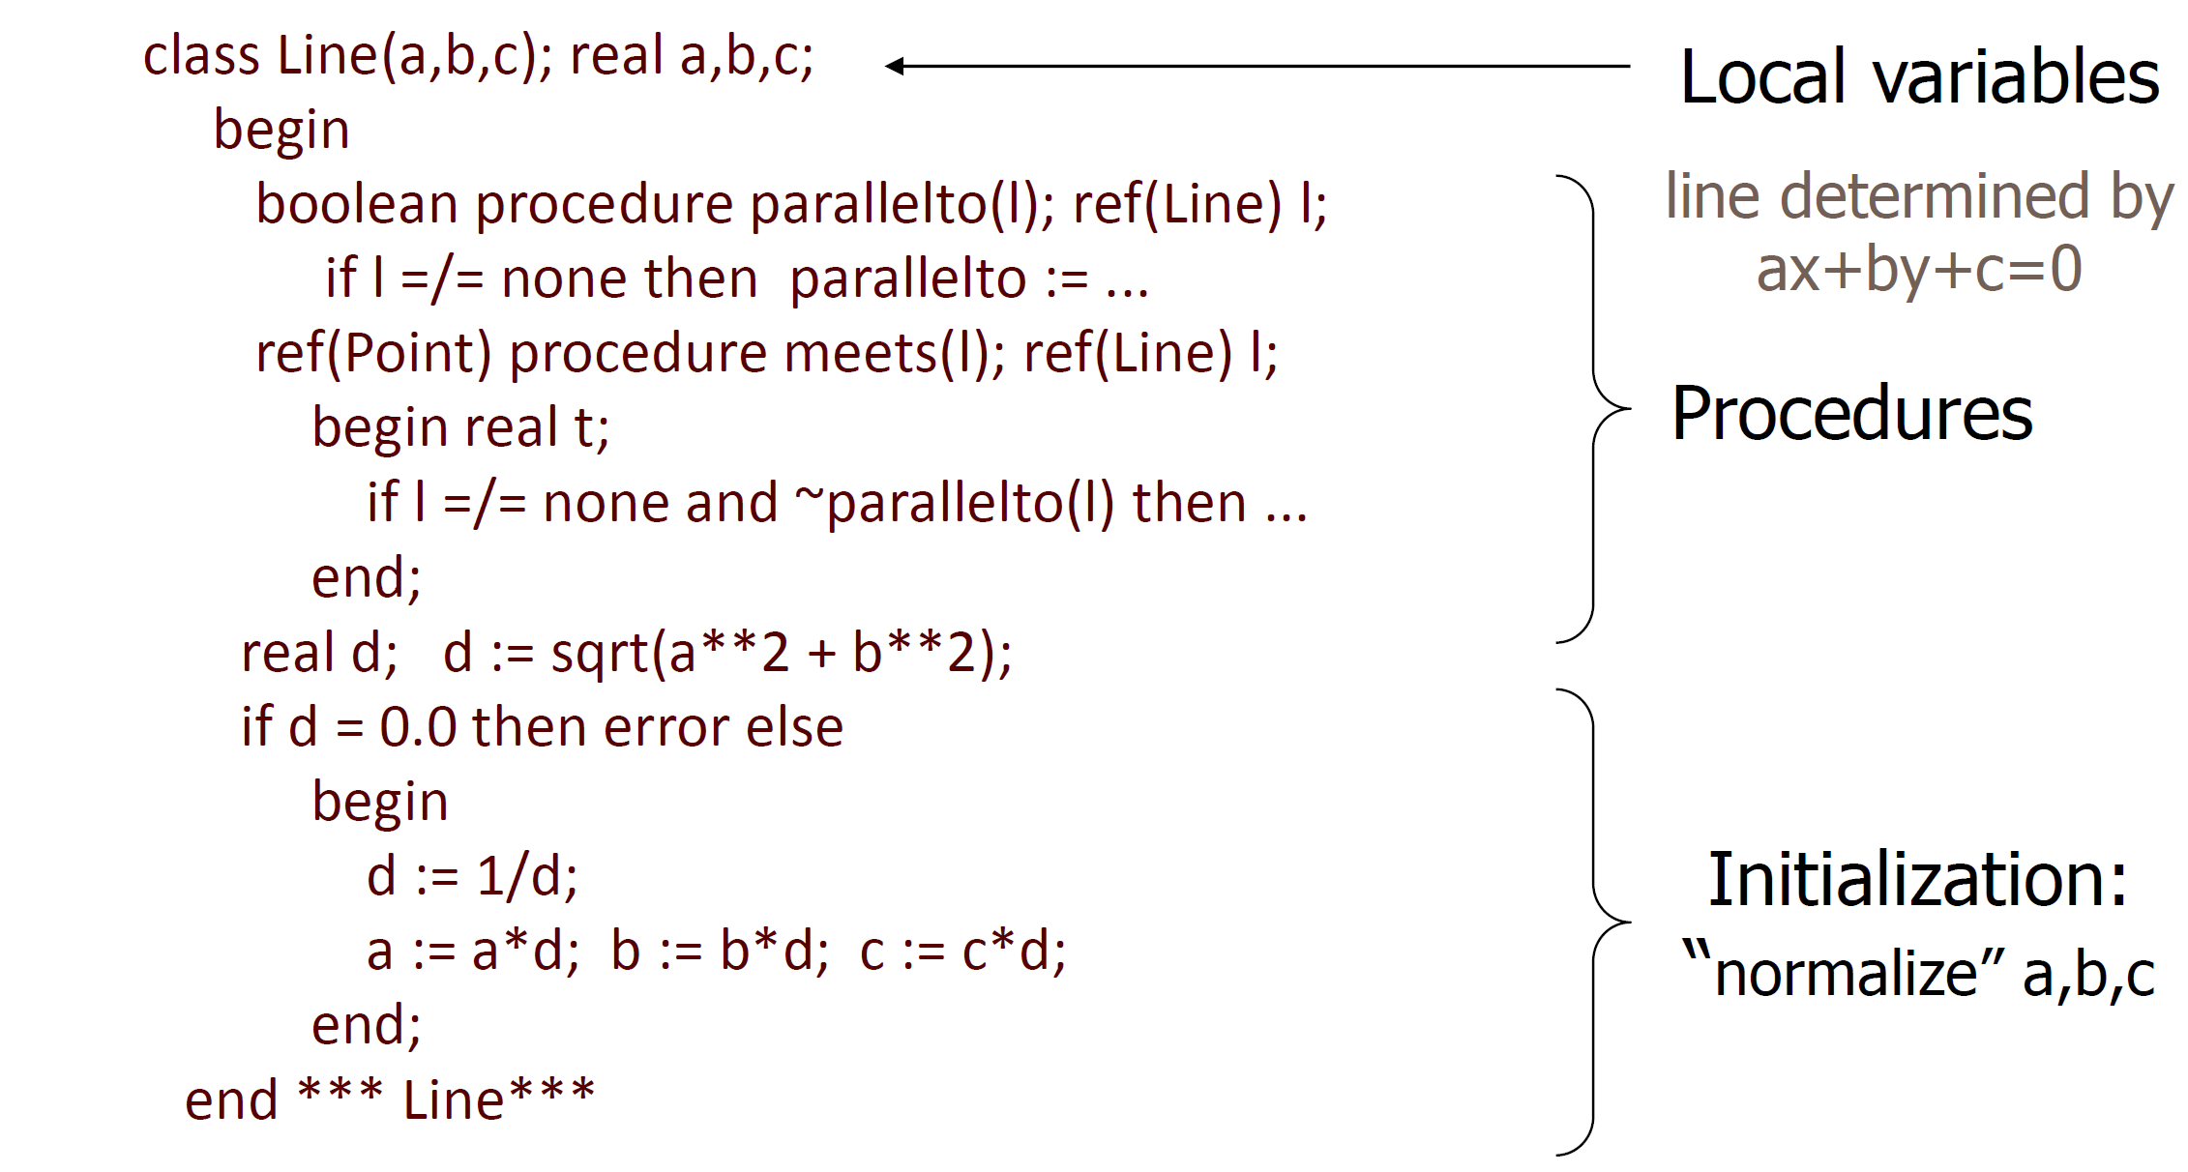
实例2

Slide 14
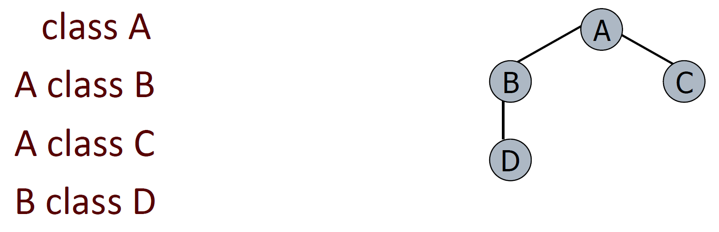
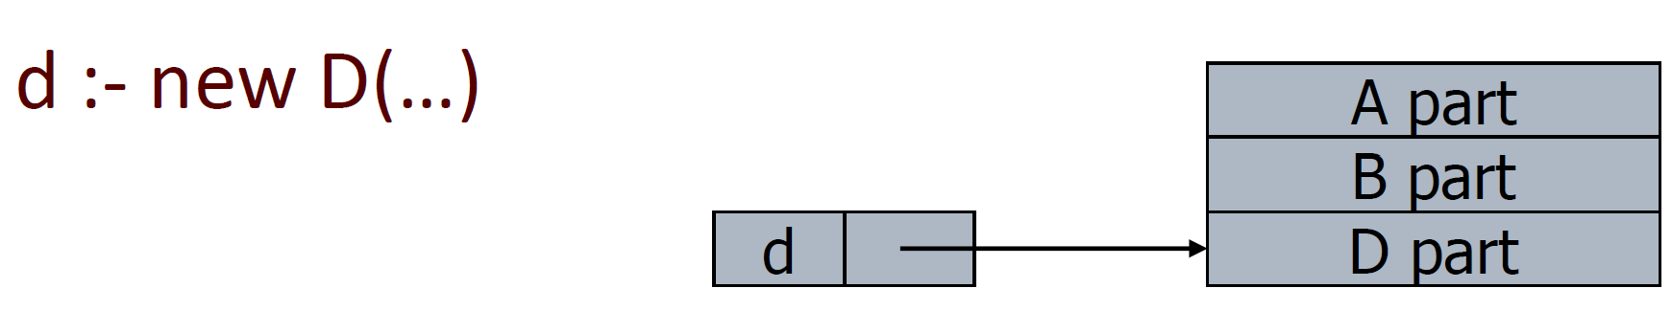
Simula中的继承
类的声明前面可以加上父类的名字作为前缀
子类的对象是父类对象和子类对象自身的拼接

Slide 15
Simula主要特性总结
类、对象、继承（prefixing）、子类型、虚方法（virtual methods）…
协程（Coroutine）
垃圾收集（GC）
缺失特性
  封装、self/super、类成员变量（静态变量）、异常

Slide 16
面向对象语言发展历史 —— Smalltalk
首次提出面向对象概念
在Xerox PARC 开发
纯面向对象语言，一切皆对象
  类（class）也是对象
  所有操作变现为“向对象发送消息”
  非常灵活和强大
    类似于Lisp的“一切皆list”的思想，但更加强大
    例如：对象能够发现它收到一条自己不能理解的消息（不支持的消息/方法），并现场决定如何回应

Slide 17
主要开发动机和核心应用——Dynabook
概念主要由Alan Kay提出
  Smalltalk项目的愿景领袖和命名者
小型便携计算机
  在1970年代，是一种革命性概念
    当时，所谓的mini-computer往往放在专门的房间里，一台机器由十余人共享
  一种可以在飞机上飞行旅途中使用的计算机
对Smalltalk语言的影响
  语言同时作为编程语言和操作系统界面
  为“非程序员”设计
  语法为语言相关的编辑器设计

Slide 18
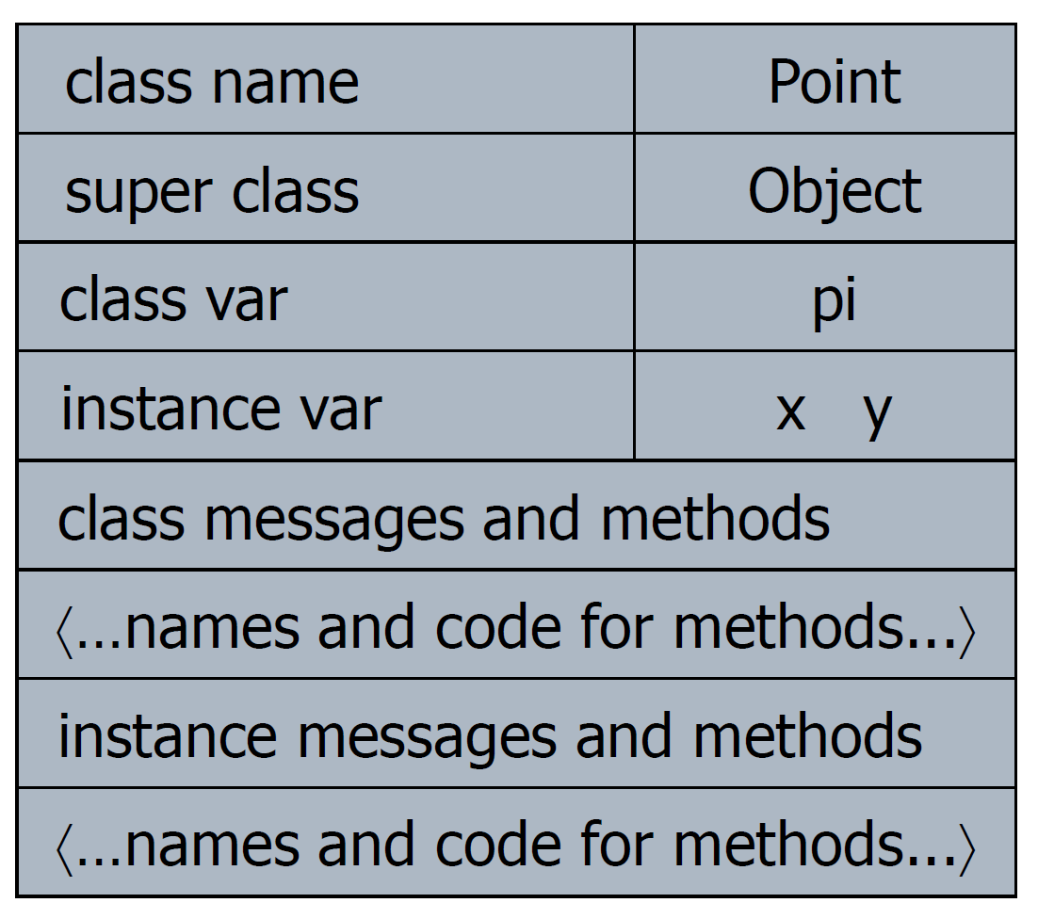
程序示例：Point
程序写成表格形式：

Slide 19
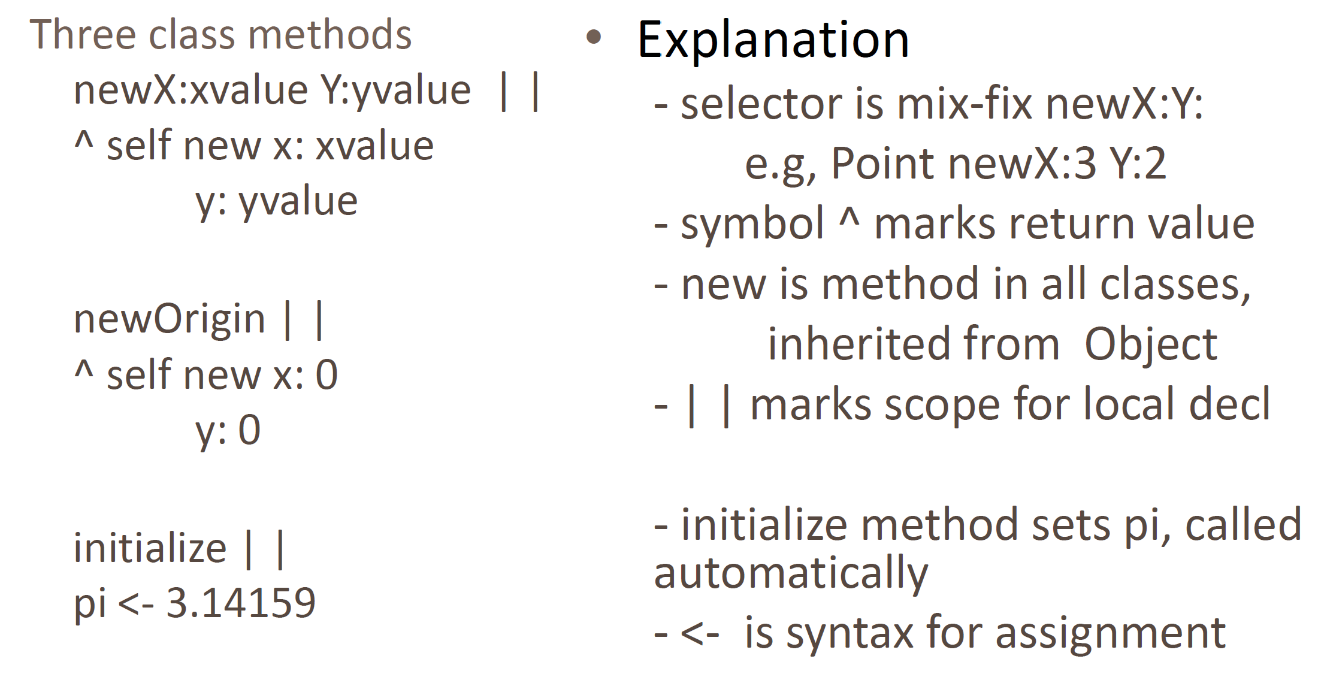
程序示例：类消息和方法

Slide 20
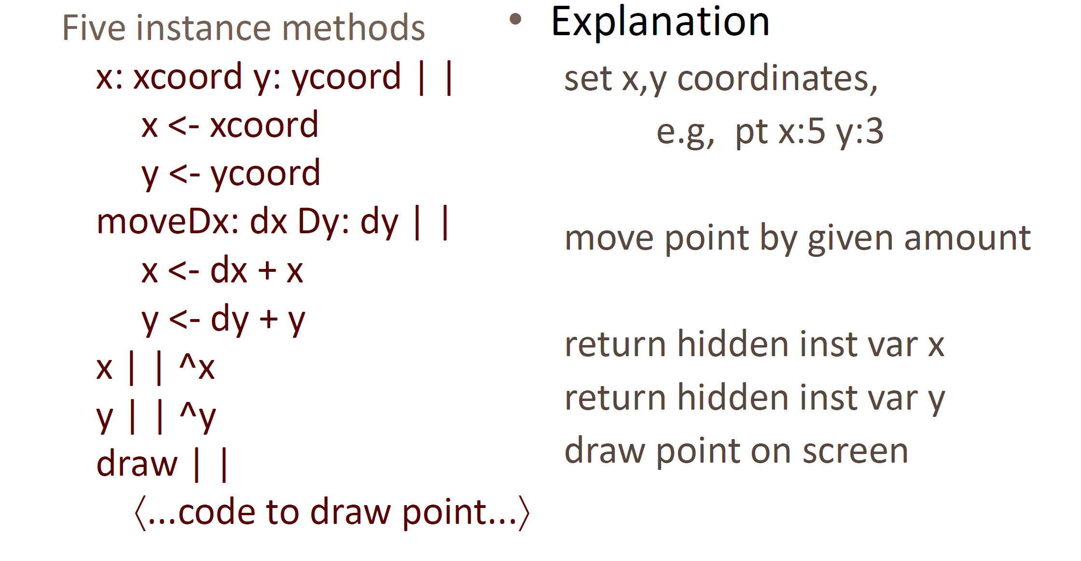
程序示例：实例消息和方法

Slide 21
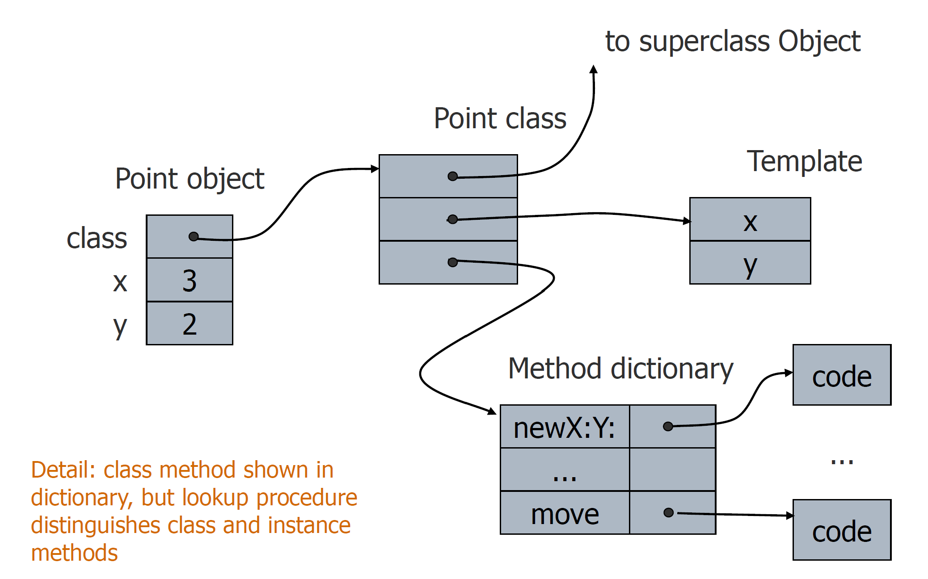
对象的表示

Slide 22
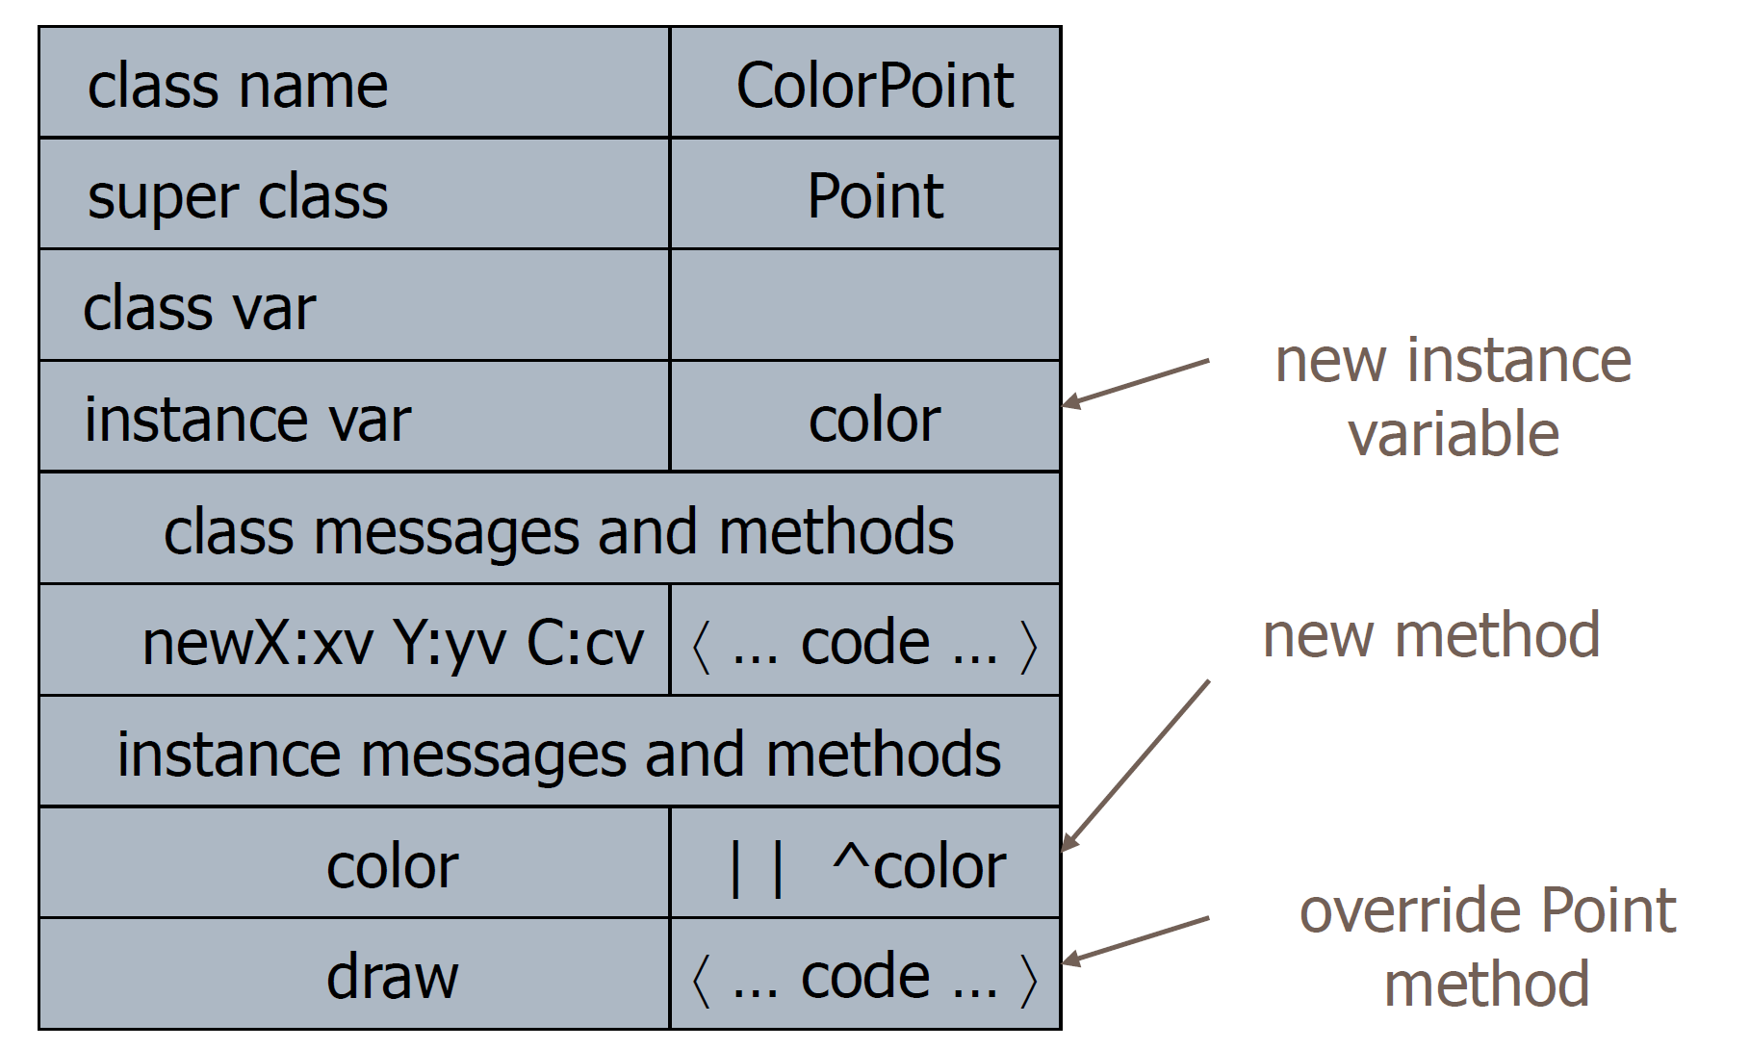
子类：ColorPoint

Slide 23
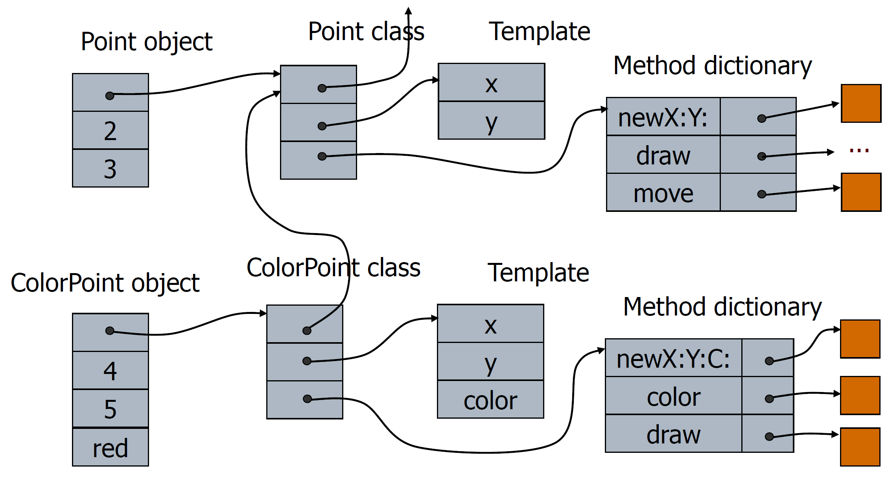
子类：ColorPoint

Slide 24
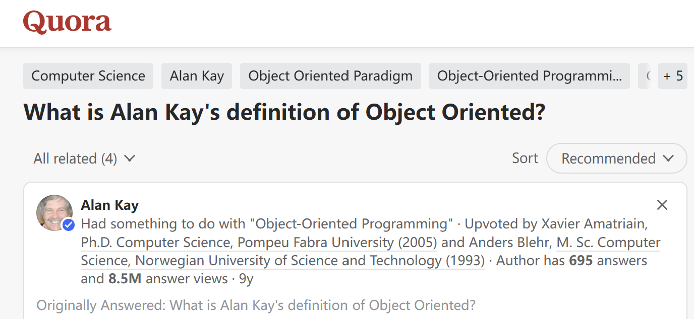
The other answers are well worth reading. An interesting question arises about terminology: to what extent is it reasonable to try to retain original definitions versus having a term get “softer” in meaning as time passes and new and additional conceptions are formed? (The latter happens in part because of the ways we spontaneously evolve our languages, so trying to legislate against it doesn’t work.)
However, I think “colonizing” a term to get reflected status is not a good practice, because it really weakens the central ideas (for example, C++ is called an “object-oriented language” — and most people argue “it is!” — but it is much too far from the ways I was thinking to be included in any definition I would come up with).
Part of the problem here is that I made a mistake with how the term was coined — I should have picked something else — in hindsight: “server-oriented programming”?
In any case, the “server” metaphor — mentioned by Eric des Courtis below — is good enough here (since I’ve written about and answered questions about “objects” in the past, and especially in the “The Early History of Smalltalk” written for the ACM ca 1993.).
There is a bit of a red herring here because the power of a comprehensive universal building block can also be its downfall. For example, a “server” could choose to allow its encapsulation to be violated — e.g. by making its services to closely resemble data structures acted on by procedures. Here, in my opinion, we would be simulating quite the wrong kinds of things, and devolving back into weak and fragile programming styles. (That is my view of what has mostly happened with “objects” — “real objects” never showed up because most people wanted to retain their data oriented style, etc.)
We could argue that the definition was incomplete — even: poor. It allowed too much discretion on the parts of programmers (this was partly because we used it for our own purposes at Parc and thought — not terribly accurately — that -we- had sufficient discretion to use it wisely (certainly not 100% of the time!)
And … this November will be the 50th anniversary of my “recognition” of the powers of the simple idea of making everything from “encapsulated servers exchanging non-command messages”.
Even though — in my opinion again — the simple idea of making computation systems “be like computers on the Internet” still isn’t generally recognized, much more is needed in programming and systems building than “a great recognition” from 50 years ago which had enormous relative power for about two decades.
For example — today and tomorrow — we should be programming in terms of “requirements and goals” that can manifest a workable system (possibly needing a super-computer).
We should be able to optimize a system like this without touching the requirements and goals part, etc. The feeling of such programming should be like the CAD-SIM-FAB cycles in more developed parts of engineering. In other words, we want to devote most of our attention into “the whats” rather than “the hows”, use most of our energy for design, and we’d like to “ship the design!” (that would be a good slogan for the next few years).
Just as the great language Lisp was first for programming, but then became “a very high level machine code” for higher level ideas, we should see that what was powerful about direct programming with the kinds of object systems we made at Parc and subsequently so many years ago, should now be retained for structural integrity and other pragmatic reasons, but that the code should now be automatically written from much higher level sources. This doesn’t mean that “objects are now hidden”, but that they should be part of the “modeling and designing of ideas and processes” that is the center of what programming needs to be.
https://www.quora.com/What-is-Alan-Kays-definition-of-Object-Oriented

