Slide 1
Mapping The Crowd Funding
Philip Ginand, Chan Feng, Shika

Slide 2
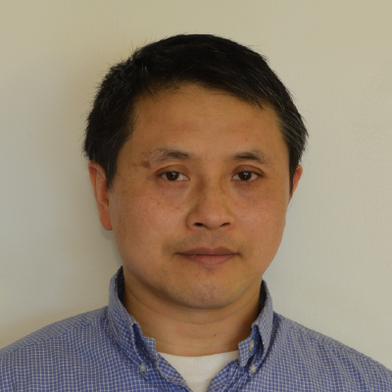
Scenario
As a warm hearted philanthropist, Chan would like to to put his $500 into good use.
Kiva, a crowdfunding company which provides finance to people in developing countries.
Philip and Shika will help Chan use Python, D3, MySQL and MongoDB to find where to pin point a location to extend his good deed.

Slide 3
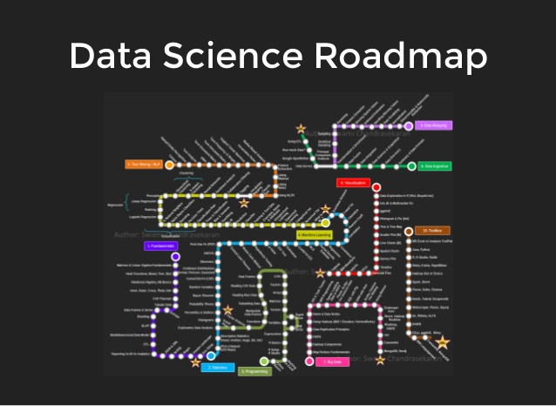
Road Map
Map view of loans, region, genders
Scatter chart show correlation of average loan amount, per capita GDP, loan volume and gender.
Sankey chart showing relationship between lender and borrowers with load total amount and volume

Slide 4
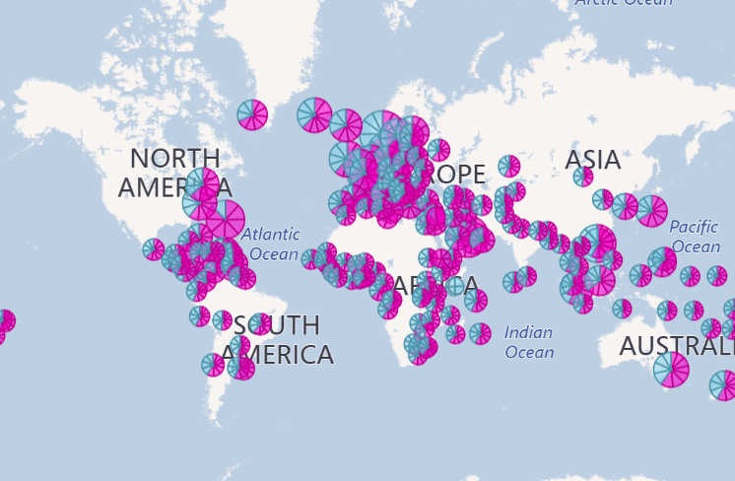
Map View
2006-2014
Women (68%) > Men, receiving funding
Central America + Europe 72% of funding
South Pacific 9%

Slide 5
Scatter chart

Slide 6
Chord Chart

Slide 7
Conclusion

