Slide 1
Job Dealer: Streamlining the Job Seeking and Hiring Process
Bohan Feng
Notes:
Introduction:
Welcome everyone, today I'll be presenting JobDealer, a platform designed to streamline the job seeking and hiring process.

Slide 2
Introduction
Inefficiencies in the job seeking and hiring process
JobDealer: A platform for job seekers and employers to connect and communicate
Notes:
The traditional job seeking and hiring process can be inefficient, with communication barriers between job seekers and employers.
JobDealer aims to bridge this gap by providing an intuitive platform for job seekers and employers to connect, communicate, and exchange information efficiently.

Slide 3
Design and Approach
Module 1: Job Post Browsing
Module 2: Job Seeker Browsing
Module 3: Chat
Notes:
JobDealer consists of three main modules: Job Post Browsing, Job Seeker Browsing, and Chat.
All of the uis are developed using swifui, no need to care different screens
These modules work together to create a seamless experience for both job seekers and employers.

Slide 4
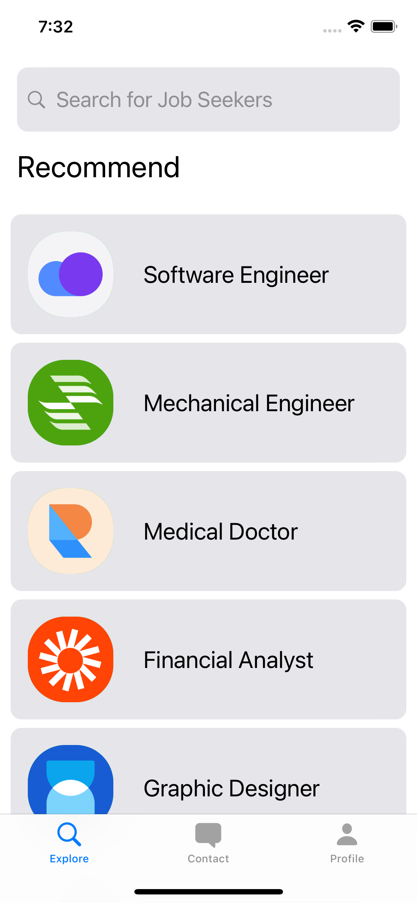
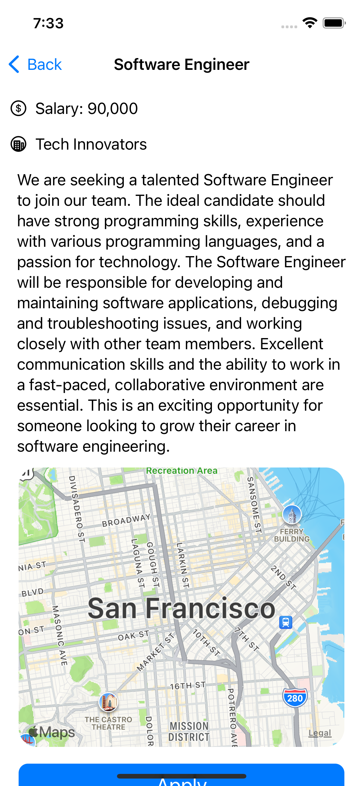
Job Post Browsing
Allows job seekers to browse and search for job posts
View job post details, including job location map
"Recently Browsed" list for easy access
Implemented using SwiftUI
Notes:
The Job Post Browsing module allows job seekers to browse and search for job posts that match their skills and interests.
Users can view job post details, including a map showing the job location.
Recently viewed job posts are displayed in a "Recently Browsed" list for easy access.
We've implemented this feature using SwiftUI to create an easy-to-use interface.

Slide 5
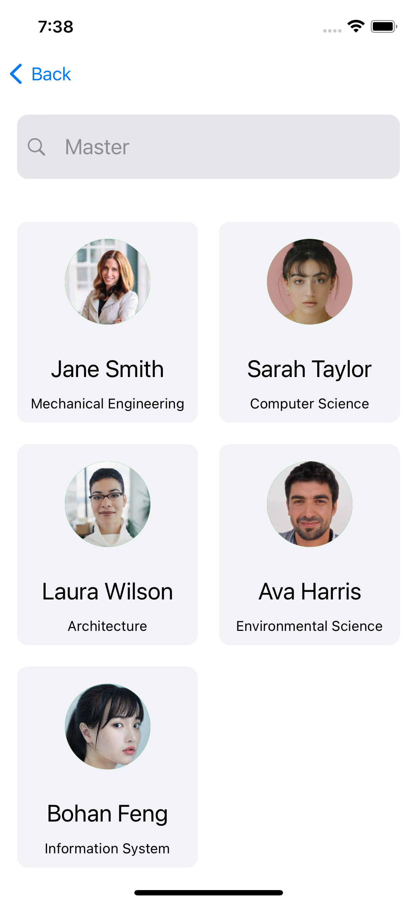
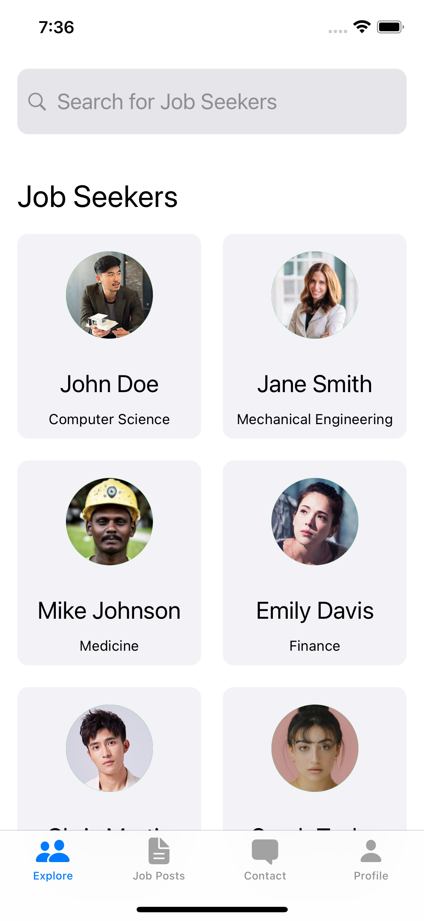
Job Seeker Browsing
Allows employers to browse and search for job seekers
Notes:
The Job Seeker Browsing module allows employers to browse and search for job seekers with the skills and experience they're looking for.
This feature also utilizes SwiftUI to create an efficient user interface.

Slide 6
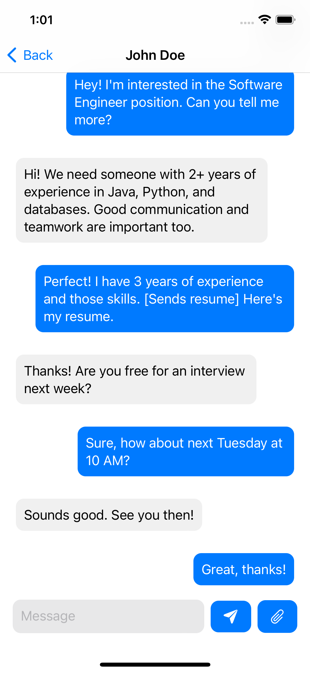
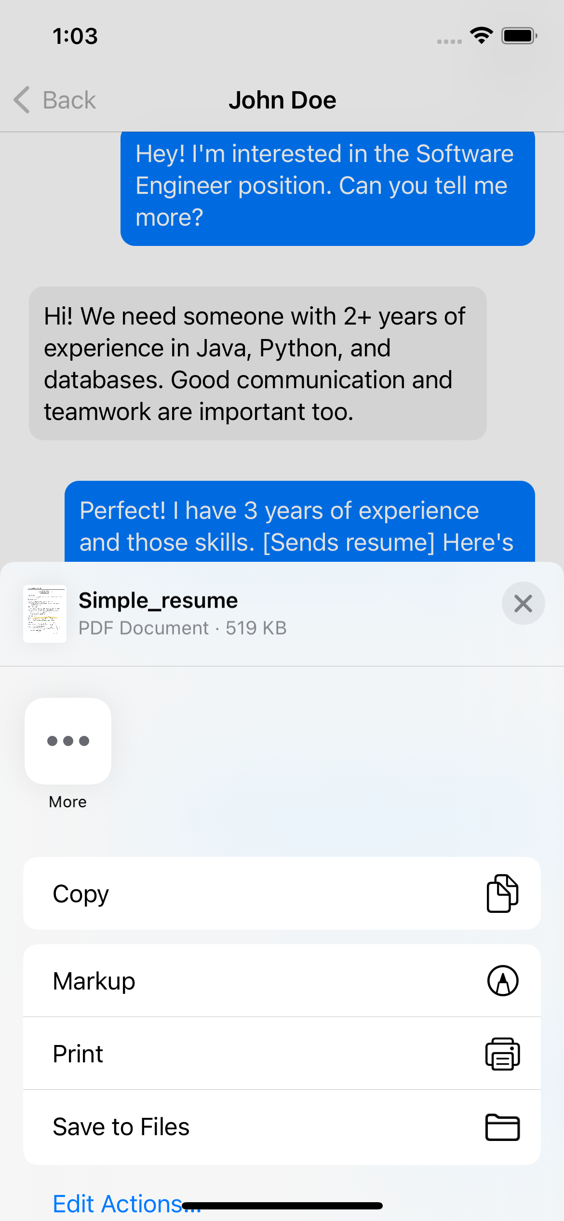
Chat
Chat interface for communication and file exchange
Implemented using .NET server-side, SignalR framework, and WebApi
Notes:
The Chat module provides a chat interface for job seekers and employers to communicate and exchange files in real-time.
We've implemented this feature using a .NET server-side, the SignalR framework for real-time data exchange, and WebApi for data management.

Slide 7
Advanced Techniques and Innovations
Real-time chat and file exchange
Notes:
One of the key innovations of JobDealer is its real-time chat and file exchange functionality, which sets it apart from other job-seeking platforms.

Slide 8
Demo
Showcasing the real-time chat feature
Efficient communication between job seeker and employer
Notes:
Now, let's move on to the demo. I'll showcase not only the real-time chat feature but also other key functionalities of the JobDealer platform, including job post browsing and job seeker browsing.
(Conduct demo, demonstrating the following)
Browsing and searching for job posts
Browsing and searching for job seekers
Real-time chat functionality and file exchange between job seekers and employers

Slide 9
Conclusion and Future Work
Addressing core functionalities for job seeking and hiring
Potential future enhancements
Notes:
In conclusion, JobDealer addresses core functionalities for job seeking and hiring while streamlining the process.
Potential future enhancements include personalized recommendations, enhanced chat functionality, bookmarking and sharing features, and a community for users to share content and experiences.

Slide 10
Q&A
Notes:
Thank you for your attention. I'll now open the floor for questions and discussion.

