Slide 1

Compiler - Lab 3
BUPT-Compiler 1

Slide 2
Outline
• Context-Free Grammar Introduction
• GNU Bison Introduction
• Interacting Bison with Flex
• Bison Exercise
BUPT-Compiler 2

Slide 3
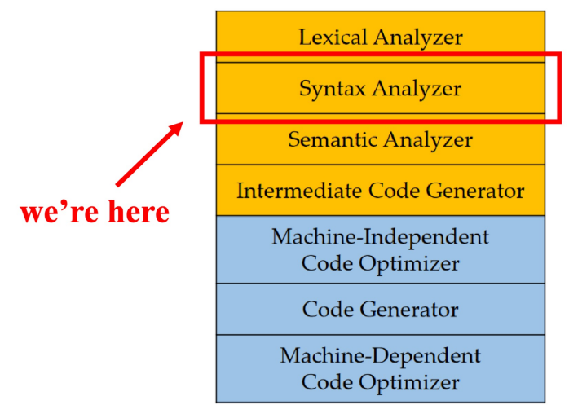
Syntax Analysis
BUPT-Compiler 4

Slide 4
Context-Free Grammar Introduction
• Context-Free Grammar
Context-free grammar (or CFG) defines the context-free languages, a strict superset of the regular language
BUPT-Compiler 5

Slide 5
Context-Free Grammar Introduction
• A context-free grammar (CFG) consists of four parts:
• Terminals (终结符号): Basic symbols from which strings are formed (token names)
• Nonterminals (非终结符号): Syntactic variables that denote sets of strings
• Usually correspond to a language construct, such as stmt (statements)
• One nonterminal is distinguished as the start symbol (开始符号)
• The set of strings denoted by the start symbol is the language generated by the CFG
• Productions (产生式): Specify the manner in which the terminals and non-terminals can be combined to form strings
• Format: head (left side) → body (right side)
• The head is a nonterminal; the body consists of zero or more terminals/nonterminals
BUPT-Compiler 6

Slide 6
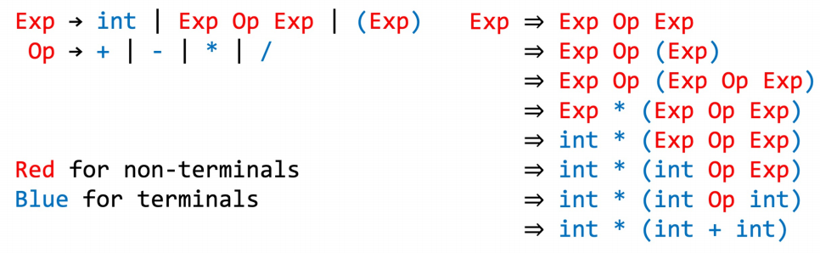
Context-Free Grammar Introduction
• Example – Arithmetic Expression
BUPT-Compiler 7

Slide 7
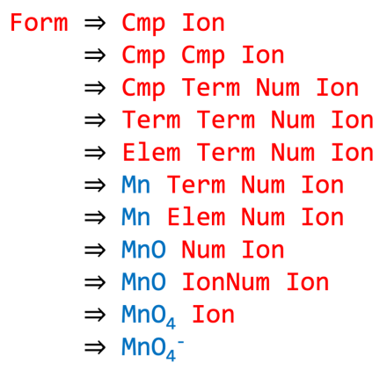
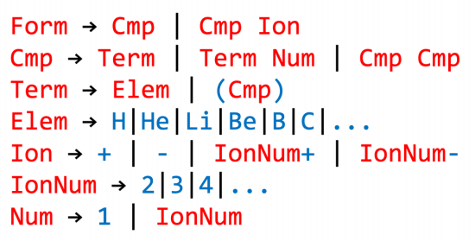
Context-Free Grammar Introduction
• Example – Chemistry
BUPT-Compiler 8

Slide 8
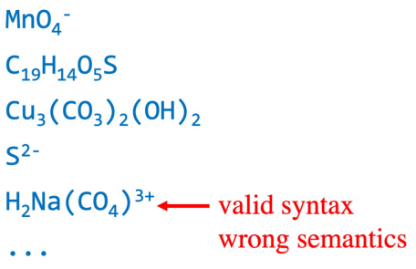
Context-Free Grammar Introduction
• Example – Chemistry
Derived forms:
BUPT-Compiler 9

Slide 9
GNU Bison Introduction
• Bison的前身为基于Unix的Yacc。令人惊讶的是， Yacc的发布时 间甚至比Lex还要早。 Yacc所采用的LR分析技术的理论基础早在 20世纪50年代就已经由Knuth逐步建立了起来，而Yacc本身则是 贝尔实验室的S.C. Johnson基于这些理论在1975年到1978年写成 的。到了1985年，当时在UC Berkeley的一个研究生Bob Corbett 在BSD下重写了Yacc ，后来GNU Project接管了这个项目，为其增 加了许多新的特性，于是就有了我们今天所用的GNU Bison。
BUPT-Compiler 10

Slide 10
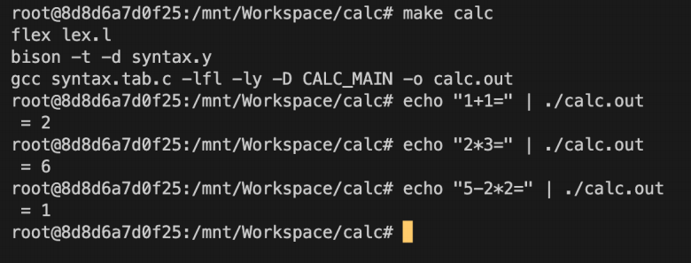
Interacting Bison with Flex
• Calculator Example
BUPT-Compiler 11

Slide 11
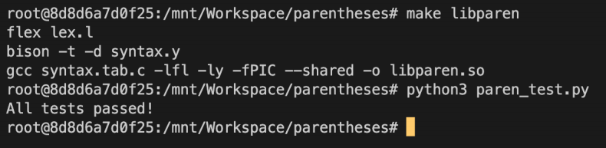
Bison Exercise
• Valid Parentheses
Leetcode 20, solve it with Flex/Bison in the lab
BUPT-Compiler 12

