Slide 1
Compilers – lab6

Slide 2
Outline
Type Checking
Implementation Hints

Slide 3
Type Checking
We have two categories of types:
Primitive type: int/char/float
Derived type: array/structure

Slide 4
Type Checking
Some constructs are associated with types:
Variable: the type of itself
Function: return type, parameter types
Expression: type of evaluated value

Slide 5
Type Checking
How two types are equal?
Primitive type: constant equal
Array: base type equal, size equal
Structure:
Named equal: two struct types have the same name
Structural equal: two struct types have the same definition

Slide 6
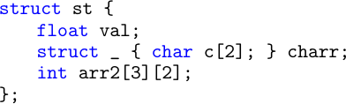
Type Checking
How to define a type? (Recursive definition)

Slide 7
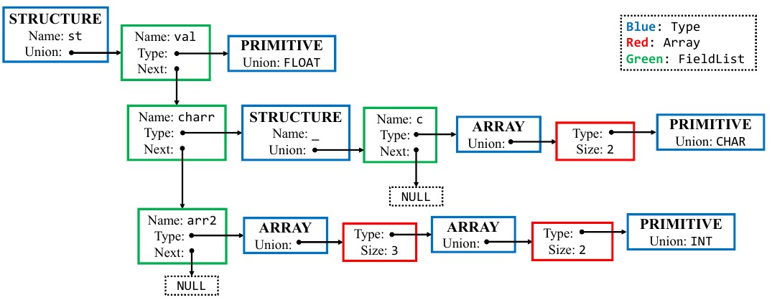
Type Checking
How to define a type?

Slide 8
Implementation Hints
To reuse the lab5 code into project2
redefine VAL_T macro as your self-defined type
the self-defined type represents the information of a symbol

Slide 9
Implementation Hints
Recorded information
variable: type (primitive, array, structure)
function: return type, parameter types
type name: type itself

Slide 10
Implementation Hints
When to push symbol
ExtDef -> Specifier ExtDecList: global variable
ExtDef -> Specifier SEMI: user-defined type
ExtDef -> Specifier FunDec CompSt: function definition
Def -> Specifier DecList SEMI: local variable

Slide 11
Implementation Hints
What is lvalue?
Exp -> Exp₁ ASSIGN Exp₂
only when:
Exp₁ | -> | ID
 | | | Exp | DOT | ID
 | | | Exp | LB | Exp | RB

Slide 12
Exercise
JSON object
Write a struct definition of a JSON object. You may refer to project 2 doc, Listing 2.

