Slide 1
Lab2 techniques to improve sequential dgemm
Feng Li
Feb 16, 2017

Slide 2
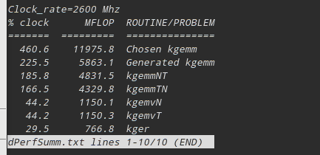
Atlas Auto-tune
Atlas was built in login node, dPerfSumm.txt gives the belowing info:
Compared with results from Zachary, the gflops in login node is much lower than compute node(7.964)

Slide 3
Two typical methods
Block algorithm
  Better data reuse, small blocks are moved into fast memory
Loop unrolling
  More lines of code, but less loop-controlling instructions
  Space-time trade-off

Slide 4
Blocked algorithm, Cont
Matrix size =1024
Block size 1024 is corresponding to the naiive version in lab1, gflops 1.28
Block size 128 gives best gflops of 1.71(33.6% increase)
Lager block size=> lower L1 data cache miss ratio(better data reuse)
When block size > 256, TLB data misses increase significantly.

Slide 5
Loop unrolling, Cont
Matrix size =1024
Based on the block size 128, which has the best performance in the first part.
Unrolling size =8 gives best gflops of 2.31(a further 350.0% increase)
Larger unrolling size => lower TLB data misses but higher L1 data cache miss ratio

Slide 6
Conclusion
Loop unrolling and blocked algorithm together give 80% improvement on sequential dgemm problem.
Still not quite efficient(2.31 gflops compared with 7.96 gflops)

