Slide 1
SUMMA Implementation using MPI
Feng Li
Mar 7 2017

Slide 2
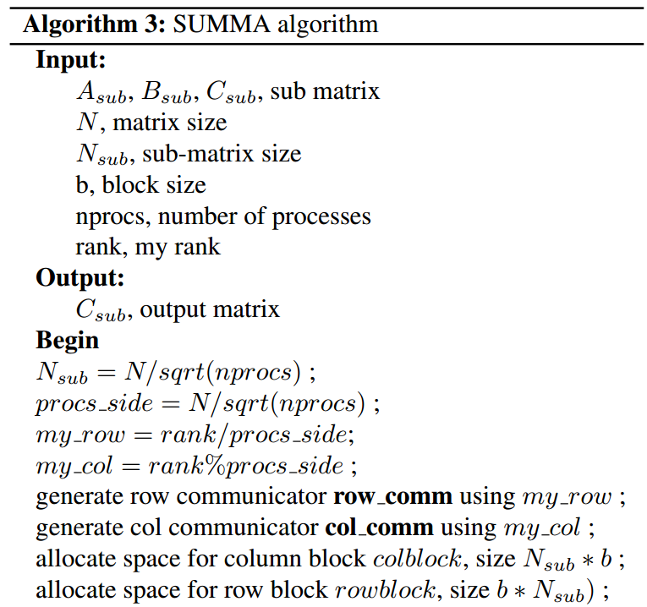
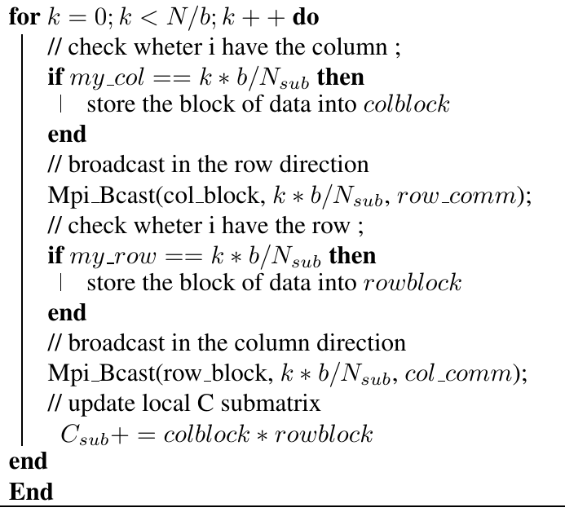
Pesedo code

Slide 3
Implemetation details
Verification
  1. Rank 0 will generate matrix A, B
  2. get result C_blas using libsci
  3. split A, B and distribute them to different processes.
  4. each process call algorithm in the last side
  5. rank 0 will gather local results of C from all processes
Timer
  Barrier
    Timer start
    Summa subroutine
    Timer stop
  (Barrier)

Slide 4
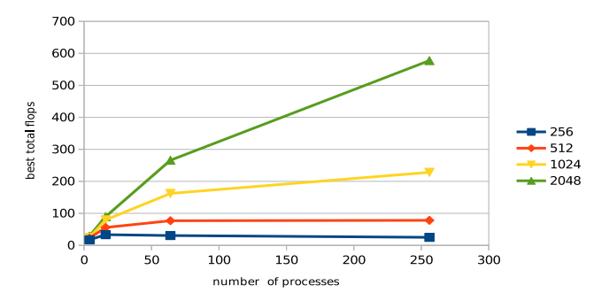
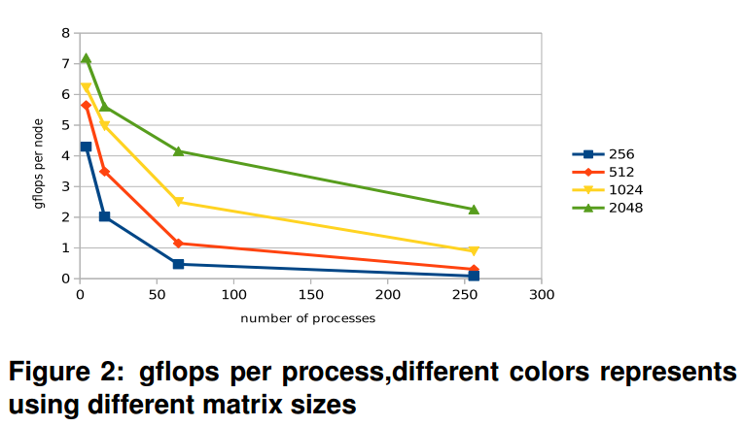
Best overall gflops
  1. Each point is after running best block size.
  2. Increasing number of processes generally increase total gflops
  3. Even more processes doesn’t help much: more communications
  4. larger matrix size gives better performance
  5. actual efficiency drops with more processes.

Slide 5
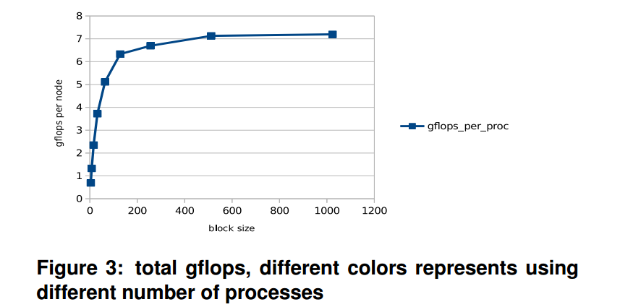
Effects of block size
  Using fixed matrix size 2048 and 4 processes.
  Larger block sizes give better efficiency
  In this case(matrix size 2048 and process number 4), best block size is equal to sub-matrix size.

