Slide 1
Finite State Machine
有限状态机
Digital Design Concept
凤黄浩

Slide 2
Overview
What is Finite State Machine (FSM)
Components of FSM
Example
Strategy for Building an FSM

Slide 3





What is Finite State Machine (FSM)
A mathematical model of computation，一个数学计算模型
An abstract machine，一个抽象的概念
Represents transactions/actions among states
Being wildly used in electrical engineering , computer science, linguistics, biology and logic etc. 运用在很多领域，不光是逻辑电路设计中

Slide 4

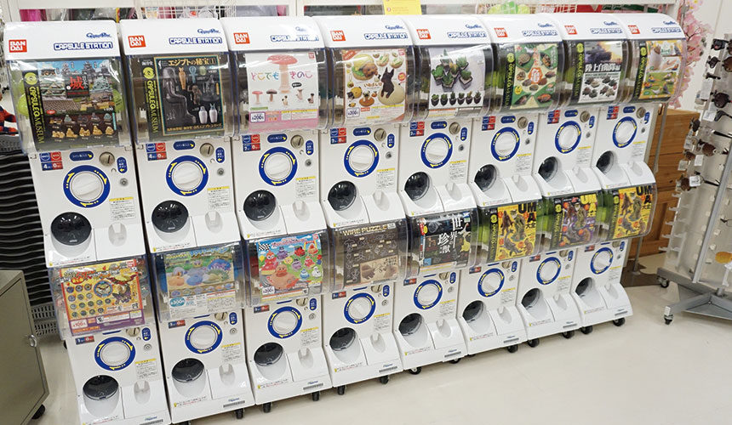

Slide 5
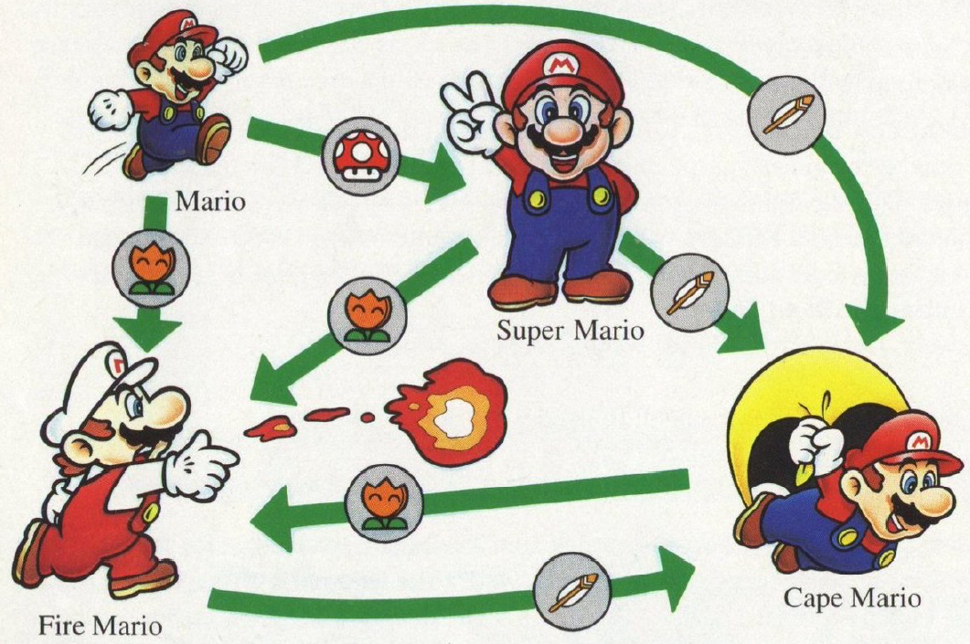
Notes:
Ask student try to understand and explain this

Slide 6
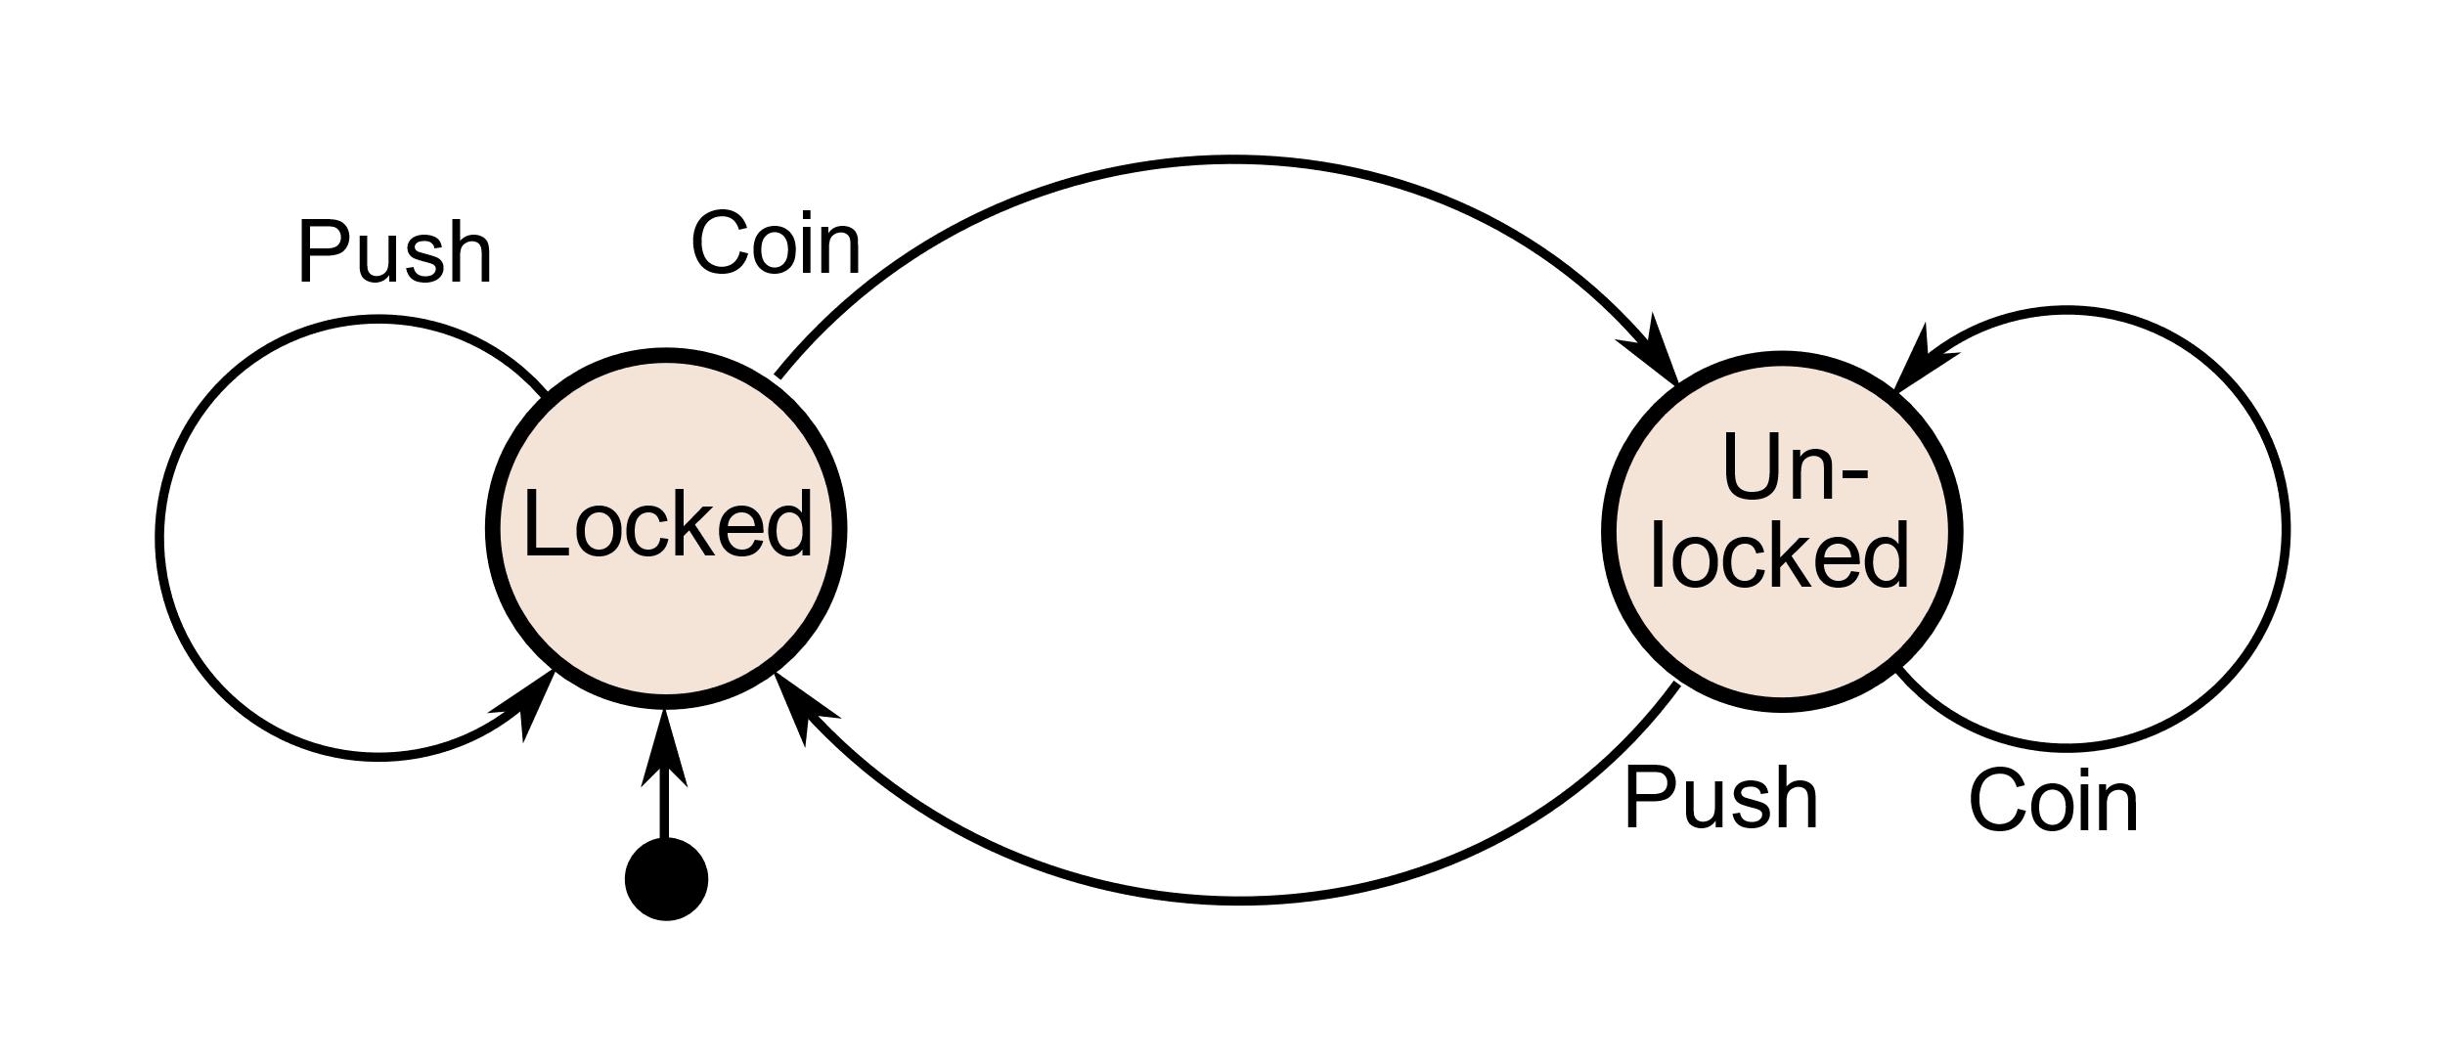
How Capsule Machine Work?

Slide 7
Components of FSM
Finite States，有限个状态
Transitions，状态间的转换过程
Inputs/Outputs，对应的输入和输出信号

Slide 8
Capsule Machine Example Again

Slide 9
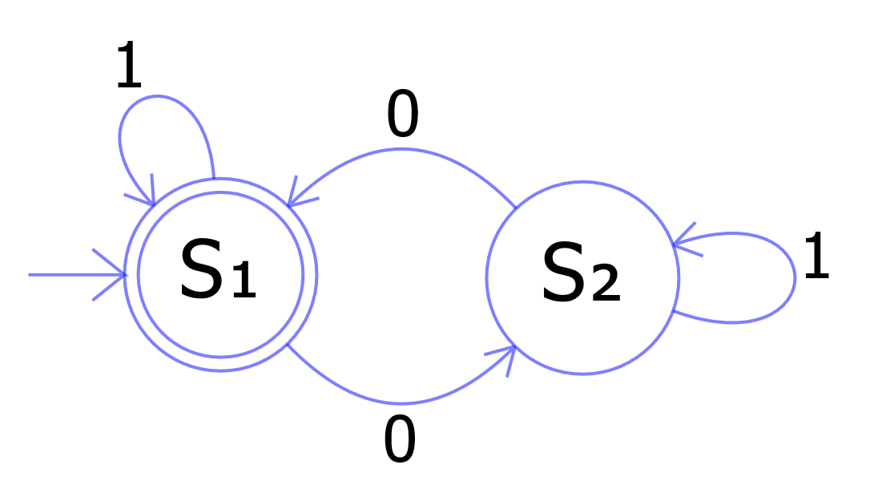
Simple FSM
Outputs and next state depend on both current state and input
输出与下一个状态，由现有状态以及对应的输入决定！
非常重要！！！

Slide 10
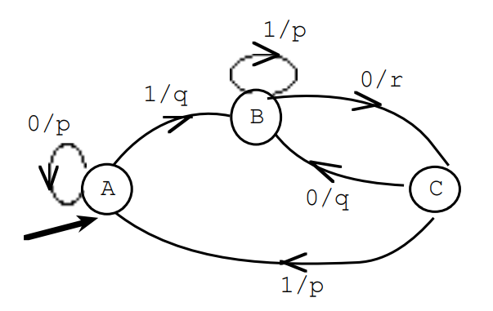
Practical Problem
Fill in the following table for the given FSM
Input | 0 | 0 | 1 | 1 | 0 | 0 | 0 | 1 | 0
Next state
output

Slide 11
Notes:
要求学生来解释这个，互动环节

Slide 12
The Mario Game Example
How many states?
What are the inputs/outputs?
What are the transitions?
Notes:
让学生先讨论，再让学生上台来做出这个状态机

Slide 13
Your Time to Analysis

Slide 14
Strategy for Building an FSM in Digital Design
画
Draw a state diagram
写
Write output and next-state tables
编
Encode states, inputs, and outputs as bits
决
Determine logic equations for next state and outputs
连
Draw the circuit

Slide 15
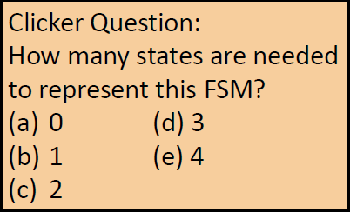
Activity: Build a Circuit for a Serial Adder
Add two infinite input bit streams
Streams sent with least-significant-bit (lsb) first
…100011
…111100
…011001

Slide 16
Strategy for Building an FSM in Digital Design
画
画出状态机的大致模型
写
Write output and next-state tables
编
Encode states, inputs, and outputs as bits
决
Determine logic equations for next state and outputs
连
Draw the circuit

Slide 17
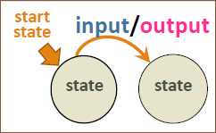
Step 1: State Diagram
Start Here
S0
States:
Inputs: a and b (drawn as 2-bit input ab)
Output: z
…100011
…111100
…011001
Notes:
课上现场带学生一起完成状态机模型，留白处用触控板进行手动作画

Slide 18
Strategy for Building an FSM in Digital Design
画
Draw a state diagram
写
用表格形式来表现运作流程
编
Encode states, inputs, and outputs as bits
决
Determine logic equations for next state and outputs
连
Draw the circuit

Slide 19
Step 2: Output & Next State Tables
a | b | Current states | z | Next states
Notes:
完成状态机后，完成此表，与学生一同完成，进行互动

Slide 20
Strategy for Building an FSM in Digital Design
画
Draw a state diagram
写
Write output and next-state tables
编
使用编码来表示表中的信息
决
Determine logic equations for next state and outputs
连
Draw the circuit

Slide 21
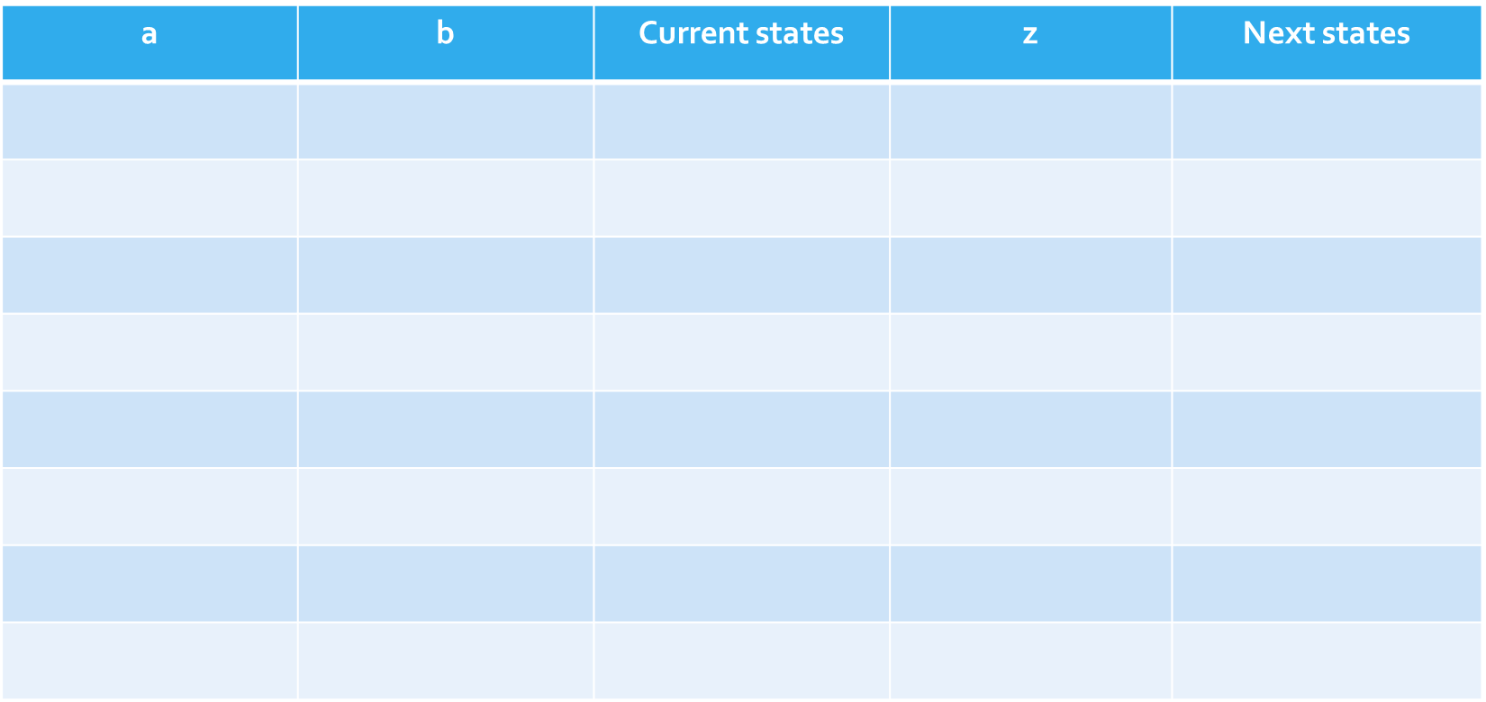
Step 3: Create Bit Encoding
Encode states as bits
S0 =
S1 =
2 states -> 1-bit enough
(1-hot also an option)
Notes:
此处带学生对先前的表做修改，全部抽象化，完成最简表达

Slide 22
Strategy for Building an FSM in Digital Design
画
Draw a state diagram
写
Write output and next-state tables
编
Encode states, inputs, and outputs as bits
决
把流程用布尔方程表示出来并化简
连
Draw the circuit

Slide 23
Step 4: Create Logic Equations
Determine logic equations for next state and outputs
S’ =
z =
Notes:
写出输入输出的布尔表达式

Slide 24
Strategy for Building an FSM in Digital Design
画
Draw a state diagram
写
Write output and next-state tables
编
Encode states, inputs, and outputs as bits
决
Determine logic equations for next state and outputs
连
完成最终电路图

Slide 25
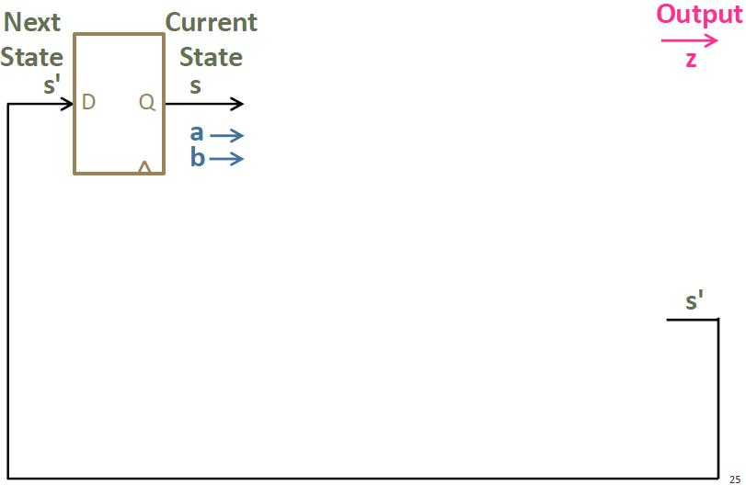
Step 5: Draw the Circuit
Notes:
带领学生一起完成电路图

