Slide 1
Finite State Machine 有限状态机
凤黄浩

Slide 2
Overview
What is Finite State Machine (FSM)
Components of FSM
Example

Slide 3

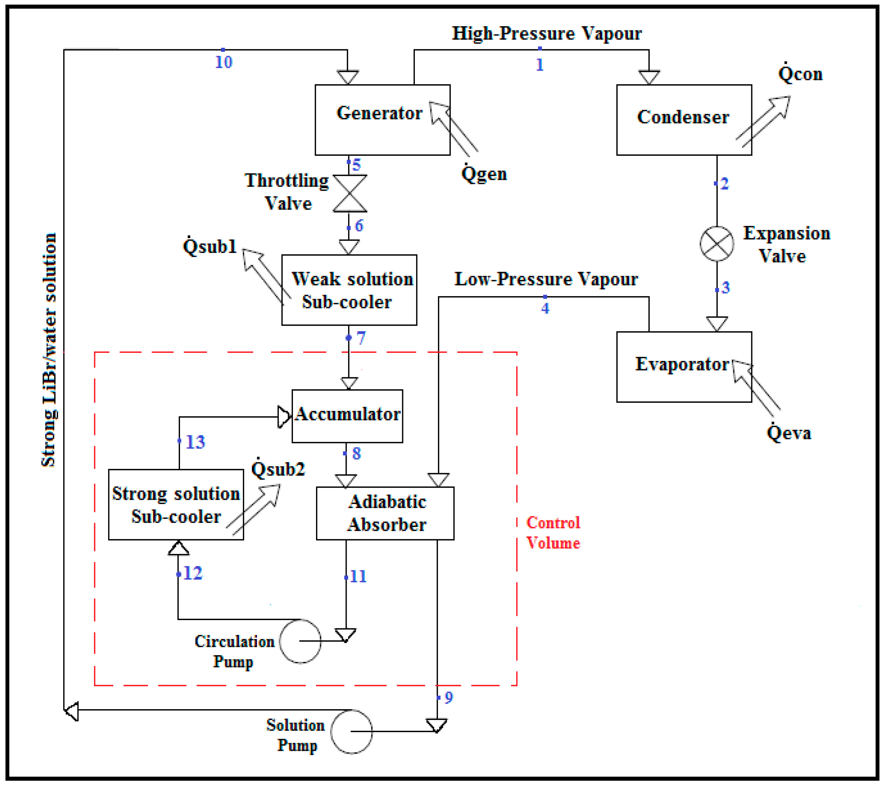




What is Finite State Machine (FSM)
A mathematical model of computation
An abstract machine
Represents transactions/actions among states
Being wildly used in electrical engineering , computer science, linguistics, biology and logic etc.

Slide 4

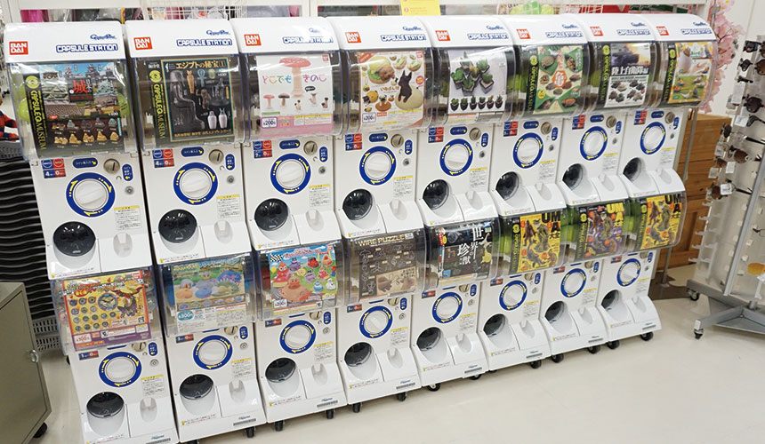

Slide 5
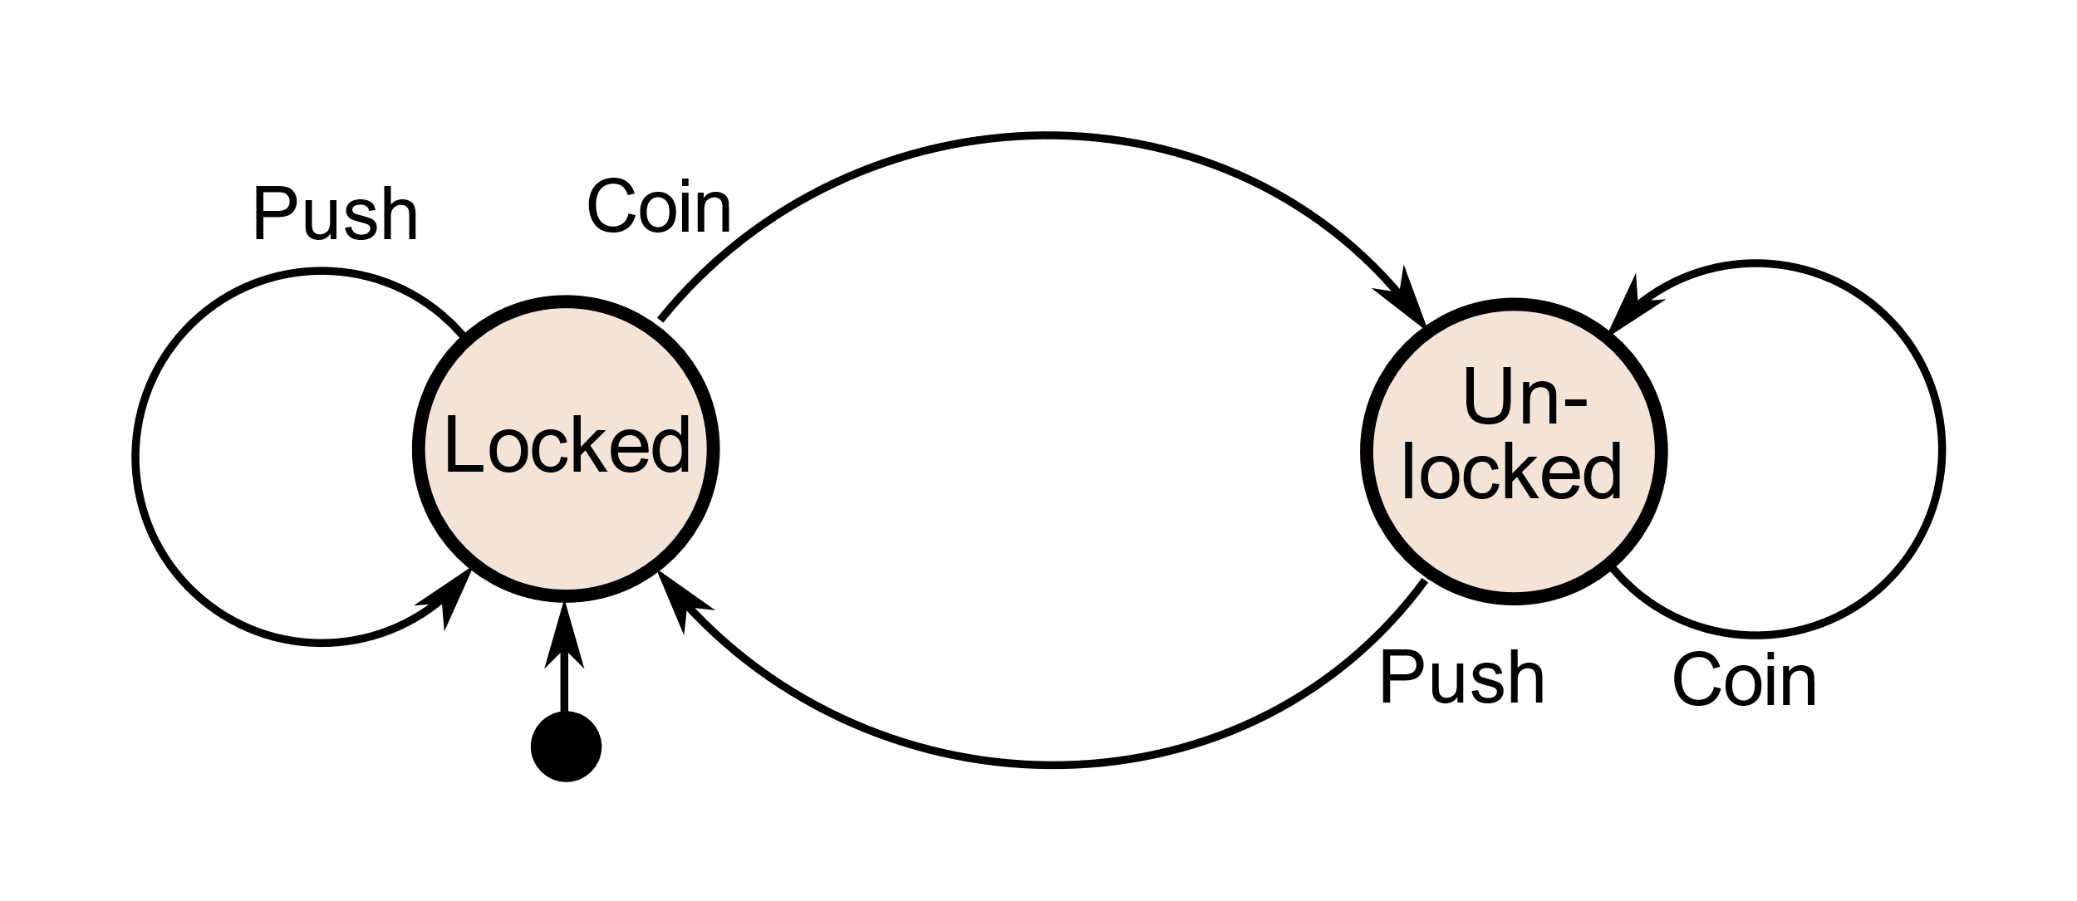
How Capsule Machine Work?

Slide 6
Components of FSM
Finite States
Transitions
Outputs

Slide 7
Capsule Machine Example Again

Slide 8
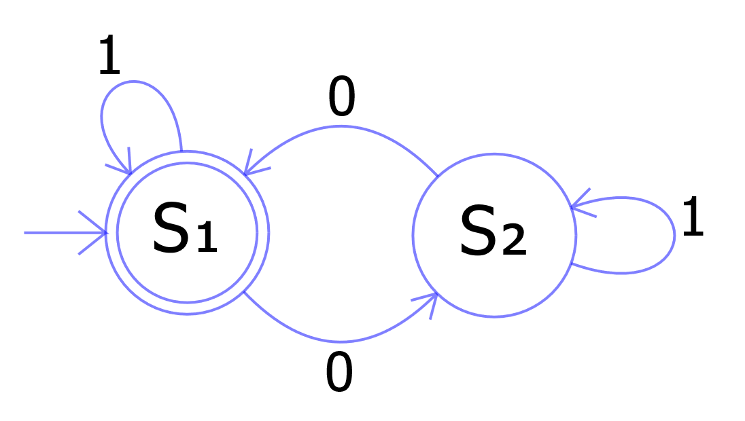
Simple FSM

Slide 9
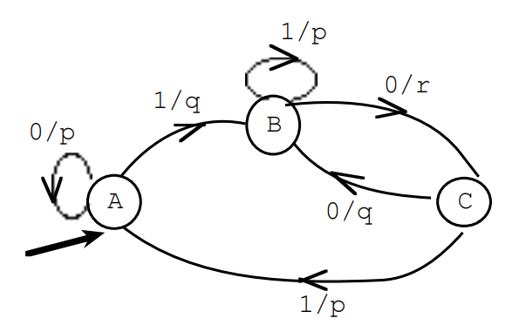
Practical Problem
Fill in the following table for the given FSM
Input | 0 | 0 | 1 | 1 | 0 | 0 | 0 | 1 | 0
Next state
output

