Slide 1

Group 6: Project Overview
ThemeChat — A Theme-Based Chat Application
Background:
ThemeChat allows users to join theme-based chat rooms built with Django REST Framework (backend) and React + Tailwind CSS (frontend).
Team Members:
Fenghua Tong (Lead Developer) — Backend & Authentication
Fanyun Xu — Home Page
Linyang Liu — Message List
Shuangxueer Zhang — Contacts Page

Slide 2
Sprint 1 Goal
Establish the core application framework with secure user authentication and navigation across main pages.
Objectives:
• Build Django REST APIs and frontend structure.
• Implement OAuth login/register/logout.
• Connect React pages via routing and consistent navbar.

Slide 3
Completed Functionalities
1. User Authentication (login, register, logout via DRF)
2. Home Page: shows public theme rooms
3. Message List Page: lists joined chats sorted by activity
4. Contacts Page: displays friends & groups
5. Page Navigation: consistent routes & header

Slide 4
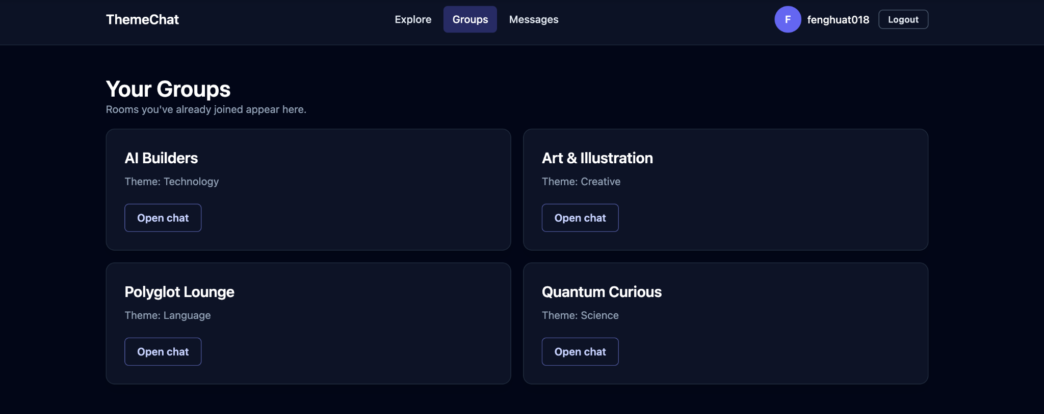
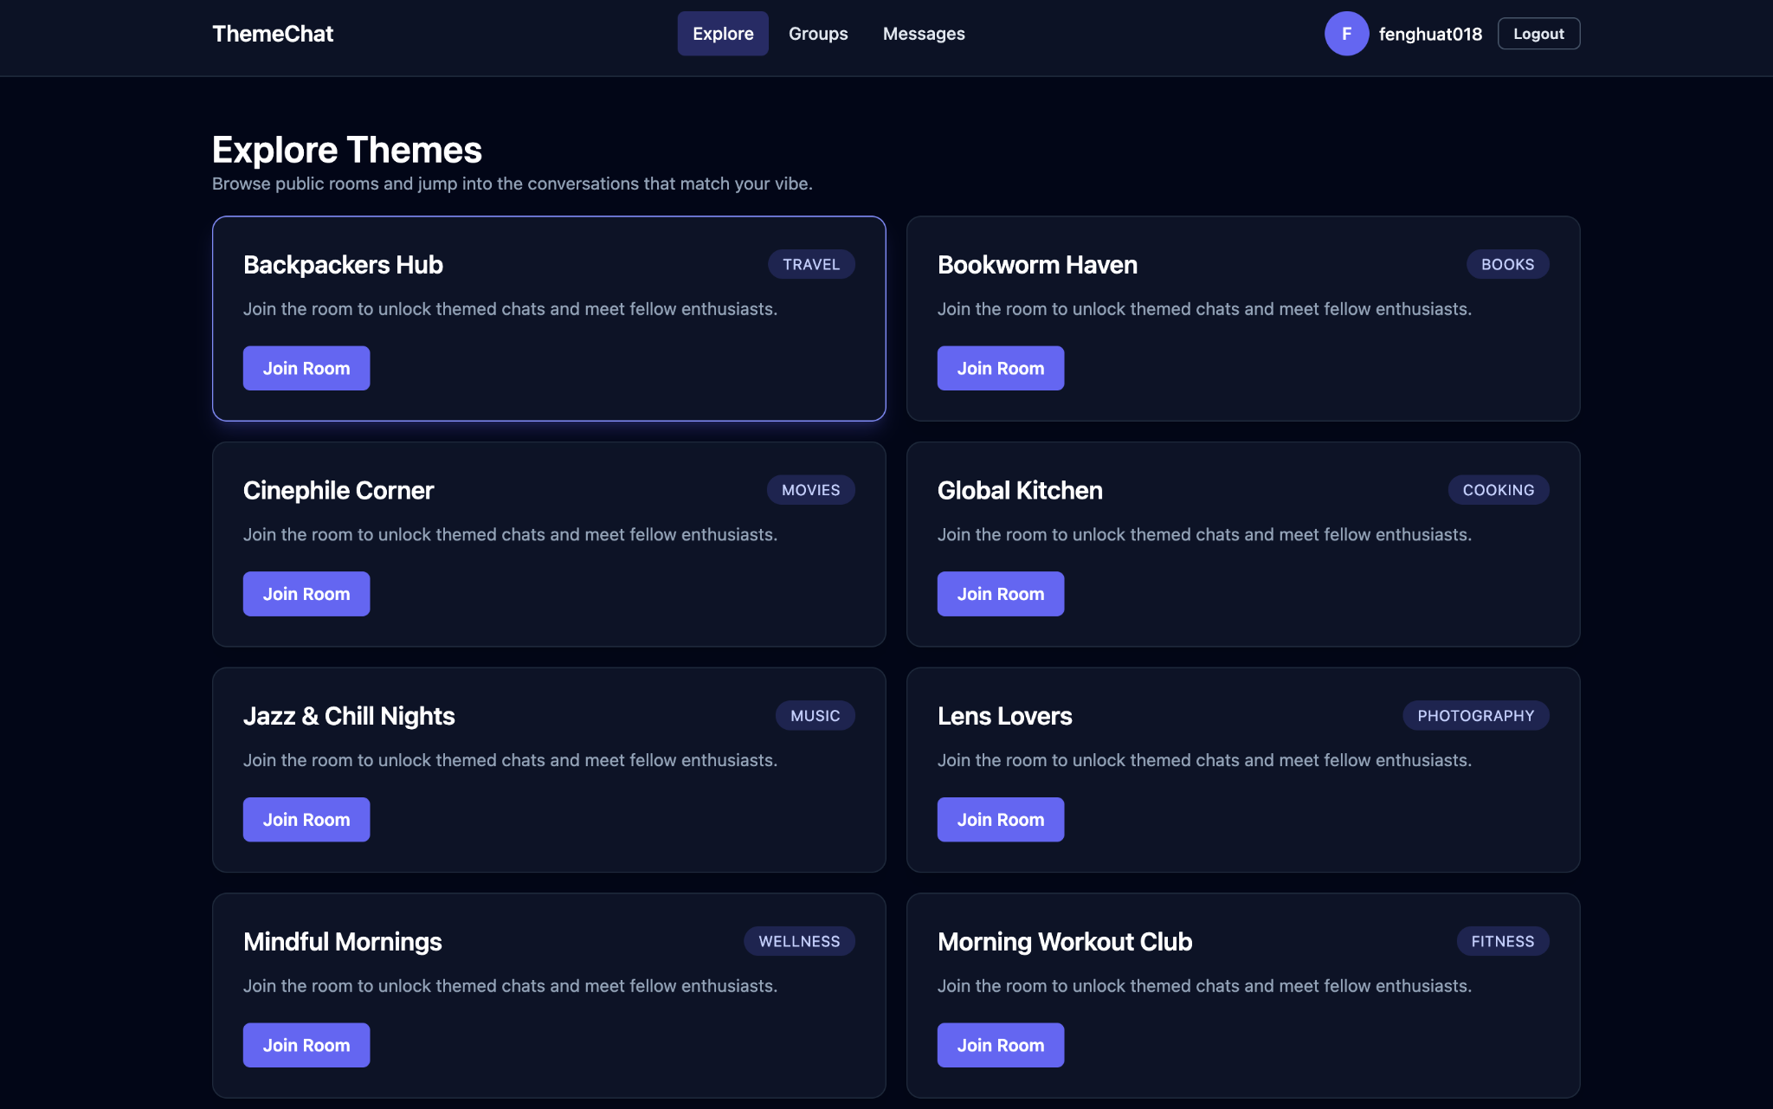
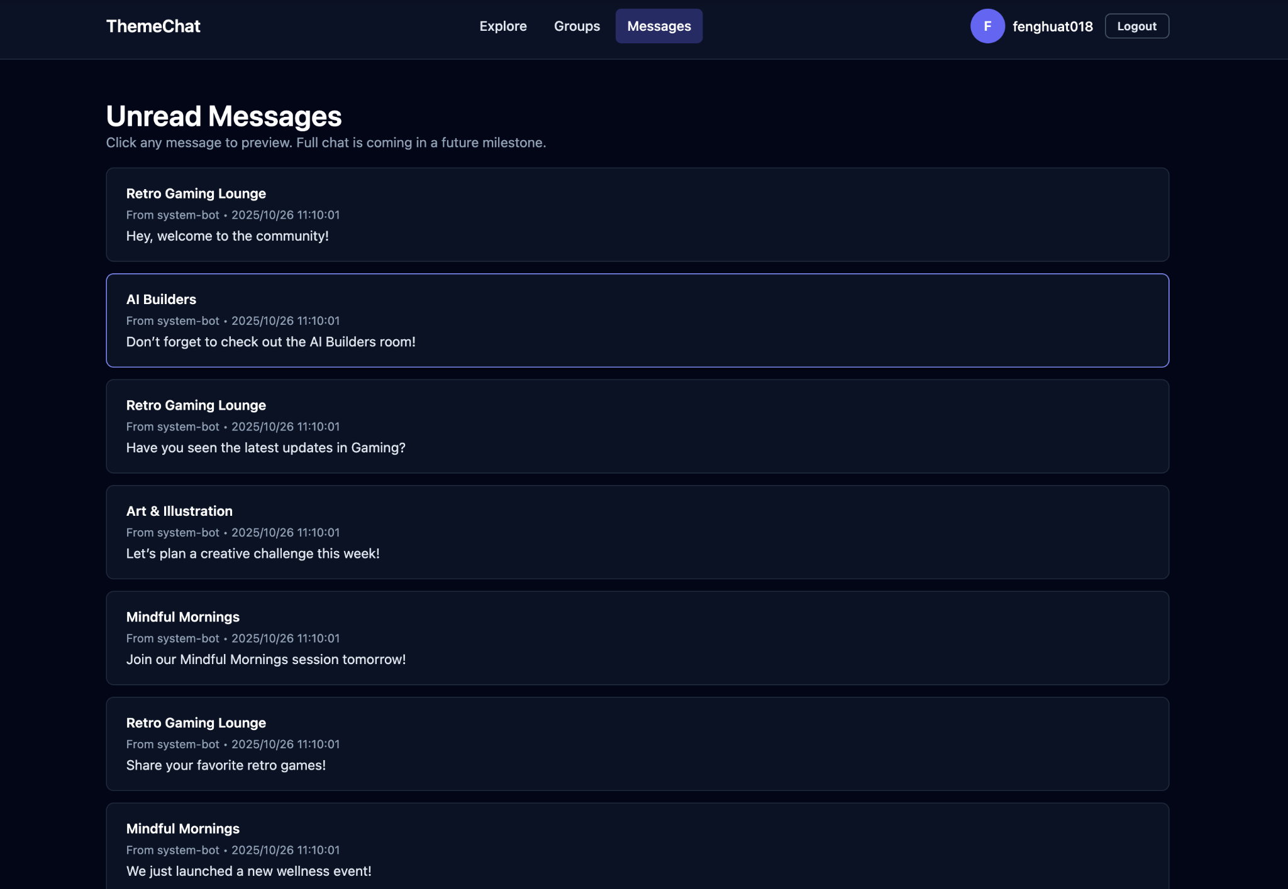
Basic Layout of the Site
Frontend Interface Preview:
Explore, Groups, Messages

Slide 5
Progress & Challenges
Progress:
• Backend and frontend integrated via Django REST API.
• Authentication and UI navigation complete.
• Tailwind CSS styling finished.
Challenges:
• OAuth callback configuration.
• MySQL connection issues.
• Session persistence with JWT.
Resolutions:
• .env variables for DB settings.
• Django AllAuth + dj-rest-auth for OAuth.

Slide 6
Next Sprint Goals
Goals:
1. Add real-time messaging with WebSockets.
2. Join/leave chat groups.
3. Chat detail and message input UI.
4. Unread message notifications.
Expected Deliverable:
Interactive chat system with real-time updates.

Slide 7
Summary
Sprint 1 delivered a functioning base system with authentication, navigation, and UI layouts.
Ready for Sprint 2: real-time communication and user interaction.
Lead Developer: Fenghua Tong
Team: Fanyun Xu, Linyang Liu, Shuangxueer Zhang

