Slide 1

CSCE 5218
Deep Learning
Neural Network Training
Slides adapted from Adriana Kovashka

Slide 2
Computation graphs

Slide 3
How do we compute the gradient?
Derive on paper? Tedious
What about vector-valued functions?

Slide 4



Computational graphs
x
*
s (scores)
hinge loss
+
L
W
R
Fei-Fei Li, Justin Johnson, Serena Yeung

Slide 5
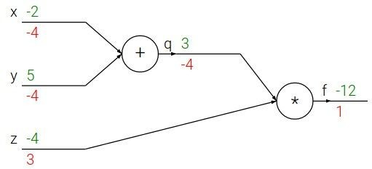








Backpropagation: a simple example
e.g. x = -2, y = 5, z = -4
Chain rule:
Want:
Upstream gradient
Local gradient
April 13, 2017
Fei-Fei Li, Justin Johnson, Serena Yeung

Slide 6

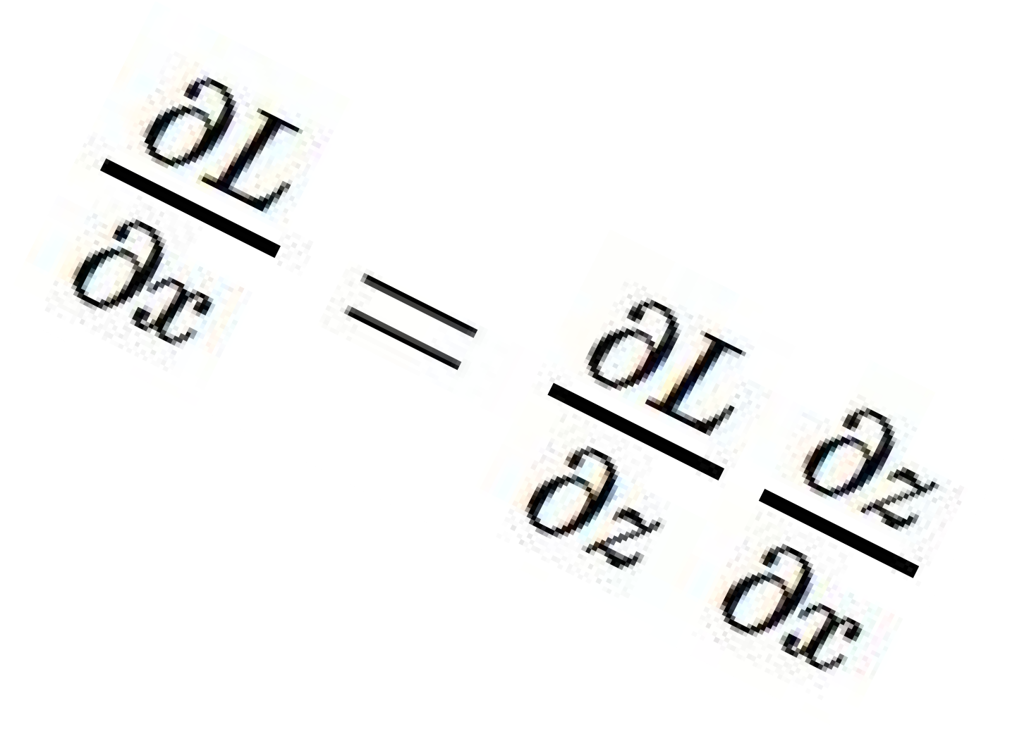




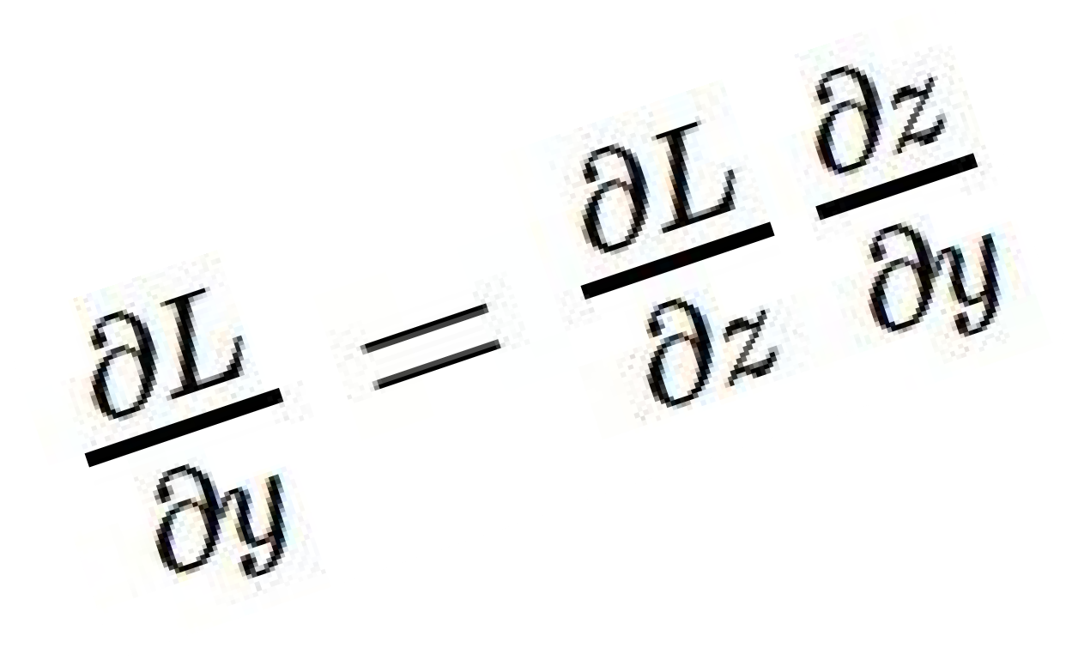
f
“local gradient”
Adapted from Fei-Fei Li, Justin Johnson, Serena Yeung

Slide 7

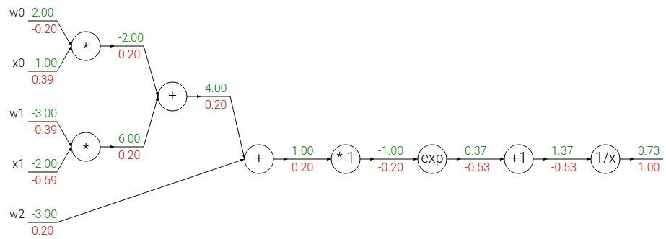
Another example:
Fei-Fei Li, Justin Johnson, Serena Yeung

Slide 8
Another example:
Fei-Fei Li, Justin Johnson, Serena Yeung

Slide 9
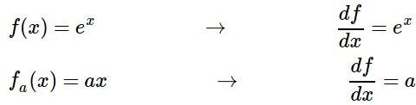
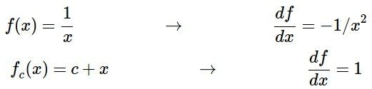
Another example:
Fei-Fei Li, Justin Johnson, Serena Yeung

Slide 10

Another example:
Upstream gradient
Local gradient
Fei-Fei Li, Justin Johnson, Serena Yeung

Slide 11
Another example:
Upstream gradient
Local gradient
Fei-Fei Li, Justin Johnson, Serena Yeung

Slide 12
Another example:
Upstream gradient
Local gradient
Fei-Fei Li, Justin Johnson, Serena Yeung

Slide 13
Another example:
Upstream gradient
Local gradient
Fei-Fei Li, Justin Johnson, Serena Yeung

Slide 14
Another example:
[upstream gradient] x [local gradient] [0.2] x [1] = 0.2
[0.2] x [1] = 0.2 (both inputs!)
Fei-Fei Li, Justin Johnson, Serena Yeung

Slide 15
Another example:
Fei-Fei Li, Justin Johnson, Serena Yeung

Slide 16
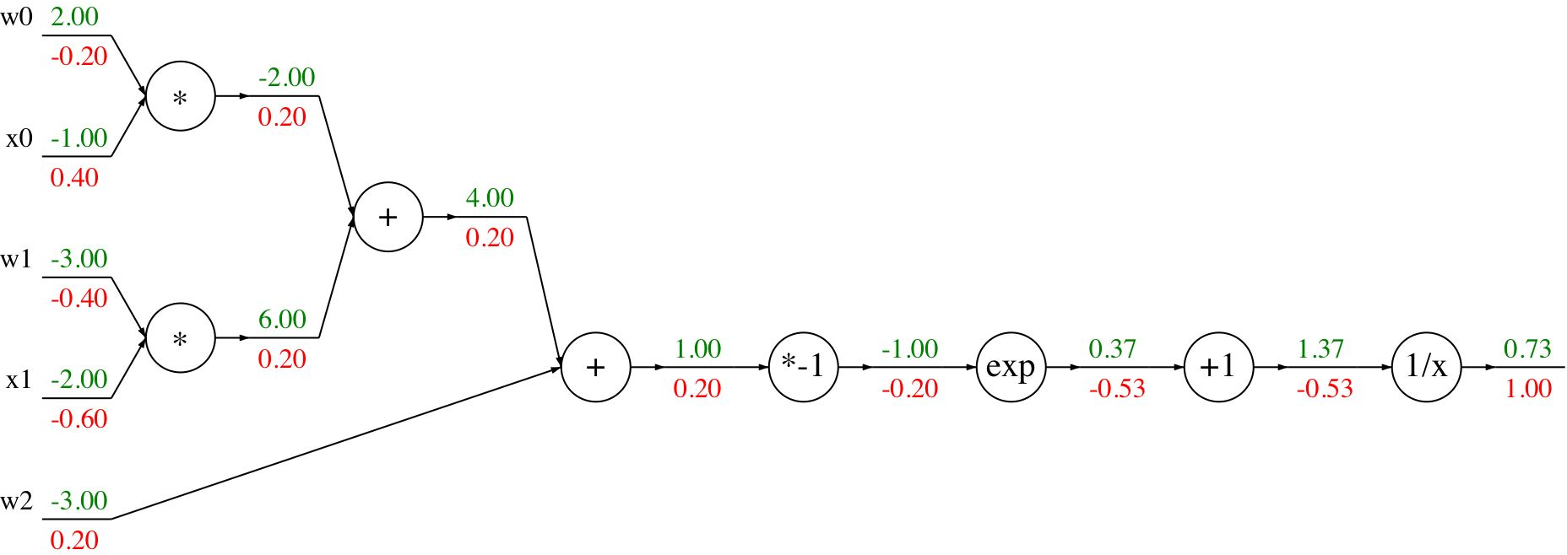
Another example:
[upstream gradient] x [local gradient] x0: [0.2] x [2] = 0.4
w0: [0.2] x [-1] = -0.2
Fei-Fei Li, Justin Johnson, Serena Yeung

Slide 17

Another example:
Computational graph representation may not be unique. Choose one where local gradients at each node can be easily expressed!
Sigmoid function
Sigmoid
Fei-Fei Li, Justin Johnson, Serena Yeung

Slide 18
Another example:
Computational graph representation may not be unique. Choose one where local gradients at each node can be easily expressed!
Sigmoid function
Sigmoid
[upstream gradient] x [local gradient] [1.00] x [(1 - 0.73) (0.73)] = 0.2
Sigmoid local gradient:
Fei-Fei Li, Justin Johnson, Serena Yeung

Slide 19
Patterns in gradient flow
add gate: gradient distributor
mul gate: “swap multiplier”
3
2
2
4
₊ 7
5*3=15
3
× 6
2
5
2
copy gate: gradient adder
7
7
4+2=6
5*2=10
max gate: gradient router
4
4
7
0
5
5
9
max
2
9
Fei-Fei Li, Justin Johnson, Serena Yeung

Slide 20
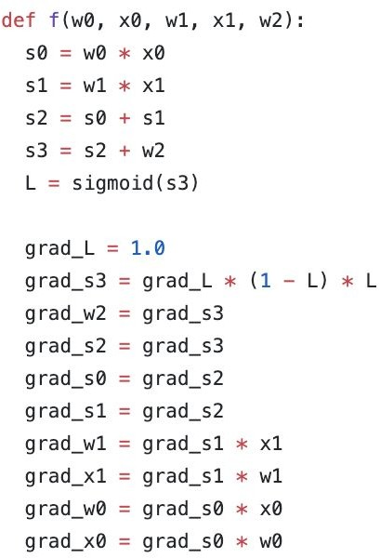
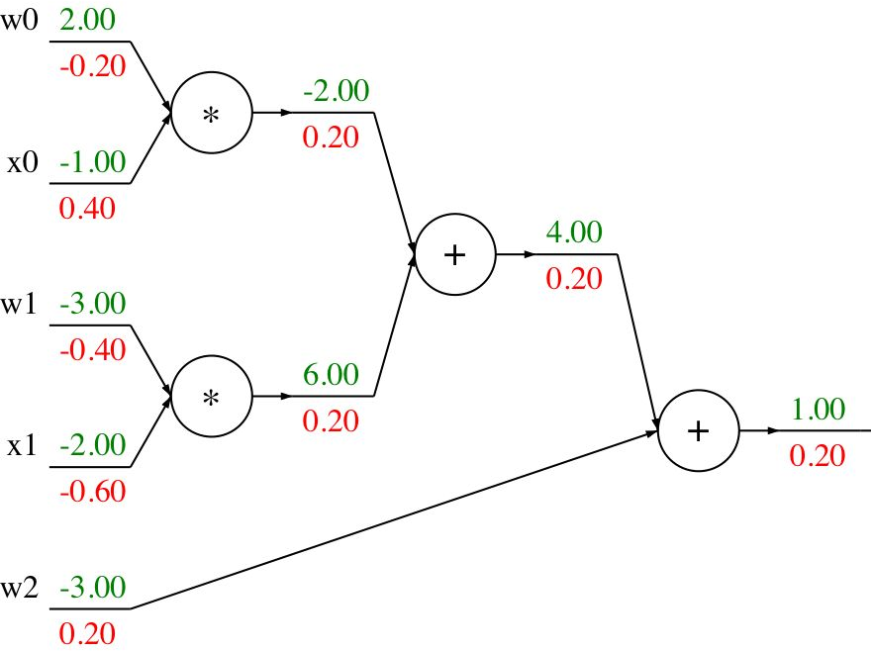

Backprop Implementation: “Flat” code
Forward pass: Compute output
Backward pass: Compute grads
Fei-Fei Li, Justin Johnson, Serena Yeung

Slide 21
Backprop Implementation: “Flat” code
Forward pass: Compute output
Base case
Fei-Fei Li, Justin Johnson, Serena Yeung

Slide 22
Backprop Implementation: “Flat” code
Forward pass: Compute output
Sigmoid
Fei-Fei Li, Justin Johnson, Serena Yeung

Slide 23
Backprop Implementation: “Flat” code
Forward pass: Compute output
Add gate
Fei-Fei Li, Justin Johnson, Serena Yeung

Slide 24
Backprop Implementation: “Flat” code
Forward pass: Compute output
Add gate
Fei-Fei Li, Justin Johnson, Serena Yeung

Slide 25
Backprop Implementation: “Flat” code
Forward pass: Compute output
Multiply gate
Fei-Fei Li, Justin Johnson, Serena Yeung

Slide 26
Backprop Implementation: “Flat” code
Forward pass: Compute output
Multiply gate
Fei-Fei Li, Justin Johnson, Serena Yeung

Slide 27
So far: backprop with scalars
What about vector-valued functions?
Fei-Fei Li, Justin Johnson, Serena Yeung

Slide 28

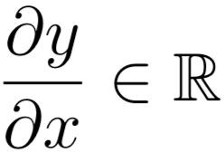
Recap: Vector derivatives
Scalar to Scalar
Regular derivative:
If x changes by a small amount, how much will y change?
Lecture 4 - 28
Fei-Fei Li, Justin Johnson, Serena Yeung

Slide 29

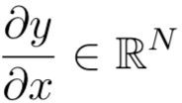
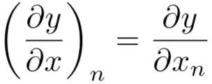
Recap: Vector derivatives
Scalar to Scalar Vector to Scalar
Regular derivative:
Derivative is Gradient:
If x changes by a small amount, how much will y change?
For each element of x, if it changes by a small amount then how much will y change?
Lecture 4 - 29
Fei-Fei Li, Justin Johnson, Serena Yeung

Slide 30

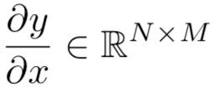
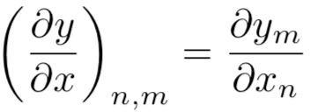
Recap: Vector derivatives
Scalar to Scalar Vector to Scalar
Vector to Vector
Regular derivative:
Derivative is Gradient:
Derivative is Jacobian:
If x changes by a small amount, how much will y change?
For each element of x, if it changes by a small amount then how much will y change?
For each element of x, if it changes by a small amount then how much will each element of y change?
Lecture 4 - 30
Fei-Fei Li, Justin Johnson, Serena Yeung

Slide 31
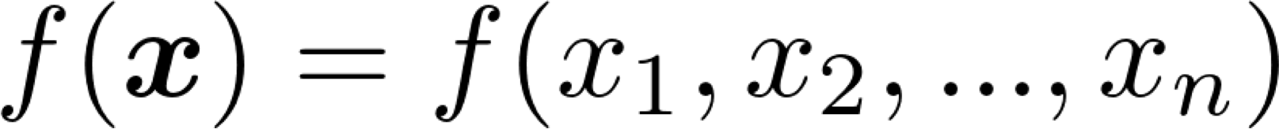
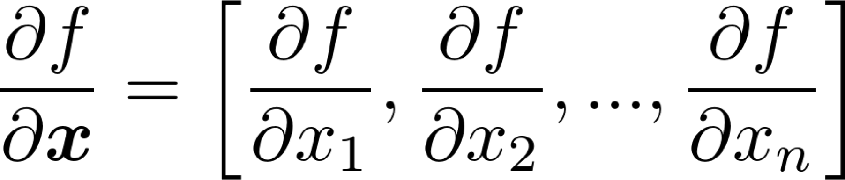
Gradients
Given a function with 1 output and n inputs
Its gradient is a vector of partial derivatives with respect to each input
Christopher Manning

Slide 32
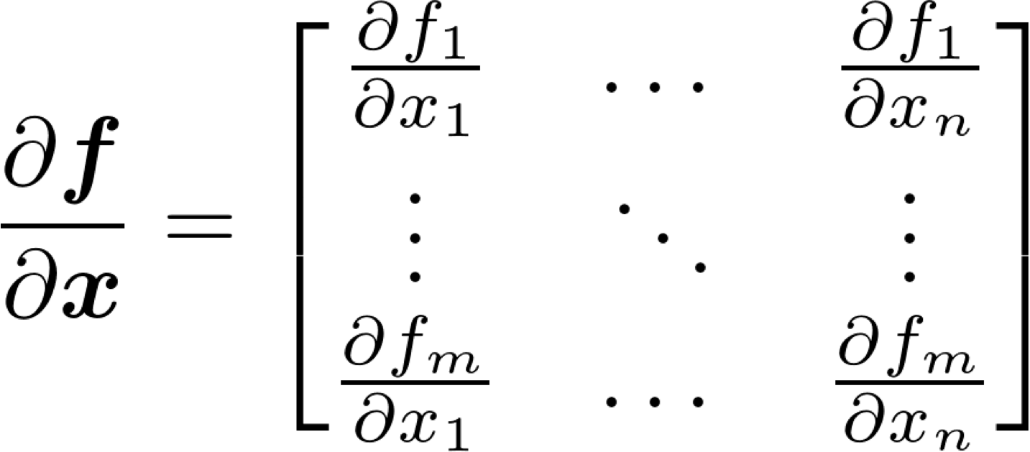
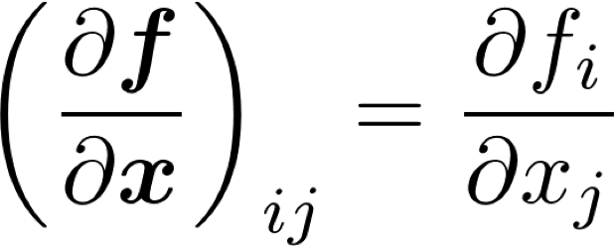
Jacobian Matrix: Generalization of Gradient
Given a function with m outputs and n inputs
Its Jacobian is an m x n matrix of partial derivatives
Christopher Manning

Slide 33
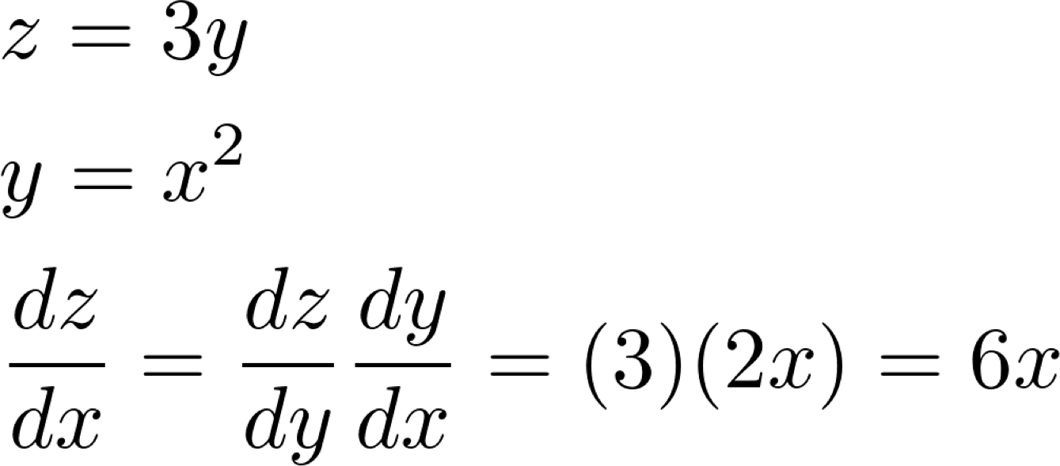
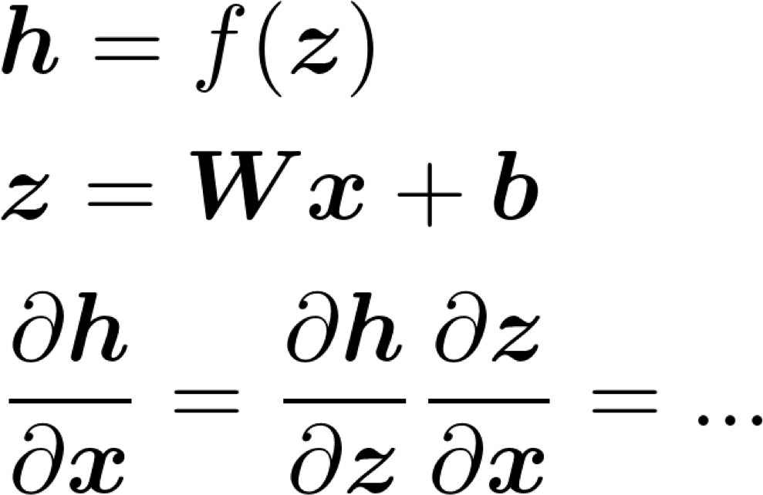
Chain Rule
For one-variable functions: multiply derivatives
For multiple variables at once: multiply Jacobians
Christopher Manning

Slide 34
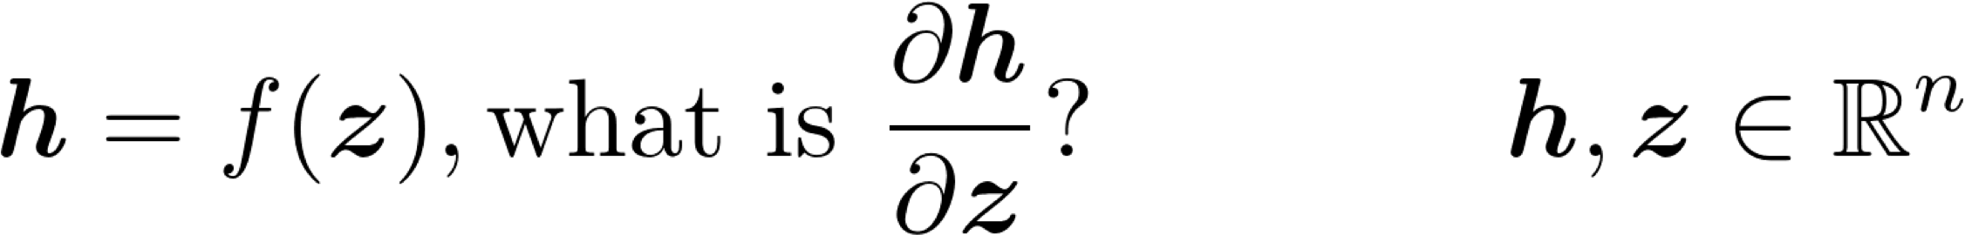
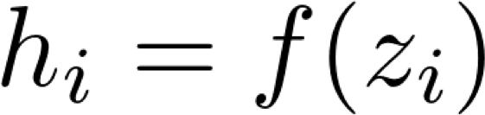
Example Jacobian: Elementwise activation Function
Christopher Manning

Slide 35
Example Jacobian: Elementwise activation Function
Function has n outputs and n inputs → n by n Jacobian
Christopher Manning

Slide 36
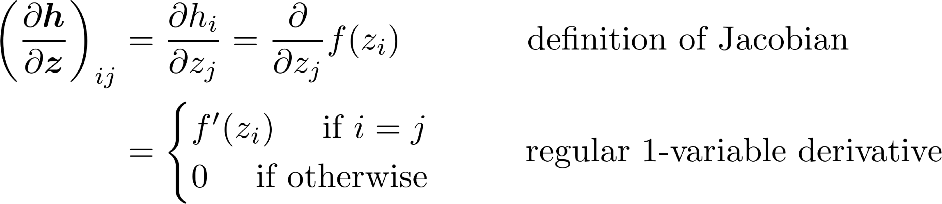
Example Jacobian: Elementwise activation Function
Christopher Manning

Slide 37
Example Jacobian: Elementwise activation Function
Christopher Manning

Slide 38
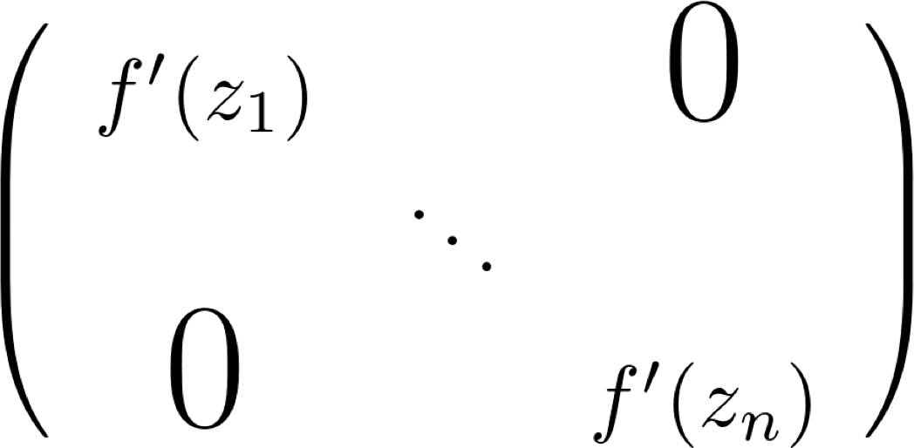
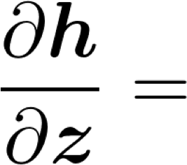
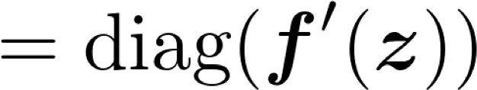
Example Jacobian: Elementwise activation Function
Christopher Manning

Slide 39

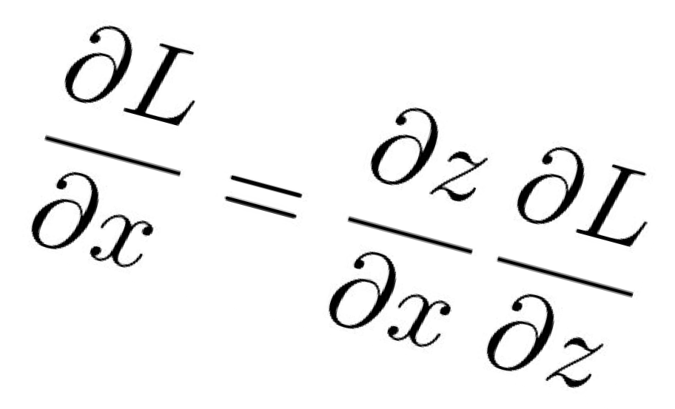
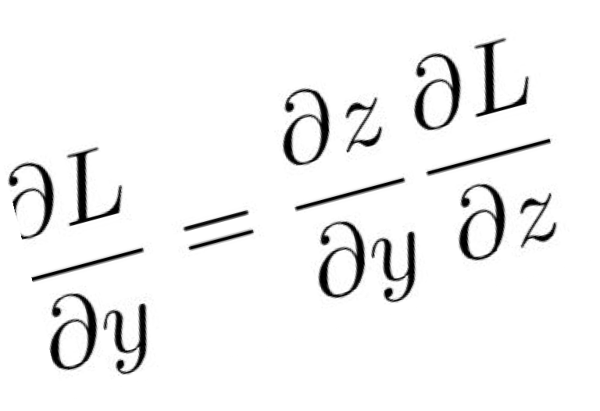
Backprop with Vectors
D_{x}
Loss L still a scalar!
“local gradients”
[D_{x} x D_{z}]
f
D_{x}
D_{z}
“Downstream
gradients”
Matrix-vector multiply
[D x D ]
D_{z}
D_{y}
y z
Jacobian matrices
“Upstream gradient” For each element of z, how much does it influence L?
D_{y}
Lecture 4 - 39
Fei-Fei Li, Justin Johnson, Serena Yeung

Slide 40
Backprop with Vectors
4D input x:
4D output y:
[ 1 ]
[ -2 ]
[ 3 ]
[ -1 ]
f(x) = max(0,x)
(elementwise)
[ 1 ]
[ 0 ]
[ 3 ]
[ 0 ]
Lecture 4 - 40
Fei-Fei Li, Justin Johnson, Serena Yeung

Slide 41
Backprop with Vectors
4D input x:
4D output y:
[ 1 ]
[ -2 ]
[ 3 ]
[ -1 ]
f(x) = max(0,x)
(elementwise)
[ 1 ]
[ 0 ]
[ 3 ]
[ 0 ]
4D dL/dy:
Upstream gradient
[ | 4 ]
[ | -1 ]
[ | 5 ]
[ | 9 ]
Lecture 4 - 41
Fei-Fei Li, Justin Johnson, Serena Yeung

Slide 42
Backprop with Vectors
4D input x:
4D output y:
[ 1 ]
[ -2 ]
[ 3 ]
[ -1 ]
f(x) = max(0,x)
(elementwise)
[ 1 ]
[ 0 ]
[ 3 ]
[ 0 ]
Jacobian dy/dx [ 1 0 0 0 ]
[ 0 0 0 0 ]
[ 0 0 1 0 ]
[ 0 0 0 0 ]
4D dL/dy:
[ 4 ]
[ -1 ]
[ 5 ]
[ 9 ]
Upstream gradient
Lecture 4 - 42
Fei-Fei Li, Justin Johnson, Serena Yeung

Slide 43
Backprop with Vectors
4D input x:
4D output y:
[ 1 ]
[ -2 ]
[ 3 ]
[ -1 ]
f(x) = max(0,x)
(elementwise)
[ 1 ]
[ 0 ]
[ 3 ]
[ 0 ]
[dy/dx] [dL/dy] [ 1 0 0 0 ] [ 4 ]
[ 0 0 0 0 ] [ -1 ]
[ 0 0 1 0 ] [ 5 ]
[ 0 0 0 0 ] [ 9 ]
4D dL/dy:
[ 4 ]
[ -1 ]
[ 5 ]
[ 9 ]
Upstream gradient
Lecture 4 - 43
Fei-Fei Li, Justin Johnson, Serena Yeung

Slide 44
Backprop with Vectors
4D input x:
4D output y:
[ 1 ]
[ -2 ]
[ 3 ]
[ -1 ]
f(x) = max(0,x)
(elementwise)
[ 1 ]
[ 0 ]
[ 3 ]
[ 0 ]
4D dL/dx: [ 4 ]
[ 0 ]
[ 5 ]
[ 0 ]
[dy/dx] [dL/dy] [ 1 0 0 0 ] [ 4 ]
[ 0 0 0 0 ] [ -1 ]
[ 0 0 1 0 ] [ 5 ]
[ 0 0 0 0 ] [ 9 ]
4D dL/dy:
[ 4 ]
[ -1 ]
[ 5 ]
[ 9 ]
Upstream gradient
Lecture 4 - 44
Fei-Fei Li, Justin Johnson, Serena Yeung

Slide 45
Backprop with Vectors
4D input x:
4D output y:
[ 1 ]
[ -2 ]
[ 3 ]
[ -1 ]
f(x) = max(0,x)
(elementwise)
[ 1 ]
[ 0 ]
[ 3 ]
[ 0 ]
Jacobian is sparse: off-diagonal entries always zero! Never explicitly form Jacobian -- instead use implicit multiplication
4D dL/dx: [ 4 ]
[ 0 ]
[ 5 ]
[ 0 ]
[dy/dx] [dL/dy] [ 1 0 0 0 ] [ 4 ]
[ 0 0 0 0 ] [ -1 ]
[ 0 0 1 0 ] [ 5 ]
[ 0 0 0 0 ] [ 9 ]
4D dL/dy:
[ 4 ]
[ -1 ]
[ 5 ]
[ 9 ]
Upstream gradient
Lecture 4 - 45
Fei-Fei Li, Justin Johnson, Serena Yeung

Slide 46
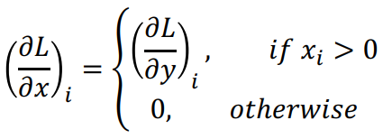
Backprop with Vectors
4D input x:
4D output y:
[ 1 ]
[ -2 ]
[ 3 ]
[ -1 ]
f(x) = max(0,x)
(elementwise)
[ 1 ]
[ 0 ]
[ 3 ]
[ 0 ]
Jacobian is sparse: off-diagonal entries always zero! Never explicitly form Jacobian -- instead use implicit multiplication
4D dL/dx: [ 4 ]
[ 0 ]
[ 5 ]
[ 0 ]
[dy/dx] [dL/dy]
4D dL/dy:
[ 4 ]
[ -1 ]
[ 5 ]
[ 9 ]
Upstream gradient
Lecture 4 - 46
Fei-Fei Li, Justin Johnson, Serena Yeung

Slide 47
A vectorized example:
Lecture 4 - 47
Fei-Fei Li, Justin Johnson, Serena Yeung

Slide 48

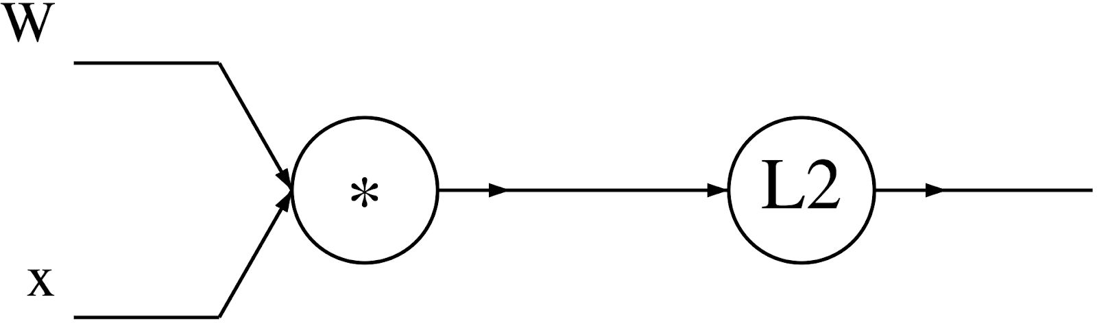

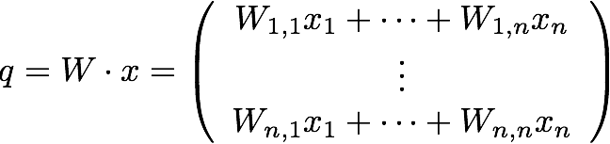
A vectorized example:
Lecture 4 - 48
Fei-Fei Li, Justin Johnson, Serena Yeung

Slide 49

A vectorized example:
Lecture 4 - 49
Fei-Fei Li, Justin Johnson, Serena Yeung

Slide 50
A vectorized example:
Lecture 4 - 50
Fei-Fei Li, Justin Johnson, Serena Yeung

Slide 51


A vectorized example:
Lecture 4 - 51
Fei-Fei Li, Justin Johnson, Serena Yeung

Slide 52

A vectorized example:
Lecture 4 - 52
Fei-Fei Li, Justin Johnson, Serena Yeung

Slide 53

A vectorized example:
Lecture 4 - 53
Fei-Fei Li, Justin Johnson, Serena Yeung

Slide 54



A vectorized example:
Lecture 4 - 54
Fei-Fei Li, Justin Johnson, Serena Yeung

Slide 55

A vectorized example:
Lecture 4 - 55
Fei-Fei Li, Justin Johnson, Serena Yeung

Slide 56

A vectorized example:
Always check: The gradient with respect to a variable should have the same shape as the variable
Lecture 4 - 56
Fei-Fei Li, Justin Johnson, Serena Yeung

Slide 57
Recap
Tricks of the trade
  Preprocessing, initialization, normalization
  Dealing with limited data
Convergence of gradient descent
  How long will it take?
  Will it work at all?
Different optimization strategies
  Alternatives to SGD
  Learning rates
  Choosing hyperparameters
How to do the computation
  Computation graphs
  Vector notation (Jacobians)

