Slide 1
进度汇报

Slide 2
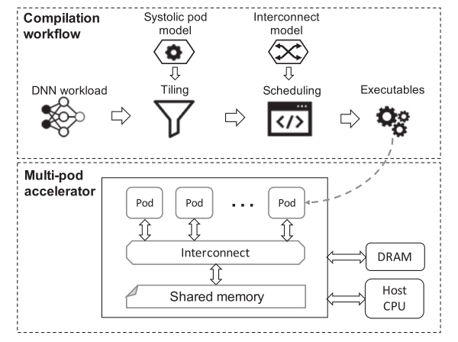
Scale-out Systolic Arrays TACO 2023
目标：设计多舱（multi-pod）脉动阵列以最大化有效吞吐量/瓦特（throughput/Watt ）
三个关键点：阵列粒度，互连和平铺（array granularity, interconnect, and tiling）
Notes:
考虑阵列利用率时调整的吞吐量
多舱收缩阵列设计的三个关键支柱:阵列粒度，互连和切分 array granularity, interconnect, and tiling

Slide 3
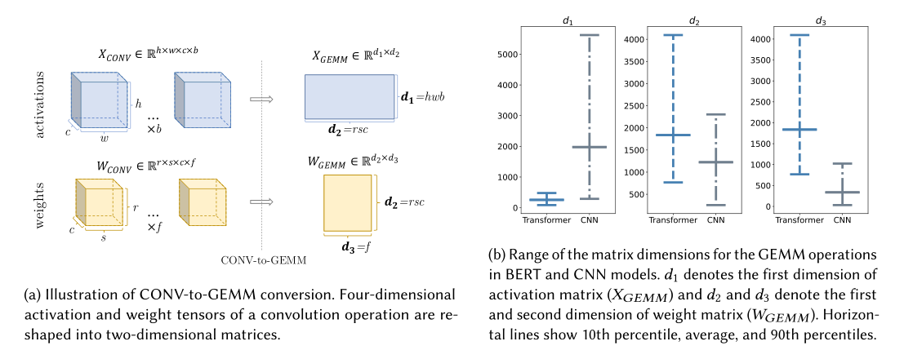
使用脉动阵列硬件模型来获得功率效率和利用率值，然后用峰值吞吐量乘以利用率来计算有效吞吐量。

Slide 4
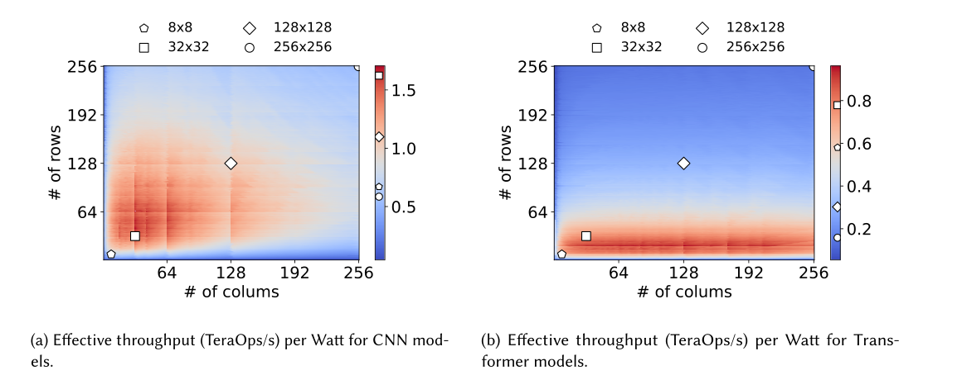

Slide 5
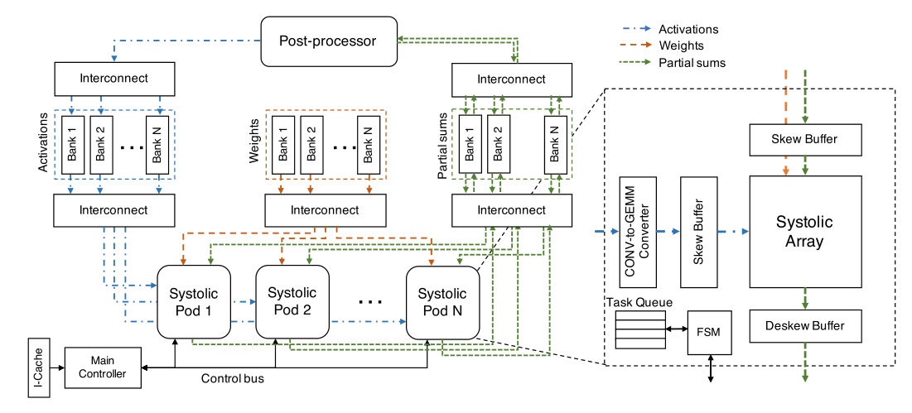

Slide 6
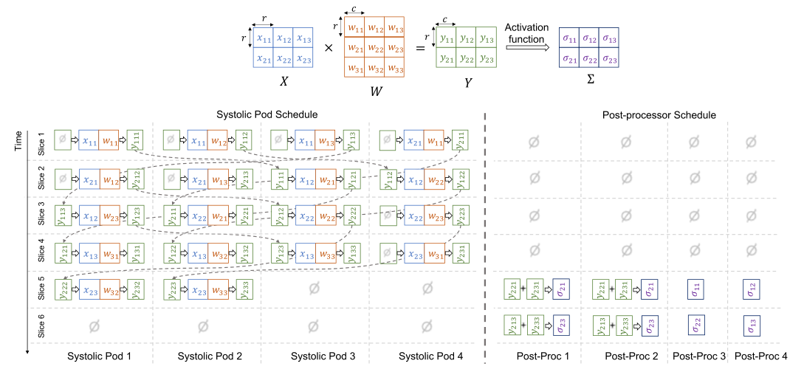
Offline Scheduling Algorithm

Slide 7
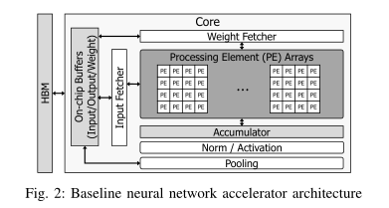
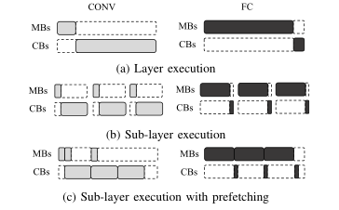
A Multi-Neural Network Acceleration Architecture ISCA 2019

Slide 8
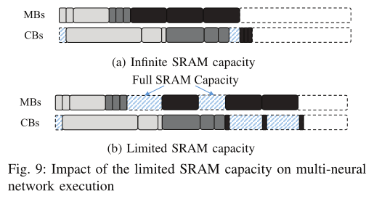
The result shows that even a single batch layer execution can require over 10 MB SRAM to fully utilize the memory bandwidth, and this capacity pressure can be accumulated during the multiple neural network execution.

Slide 9
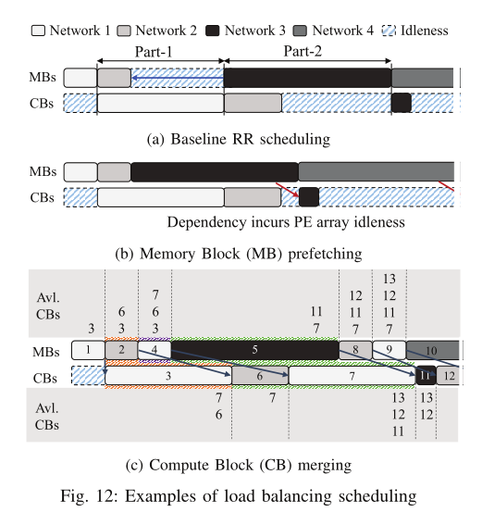

Slide 10
一、模型进展
a11 | a12 | a13 | a13
a21 | a22 | a23 | a24
a31 | a32 | a33 | a34
a41 | a42 | a43 | a44
B11 | B12 | B13 | b13
B21 | B22 | B23 | B24
B31 | B32 | B33 | B34
B41 | B42 | b43 | B44
C11 | c12 | C13 | C13
C21 | C22 | C23 | C24
C31 | C32 | C33 | C34
c41 | C42 | C43 | c44
A
B
C
L3 CACHE
4M | 4M | 2M | 2M
DDR

Slide 11
SA
Buffer a
Buffer b
a11
Buffer c
A、B | C
a11
a21
a31
a41
c12
C22
C32
C42
C11
C21
C31
c41

Slide 12
a11 | a12 | a13 | a13
a21 | a22 | a23 | a24
a31 | a32 | a33 | a34
a41 | a42 | a43 | a44
B11 | B12 | B13 | b13
B21 | B22 | B23 | B24
B31 | B32 | B33 | B34
B41 | B42 | b43 | B44
C11 | c12 | C13 | C13
C21 | C22 | C23 | C24
C31 | C32 | C33 | C34
c41 | C42 | C43 | c44
A
B
C
A | C | B
A<4MB
B<2MB
C<4MB
a11
a21
a31
a41
C11
C21
C31
c41
数据搬移
计算

Slide 13
a11 | a12 | a13 | a13
a21 | a22 | a23 | a24
a31 | a32 | a33 | a34
a41 | a42 | a43 | a44
B11 | B12 | B13 | b13
B21 | B22 | B23 | B24
B31 | B32 | B33 | B34
B41 | B42 | b43 | B44
C11 | c12 | C13 | C13
C21 | C22 | C23 | C24
C31 | C32 | C33 | C34
c41 | C42 | C43 | c44
A
B
C
A | C | B
A<4MB
B<2MB
C<2MB
a11
a21
a31
a41
c12
C22
C32
C42
C11
C21
C31
c41
数据搬移
计算

Slide 14
a11 | a12 | a13 | a13
a21 | a22 | a23 | a24
a31 | a32 | a33 | a34
a41 | a42 | a43 | a44
B11 | B12 | B13 | b13
B21 | B22 | B23 | B24
B31 | B32 | B33 | B34
B41 | B42 | b43 | B44
C11 | c12 | C13 | C13
C21 | C22 | C23 | C24
C31 | C32 | C33 | C34
c41 | C42 | C43 | c44
A
B
C
A、B | C
A+B<4MB
C<4MB
a11
a21
a31
a41
C11
C21
C31
c41
数据搬移
计算

Slide 15
a11 | a12 | a13 | a13
a21 | a22 | a23 | a24
a31 | a32 | a33 | a34
a41 | a42 | a43 | a44
B11 | B12 | B13 | b13
B21 | B22 | B23 | B24
B31 | B32 | B33 | B34
B41 | B42 | b43 | B44
C11 | c12 | C13 | C13
C21 | C22 | C23 | C24
C31 | C32 | C33 | C34
c41 | C42 | C43 | c44
A
B
C
A、B | C
A+B<4MB
C<2MB
A<2MB
趋向于B分块尽可能大
a11
a21
a31
a41
c12
C22
C32
C42
C11
C21
C31
c41
数据搬移
计算

