Slide 1

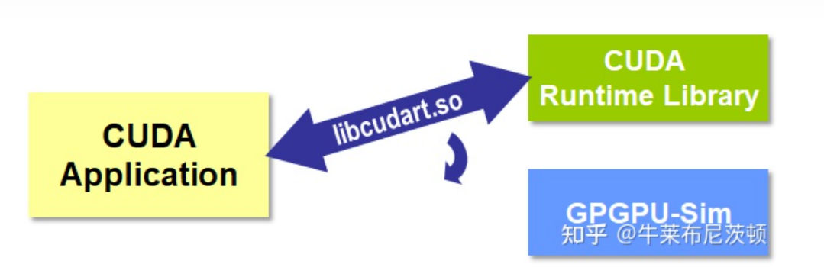
Pytorch-gpgpu-sim

Slide 2
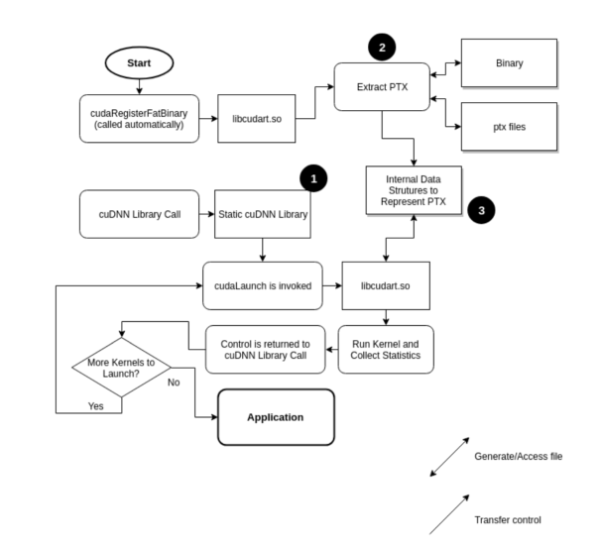


Pytorch-gpgpu-sim

Slide 3


Pytorch-gpgpu-sim
Pytorch 1.13.1
Pytorch 0.4.1

Slide 4
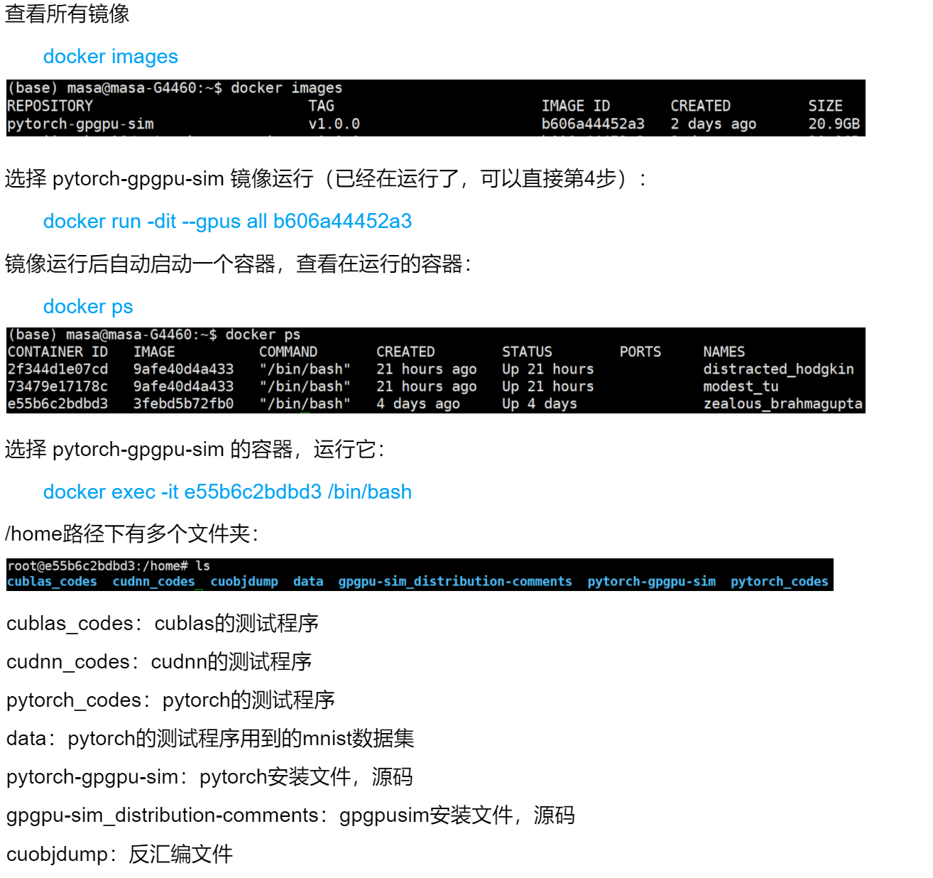
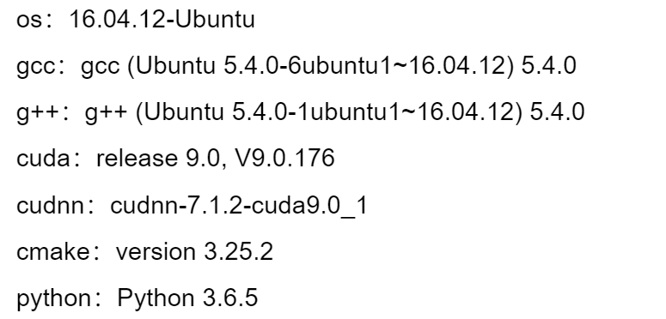
Pytorch-gpgpu-sim
Pytorch 1.0.0

Slide 5



Pytorch-gpgpu-sim

