Slide 1
20231028汇报
杨建超

Slide 2
背景
模拟器能够观测到程序执行的动态特性，真实硬件上无法观测。
模拟器的目标：
准确、快速、可扩展
可预测程序的整体执行时间
发现尽可能多的stall和性能瓶颈
给出优化建议

Slide 3
现有模拟器的优缺点
周期精确模拟器
准确，但速度慢、难扩展
GPGPU-Sim，Accel-Sim
传统的周期近似模拟器—数学方程分析
捕获关键性能趋势，误差大，速度快，但不关注执行的动态特性
GPUMech，SLA&TBS，interval分析，没有能用的代码
改进的周期近似模拟器：memory trace+数学方程
部分计算限制模拟+存储Reuse Distance分析
MDM，PPT-GPU

Slide 4
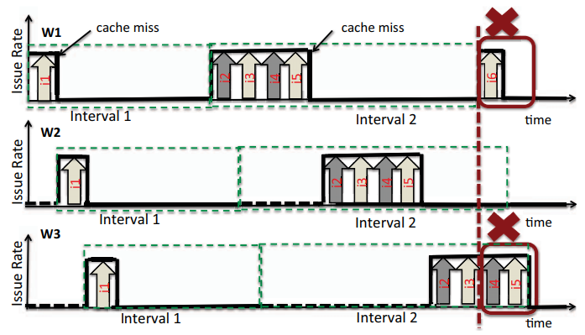
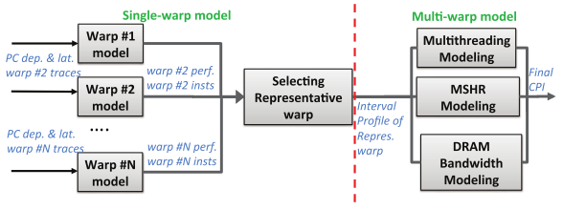
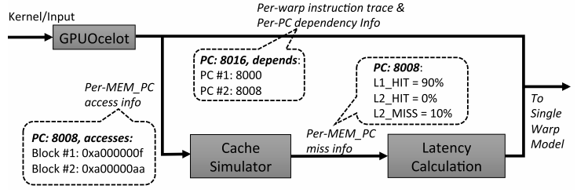
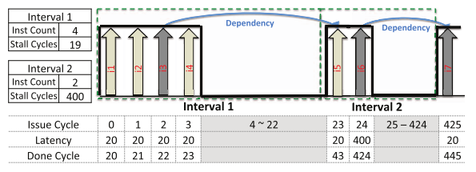
GPUMech
Naïve Interval假设
处理器性能=无stall周期+stall周期
无stall周期按指令最大发射速率计算
Stall周期分析
功能模拟器GPUOcelot
对单个warp进行模拟生成interval profile
聚类找一个代表性warp
MT+MSHR+DRAM建模，找到interval
数学公式分析

Slide 5
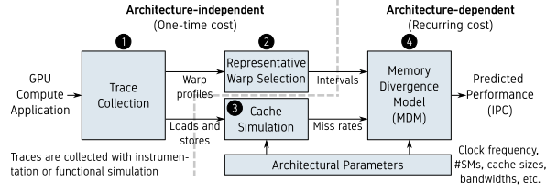
MDM
Memory-Divergent
每千条指令的发散负载的个数>10
MD程序会耗尽MSHR，导致TLP隐藏存储器访问延迟的能力
同时会阻塞NoC和DRAM子系统，进而导致长的存储延迟
NVBIT插桩获取SASS+Cache模拟+数学分析
实际上还是使用GPGPU-Sim功能模拟收集PTX
选择代表性warp与GPUMech相同
执行性能模拟，获取interval和命中率
数学分析

Slide 6
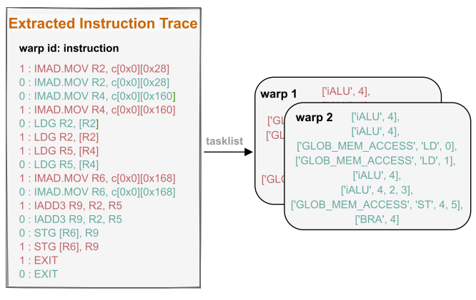
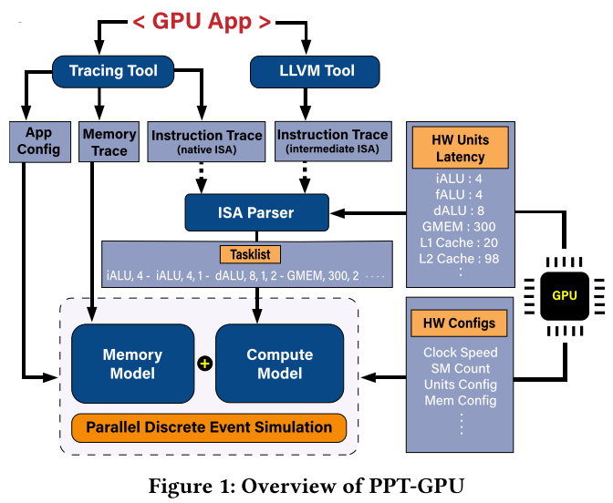
PPT-GPU
计算模拟+存储分析+数学分析
NVBIT获取SASS，LLVM获取PTX
ISA解析器将指令替换为任务列表
存储分析—Reuse Distance
计算模拟
从存储分析中计算LD/ST的平均访问延迟
指令逐周期推进模拟kernel延迟

Slide 7
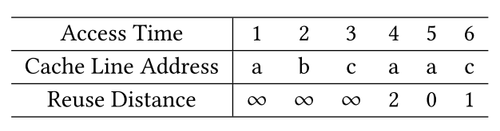
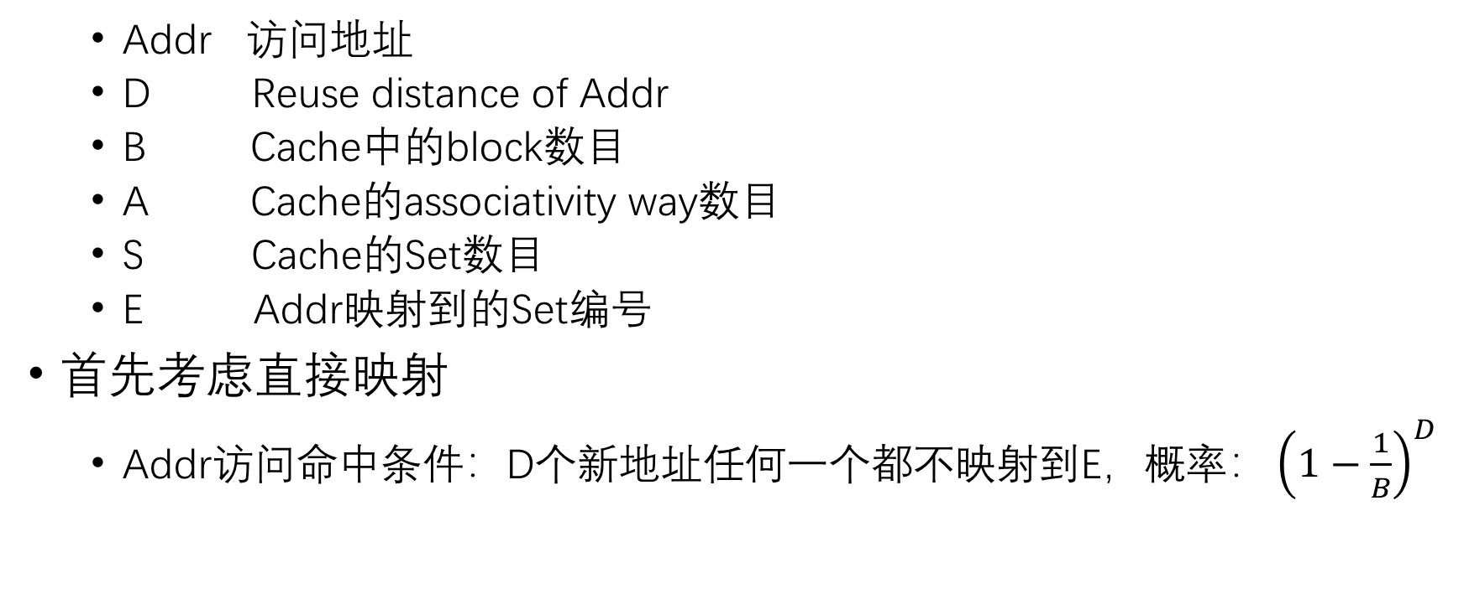
Reuse Distance预测Cache命中率
Addr 访问地址
D Reuse distance of Addr
B Cache中的block数目
A Cache的associativity way数目
S Cache的Set数目
E Addr映射到的Set编号
首先考虑直接映射
Addr访问命中条件：D个新地址任何一个都不映射到E，概率$：{\left(1−\frac{1}{B}\right)}^{D}$

Slide 8
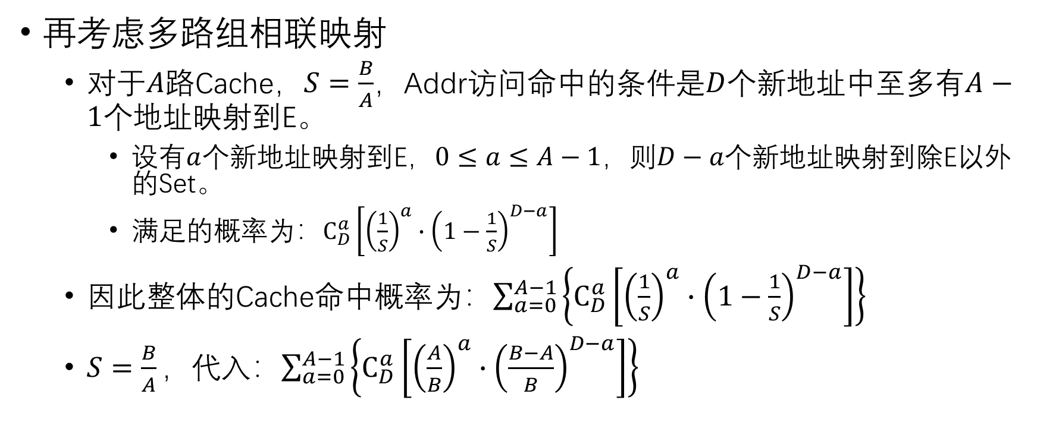
Reuse Distance预测Cache命中率
再考虑多路组相联映射
对于$A$路Cache，$S=\frac{B}{A}$，Addr访问命中的条件是$D$个新地址中至多有$A−1$个地址映射到E。
设有$a$个新地址映射到E，$0≤a≤A−1$，则$D−a$个新地址映射到除E以外的Set。
满足的概率为：$C_{D}^{a}\left[{\left(\frac{1}{S}\right)}^{a}∙{\left(1−\frac{1}{S}\right)}^{D−a}\right]$
因此整体的Cache命中概率为：$\sum_{a=0}^{A−1}{\left\{C_{D}^{a}\left[{\left(\frac{1}{S}\right)}^{a}∙{\left(1−\frac{1}{S}\right)}^{D−a}\right]\right\}}$
$S=\frac{B}{A}，代入$：$\sum_{a=0}^{A−1}{\left\{C_{D}^{a}\left[{\left(\frac{A}{B}\right)}^{a}∙{\left(\frac{B−A}{B}\right)}^{D−a}\right]\right\}}$

Slide 9
计算模型
1 | Issue: ibuffer_empty
2 | Issue: waiting for barrier
3 | Issue: ibuffer_empty and also waiting for barrier
4 | Issue: control hazard
5 | Issue: m_mem_out has no free slot
6 | Issue: previous_issued_inst_exec_type is MEM
7 | Issue: m_int_out has no free slot
8 | Issue: previous_issued_inst_exec_type is INT
9 | Issue: m_sp_out has no free slot
10 | Issue: previous_issued_inst_exec_type is SP
11 | Issue: m_dp_out has no free slot
12 | Issue: previous_issued_inst_exec_type is DP
13 | Issue: m_sfu_out has no free slot
14 | Issue: previous_issued_inst_exec_type is SFU
15 | Issue: m_tensor_core_out has no free slot
16 | Issue: previous_issued_inst_exec_type is TENSOR
17 | Issue: m_spec_cores_out has no free slot
18 | Issue: previous_issued_inst_exec_type is SPECIALIZED
19 | Issue: scoreboard
20 | Fetch: read miss an insn from L1I
21 | Fetch: reservation fail an insn from L1I
22 | Execute: m_memport of L1D is not free
23 | Execute: m_dispatch_reg of fu\[\d+\]-\w+\s is not empty
24 | Execute: result_bus has no slot for latency-\d+
25 | Execute: dispatch delay of insn is \d+ > 0
26 | Execute: l1_latency_queue\[\d+\]\[\d+\] is not free
27 | Execute: COAL_STALL occurs
28 | Execute: mf_next->get_inst()'s out_reg\[R\d+\] has \d+ pending writes
29 | Execute: icnt_injection_buffer is full
30 | Execute: m_next_wb's out_reg\[R\d+\] has \d+ pending writes
31 | Execute: m_next_global of ldst unit is not free
32 | Execute: fill_port of L1D is not free
33 | Execute: m_pipeline_reg\[\d+\] is not empty
34 | Execute: m_dispatch_reg has pending writes
35 | Execute: bank-\d+ of reg-\d+ is not idle
36 | ReadOperands: bank\[\d+\] reg-\d+ \(order:\d+\) belonged to was allocated for write
37 | ReadOperands: bank\[\d+\] reg-\d+ \(order:\d+\) belonged to was allocated for other regs
38 | ReadOperands: port_num-\d+/m_in_ports\[\d+\].m_in\[\d+\] fails as not found free cu
39 | Writeback: bank-\d+ of reg-\d+ is not idle
流水线部分
对<39种Stall建模
NOC+DRAM Stall
存储部分
指令执行顺序模拟
改进Reuse Distance

Slide 10
流水线部分
单个SM上wmma的Stall类型
作为预测模型的参考
指令执行顺序模拟
指导多线程的Reuse Distance计算
RD计算
反过来指导计算部分的LD/ST Stall
Stall Type | Stall Ratio | Stall Num | Stall Reason
1 | 1.499875 | 1675 | Issue: m_mem_out has no free slot
2 | 38.58573 | 43091 | Issue: m_int_out has no free slot
3 | 0.081486 | 91 | Issue: m_sp_out has no free slot
4 | 38.07891 | 42525 | Issue: m_spec_cores_out has no free slot
5 | 8.294531 | 9263 | Issue: scoreboard
6 | 4.894516 | 5466 | Execute: m_dispatch_reg of fu\[\d+\]-\w+\s is not empty
7 | 4.326803 | 4832 | Execute: l1_latency_queue\[\d+\]\[\d+\] is not free
8 | 1.625237 | 1815 | Execute: m_next_wb's out_reg\[R\d+\] has \d+ pending writes
9 | 0.286543 | 320 | Execute: m_dispatch_reg has pending writes
10 | 0.074322 | 83 | Execute: bank-\d+ of reg-\d+ is not idle
11 | 0.665318 | 743 | ReadOperands: bank\[\d+\] reg-\d+ \(order:\d+\) belonged to was allocated for write
12 | 1.586733 | 1772 | ReadOperands: bank\[\d+\] reg-\d+ \(order:\d+\) belonged to was allocated for other regs

Slide 11
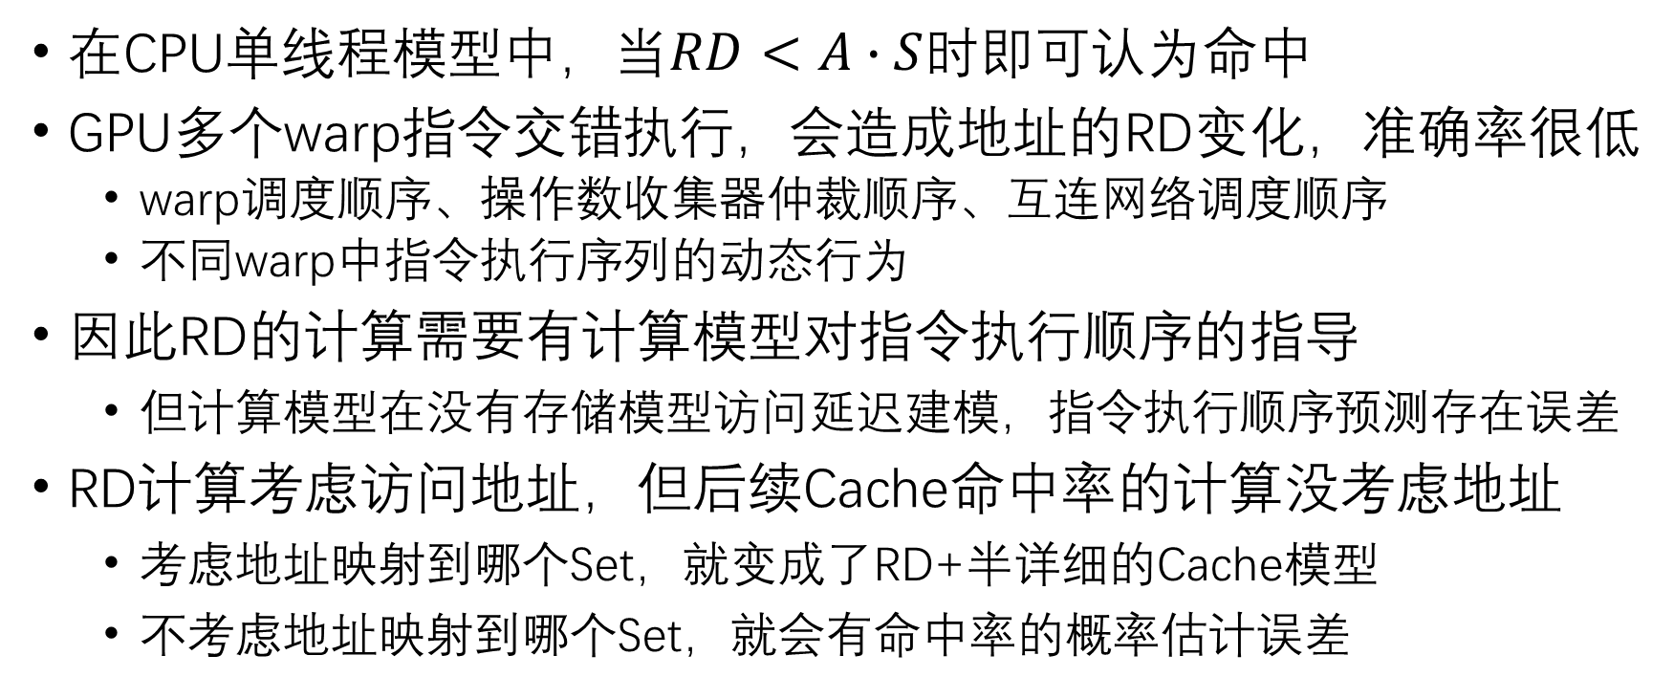
Reuse Distance在多线程上的不同
在CPU单线程模型中，当$RD<A∙S$时即可认为命中
GPU多个warp指令交错执行，会造成地址的RD变化，准确率很低
warp调度顺序、操作数收集器仲裁顺序、互连网络调度顺序
不同warp中指令执行序列的动态行为
因此RD的计算需要有计算模型对指令执行顺序的指导
但计算模型在没有存储模型访问延迟建模，指令执行顺序预测存在误差
RD计算考虑访问地址，但后续Cache命中率的计算没考虑地址
考虑地址映射到哪个Set，就变成了RD+半详细的Cache模型
不考虑地址映射到哪个Set，就会有命中率的概率估计误差

