Slide 1
大模型计算

Slide 2
编码器-解码器
编码信息C
I have a cat <end>
I have a dog <end>
Transformer：解码器+编码器
BERT：编码器
GPT：解码器
Encoder
Decoder
Encoder
Decoder
Encoder
Decoder
Encoder
Decoder
Encoder
Decoder
我 有 一只 猫
我 有 一只 狗
<begin> I have a cat
<begin> I have a dog

Slide 3
1. 嵌入
seq_len
batch
我 有 一只 猫
我 有 一只 狗
词 Embedding
＋
位置 Embedding
＝
合并 X
batch
hidden size
hidden size
seq_len
输入X形状 [Batch, seq_len, hidden_size]
batch

Slide 4
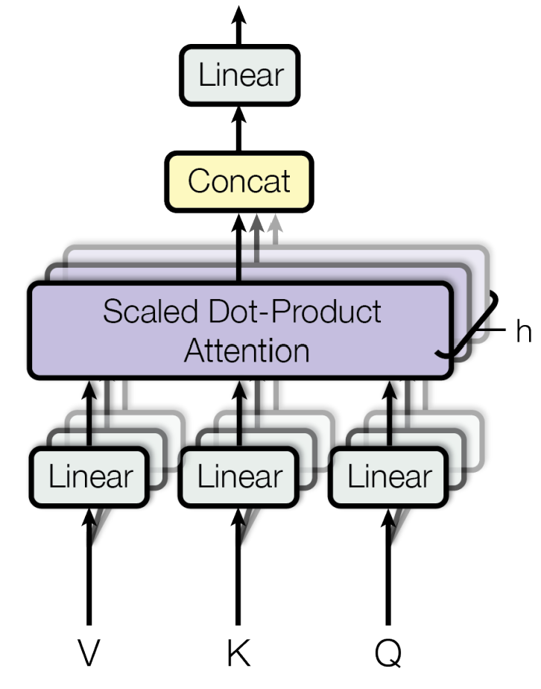
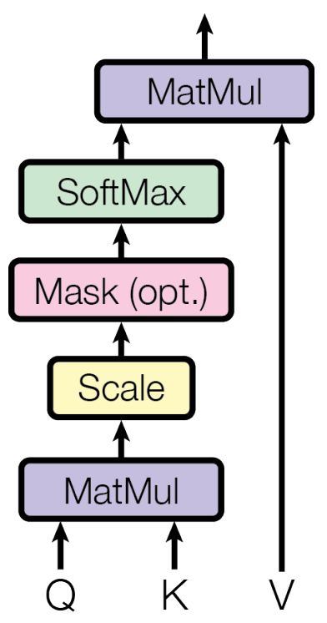
2. Encoder
enc_out: [batch, seq_len, hidden_size]
Attention=Q.T*K.T*V.T:
[batch, head, seq_len, dv]
W2
enc_out:
[batch, seq_len, d_ff]
W1
enc_out:
[batch, seq_len, hidden_size]
WL
Attention.T:
[batch, seq_len, dv*head]
W1形状: [hidden_size, d_ff]
W2形状: [d_ff, hidden_size]
WL形状: [dv*head, hidden_size]
Wq形状: [hidden_size, dk*head]
Wk形状: [hidden_size, dk*head]
Wv形状: [hidden_size, dv*head]
hidden size
Q: [batch, seq_len, dk*head]
K: [batch, seq_len, dk*head]
V: [batch, seq_len, dv*head]
Q.T: [batch, head, seq_len, dk]
K.T: [batch, head, dk, seq_len]
V.T: [batch, head, seq_len, dv]
Wq
Wk
Wv
seq_len
X
X
X
[batch, seq_len, hidden_size]
batch
X

Slide 5
3. Decoder-1
Attention=Q.T*K.T*V.T:
[batch, head, tgt_len, dv]
dec_out: [batch, tgt_len, hidden_size]
WL
Attention.T:
[batch, tgt_len, dv*head]
WL形状: [dv*head, hidden_size]
Wq形状: [hidden_size, dk*head]
Wk形状: [hidden_size, dk*head]
Wv形状: [hidden_size, dv*head]
Q: [batch, tgt_len, dk*head]
K: [batch, tgt_len, dk*head]
V: [batch, tgt_len, dv*head]
Q.T: [batch, head, tgt_len, dk]
K.T: [batch, head, dk, tgt_len]
V.T: [batch, head, tgt_len, dv]
Wq
Wk
Wv
dec_in
dec_in
dec_in
[batch, tgt_len, hidden_size]

Slide 6
4. Decoder-2
dec_out: [batch, tgt_len, hidden_size]
Attention=Q.T*K.T*V.T:
[batch, head, tgt_len, dv]
W2
enc_out:
[batch, tgt_len, d_ff]
W1
enc_out:
[batch, tgt_len, hidden_size]
WL
Attention.T:
[batch, tgt_len, dv*head]
W1形状: [hidden_size, d_ff]
W2形状: [d_ff, hidden_size]
WL形状: [dv*head, hidden_size]
Wq形状: [hidden_size, dk*head]
Wk形状: [hidden_size, dk*head]
Wv形状: [hidden_size, dv*head]
W’形状: [hidden_size, vocab_size]
W’
Q: [batch, tgt_len, dk*head]
K: [batch, seq_len, dk*head]
V: [batch, seq_len, dv*head]
Q.T: [batch, head, tgt_len, dk]
K.T: [batch, head, dk, seq_len]
V.T: [batch, head, seq_len, dv]
Wq
Wk
Wv
Predict: [batch, tgt_len, vocab_size]
dec_out
enc_out
enc_out
dec_out: [batch, tgt_len, hidden_size]
enc_out: [batch, seq_len, hidden_size]

Slide 7
Transformer矩阵乘-Encoder
配置 | Encoder/Decoder | head | hidden_size | d_ff | dk=dv | 参数量 | seq_len | tgt_len
TRM-base | 6 | 8 | 512 | 2048 | 64 | 65M | 512 | 1024
TRM-large | 6 | 16 | 1024 | 4096 | 128 | 213M | 512 | 1024
Encoder | 源矩阵A | 源矩阵W | 输出矩阵
由x计算Query | [batch, 512, 1024] | [1024, 2048] | [batch, 512, 2048]
由x计算Key | [batch, 512, 1024] | [1024, 2048] | [batch, 512, 2048]
由x计算Value | [batch, 512, 1024] | [1024, 2048] | [batch, 512, 2048]
Query*Key | [batch, 16, 512, 128] | [batch, 16, 128, 512] | [batch, 16, 512, 512]
Attention | [batch, 16, 512, 512] | [batch, 16, 512, 128] | [batch, 16, 512, 128]
Attention映射 | [batch, 512, 2048] | [2048, 1024] | [batch, 512, 1024]
前馈神经网络1 | [batch, 512, 1024] | [1024, 4096] | [batch, 512, 4096]
前馈神经网络2 | [batch, 512, 4096] | [4096, 1024] | [batch, 512, 1024]
×6

Slide 8
Transformer矩阵乘-Decoder
配置 | Encoder/Decoder | head | hidden_size | d_ff | dk=dv | 参数量 | seq_len | tgt_len
TRM-base | 6 | 8 | 512 | 2048 | 64 | 65M | 512 | 1024
TRM-large | 6 | 16 | 1024 | 4096 | 128 | 213M | 512 | 1024
Decoder | 源矩阵A | 源矩阵W | 输出矩阵
由x计算Query | [batch, 1024, 1024] | [1024, 2048] | [batch, 1024, 2048]
由x计算Key | [batch, 1024, 1024] | [1024, 2048] | [batch, 1024, 2048]
由x计算Value | [batch, 1024, 1024] | [1024, 2048] | [batch, 1024, 2048]
Query*Key | [batch, 16, 1024, 128] | [batch, 16, 128, 1024] | [batch, 16, 1024, 1024]
Attention | [batch, 16, 1024, 1024] | [batch, 16, 1024, 128] | [batch, 16, 1024, 128]
Attention映射 | [batch, 1024, 2048] | [2048, 1024] | [batch, 1024, 1024]
前馈神经网络1 | [batch, 1024, 1024] | [1024, 4096] | [batch, 1024, 4096]
前馈神经网络2 | [batch, 1024, 4096] | [4096, 1024] | [batch, 1024, 1024]
前馈神经网络3 | [batch, 1024, 1024] | [1024, vocab_size] | [batch, 1024, vocab_size]
×2
×6

Slide 9
BERT-Encoder
dk=dv=hidden_size//head
d_ff=4*hidden_size
enc_out: [batch, seq_len, hidden_size]
Attention=Q.T*K.T*V.T:
[batch, head, seq_len, dv]
W2
enc_out:
[batch, seq_len, d_ff]
W1
enc_out:
[batch, seq_len, hidden_size]
WL
Attention.T:
[batch, seq_len, dv*head]
W1形状: [hidden_size, d_ff]
W2形状: [d_ff, hidden_size]
WL形状: [dv*head, hidden_size]
Wq形状: [hidden_size, dk*head]
Wk形状: [hidden_size, dk*head]
Wv形状: [hidden_size, dv*head]
hidden size
Q: [batch, seq_len, dk*head]
K: [batch, seq_len, dk*head]
V: [batch, seq_len, dv*head]
Q.T: [batch, head, seq_len, dk]
K.T: [batch, head, dk, seq_len]
V.T: [batch, head, seq_len, dv]
Wq
Wk
Wv
seq_len
X
X
X
[batch, seq_len, hidden_size]
batch
X

Slide 10
BERT矩阵乘-Encoder
配置 | Encoder | head | hidden_size | d_ff | dk=dv | 参数量 | seq_len
BERT-base | 12 | 12 | 768 | 3072 | 64 | 110M | 512
BERT-large | 24 | 16 | 1024 | 4096 | 64 | 340M | 512
Encoder | 源矩阵A | 源矩阵W | 输出矩阵
由x计算Query | [batch, 512, 1024] | [1024, 1024] | [batch, 512, 1024]
由x计算Key | [batch, 512, 1024] | [1024, 1024] | [batch, 512, 1024]
由x计算Value | [batch, 512, 1024] | [1024, 1024] | [batch, 512, 1024]
Query*Key | [batch, 16, 512, 64] | [batch, 16, 64, 512] | [batch, 16, 512, 512]
Attention | [batch, 16, 512, 512] | [batch, 16, 512, 64] | [batch, 16, 512, 64]
Attention映射 | [batch, 512, 1024] | [1024, 1024] | [batch, 512, 1024]
前馈神经网络1 | [batch, 512, 1024] | [1024, 4096] | [batch, 512, 4096]
前馈神经网络2 | [batch, 512, 4096] | [4096, 1024] | [batch, 512, 1024]
×24

Slide 11
GPT-Decoder
dk=dv=hidden_size//head
d_ff=4*hidden_size
dec_out: [batch, tgt_len, hidden_size]
Attention=Q.T*K.T*V.T:
[batch, head, tgt_len, dv]
W2
enc_out:
[batch, tgt_len, d_ff]
W1
enc_out:
[batch, tgt_len, hidden_size]
WL
Attention.T:
[batch, tgt_len, dv*head]
W1形状: [hidden_size, d_ff]
W2形状: [d_ff, hidden_size]
WL形状: [dv*head, hidden_size]
Wq形状: [hidden_size, dk*head]
Wk形状: [hidden_size, dk*head]
Wv形状: [hidden_size, dv*head]
W’形状: [hidden_size, vocab_size]
W’
Q: [batch, tgt_len, dk*head]
K: [batch, seq_len, dk*head]
V: [batch, seq_len, dv*head]
Q.T: [batch, head, tgt_len, dk]
K.T: [batch, head, dk, seq_len]
V.T: [batch, head, seq_len, dv]
Wq
Wk
Wv
Predict: [batch, tgt_len, vocab_size]
dec_out
enc_out
enc_out
dec_out: [batch, tgt_len, hidden_size]
enc_out: [batch, seq_len, hidden_size]

Slide 12
GPT矩阵乘
配置 | Decoder | head | hidden_size | d_ff | dk=dv | 参数量 | seq_len
GPT1 | 12 | 12 | 768 | 3072 | 64 | 117M | 512
GPT2-small | 12 | 12 | 768 | 3072 | 64 | 124M | 512
GPT2-medium | 24 | 16 | 1024 | 4096 | 64 | 350M | 512
GPT2-large | 36 | 20 | 1280 | 5120 | 64 | 774M | 512
GPT2-xl | 48 | 25 | 1600 | 6400 | 64 | 1558M | 512
GPT3-small | 12 | 12 | 768 | 3072 | 64 | 125M | 512
GPT3-medium | 24 | 16 | 1024 | 4096 | 64 | 350M | 512
GPT3-large | 24 | 16 | 1536 | 6144 | 96 | 760M | 512
GPT3-xl | 24 | 24 | 2048 | 8192 | 86 | 1300M | 512
GPT3-2.7B | 32 | 32 | 2560 | 10240 | 80 | 2700M | 512
GPT3-6.7B | 32 | 32 | 4096 | 16384 | 128 | 6700M | 512
GPT3-13B | 40 | 40 | 5140 | 20560 | 128 | 13000M | 512
GPT3-175B | 96 | 96 | 12288 | 49152 | 128 | 175000M | 512

Slide 13
GPT矩阵乘
配置 | Encoder | head | hidden_size | d_ff | dk=dv | 参数量 | seq_len
GPT3-175B | 96 | 96 | 12288 | 49152 | 128 | 175000M | 512
Decoder | 源矩阵A | 源矩阵W | 输出矩阵
由x计算Query | [batch, 512, 12288] | [12288, 12288] | [batch, 512, 12288]
由x计算Key | [batch, 512, 12288] | [12288, 12288] | [batch, 512, 12288]
由x计算Value | [batch, 512, 12288] | [12288, 12288] | [batch, 512, 12288]
Query*Key | [batch, 96, 512, 128] | [batch, 96, 128, 512] | [batch, 96, 512, 512]
Attention | [batch, 96, 512, 512] | [batch, 96, 512, 128] | [batch, 96, 512, 128]
Attention映射 | [batch, 512, 12288] | [12288, 12288] | [batch, 512, 12288]
前馈神经网络1 | [batch, 512, 12288] | [12288, 49152] | [batch, 512, 49152]
前馈神经网络2 | [batch, 512, 49152] | [49152, 12288] | [batch, 512, 12288]
前馈神经网络3 | [batch, 512, 12288] | [12288, vocab_size] | [batch, 512, vocab_size]
×96

Slide 14
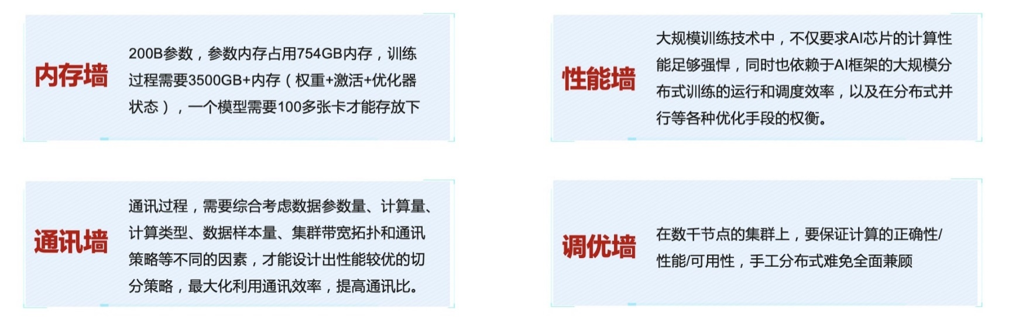
大模型特点
基于Transformer的Self-Attention机制
模型参数占用存储更大
DenseNet169: 14.15M
GPT1: 117M // Transformer-base 65M
矩阵乘规模更大，特征图占用存储大
DenseNet169: Conv2d(1568, 128, kernel_size=(1, 1), stride=(1, 1))
Linear(in_features=1664, out_features=1000)
训练数据更多
GPT3, 45 TB
ImageNet, 120 GB
训练难

