Slide 1
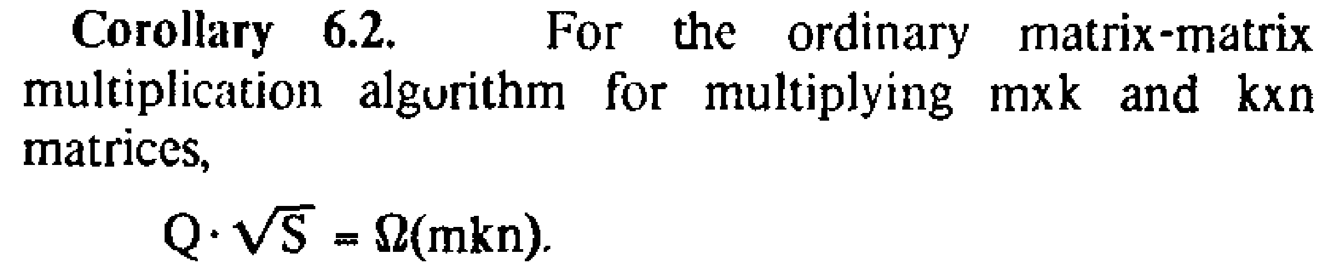



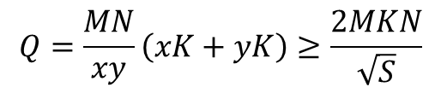
通讯下界
J.-W. Hong and H. T. Kung, “I/O Complexity: The Red-blue Pebble Game,” in Thirteenth ACM Symposium on Theory of Computing, 1981, pp. 326–333.
K
N
N
K
N
N
x
y
y
$$M$$
×
=
M
$$M$$
×
=
x
M
$$Q=\frac{MN}{xy}\left(xK+yK\right)≥\frac{2MKN}{\sqrt{S}}$$
$$Q=2MKN$$
$$S=xy, x=y$$

Slide 2
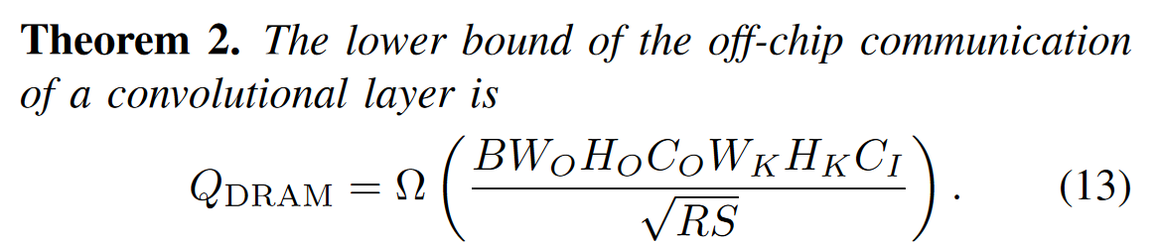
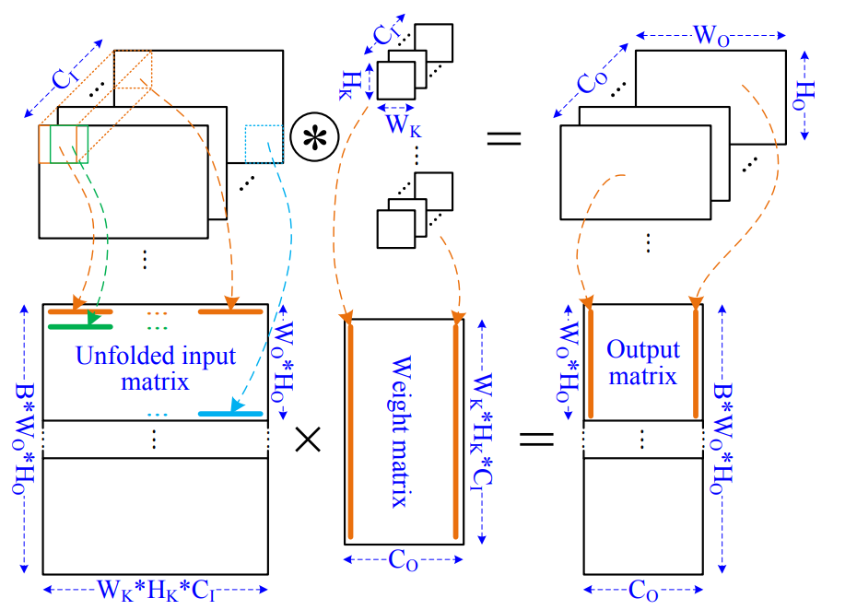
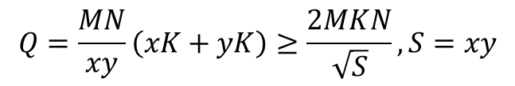
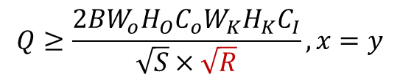


通讯下界
X. Chen, Y. Han and Y. Wang, "Communication Lower Bound in Convolution Accelerators," 2020 IEEE International Symposium on High Performance Computer Architecture (HPCA), San Diego, CA, USA, 2020, pp. 529-541, doi: 10.1109/HPCA47549.2020.00050.
$$,R=\frac{W_{K}×H_{K}}{D^{2}}$$
K
N
N
x
y
y
$$M$$
×
=
x
M
$$Q=\frac{MN}{xy}\left(xK+yK\right)≥\frac{2MKN}{\sqrt{S}}, S=xy$$
$$Q≥\frac{2BW_{o}H_{O}C_{o}W_{K}H_{K}C_{I}}{\sqrt{S}×\sqrt{R}}, x=y$$
$$x=Ry$$

