Slide 1
存内计算-CIM
compute in memory
报告人：鞠鑫
2023.03.18

Slide 2
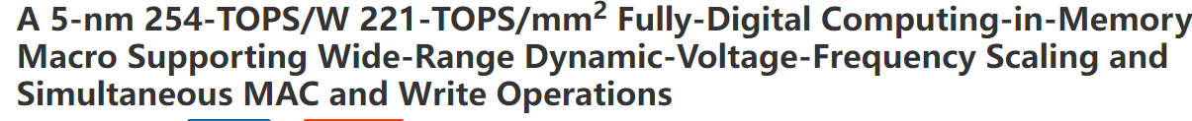
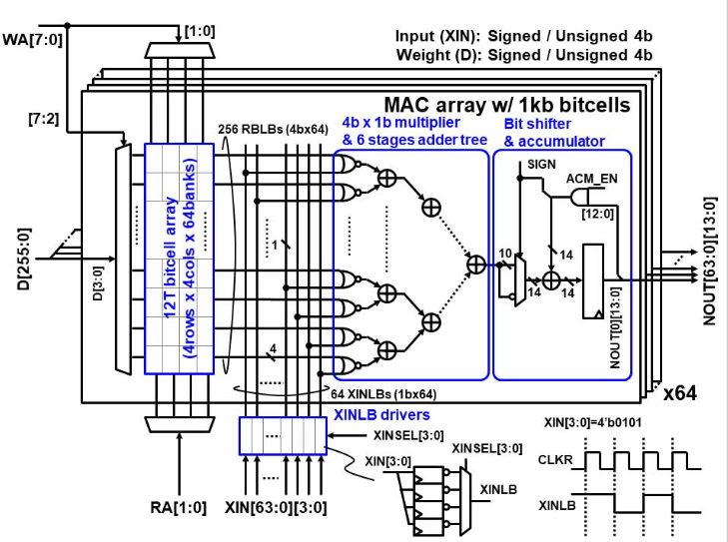
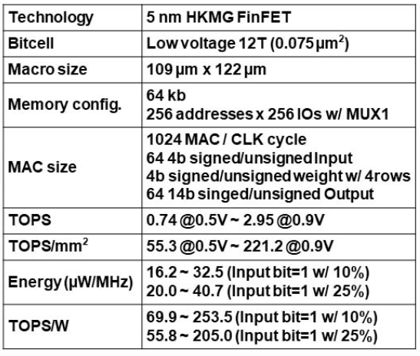
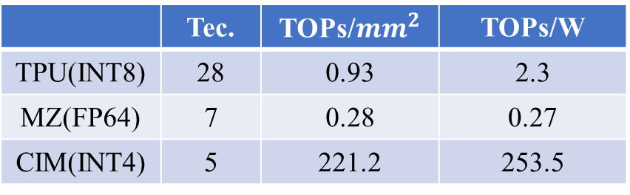
ISSCC-22
 | Tec. | TOPs/${mm}^{2}$ | TOPs/W
TPU(INT8) | 28 | 0.93 | 2.3
MZ(FP64) | 7 | 0.28 | 0.27
CIM(INT4) | 5 | 221.2 | 253.5
Notes:
TSMC

Slide 3
z
y
x

Slide 4
z
y
x
RA [1:0]
64
64
x
0
1
2
3
x
x
>> & acc
64
x 4b
x
>> & acc
XIN
64
>> & acc
x
x
x
x

Slide 5
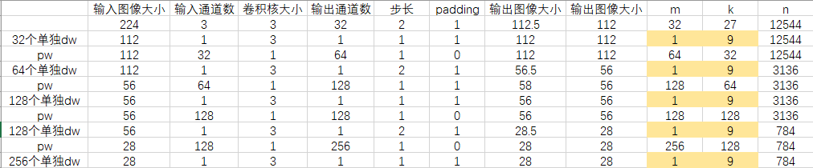
RA [1:0]
64
64
x
0
1
2
3
x
x
>> & acc
64
x 4b
x
>> & acc
XIN
64
>> & acc
x
x
x
x

Slide 6
RA [1:0]
64
64
x
0
1
2
3
x
x
>> & acc
64
x 4b
x
>> & acc
XIN
64
>> & acc
x
x
x
x
12544
9
1
9
WS
IS
OS
PE利用率极低
输入矩阵带宽占用较高
PE利用率较低
固定矩阵频繁替换，带宽占用高

Slide 7

RA [1:0]
64
64
x
0
1
2
3
x
x
>> & acc
64
x 4b
x
>> & acc
XIN
64
>> & acc
x
x
x
x
PE利用率低
带宽占用高
>> & acc
FA
>> & acc
>> & acc
RA [n-1:0]
64
>> & acc
FA
>> & acc
FA
>> & acc
FA
64
x 4b
64
>> & acc
XIN
>> & acc
>> & acc
>> & acc
>> & acc
>> & acc
$$2^{n}$$

Slide 8
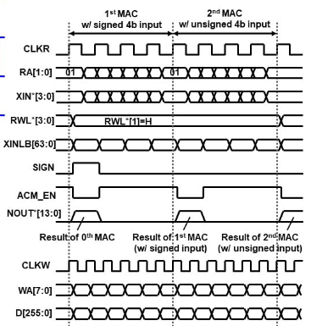
架构

Slide 9
相关工作
[1] CNN Acceleration with Joint Optimization of Practical PIM and GPU on Embedded Devices
ICCD-22
Experiment results show that our proposed framework achieves averagely the 5.9X and 37.9% inference performance boosts compared to the original GPU-only approach and the GPU-HBM approach, respectively.
[2] Configurable Multi-directional Systolic Array for Convolutional Neural Networks
ICCD-20 TACO-21
When running depthwise convolution in MobileNet, CMSA can increase the utilization rate by up to 14.8×.
[3] A 28nm Horizontal-Weight-Shift and Vertical-Feature-ShiftBased Separate-WL 6T-SRAM Computation-in-Memory Unit-Macro for Edge Depthwise Neural-Networks ISSCC-23

