Slide 1

The Quest to Memory Safety
Programming Languages
Sebastian Fernandez @snfernandez
Microsoft Security Response Center
Vulnerabilities & Mitigations
This presentation is for informational purposes only. MICROSOFT MAKES NO WARRANTIES, EXPRESS OR IMPLIED, IN THIS SUMMARY.

Slide 2
Who am I?
Vulnerabilities and Mitigations team in MSRC
Study and promote the use of safer languages
Bug hunts and sometimes writes exploits

Slide 3
Defining the problem
Software vulnerabilities incur a high cost for everyone
For vendors
Enforcing secure development practices (SDL)
Fixing, verifying and shipping security patches
Bad PR
For customers
Vulnerable software leaves computers open to attacks
Extra layers of security
Disruptive security updates
25

Slide 4
Defining our scope
Vulnerabilities reported to Microsoft are typically addressed in one of two ways
Online Service Update
Vulnerability report to secure@microsoft.com
Open MSRC case
Magic Happens
☺
Endpoint Software Update
In 2018, ~54% of reported vulnerabilities were addressed via a software update
~85% of those vulnerabilities were Remote Code Execution (RCE), Elevation of Privilege (EOP), or Information Disclosure (ID)
4

Slide 5
Memory safety issues remain dominant
We closely study the root cause trends of vulnerabilities & search for patterns
~70% of the vulnerabilities addressed through a security update each year continue to be memory safety issues
10

Slide 6
Drilling down into root causes
Top root causes since 2016:
#1: heap out-of-bounds
#2: use after free
#3: type confusion
#4: uninitialized use
11
Note: CVEs may have multiple root causes, so they can be counted in multiple categories

Slide 7
And we are not alone
“Most of Android’s vulnerabilities occur in the media and Bluetooth components. Use-after-free (UAF), integer overflows, and out of bounds (OOB) reads/writes comprise 90% of vulnerabilities with OOB being the most common.” – Jeff Vander Stoep about bugs in Android during 2018
“Across the entirety of iOS 12 Apple has fixed 261 CVEs, 173 of which were memory unsafety. That’s 66.3% of all vulnerabilities.
Across the entirety of Mojave Apple has fixed 298 CVEs, 213 of which were memory unsafety. That’s 71.5% of all vulnerabilities.” – Paul Kehrer about bugs in Apple software
“There’s a significant overlap between memory vulnerabilities and severe security problems. Of the 34 critical/high bugs, 32 were memory-related.” – Diane Hosfelt about bugs in the Firefox’s styling code

Slide 8
Microsoft’s vulnerability mitigation strategy
Break exploitation techniques
StackCookies, DEP, Heap Isolation, ACG, CFG, CIG
Eliminate vulnerabilities
NULL deref protection, MemGC, InitAll
Contain damage & prevent persistence
AppContainer, Virtualization
Promote safer programming languages
.NET, Rust, C++17 & Core Guidelines

Slide 9
Transitioning to safer languages

Slide 10
Not a smart pointer
string &not_fun(vector<char>& vec, Ending *ending) {
string str = string();
for(auto it = vec.begin(); it != vec.end(); ++it){
auto v = *it;
if (v >= 65) {
str.push_back(v+12);
} else {
vec.erase(it);
}
}
str.push_back(reinterpret_cast<AsciiEnding*>(ending)->get_char());
return str;
}
Dangling pointer
Might be a dangling pointer
Undefined behavior if signed char overflows
Hmmm….
Invalidates iterator
No NULL check
Returns a local dangling reference
Invalid cast

Slide 11
Systems programming
Systems programming aims to produce software and software platforms which provide services to other software, are performance constrained, or both
Desired features
Raw control over memory access and control flow
Easily interoperate with existing ABIs
Little runtime overhead
Software examples
Kernels and Hypervisors
Runtime libraries
Low latency (servers, game engines, browsers)

Slide 12
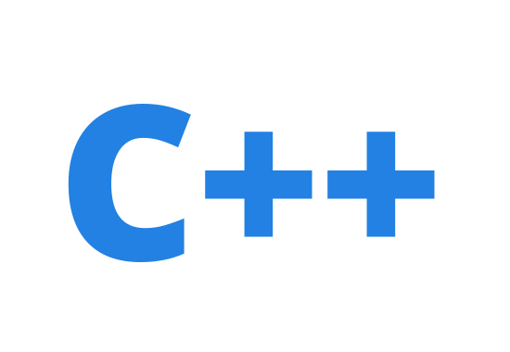
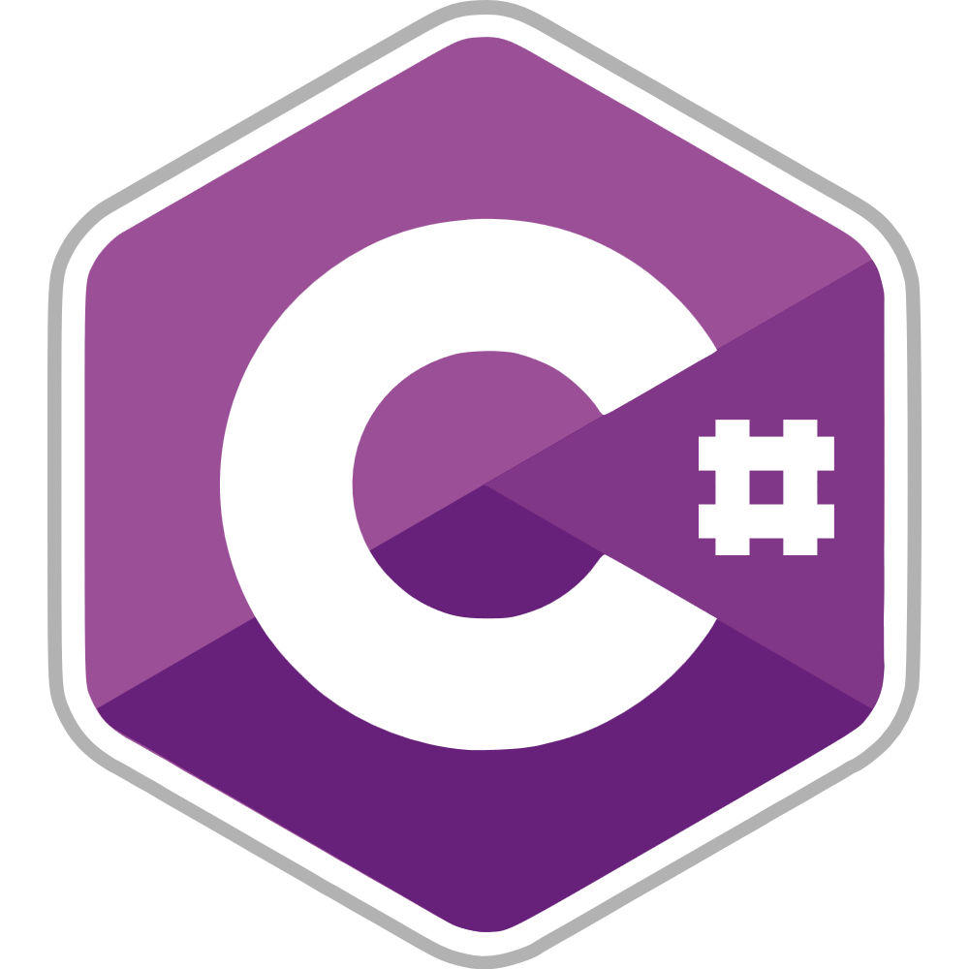




Which are our options?
C++ >= 17
& Core Guidelines
New features to help the user stay memory safe
Easiest to integrate with existing C/C++ codebases
No boundaries between unsafe and safe code
Not strong enough safety guarantees
Garbage Collected languages (C#, F#, TypeScript, Go, etc)
Memory is managed by the runtime
Applies bounds checks at runtime
Impact on performance predictability
Doesn’t meet all “SPL” criteria
Rust
Memory safe by default
Fearless concurrency: data race safe by default
Allows memory unsafety in a well-defined scope
Performance comparable to C++

Slide 13
Memory safety
Spatial memory safety
Temporal memory safety
Type safety
Pointer indexing
Use after free
Incorrect casting
Buffer overflows
Double free
Undefined behavior
Pointers lack size information
No ownership model
Unsafe operations
Time of check vs time of use
Lack of lifetime enforcement
Undefined states
Arithmetic operations

Slide 14
Spatial Memory Safety

Slide 15

Spatial memory safety
Allocates memory
Memory
char *ptr1;
Ptr1
mem = alloc(1)
memset(mem, 0, 2)
Copies more than allocated

Slide 16
Checked memory access
Transfers the responsibility of verifying the bounds of the objects to the runtime or enforcing them statically. Safeguards the user from making mistakes checking sizes
Fat pointers
(pointer+size)
Rust std::slices<T>
C++ gsl::span<T>
Arbitrary pointer dereferencing
No ☺. Well, you can still use unsafe

Slide 17
Temporal memory safety

Slide 18
Temporal memory safety
Allocates memory
Frees memory
Memory
char *ptr1;
Ptr1
mem = alloc(..)
Copies pointer
char *ptr2;
Ptr2
ptr2 = ptr1;
free(ptr1);
memset(ptr2, ..)
Use freed
memory

Slide 19
Enter memory ownership
A system that allows the developer to enforce when memory can be freed, transferred or moved, thus preventing them from accidentally creating and dereferencing dangling pointers
Single ownership
Rust lifetimes enforced statically
C++ gsl::owner<T*> (and std::unique_ptr<T>)
Shared ownership
(Reference counted pointers)
Rust std::Rc<T>/std::Arc<T>
C++ std::shared_ptr<T>/std::weak_ptr<T>

Slide 20
Let’s move to safer languages!

Slide 21
The stages of software
Hypotheses
New software
Usually open to new technologies
Use safe language
Software actively developed
Must interoperate with existing code
Prohibitive to introduce a different runtime
Use safe language if possible
Adopt safer development practices
Software in maintenance
Only fixes
Must be careful with regressions
Rewrite is expensive
Adopt safer practices if new code is added
Mitigations!

Slide 22

Conclusion
If possible, switch to safer languages like Rust or .NET
Transition to C++ 17 and enforce the Core Guidelines
In 20 years we shouldn’t be introducing any memory safety vulnerabilities ☺
Report vulnerabilities & mitigation bypasses via our bounty programs!
https://aka.ms/bugbounty

Slide 23

© 2019 Microsoft. All rights reserved. Microsoft, Windows and other product names are or may be registered trademarks and/or trademarks in the U.S. and/or other countries. The information herein is for informational purposes only and represents the current view of Microsoft Corporation as of the date of this presentation. Because Microsoft must respond to changing market conditions, it should not be interpreted to be a commitment on the part of Microsoft, and Microsoft cannot guarantee the accuracy of any information provided after the date of this presentation. MICROSOFT MAKES NO WARRANTIES, EXPRESS, IMPLIED OR STATUTORY, AS TO THE INFORMATION IN THIS PRESENTATION.

