Slide 1
Document-Domain Resampling Framework
Keh-Harng Feng
Department of Computer Science
University of Illinois - Urbana Champaign

Slide 2
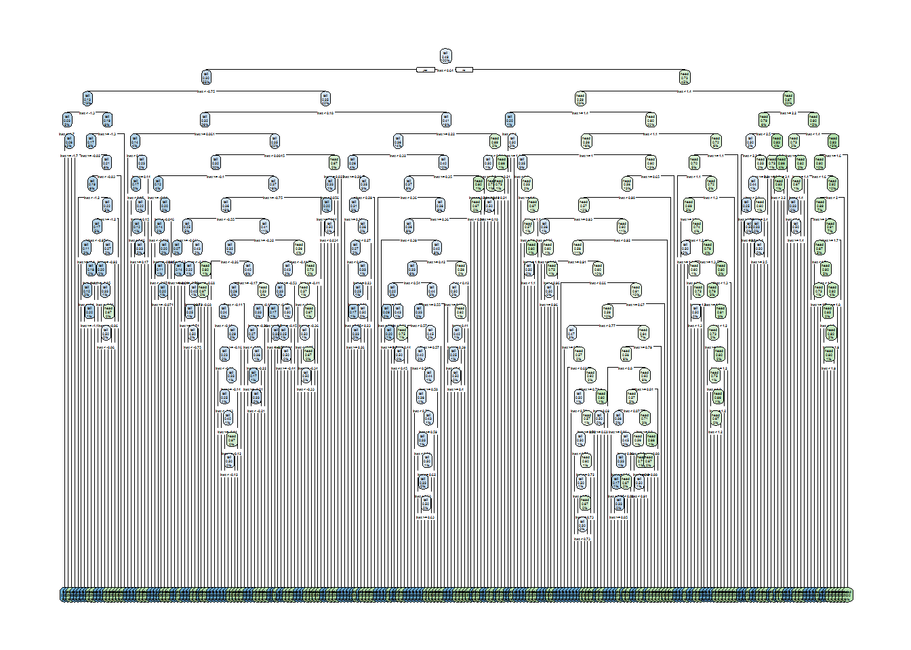
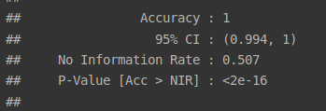
Why Resampling?
To avoid reporting on inflated evaluation score due to model over-fitting on training set.

Slide 3

How?
Basic Idea: train/test split.
What if…
1. Want to change the model to improve its performance?
2. Want to avoid possible sampling bias caused by split. Ex: 100m dash (50% male, 50% female). 30% set to validation → what if it’s all male?

Slide 4
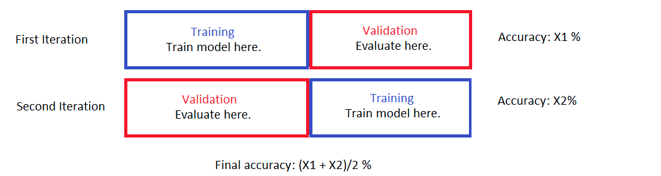

Solution: repeated random resamples. Aggregate evaluation scores on each with test/train split.

Slide 5
Text Retrieval Complications
Features (corpus) separate from responses (query relevance judgments) → require mapping after each resample!
Evaluation scheme requires support for train/test split → what does this mean in TR?
Slow (many sets of many documents!), unsafe (require large amount of memory) → don’t care.

Slide 6
Framework Layers
Resampling: tools for data partitioning and generation of support files (config, docID mapping, etc).
Evaluation: facilitate model evaluation using the train/test split methodology. Supports modular ranker. Currently a BM25 ranker and logarithmic NDCG are implemented by interfacing with the MeTA toolkit(https://meta-toolkit.org/).
Testing: template codes showing example use cases and to generate statistics to study method efficacy.

Slide 7
Data Format
Assumed to be organized in the line corpus format (ie: single text files with each line representing a document).
Both judgments and query are to be provided in separate text files. Judgments are stored as a mapping between query ID and document ID per line.
Root folder contains the configuration toml and other files such as the collection of stopwords.
The configuration toml should have the basic entries pointing to the correct paths.
A /dataset/ sub-folder that contains the actual corpus data files (corpus-format.toml, corpus.dat, query-relevance.txt, queries.txt...etc).

Slide 8
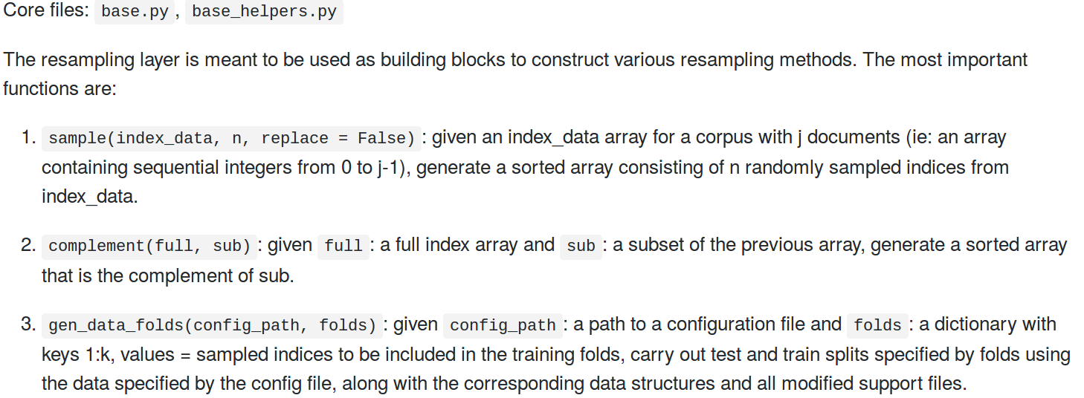
Resampling Layer

Slide 9
Testing Methodology
Split a large corpus (apnews) into two disjoint sets. Set 2 is set aside as a held-out validation set.
Set 1 is further split into five disjoint sets S11, S12, S13, S14, S15.
Get evaluation scores on BM25 (vanilla, grid-search) using 5-fold CV, training set evaluation and test set (S2) evaluation.

Slide 10
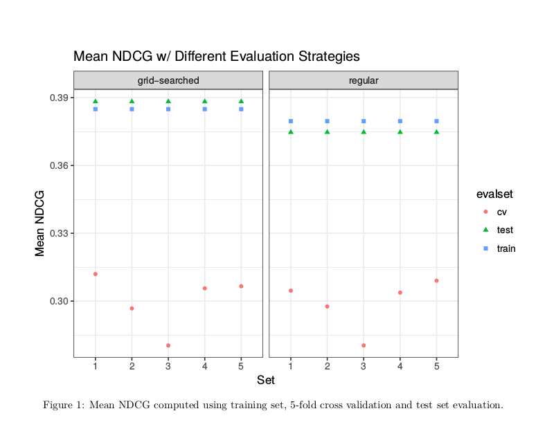

Slide 11
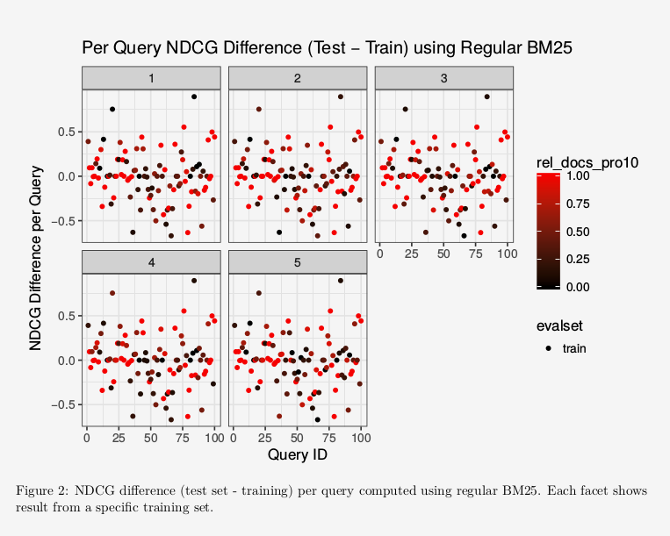

Slide 12
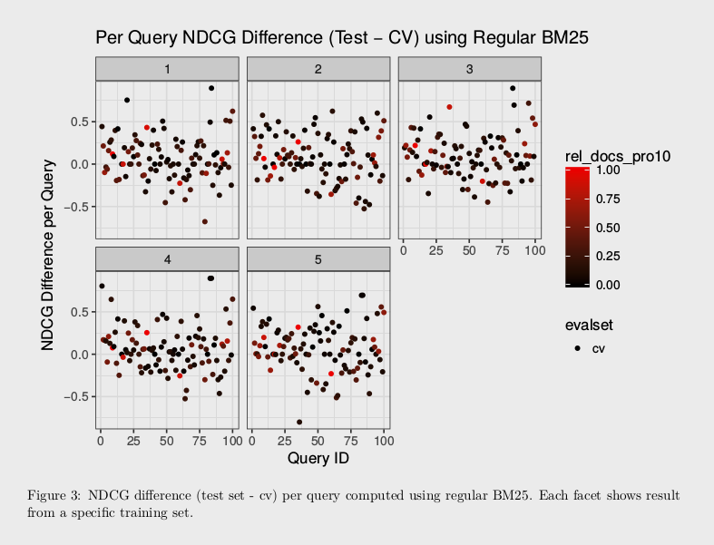

Slide 13
Summary
The resampling framework provides flexible building blocks for users to build a multitude of document-domain resampling methods.
However, resampled evaluation scores contain large pessimistic bias due to lack of considerations for relevant document erosions from resampling.
To combat this, data stratification is key!

