Slide 1
2
Approach
Notes:
In this section, We first briefly introduce the image encoder and the topic extractor. Then, we introduce the proposed stepwise image-topic merging decoder in detail

Slide 2
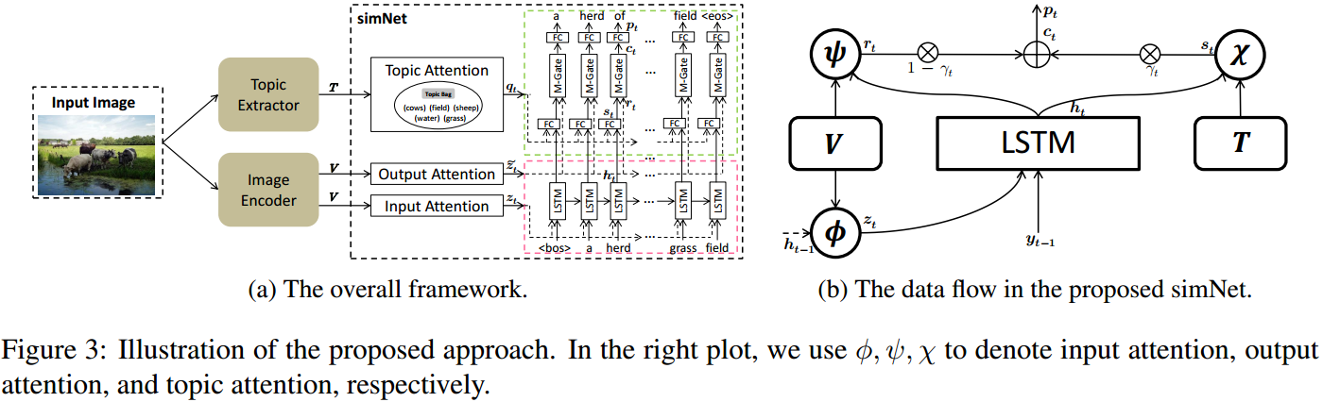
simNet: Stepwise Image-Topic Merging Network for
Generating Detailed and Comprehensive Image Captions
Notes:
这个图片展示了我们模型的方法，其中右边是数据流向。模型里的每个模块细节我们会进行详细解释。

Slide 3
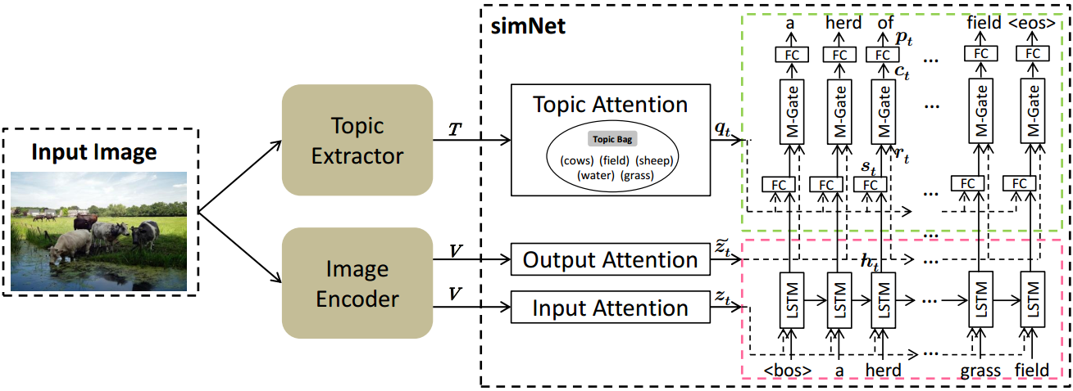
Approach: Image Encoder
Image Encoder: We use a ResNet152 (He et al., 2016), which is commonly used in image captioning, to
generate the visual features.
He et al., 2016: Deep residual learning for image recognition. In CVPR 2016.
Notes:
Image encoder部分中我们采用了ResNet网络，因为it is commonly used in image captioning, to generate the visual features.

Slide 4
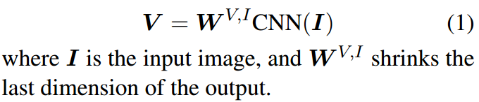
Approach: Image Encoder
Notes:
然后取网络的最后一层卷积层作为图片的特征图，最后再用一个线性变换，得到缩小维度后的特征图。

Slide 5
Approach: Topic Extractor
Topic Extractor: We adopt the weakly-supervised approach of Multiple Instance Learning (Zhang et al., 2006)
to build a topic extractor. Please refer to Fang et al. (2015) for detailed explanation.
Zhang et al., 2006: Multiple instance boosting for object detection. In NIPS 2006.
Fang et al., 2015: From captions to visual concepts and back. In CVPR2015
Notes:
Topic Extractor提取部分，我们直接踩踏了Fang论文里的模型，这个模型是adopt the weakly-supervised approach of Multiple Instance Learning (Zhang et al., 2006) to build a topic extractor的。

Slide 6
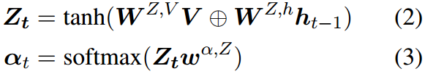

Approach: Visual Attention
Input Attention[1]:
[1]: Show, attend and tell: Neural image caption generation with visual attention. In PMLR 2015
Notes:
在得到图片的特征图和图片的topic后，为了提高模型decoder端的解码能力，我们进一步对这些信息进行预处理。
这里我们首先介绍如何处理特征图。
We adopt this paper’s approach.
得到z_t后，我们再将其与输入的word_embedding concate起来。

Slide 7
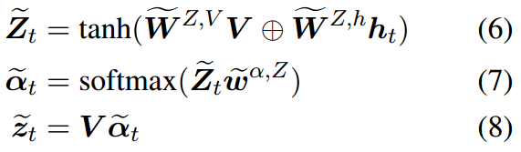
Approach: Visual Attention
Output Attention[2,3]:
[2]: Image captioning with semantic attention. In CVPR 2016
[3]: Knowing when to look: Adaptive attention via a visual sentinel for image captioning. In CVPR 2017
Notes:
之后，我们再对特征图做一次output attention，这个动机是来自于[2]文献。
另外值得注意的是，这个is essentially the same with the spatial visual attention proposed by 文献[3]。

Slide 8

Approach: Visual Attention
Output Attention[2,3]:
the visual information:
Notes:
因此，最后我们可以通过该式子得到visual Information

Slide 9
Approach: Visual Attention
Topic Attention[2]:
Notes:
Topic Attention首次是在文献2中提出的。在这篇论文里他们运用方程9实现topic attention模型，这里的T是Topic 词表，y_t-1是上一时刻模型的输出。U是一个可学习的矩阵。从这个公式我们可以清楚的发现The profound issue is that this approach neglects the visual information. 所以It should be beneficial to provide the attentive visual information when selecting topics.

Slide 10
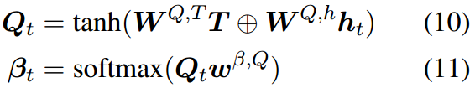
Approach: Visual Attention
Topic Attention(Ours):
Notes:
所以我们加入当前时刻hidden state的信息，因为The hidden state of the LSTM contains both the information of previous words and the attentive input visual information.
因此，我们模型topic attention是based on the hidden state of the LSTM的。

Slide 11

Approach: Visual Attention
Topic Attention(Ours):
the contextual information:
Notes:
最后，我们将q_t和h_t加权和，得到contextual information。

Slide 12
Approach: Merging Gate
How to make full use of the visual information and the contextual information?
Notes:
现在，我们得到了the visual information the contextual information ，那么我们该如何make full use of the visual information and the contextual information?

Slide 13
Approach: Merging Gate
It is not reasonable to treat the two kinds of information equally when the decoder generates different types of words. For example, when generating descriptive words
(e.g., behind, red) , the visual information should matter more than the contextual information. However, when generating object words (e.g., people, table), the contextual information is more important.

Slide 14

Approach: Merging Gate
In our approach, we build a novel score-based “merging gate” which is used to adaptively learn to adjust the balance of the visual information and the contextual information ( Where σ is the sigmoid function )
Notes:
现在，我们将告诉大家如何得到the visual information and the contextual information 的分数。

Slide 15
Approach: Merging Gate
The γt indicates how important the topic attention is compared to the visual attention，so the scoring function needs to evaluate the importance of the topic attention.
Notes:
首先我们需要注意到，gama_t indicates how important the topic attention is compared to the visual attention，所以The scoring function needs to evaluate the importance of the topic attention.

Slide 16
Approach: Merging Gate
Notes:
现在，我们回顾下Topic Attention中的公式。我们可以发现，方程10和方程11就是评价了the importance of every topic。

Slide 17
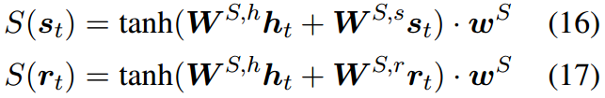
Approach: Merging Gate
Notes:
因此，我们类似的定义The scoring function。其中，这里的W_Sh; w_s share the weights of
W_Q;h; w_β;Q from Eq. (10) and Eq. (11), respectively.

Slide 18

simNet: Stepwise Image-Topic Merging Network for
Generating Detailed and Comprehensive Image Captions
the contextual information:
Notes:
最后，我们使用该方程得到模型的输出。

Slide 19
3
Experiments
Notes:
We describe the datasets and the metrics used for evaluation, followed by the evaluation of the proposed approach.

Slide 20
Experiments
Dataset
Evaluation Metrics
Microsoft COCO(MSCOCO) and Flickr30k: They contain 123,287 images and 31,000 images, respectively, and each image is annotated with 5 sentences. We report results using the widely-used publicly-available splits in the work of Karpathy and Li (2015). There are 5,000 images each in the validation set and the test set for COCO, 1,000 images for Flickr30k.
Karpathy and Li (2015): Deep visual-semantic alignments for generating image descriptions. CVPR 2015.
SPICE, CIDEr, BLEU, METEOR and ROUGE:
1.SPICE is based on scene graph matching.
2.CIDEr is based on n-gram matching.
3.BLEU and METEOR are originally proposed for machine translation evaluation.
4.ROUGE is designed for automatic evaluation of extractive text summarization.
Notes:
我们在两个benchmark datasets 评估了我们的模型。分别是Microsoft COCO(MSCOCO) and Flickr30k。
We report results using the COCO captioning evaluation toolkit (Chen et al., 2015) that reports the widely-used automatic evaluation metrics SPICE, CIDEr, BLEU, METEOR, and ROUGE。
另外值得注意的是：In the related studies, it is concluded that SPICE correlates the best with human judgments with a remarkable margin over the other metrics, and is expert in judging detailedness, where the other metrics show negative correlations, surprisingly;

Slide 21
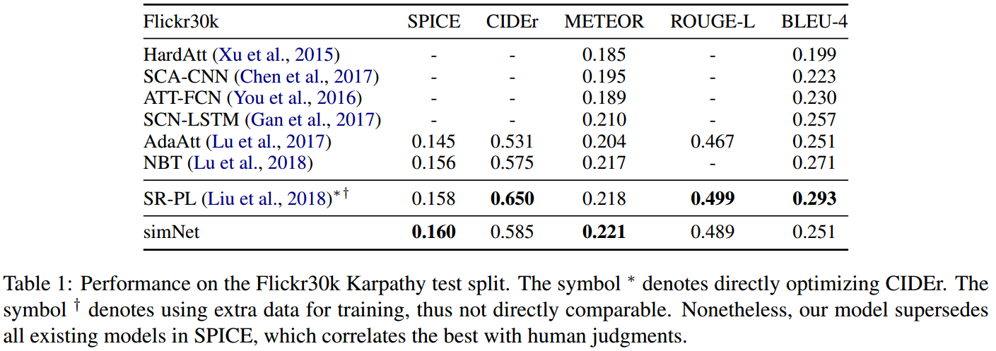
Experiments: Results (Flickr30k)
Notes:
We compare our approach with various representative systems on Flickr30k and COCO, including the recently proposed NBT that is the state-of-the art on the two datasets in comparable settings. Table 1 shows the result on Flickr30k. As we can see, our model outperforms the comparable systems in terms of all of the metrics except BLEU-4.
Moreover, our model overpasses the state-of-the art with a comfortable margin in terms of SPICE, which is shown to correlate the best with human judgments

Slide 22
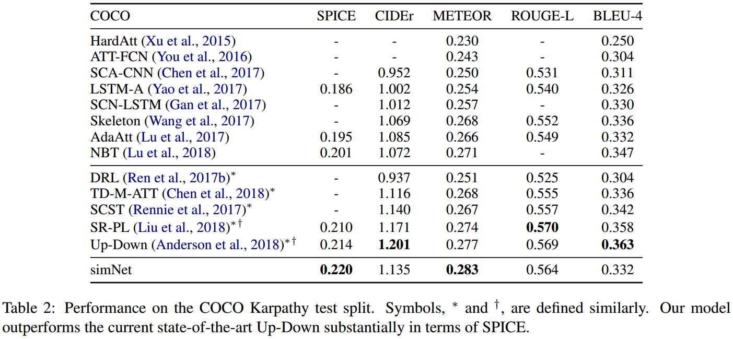
Experiments: Results (MSCOCO)
Notes:
Table 2 shows the results on COCO. Among the directly comparable models, our model is arguably the best and outperforms the existing models except in terms of BLEU-4. Most encouragingly, our model is also competitive with Up-Down，which uses much larger dataset, Visual Genome，with dense annotations to train the object detector, and directly optimizes CIDEr. Especially, our model outperforms the state-of-the-art substantially in SPICE.

Slide 23
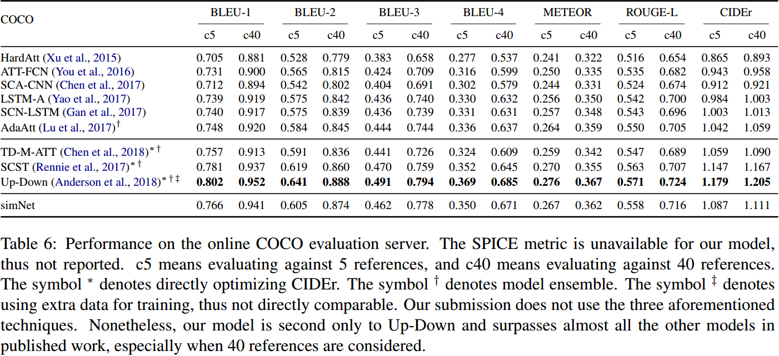
Experiments: Results (MSCOCO)
Notes:
这是我们的模型在coco server上的表现。不幸的是，the online COCO evaluation server missing SPICE，另外，Our submission does not directly optimize CIDEr, use model ensemble, or use extra training data. The three techniques typically result in orthogonal improvements 。Nonetheless, our model is second only to Up-Down and surpasses almost all the other models in published work, especially when 40 references are considered.

Slide 24
4
Analysis
Notes:
In this section, we analyze the contribution of each component in the proposed approach, and give examples to show the strength and the potential improvements of the model. The analysis is conducted on the test set of COCO.

Slide 25
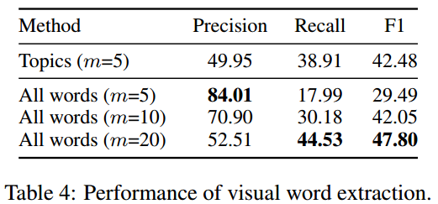
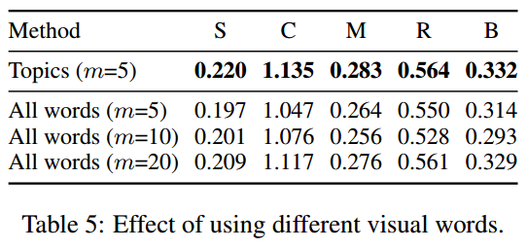
Analysis: Topic Extraction
The reason of using objects as topics is that they are easier to identify so that the generation suffers less from erroneous predictions.
It proves that for semantic attention, it is also important to limit the absolute number of incorrect visual words instead of merely the precision or the recall.
Notes:
The motivation of using objects as topics is that they are easier to identify so that the generation suffers less from erroneous predictions. This can be proved by the F-score of the identified topics in the test set, which is shown in Table 4.
However, even when top-20 all words are used, the performance is still far behind using only top-5 object words and seems to reach the performance ceiling. It proves that for semantic attention, it is also important to limit the absolute number of incorrect visual words instead of merely the precision or the recall.
It is also interesting to check whether using other kind of words can reach the same effect. Unfortunately, in our experiments, only using verbs or adjectives as semantic concepts works poorly

Slide 26
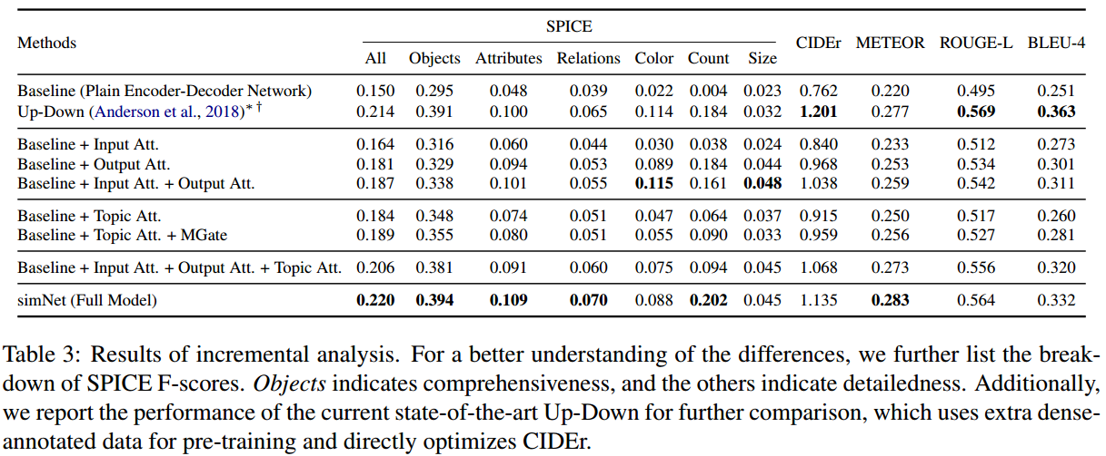
Analysis: Visual Attention and Topic Attention
Notes:
To examine the contributions of the submodules in our model, we conduct a series of experiments. The results are summarized in Table 3. To help with the understanding of the differences, we also report the breakdown of SPICE F-scores.

Slide 27
Analysis: Visual Attention
Notes:
从这个表中，我们可以得知Using only the output attention is much more effective than using only the input attention, with substantial improvements in all metrics, showing the impact of information gap caused by delayed input in attention.

Slide 28
Analysis: Visual Attention
Notes:
进一步的可以得知，Combining the input attention and the output attention can further improve the results, especially in color and size descriptions

Slide 29
Analysis: Topic Attention
Notes:
As expected, compared with visual attention, the topic attention is better at identifying objects but worse at identifying attributes.

Slide 30
Analysis: Topic Attention
Notes:
We also apply the merging gate to the topic attention, but it now merges topic information and hidden state. With the merging gate, the model can balance the information in caption text and extracted topics, resulting in better overall scores.

Slide 31
Analysis: Topic Attention
Notes:
Combing the visual attention and the topic attention directly indeed results in a huge boost in performance, which confirms our motivation.

Slide 32
Analysis: Topic Attention
Notes:
However, directly combining them also causes lower scores in attributes, color, count, and size, showing that the advantages are not fully made use of. The most dramatic improvements come from applying the merging gate to the combined attention, showing that the proposed balance mechanism can adaptively combine the two kinds of information and is essential to the overall performance.

Slide 33
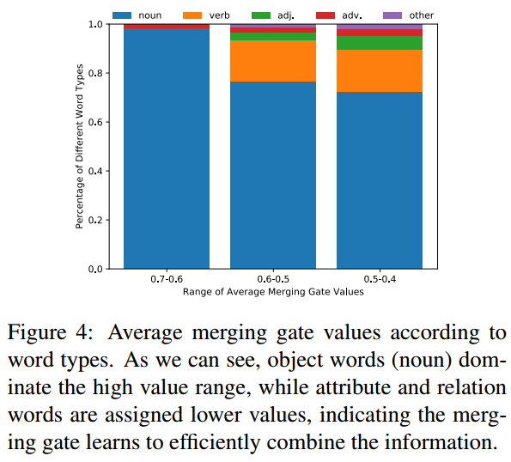
Analysis: Merging Gate
Notes:
The average merging gate value summarized in Figure 4 suggests the same
从这个图片中，我们可以看到object words dominate the high value range, while attribute and relation words are assigned lower values, indicating the merging gate learns to efficiently combine the information.

Slide 34
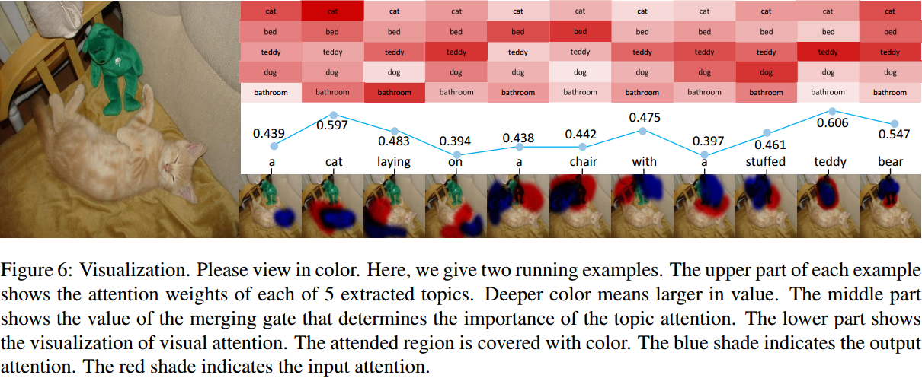
Analysis: Visualization
Notes:
我们给出了一个例子对我们的模型进行可视化。从Figure 6 中可以看到the topic attention is active when generating a phrase containing the related topic.

Slide 35


Analysis: Visualization
Notes:
Besides， we find the merging gate learns to overcome the erroneous topics, as shown in the example. When generating chair, the topic attention is focused on a wrong object bed, while the visual attention attends correctly to the chair, and especially the output attention attends to the armrest. The merging gate effectively remedies the misleading information from the topic attention and outputs a lower weight, resulting in the model correctly generating the word chair.

Slide 36
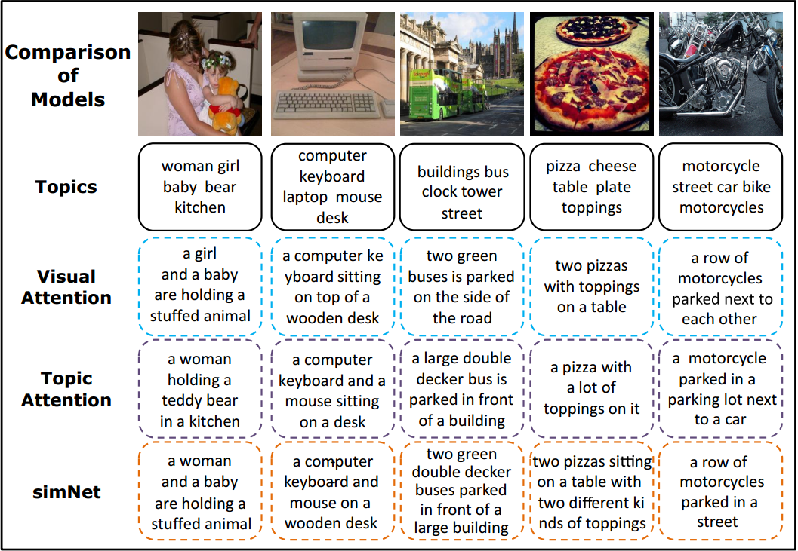
Analysis: More Examples
Notes:
We give some examples in the left plot of Figure 5 to illustrate the differences between the models more intuitively. From the examples, it is clear that Visual attention is good at portraying the relations but is less specific in objects. Topic attention includes more objects but lacks details, such as material, color, and number. the proposed simNet generates the best captions in that more objects are described and many informative and detailed attributes are included, such as the quantity and the color。

Slide 37
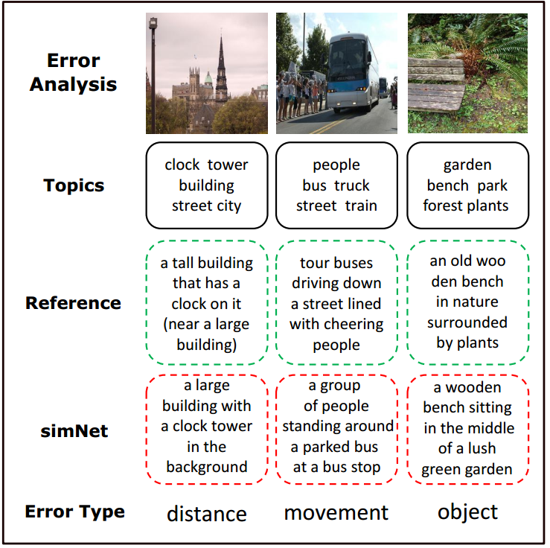
Analysis: Error Analysis
We conduct error analysis using the proposed (full) model on the test set to provide insights on how the model may be improved. We find 123 out of 1000 generated captions that are not satisfactory. There are mainly three types of errors, i.e. distance (32, 26%), movement (22,18%), and object (60, 49%), with 9 (7%) other errors.
Notes:
We also conduct error analysis using the proposed model on the test set. We find that there are mainly three types of errors, i.e. distance, movement ,and object ,with 9 other errors.

Slide 38
Analysis: Error Analysis
We conduct error analysis using the proposed (full) model on the test set to provide insights on how the model may be improved. We find 123 out of 1000 generated captions that are not satisfactory. There are mainly three types of errors, i.e. distance (32, 26%), movement (22,18%), and object (60, 49%), with 9 (7%) other errors.
Notes:
Distance error takes place when there is a lot of objects and the model cannot grasp the foreground and the background relationship. Movement error means that the model fails to describe whether the objects are moving. Those two kinds of errors are hard to eliminate, as they are fundamental problems of computer vision waiting to be resolved. Object error happens when there are incorrect extracted topics, and the merging gate regards the topic as grounded in the image.

Slide 39
Conclusion
We propose the stepwise image-topic merging network to sequentially and adaptively merge the visual and the conce-ptual information for improved image captioning.
To our knowledge, we are the first to combine the visual and the semantic attention to achieve substantial improvements.
We introduce the stepwise merging mechanism to efficiently guide the two kinds of information when generating the caption.

Slide 40
Conclusion
The experimental results demonstrate the effectiveness of the proposed approach, which substantially outperforms the state-of-the-art image captioning methods in terms of SPICE on COCO and Flickr30k datasets.
Quantitative and qualitative analysis show that the generated captions are both detailed and comprehensive in comparison with the existing methods.

Slide 41
Acknowledgments
This work was supported in part by National Natural Science Foundation of China (No. 61673028).
We thank all the anonymous reviewers for their constructive comments and suggestions.
Xu Sun is the corresponding author of this paper.

Slide 42
Thank you!
The code is available at https://github.com/lancopku/simNet

