Slide 1
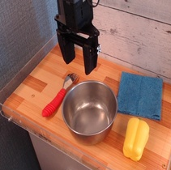
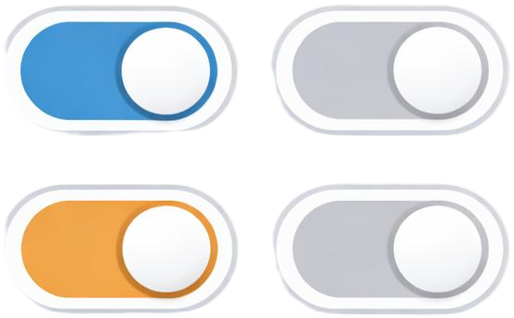



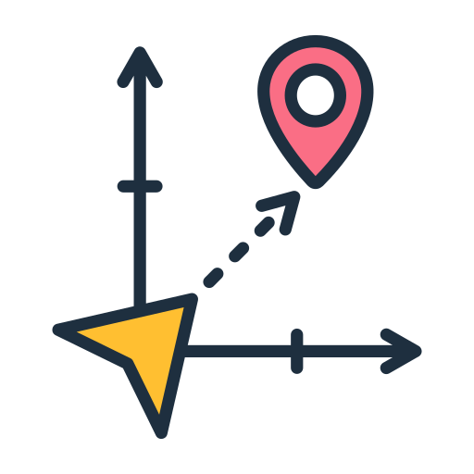
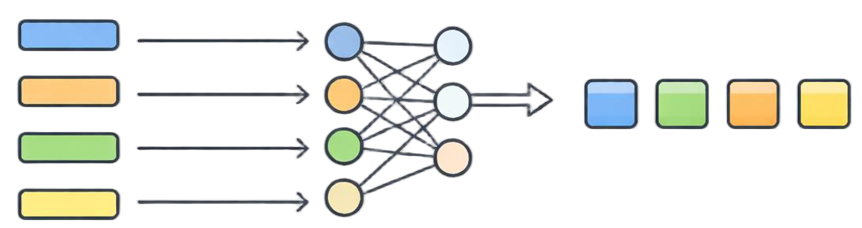
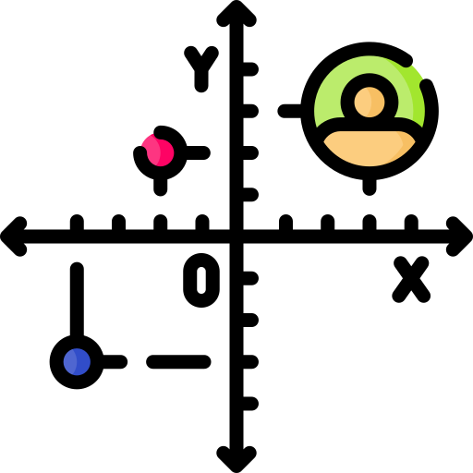
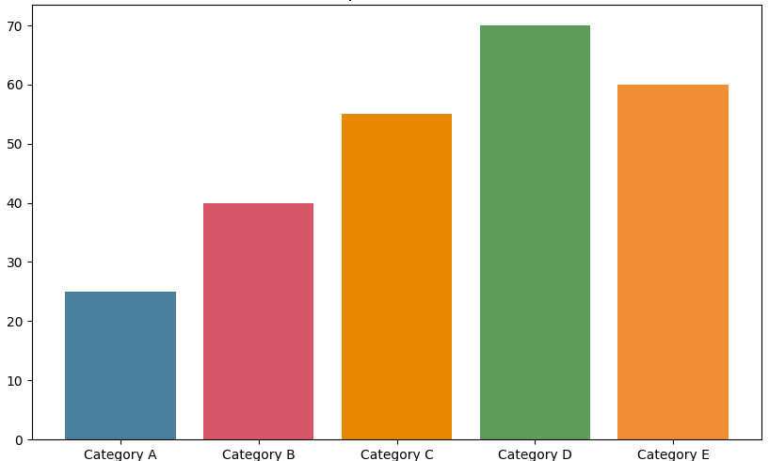

Observation &
Instruction
Structured
Evidence
Dynamic
Routing
Evidence
Adapter
BBox
hard
mask
m^{hard}
route supervision
(1 − α)m^{hard} + αm^{soft}
Edge
“Put the blue towel in the pan”
Motion
Evidence Adapter
routing gate
Relation
trace supervision
soft
score
m^{soft}
soft token injection
text token
image token
evidence token
Δx
Δθ
ΔGrip
……
training only
OpenVLA Backbone
7D Robot Action

Slide 2
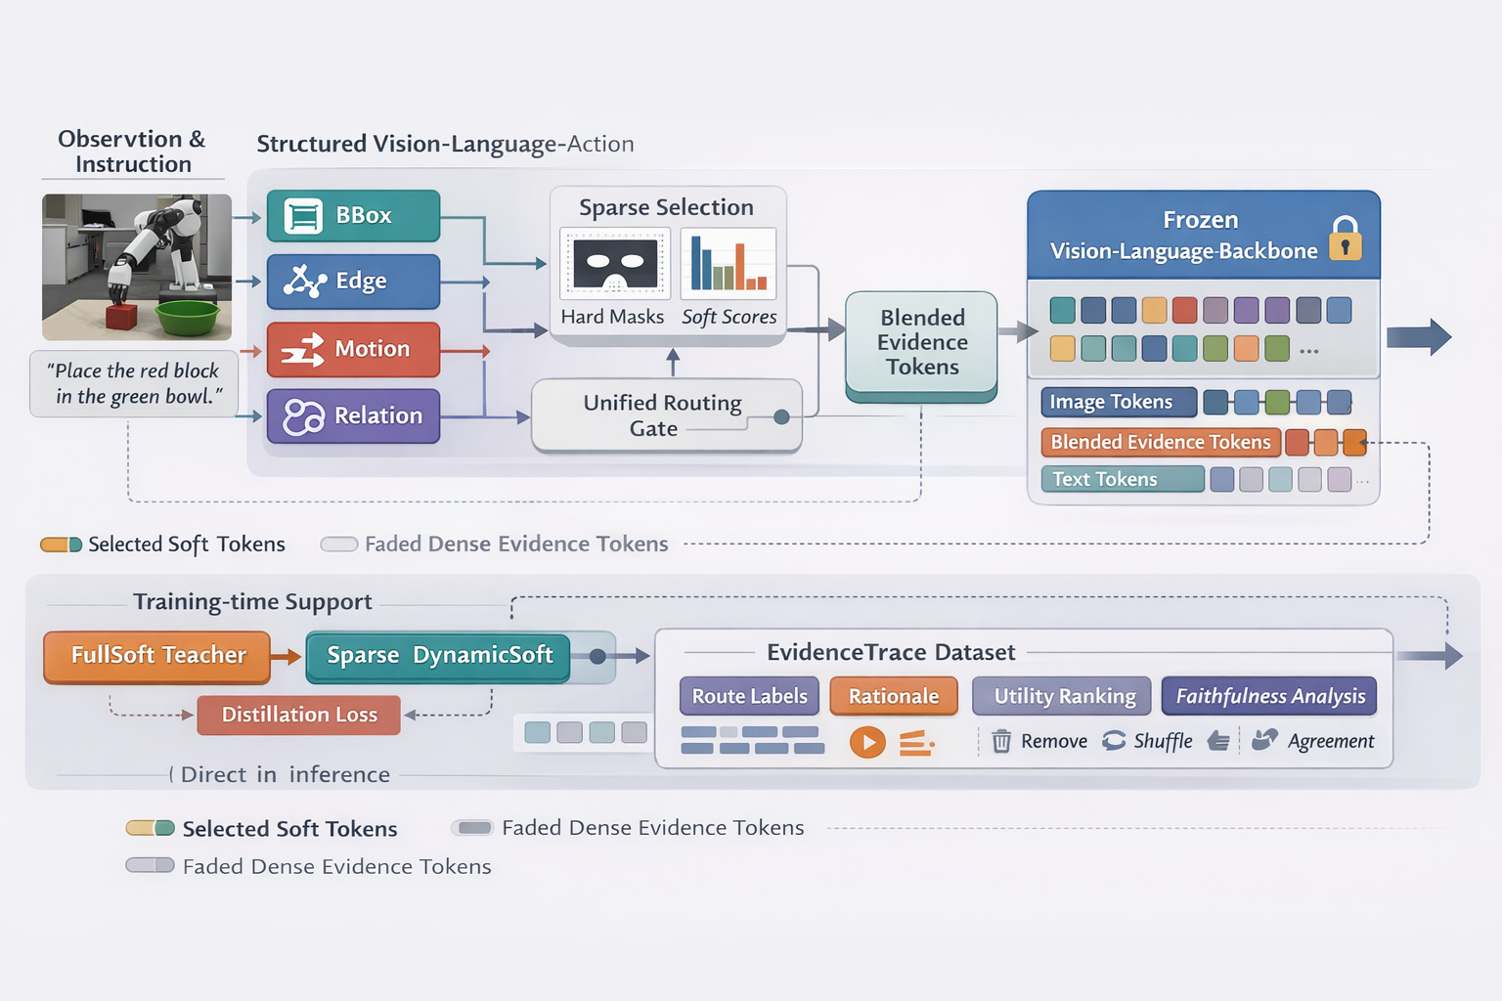

Slide 3


