Slide 1


Prominent Brain Nodes for Individual Identification Are unlike Across Different Datasets and Atlases
Pujie FENG¹, Bin JING¹, and Haiyun LI¹
¹School of Biomedical Engineering, Capital Medical University, Beijing
E-mail: FENG: Feng_Pujie@ccmu.edu.cn, JING: bjing@ccmu.edu.cn, LI: haiyunli@ccmu.edu.cn
Notes:
Hello every one,this is Feng Pujie from Capital Medical University,Beijing china.and I hope this video could help you to get know about our work briefly. In this work we Exploring 4 influential factors in RSFC-based cognitive traits prediction

Slide 2
METHOD
Dataset
380 subjects from different families from the HCP
200 subjects from the AOMIC
219 subjects from the LEMON
extracted from Brainnetome 246 and Schaefer 400 atlas
Prediction model
the discriminative ability of node was quantified by ‘differential identifiability’
Notes:
The data from HCP including 1206 healthy subjects were employed, with 3 cognitive traits including fluid intelligence, working memory, and picture vocabulary ability as the prediction targets. We compared the prediction performance under different settings of different factors using partial least square regression.

Slide 3
Exploring several influential factors in RSFC-based cognitive traits prediction
METHOD
Analysis Pipeline
5 FC types
Different variance of predicted target
12 different time series length
6 different numbers of ICs
Notes:
We investigate the impact of 4 confounding factors including 5 FC type, Different variance of predicted target, 12 time series length, 6 brain parcellation

Slide 4
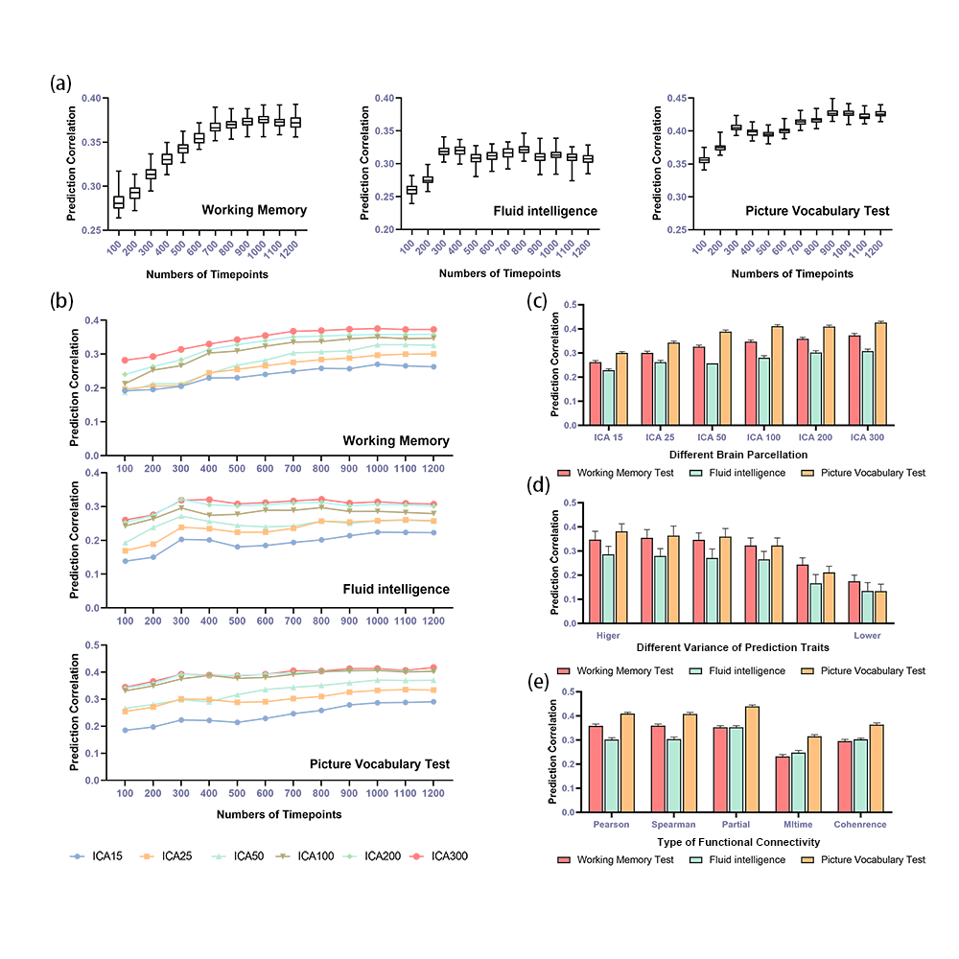
RESULT
All of these four factors could influence the RSFC-based prediction performances for cognitive traits.

Slide 5
Conclusion
Scanning time with 200 to 800 time points
A relatively finer brain parcellation (ICA100)
FC calculated by Pearson, Spearman and partial correlation
Larger variance in cognitive abilities

