Slide 1
Semi-Automatic Semantic Interoperability Enhancement Framework
Service Developer
DER Flexibility Management
Energy Efficiency Improvement
Energy domain application
Query Process
Result
Relational Database Design
Query
Knowledge Graph Generation
NoSQL Database
Relational Database
Graph Database
Timeseries Data Store
Annotated Data Store
Annotated Data
Semantic Annotation
Index Generation
Ontology Development
Columns-Property Annotation
Ontology Implementation
Evaluation
Yes
Ontology
Timeseries Data
No
Similarity Calculation
Ontology Reuse
Semantic Data
Data Classification
Selected Ontology
Data Transmission
Ontology Selection
Domain and scope of the ontology
Topic annotation
Data Provider
Ontology Sources
Semi Structured Data
Structured
Data
Data base
Automated
process
Manual process
Data/
Ontology
Decision
Legend:
Notes:
Semi-Automatic Semantic Interoperability Enhancement Framework

Slide 2
User Interfaces & Applications
Trust
Proof
Digital Signature
Encryption
Unifying Logic
Querying:
SPARQL
Ontologies:
OWL
Rules:
RIF/SWRL
RDF & RDF Schema
XML & Namespaces & XML Schema
URI / Unicode
Unicode

Slide 3
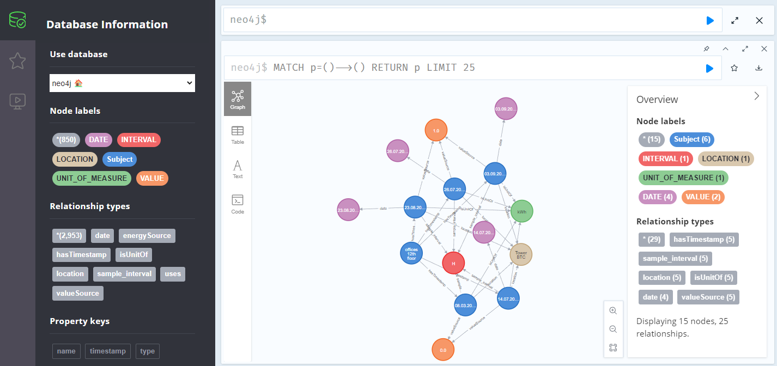

Slide 4
Level 6
Conceptual Interoperability
Composability
Level 5
Dynamic Interoperability
Modeling /
Abstraction
Level 4
Pragmatic Interoperability
Interoperability
Increasing Capability for Interoperation
Level 3
Semantic Interoperability
Simulation /
Implementation
Level 2
Syntactic Interoperability
Integratability
Level 1
Technical Interoperability
Level 0
No Interoperability
Network /
Connectivity
Notes:
The Levels of Conceptual Interoperability Model

Slide 5
Query
Transformation
System
Query
Result
Metadatabase Management System
Metadatabase
Data Transformation
Module
Mathematical
Model of Meaning
Database Selection
Subsystem
Metadatabase
Manipulation
Subsystem
Database Names,
Keywords,
Query
Integrated
Query Result
Query Transformation
Subsystem
Result
Integration
Subsystem
Metadata
Acquisition
Subsystem
Transformed
Local
Queries
Local
Query
Results
Meta Information
Wide-Area Computer Network
Multi-Databases
Query
Database Selection Subsystem
Mathematical Model of Meaning
Given Data Matrix A
Creation of Image Space
Image Space I
Function-1:
Selection of Semantic Subspace
Function-3:
Selection of
Data Item
In the Contest Free Case
Selected Semantic Subspace
Function-2:
Selection of Data Item
Selected Data Item with the Closest Meaning to the Keyword
Database Names, Keywords, Query
Notes:
Semantic interoperability process in structure of the metadatabase system.

Slide 6
Request and Response
Interaction Role
Message
Content
Ontology
Interaction
Ontology Repository
SC³
Client Application - A
Message
Processing
Trigger
Event
Service
Service 1
Service 2
Service
Activator
Context Aware Service
Bus
Service Broker
Third Party Service Provider
Request and Response
Interaction Role
Message
Content
Ontology
Interaction
Ontology Repository
Client Application - B
Message
Processing
Trigger
Event
Service
Service
Activator
Service Broker
Notes:
Service Level Semantic Interoperability (SLSI) Framework Architecture

Slide 7
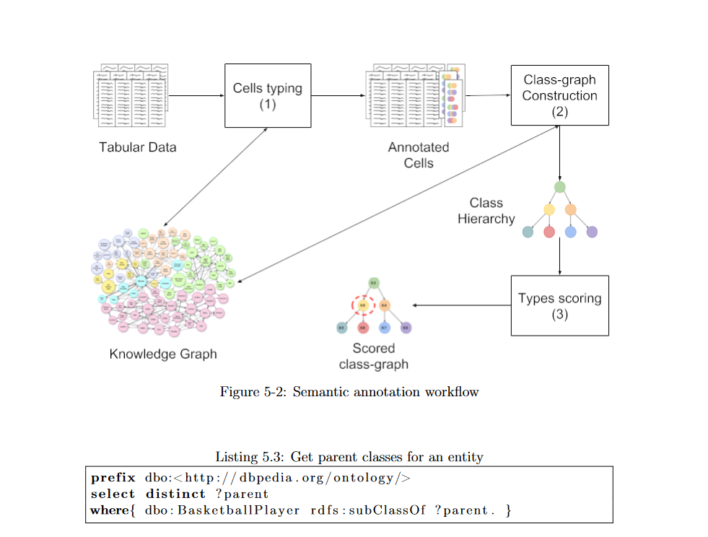

Slide 8
DATE | TIMESTAMP | LOCATION | ENERGY_SOURCE | MEASURE | UNIT | INTERVAL | VALUE
2021/1/1 | 2021/1/1 1:00 | Atlantis waterpark | electricity | billing meter | kWh | H | 60
2021/1/1 | 2021/1/1 1:00 | Atlantis waterpark | water supply (network) | billing meter (network) | m3 | H | 0
2021/1/1 | 2021/1/1 1:00 | Atlantis waterpark | water supply (well) | billing meter (well) | m3 | H | 0
2021/1/1 | 2021/1/1 1:00 | Logistic center | electricity | Logistics center main counter | kWh | H | 264
2021/1/1 | 2021/1/1 1:00 | Logistic center | district heating | Warehouse G | kWh | H | 100
2021/1/1 | 2021/1/1 1:00 | Logistic center | water supply | Warehouse G | m3 | H | 4
Ontology entity data comparison and optimal entity matching
Topic Annotation
“Event”
Column-Type Annotation
“Location”
Columns-Property Annotation
“hasValue”
Notes:
Semantic Data Annotation of a energy measure event

Slide 9
DATE | TIMESTAMP | LOCATION | ENERGY_SOURCE | MEASURE | UNIT_OF_MEASURE | INTERVAL | VALUE
2021/1/1 | 2021/1/1 1:00 | Atlantis waterpark | electricity | billing meter | kWh | H | 60
2021/1/1 | 2021/1/1 1:00 | Atlantis waterpark | district heating | billing meter (network) | kWh | H | 110
2021/1/1 | 2021/1/1 1:00 | Atlantis waterpark | waste heat | billing meter (waste heat) | kWh | H | 0
2021/1/1 | 2021/1/1 1:00 | Logistic center | water supply | Warehouse G | m3 | H | 4
billing meter
kWh
2021/1/1
hasUnit
H
Atlantis waterpark
hasUnit
hasUnit
billing meter (network)
m3
2021/1/1 1:00
Logistic center
Warehouse G
billing meter (waste heat)
hasUnit
January
Timestamp
Location
Meter
Kilowatt hour
Hour
is_a
is_a
is_a
is_a
is_a
is_a
'Date-Time description'
Channel
Device
Energy unit
is_a
is_a
is_a
is_a
Thing

Slide 10
January
Timestamp
Hour
Controller
Sensor
is_a
is_a
is_a
is_a
watt hour
Meter
Channel
is_a
is_a
'Date-Time description'
Energy unit
is_a
is_a
Kilowatt hour
is_a
Device
is_a
is_a
Location
is_a
Thing
is_a

Slide 11
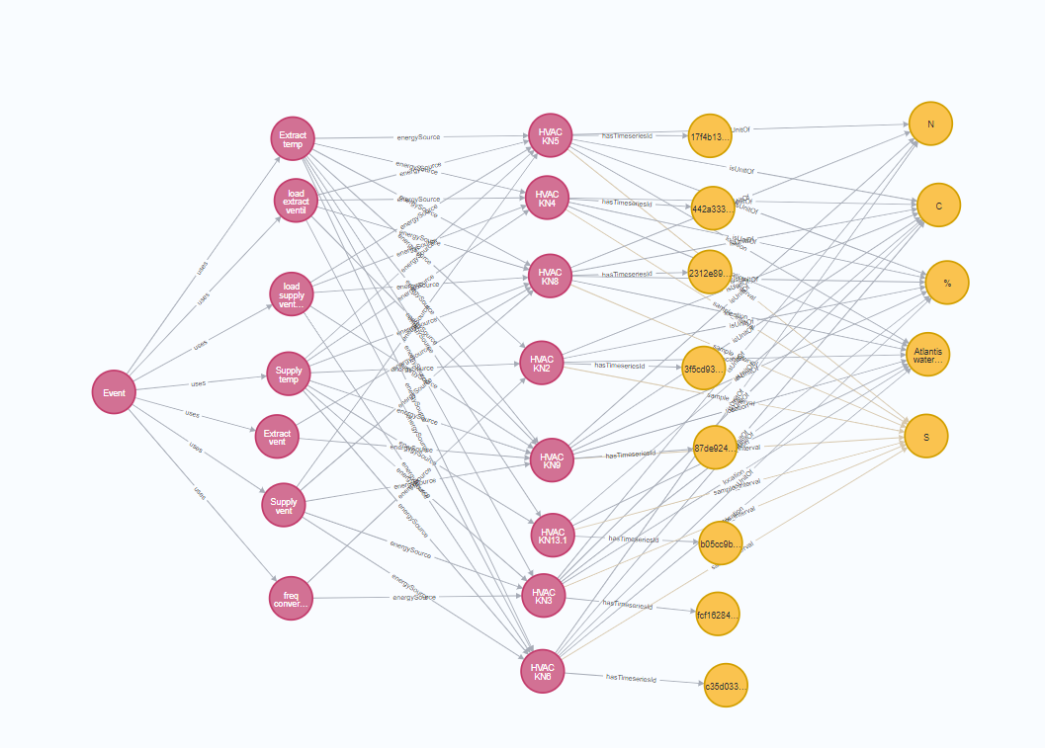

Slide 12
Neo4j
MySQL
Primary Key: 2ef7bde608ce5404e97d5f042f95f89f1c232871d7c50458b6703c1b929b1141
Time | Value
2021/1/1 1:00 | 110
2021/1/1 2:00 | 60
…… | ……
Primary Key: e82588cb7a26c92f656934b624b98b6e5d1a5d8b8a61a21d1933e51c6b2407
Time | Value
2021/2/1 1:00 | 0
2021/2/1 1:01 | 50.3
…… | ……
……
Primary Key: f9ad5e3f9e91ff5b7318e05b8d1390383f5c30a3af3f0d2f06d41ed19af9ed1e73
Time | Value
xxxx/xx/xx xx:xx | xxx
xxxx/xx/xx xx:xx | xxx
…… | ……
ID
Notes:
Relationship between the MySQL and the Neo4j.

Slide 13
Query: How much was the electricity consumption at Atlantis waterpark on January 15, 2021, at 1:00?
Singular Relational Database Method
Relational & NoSQL Database Method
Cypher Query
MATCH (n1:Subject {name: “Atlantis waterpark”})-[r1:hasTimeseriesId]->(CommonNode)
MATCH (n2:Subject {name: “electricity”})-[r2:hasTimeseriesId]->(CommonNode)
……
RETURN CommonNode.id AS TimeseriesId
SQL Query
SELECT VALUE FROM table_btc_tower_electricity WHERE LOCATION = ‘Atlantis waterpark’ AND TIMESTAMP = ‘2021-01-15 01:00:00’
AND ENERGY_SOURCE = 'electricity'
Relational Database
NoSQL Database
Relational Database
SQL Query
SELECT
VALUE
From
TimeseriesId
WHERE
TIMESTAMP=‘{2021-01-15 01:00:00}’
Response: The electricity consumption at Atlantis waterpark on January 15, 2021, at 1:00 was 2.6 kWh.
Legend:
Automatic Process
Manual Process
Notes:
An example of a comparison between the querying processes of singular relational database method and relational & NoSQL database method .

Slide 14
