Slide 1
Combinatorial Causal Bandits
Shi Feng, Institute for Interdisciplinary Information Sciences, Tsinghua University
Wei Chen, MSR Asia Theory Center, Microsoft Research
AAAI 2023

Slide 2
Contents
Background
Combinatorial Causal Bandits on BGLMs
Combinatorial Causal Bandits on BLMs
Simulations
Future Work

Slide 3
Combinatorial Causal Bandits (CCB)
Causal Inference
Combinatorial Causal Bandits
Multi-Armed Bandits / Online Learning
Combinatorial Optimization

Slide 4
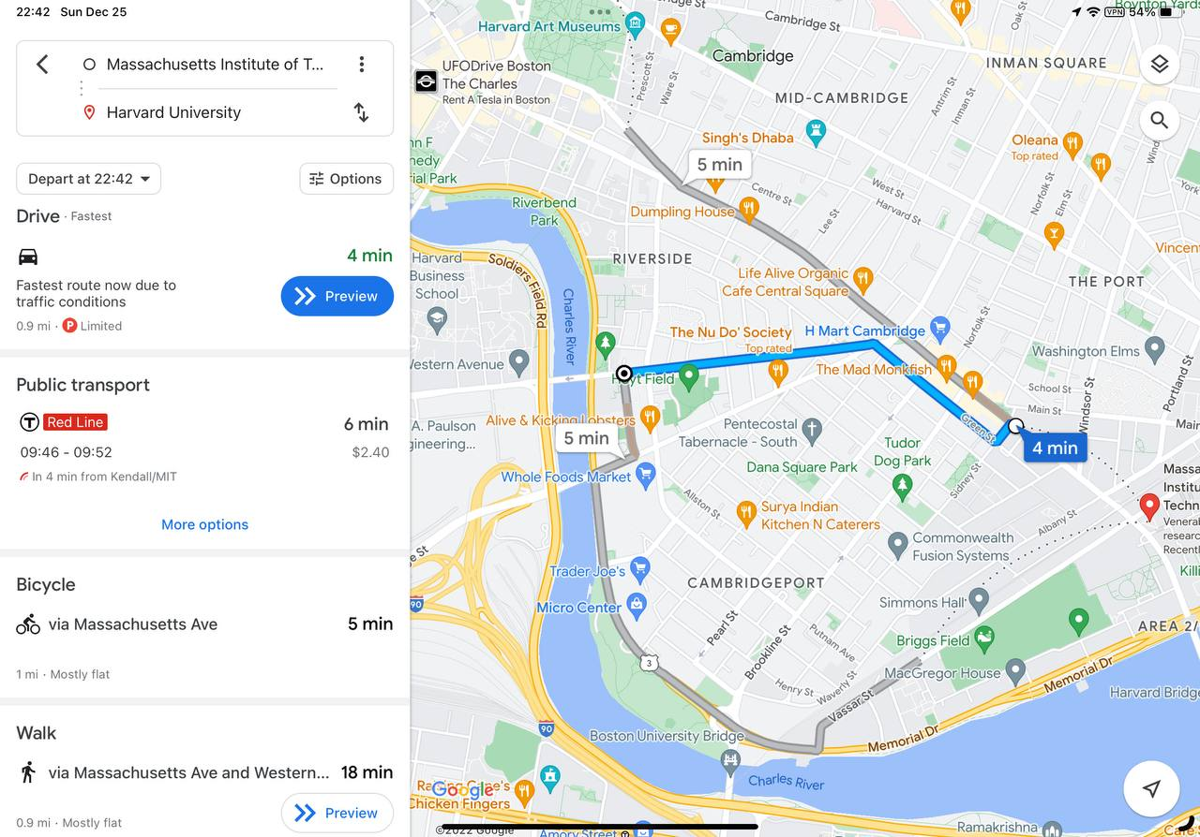
Combinatorial Optimization with Online Learning
Actions (or super arms) are combinatorial objects
E.g. route communication, a mixture of news recommendation
Action space is exponentially large, cannot fully explore
Feedback at the base arm level
E.g. get delay feedback on every road segment, click through feedback on every news piece
Online Learning / Multi-Armed Bandits
Combinatorial Optimization

Slide 5
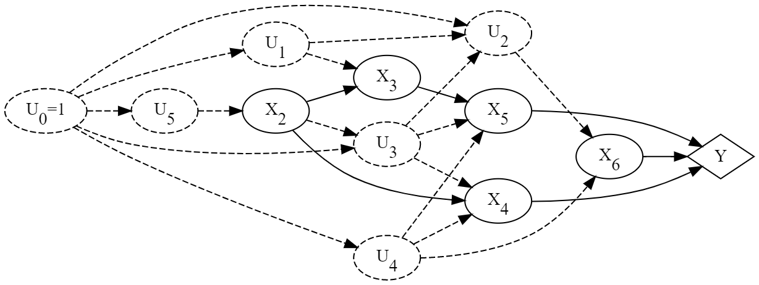
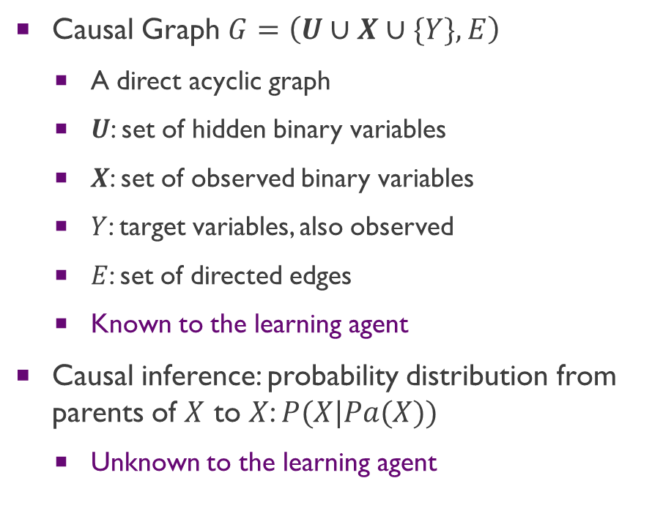
CCB Model: Causal Graph Model
Causal Graph $G=\left(U∪X∪\{Y\},E\right)$
A direct acyclic graph
$U$: set of hidden binary variables
$X$: set of observed binary variables
$Y$: target variables, also observed
$E$: set of directed edges
Known to the learning agent
Causal inference: probability distribution from parents of $X$ to $X$: $P(X|Pa(X))$
Unknown to the learning agent

Slide 6
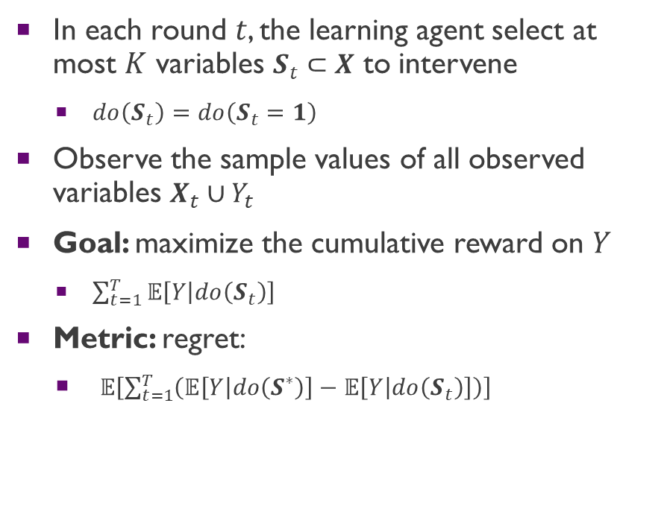
CCB Model: Learning Process and the Goal
In each round $t$, the learning agent select at most $K$ variables $S_{t}⊂X$ to intervene
$do\left(S_{t}\right)=do\left(S_{t}=1\right)$
Observe the sample values of all observed variables $X_{t}∪Y_{t}$
Goal: maximize the cumulative reward on $Y$
$\sum_{t=1}^{T}{𝔼\left[Y | do\left(S_{t}\right)\right]}$
Metric: regret:
$𝔼\left[\sum_{t=1}^{T}{\left(𝔼\left[Y | do\left(S^{∗}\right)\right]−𝔼\left[Y | do\left(S_{t}\right)\right]\right)}\right]$

Slide 7
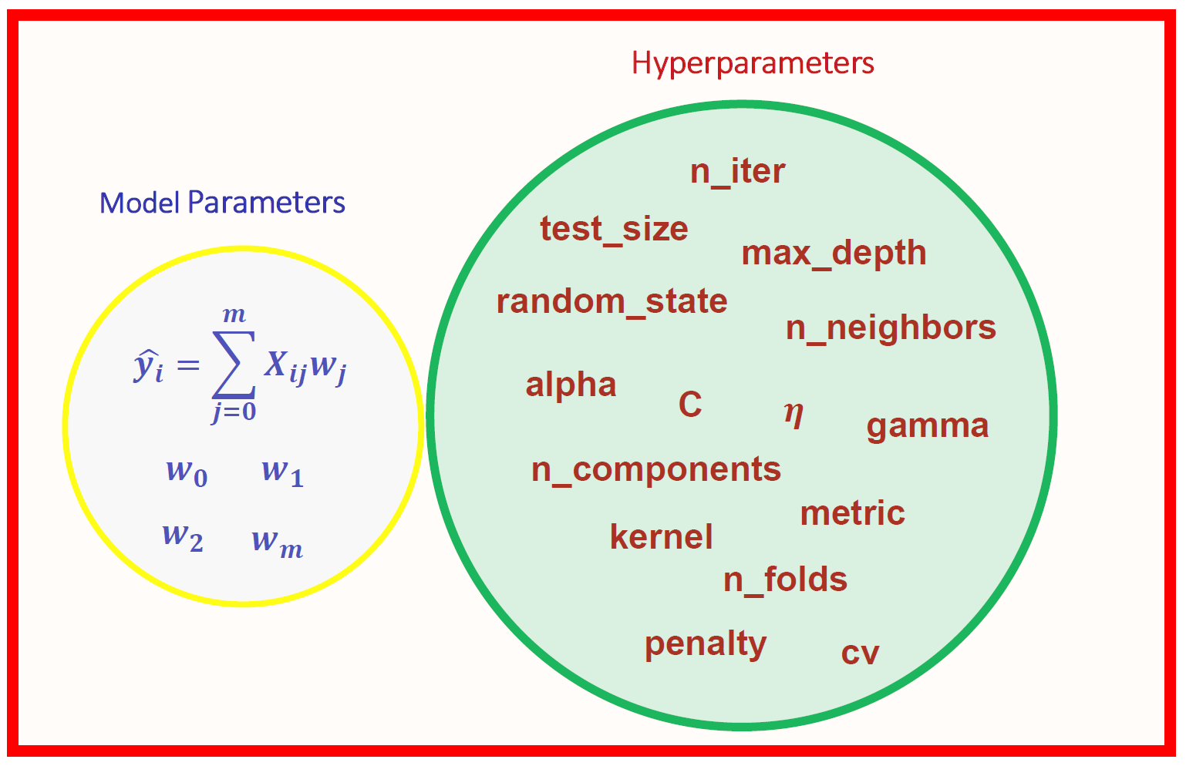

Application of CCB
Parameter Tuning
Drug Testing

Slide 8
Contents
Background
Combinatorial Causal Bandits on BGLMs
Combinatorial Causal Bandits on BLMs
Simulations
Future Work

Slide 9
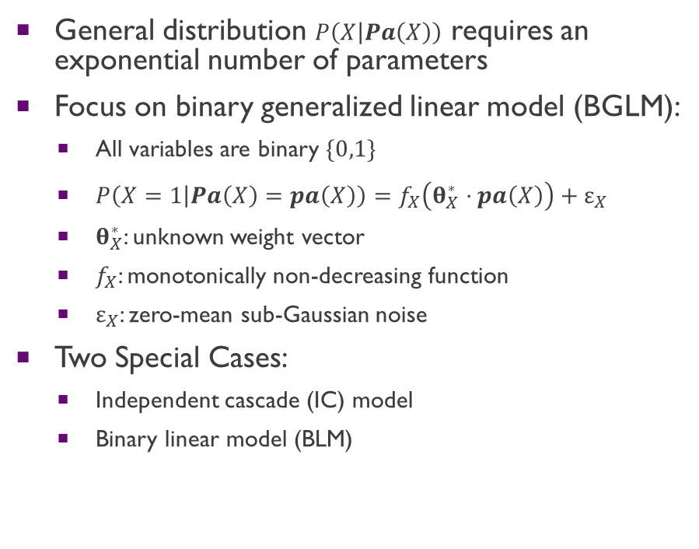
Binary Generalized Linear Model (BGLM)
General distribution $P\left(X | Pa\left(X\right)\right)$ requires an exponential number of parameters
Focus on binary generalized linear model (BGLM):
All variables are binary $\{0,1\}$
$P\left(X=1 | Pa\left(X\right)=pa\left(X\right)\right)=f_{X}\left(θ_{X}^{∗}⋅pa\left(X\right)\right)+ε_{X}$
$θ_{X}^{∗}$: unknown weight vector
$f_{X}$: monotonically non-decreasing function
$ε_{X}$: zero-mean sub-Gaussian noise
Two Special Cases:
Independent cascade (IC) model
Binary linear model (BLM)

Slide 10
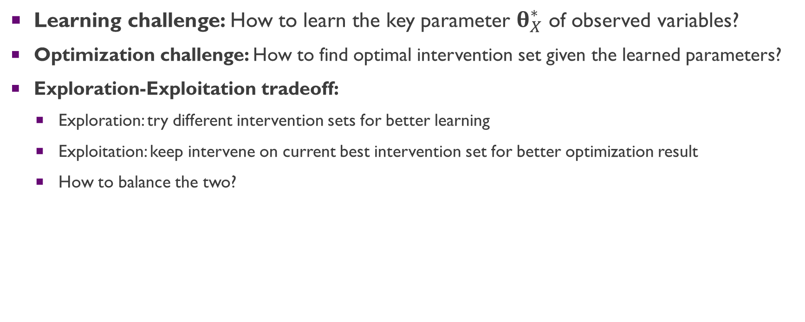
Challenges of BGLM CCB
Learning challenge: How to learn the key parameter $θ_{X}^{∗}$ of observed variables?
Optimization challenge: How to find optimal intervention set given the learned parameters?
Exploration-Exploitation tradeoff:
Exploration: try different intervention sets for better learning
Exploitation: keep intervene on current best intervention set for better optimization result
How to balance the two?

Slide 11
Our Approach
Learning: applying maximum likelihood estimation approach on BGLM
Optimization: computation may be inefficient, can use Lagrange multiplier method to optimize
Exploration-Exploitation tradeoff: Apply the principles of Optimism in the Face of Uncertainty (OFU)
Compute confidence region of the parameter estimate to cover the uncertainty
Optimize both the intervention set and the parameter setting in the confidence region

Slide 12
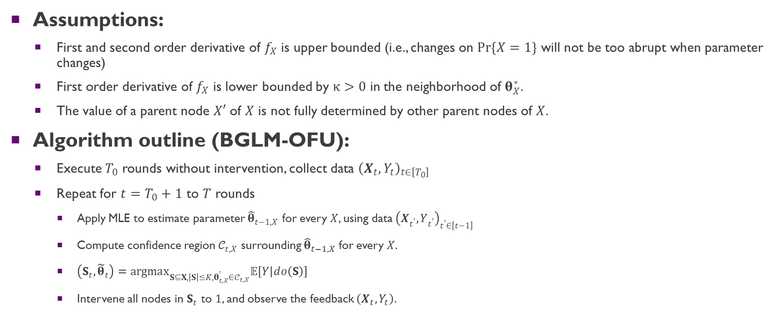
CCB for BGLM under Markovian Models
Assumptions:
First and second order derivative of $f_{X}$ is upper bounded (i.e., changes on $Pr\{X=1\}$ will not be too abrupt when parameter changes)
First order derivative of $f_{X}$ is lower bounded by $κ>0$ in the neighborhood of $θ_{X}^{∗}$.
The value of a parent node $X′$ of $X$ is not fully determined by other parent nodes of $X$.
Algorithm outline (BGLM-OFU):
Execute $T_{0}$ rounds without intervention, collect data ${\left(X_{t},Y_{t}\right)}_{t∈\left[T_{0}\right]}$
Repeat for $t=T_{0}+1$ to $T$ rounds
Apply MLE to estimate parameter ${\hat{θ}}_{t−1,X}$ for every $X$, using data ${\left(X_{t^{′}},Y_{t^{′}}\right)}_{t^{′}∈\left[t−1\right]}$
Compute confidence region $𝒞_{t,X}$ surrounding ${\hat{θ}}_{t−1,X}$ for every $X$.
$\left(S_{t},{\tilde{θ}}_{t}\right)=argmax_{S⊆X,\left|S\right|≤K,θ_{t,X}^{′}∈𝒞_{t,X}}𝔼\left[Y | do\left(S\right)\right]$
Intervene all nodes in $S_{t}$ to $1$, and observe the feedback $\left(X_{t},Y_{t}\right)$.

Slide 13
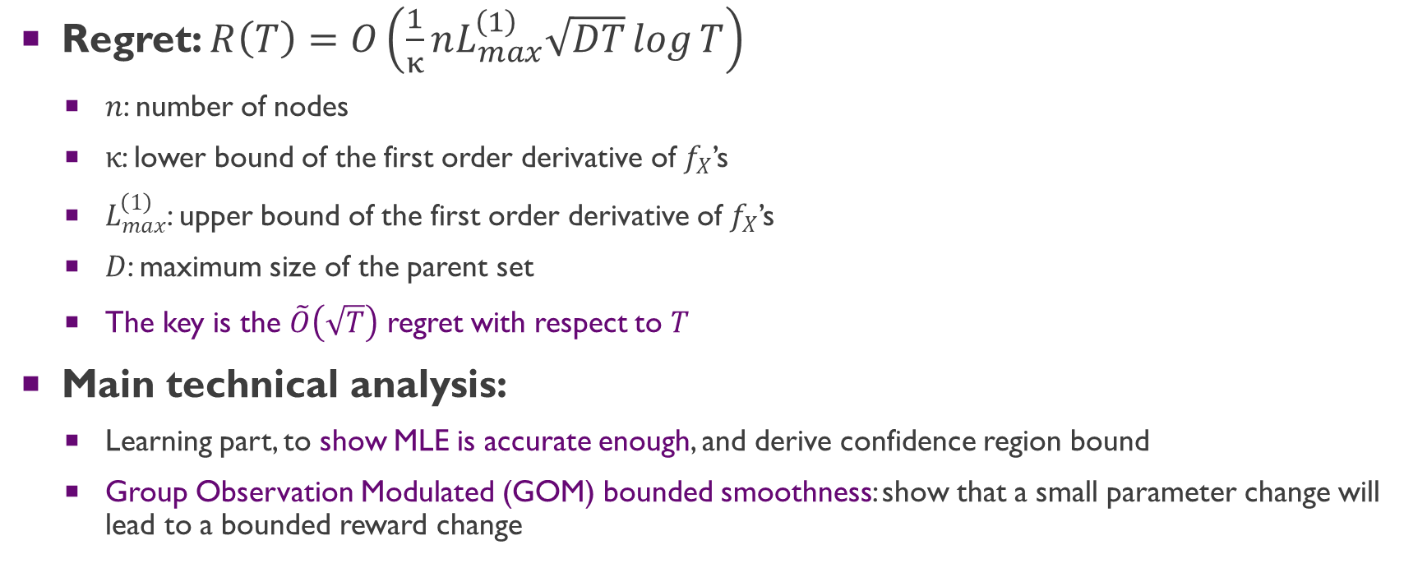
Regret of the Algorithm
Regret: $R\left(T\right)=O\left(\frac{1}{κ}nL_{max}^{\left(1\right)}\sqrt{DT}\log{T}\right)$
$n$: number of nodes
$κ$: lower bound of the first order derivative of $f_{X}$’s
$L_{max}^{\left(1\right)}$: upper bound of the first order derivative of $f_{X}$’s
$D$: maximum size of the parent set
The key is the $\tilde{O}\left(\sqrt{T}\right)$ regret with respect to $T$
Main technical analysis:
Learning part, to show MLE is accurate enough, and derive confidence region bound
Group Observation Modulated (GOM) bounded smoothness: show that a small parameter change will lead to a bounded reward change

Slide 14
Contents
Background
Combinatorial Causal Bandits on BGLMs
Combinatorial Causal Bandits on BLMs
Simulations
Future Work

Slide 15
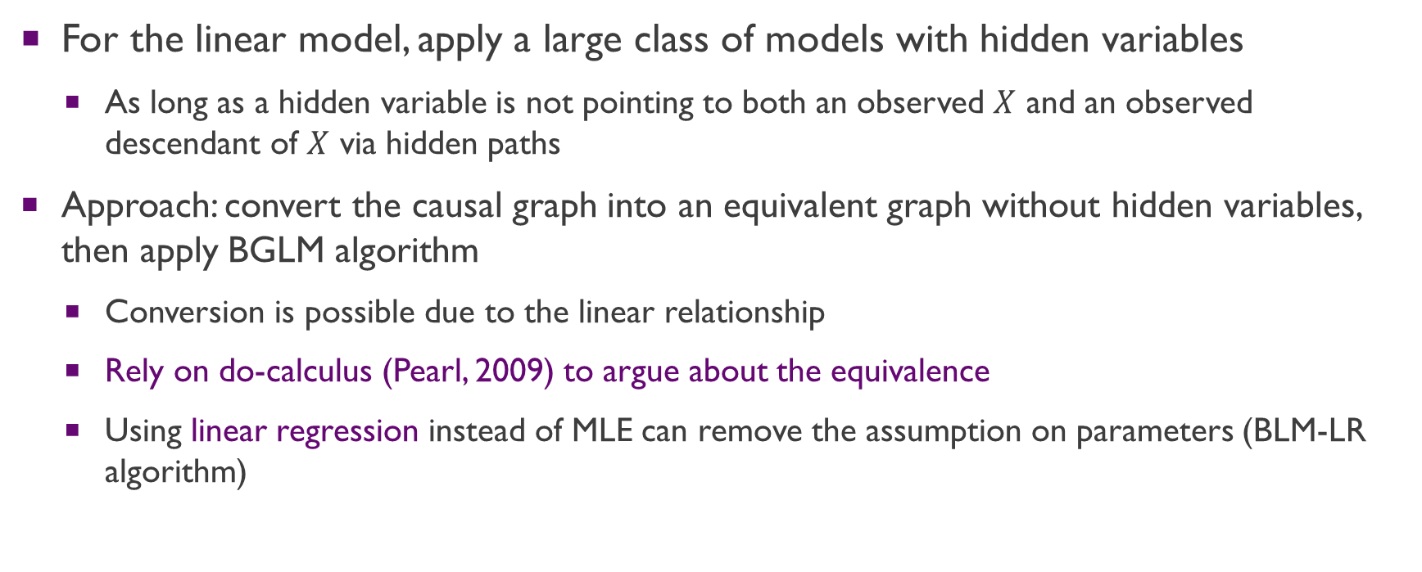
CCB under Binary Linear Model (BLM) with Hidden Variables
For the linear model, apply a large class of models with hidden variables
As long as a hidden variable is not pointing to both an observed $X$ and an observed descendant of $X$ via hidden paths
Approach: convert the causal graph into an equivalent graph without hidden variables, then apply BGLM algorithm
Conversion is possible due to the linear relationship
Rely on do-calculus (Pearl, 2009) to argue about the equivalence
Using linear regression instead of MLE can remove the assumption on parameters (BLM-LR algorithm)

Slide 16
Contents
Background
Combinatorial Causal Bandits on BGLMs
Combinatorial Causal Bandits on BLMs
Simulations
Future Work

Slide 17
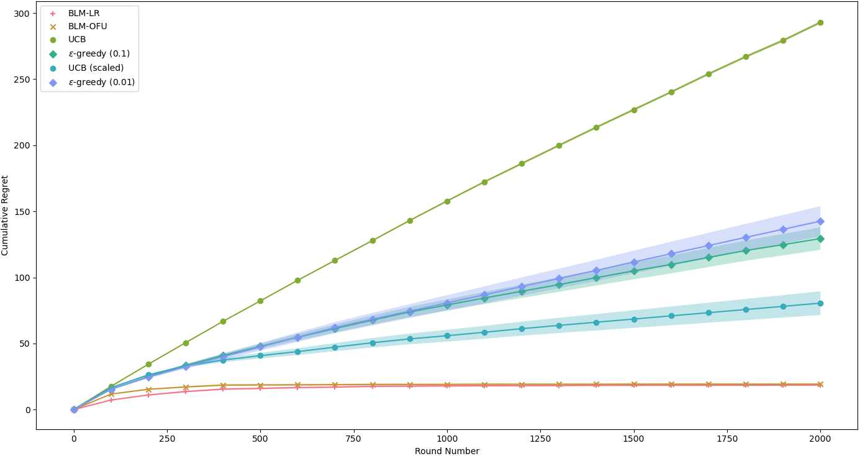
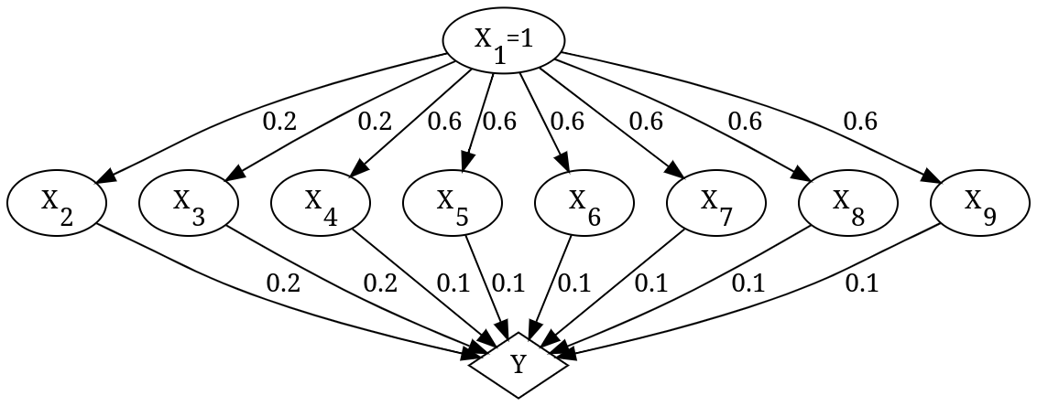
Simulations on a Parallel BLM
Comparison of average regrets when BLM-LR, BGLM-OFU, UCB and $ϵ$-greedy are applied on a parallel BLM

Slide 18
Contents
Background
Combinatorial Causal Bandits on BGLMs
Combinatorial Causal Bandits on BLMs
Simulations
Future Work

Slide 19
Future Work
For the BGLM model
How to remove assumptions
How to deal with hidden variables
How to make the computation more efficient
For the linear model
How to remove the assumption on the graph structure with hidden variables
More generally, how to apply CCB to other classes of models
How to do causal bandits when the causal graph is not fully known?

Slide 20
Thank you for watching!
AAAI 2023 Presentation by Shi Feng

