Slide 1
Multi-Agent Owner-Assisted Scoring Mechanisms
Shi Feng¹ (co-advised by Prof. Yuhao Wang¹ and Prof. Weijie Su²)
2022.12.18

Slide 2
Contents
Backgrounds
A Mechanism for Two Agents
An Extension to Multiple Agents
Simulations

Slide 3
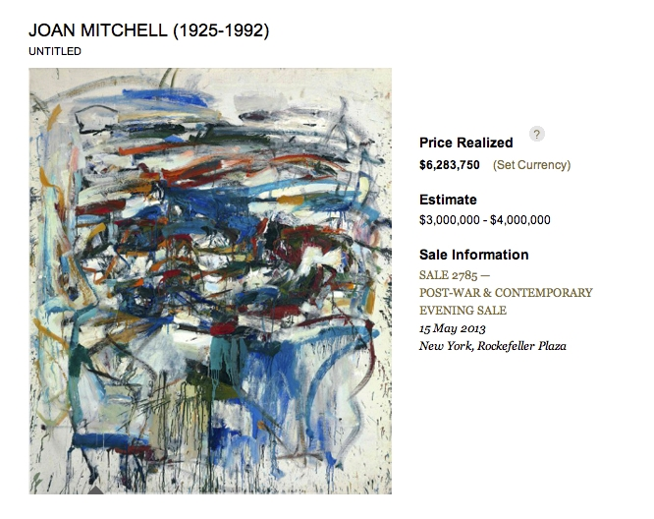
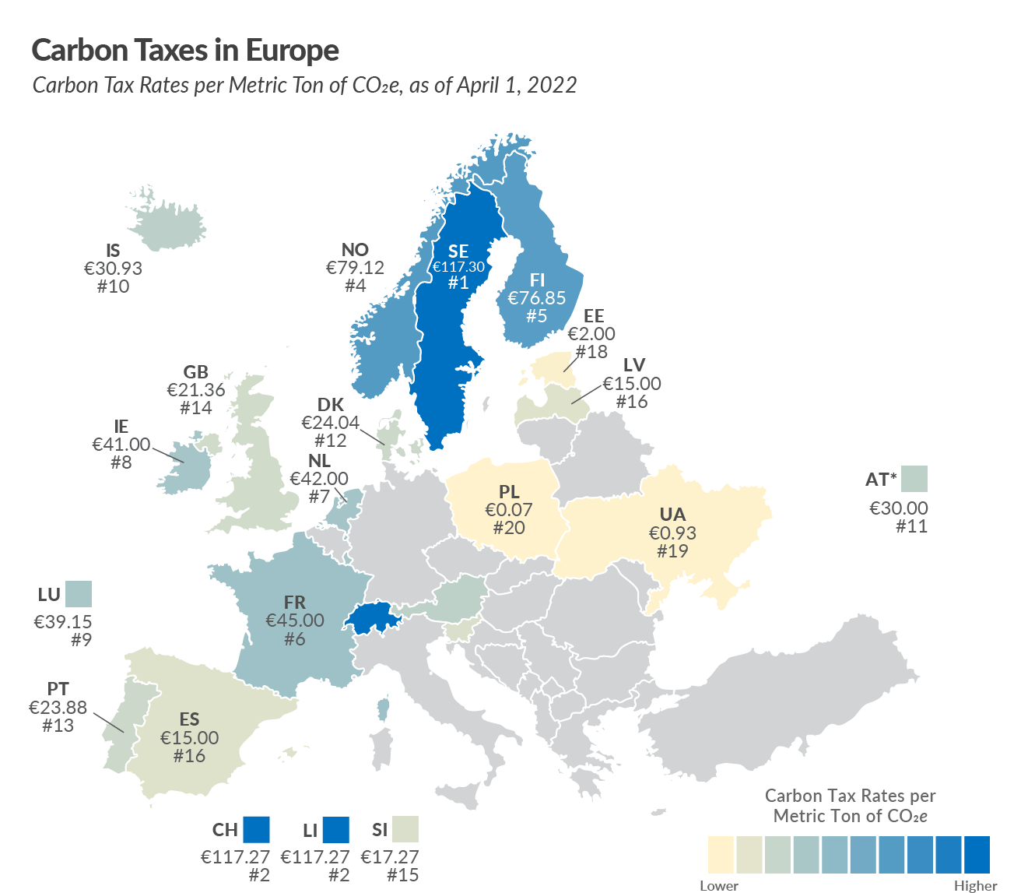
Why we need owner-assisted scoring?
Taxing requires information from multiple owners.
Single-agent (artist/collector) scoring. ¹
Soliciting information from owners to improve value evaluation!

Slide 4
Contents
Background
A Mechanism for Two Agents
An Extension to Multiple Agents
Simulations

Slide 5





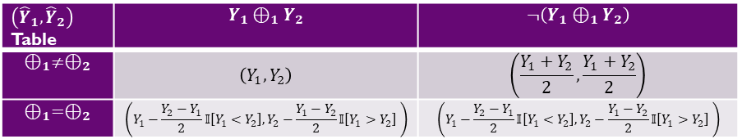

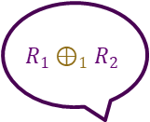
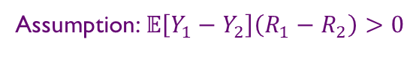


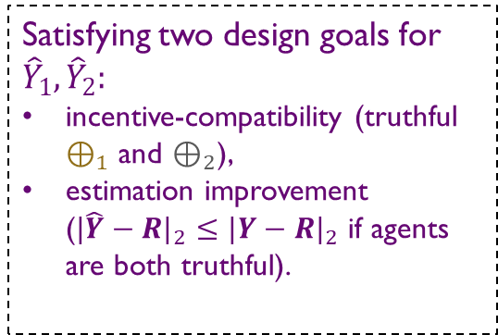



Mechanism $ℳ_{2}$ for Two Agents
Please compare your items!
Our Mechanism Design
$\left({\hat{Y}}_{1},{\hat{Y}}_{2}\right)$ Table | $$Y_{1}⊕_{1}Y_{2}$$ | $$¬\left(Y_{1}⊕_{1}Y_{2}\right)$$
$$⊕_{1}≠⊕_{2}$$ | $$\left(Y_{1},Y_{2}\right)$$ | $$\left(\frac{Y_{1}+Y_{2}}{2},\frac{Y_{1}+Y_{2}}{2}\right)$$
$$⊕_{1}=⊕_{2}$$ | $$\left(Y_{1}−\frac{Y_{2}−Y_{1}}{2}𝕀\left[Y_{1}<Y_{2}\right],Y_{2}−\frac{Y_{1}−Y_{2}}{2}𝕀\left[Y_{1}>Y_{2}\right] \right)$$ | $$\left(Y_{1}−\frac{Y_{2}−Y_{1}}{2}𝕀\left[Y_{1}<Y_{2}\right],Y_{2}−\frac{Y_{1}−Y_{2}}{2}𝕀\left[Y_{1}>Y_{2}\right] \right)$$
Return Value ${\hat{Y}}_{1}$
Return Value ${\hat{Y}}_{2}$
$$R_{2}⊕_{2}R_{1}$$
Satisfying two design goals for ${\hat{Y}}_{1},{\hat{Y}}_{2}:$
incentive-compatibility (truthful $⊕_{1}$ and $⊕_{2}$),
estimation improvement ($\left.|\hat{Y}−R\right.|_{2}≤\left.|Y−R\right.|_{2}$ if agents are both truthful).
$$R_{1}⊕_{1}R_{2}$$
Observe Noisy/Biased Estimation $Y_{2}$
Observe Noisy/Biased Estimation $Y_{1}$
$$R_{1}$$
$$R_{2}$$
Assumption: $𝔼\left[Y_{1}−Y_{2}\right]\left(R_{1}−R_{2}\right)>0$
Jerry
Tom

Slide 6
Contents
Background
A Mechanism for Two Agents
An Extension to Multiple Agents
Simulations

Slide 7
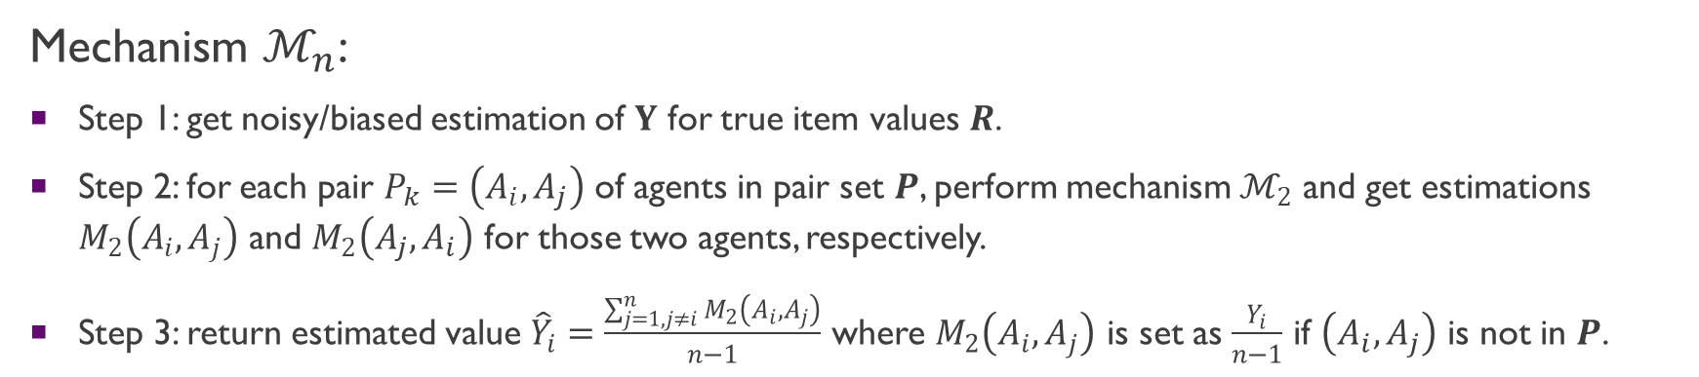

Mechanism $ℳ_{n}$ for Multiple ($n$) Agents
Mechanism $ℳ_{n}$:
Step 1: get noisy/biased estimation of $Y$ for true item values $R$.
Step 2: for each pair $P_{k}=\left(A_{i},A_{j}\right)$ of agents in pair set $P$, perform mechanism $ℳ_{2}$ and get estimations $M_{2}\left(A_{i},A_{j}\right)$ and $M_{2}\left(A_{j},A_{i}\right)$ for those two agents, respectively.
Step 3: return estimated value ${\hat{Y}}_{i}=\frac{\sum_{j=1,j≠i}^{n}{M_{2}\left(A_{i},A_{j}\right)}}{n−1}$ where $M_{2}\left(A_{i},A_{j}\right)$ is set as $\frac{Y_{i}}{n−1}$ if $\left(A_{i},A_{j}\right)$ is not in $P$.
${5\hat{Y}}_{1}$= $M_{2}\left(A_{1},A_{2}\right) + M_{2}\left(A_{1},A_{3}\right)$ + $M_{2}\left(A_{1},A_{4}\right)$ + $M_{2}\left(A_{1},A_{5}\right)$ + $M_{2}\left(A_{1},A_{6}\right)$
According to linearity of expectation, one could verify that $ℳ_{n}$ still satisfies incentive-compatible and estimation improvement.

Slide 8

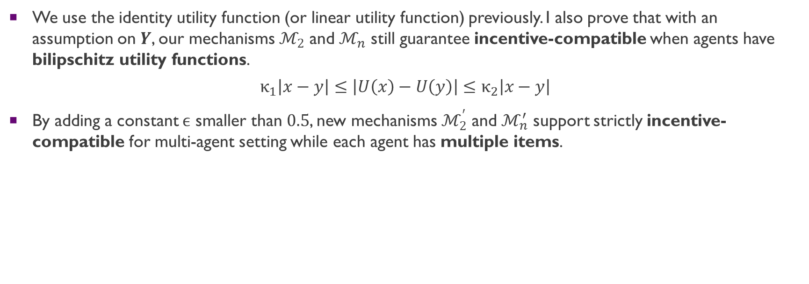
Several Extensions
We use the identity utility function (or linear utility function) previously. I also prove that with an assumption on $Y$, our mechanisms $ℳ_{2}$ and $ℳ_{n}$ still guarantee incentive-compatible when agents have bilipschitz utility functions.
$$κ_{1}\left|x−y\right|≤\left|U\left(x\right)−U\left(y\right)\right|≤κ_{2}\left|x−y\right|$$
By adding a constant $ϵ$ smaller than $0.5$, new mechanisms $ℳ_{2}^{′}$ and $ℳ_{n}^{′}$ support strictly incentive-compatible for multi-agent setting while each agent has multiple items.
$\hat{Y}$ Design for $ℳ_{2}^{′}$ and $ℳ_{n}^{′}$
$\left({\hat{Y}}_{1},{\hat{Y}}_{2}\right)$ Table | $$Y_{1}⊕_{1}Y_{2}$$ | $$¬\left(Y_{1}⊕_{1}Y_{2}\right)$$
$$⊕_{1}≠⊕_{2}$$ | $$\left(Y_{1},Y_{2}\right)$$ | $$\left(\frac{Y_{1}+Y_{2}}{2}+ϵ\frac{Y_{1}−Y_{2}}{2}𝕀\left[⊕_{1}= >\right]+ϵ\frac{Y_{2}−Y_{1}}{2}𝕀\left[⊕_{1}= <\right],\frac{Y_{1}+Y_{2}}{2}+ϵ\frac{Y_{2}−Y_{1}}{2}𝕀\left[⊕_{2}= >\right]+ϵ\frac{Y_{1}−Y_{2}}{2}𝕀\left[⊕_{2}= <\right]\right)$$
$$⊕_{1}=⊕_{2}$$ | $$\left(Y_{1}−\left(1+ϵ\right)\frac{Y_{2}−Y_{1}}{2}𝕀\left[Y_{1}<Y_{2}\right],Y_{2}−\left(1+ϵ\right)\frac{Y_{1}−Y_{2}}{2}𝕀\left[Y_{1}>Y_{2}\right]\right)$$ | $$\left(Y_{1}−\left(1+ϵ\right)\frac{Y_{2}−Y_{1}}{2}𝕀\left[Y_{1}<Y_{2}\right],Y_{2}−\left(1+ϵ\right)\frac{Y_{1}−Y_{2}}{2}𝕀\left[Y_{1}>Y_{2}\right]\right)$$

Slide 9
Contents
Background
A Mechanism for Two Agents
An Extension to Multiple Agents
Simulations

Slide 10
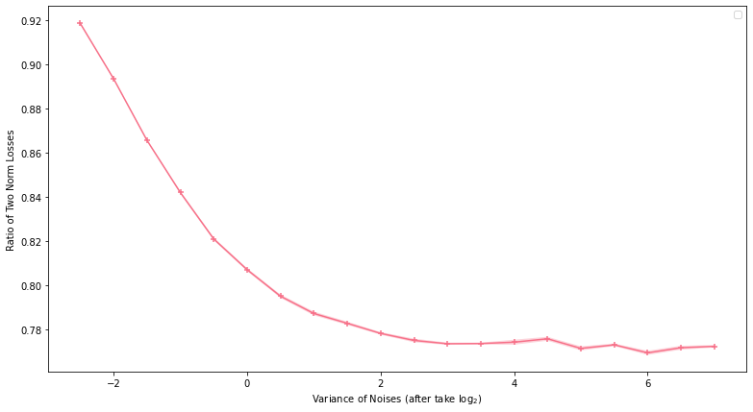

Simulations
$$\frac{\left.|\hat{Y}−R\right.|_{2}}{\left.|Y−R\right.|_{2}}$$
We run $ℳ_{n}$ for all pairs of agents on random item values $R$ and standard distribution noises $ε$ such that $Y=R+ε$. $\hat{Y}$ generated by $ℳ_{n}$ achieves 8%-20% improvement over $Y$.

Slide 11
Q&A
Thank you for your attention!

