Slide 1
Peer Prediction for Learning Agents
Shi Feng, Institute for Interdisciplinary Information Sciences, Tsinghua University
Fang-Yi Yu, Department of Computer Science, George Mason University
Yiling Chen, John A. Paulson School of Engineering and Applied Sciences, Harvard University
NeurIPS 2022

Slide 2
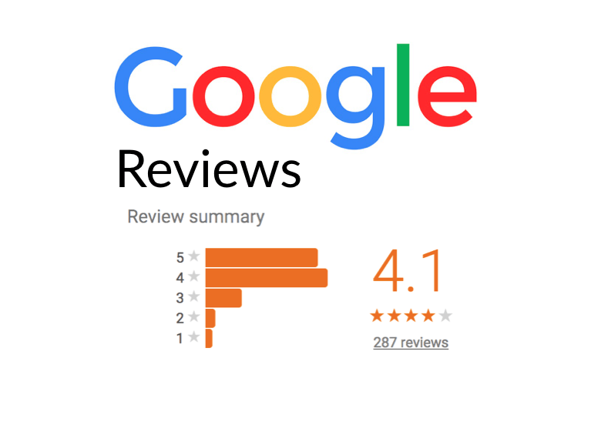
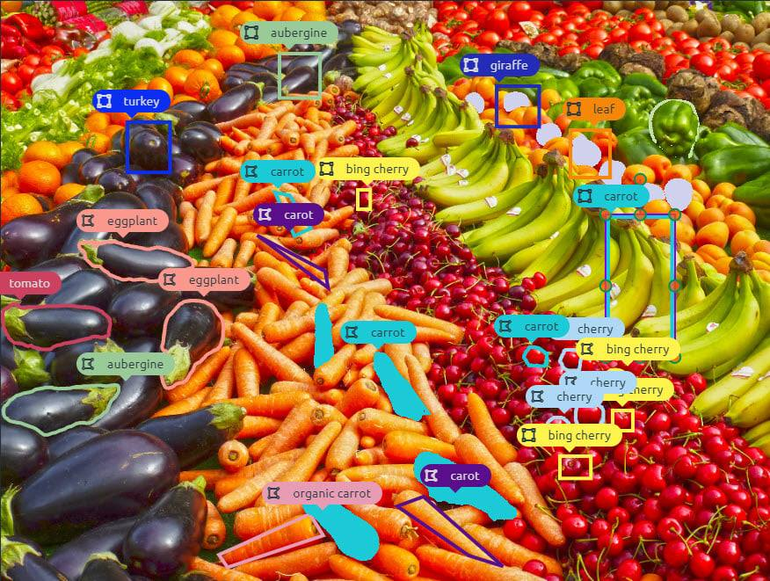
Why we need peer prediction?
Soliciting high-quality information from human agents!

Slide 3










Correlated Agreement (CA) Mechanism¹
1. First terms of the CA mechanism encourage consensus.
2. Second terms discourage report always report 0 or always report 1.
CA mechanism guarantees strong truthfulness when agents are Bayesian!
Pay $𝕀\left[{\hat{x}}_{t}={\hat{y}}_{t}\right]−𝕀\left[{\hat{x}}_{t}={\hat{y}}_{t−1}\right]$ for $t=1, 2, 3, ⋯$
Pay $𝕀\left[{\hat{y}}_{t}={\hat{x}}_{t}\right]−𝕀\left[{\hat{y}}_{t}={\hat{x}}_{t−1}\right]$ for $t=1, 2, 3, ⋯$
Principal
Reports: ${\hat{x}}_{1},{\hat{x}}_{2},{\hat{x}}_{3}, ⋯$
Reports: ${\hat{y}}_{1},{\hat{y}}_{2},{\hat{y}}_{3}, ⋯$
Alice
Bob
Private Binary Signals: $x_{1},x_{2},x_{3},⋯$
Private Binary Signals: $y_{1},y_{2},y_{3},⋯$
Positive Correlated Distribution: $𝒫_{X,Y}$

Slide 4
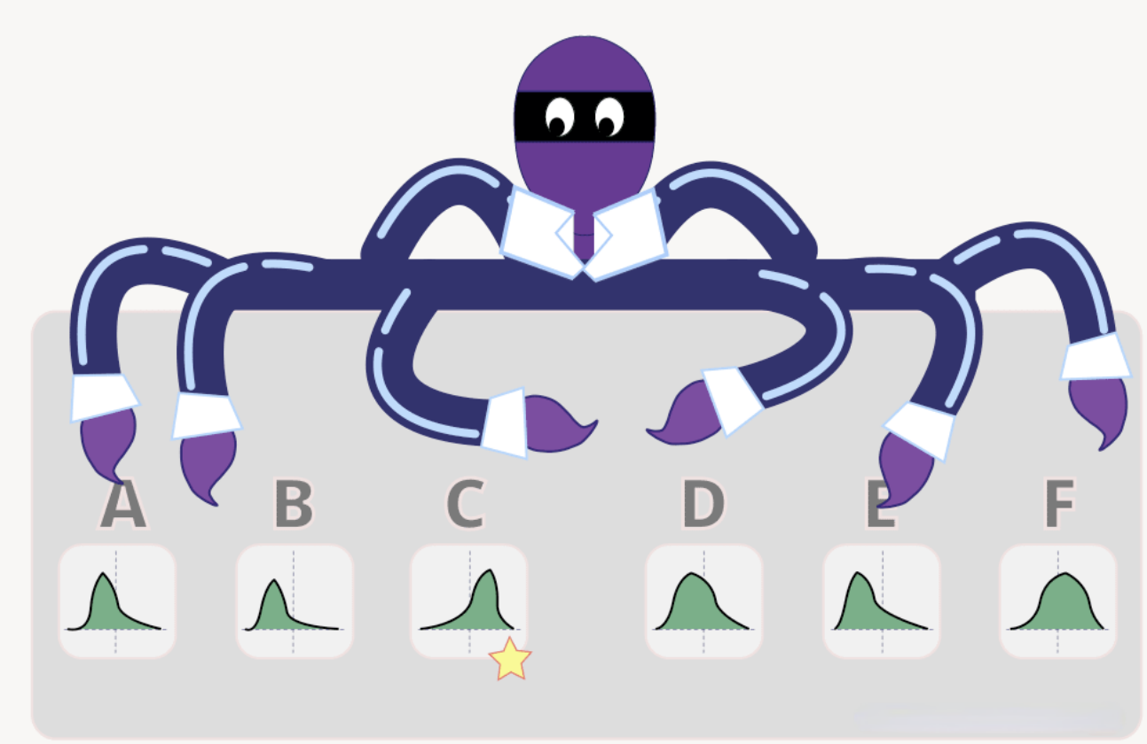
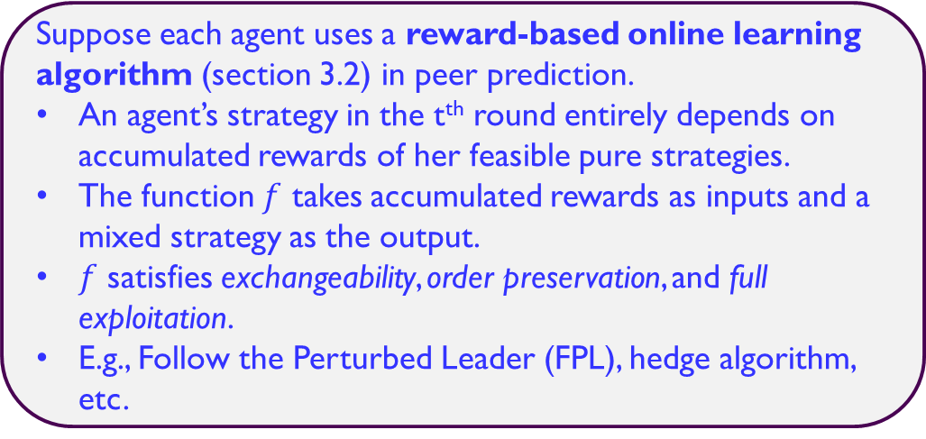
Learning Agents!
In previous theoretical analysis, each agent is critically required to use a consistent mixed strategy over all rounds (Bayesian Agents).
However, agents are learning in practice!
Will agents converge to truthful strategy?
No-”best-in-hindsight regret” assumption on agents is not enough (theorem 3.1).
Truthful convergence requires agents to be no-”best-in-hindsight regret” under a strongly truthful mechanism (theorem 3.2).
Suppose each agent uses a reward-based online learning algorithm (section 3.2) in peer prediction.
An agent’s strategy in the t^{th} round entirely depends on accumulated rewards of her feasible pure strategies.
The function $f$ takes accumulated rewards as inputs and a mixed strategy as the output.
$f$ satisfies exchangeability, order preservation, and full exploitation.
E.g., Follow the Perturbed Leader (FPL), hedge algorithm, etc.

Slide 5
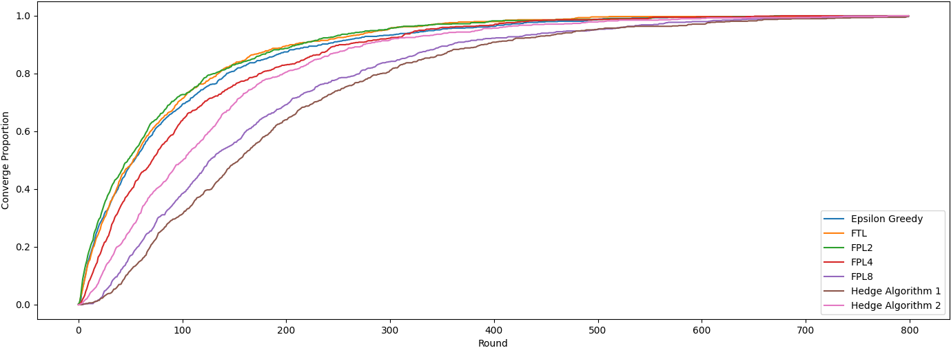
Main Theorem (theorem 4.1)
In a sequential peer prediction game with binary signals, when the CA mechanism is adopted, two agents using reward-based online learning algorithms always converge to truthful reporting (truth-telling or flip).

Slide 6
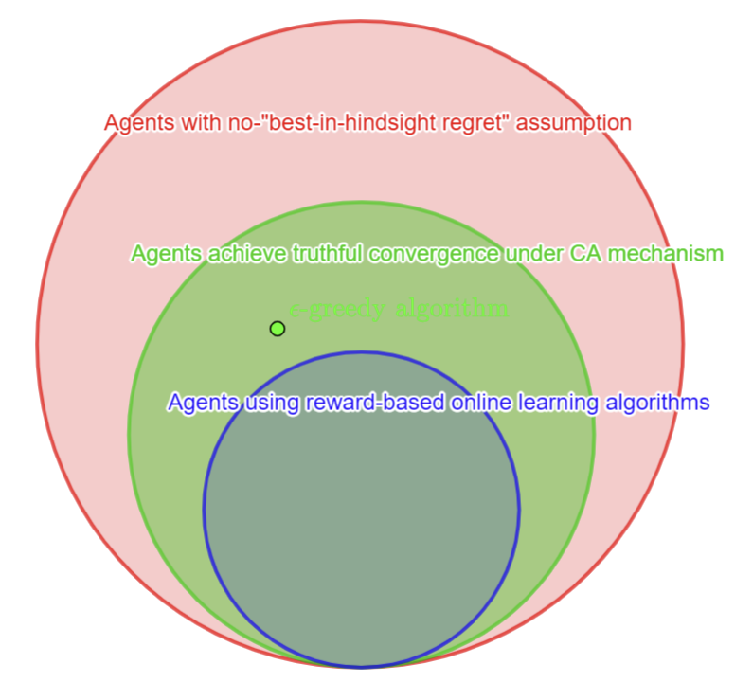
Main Theorem (theorem 4.1)
No-”best-in-hindsight regret” assumption on agents is not enough (theorem 3.1).
Truthful convergence requires agents to be no-”best-in-hindsight regret” under a strongly truthful mechanism (theorem 3.2).
In a sequential peer prediction game with binary signals, when the CA mechanism is adopted, two agents using reward-based online learning algorithms always converge to truthful reporting (truth-telling or flip).

Slide 7
Thank you!
NeurIPS 2022 Slides Live Paper Video

