Slide 1
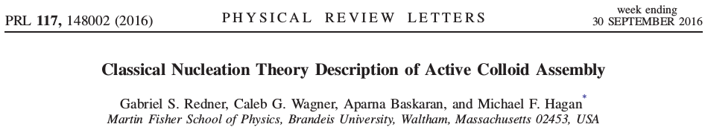
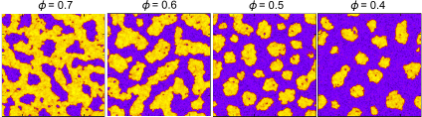
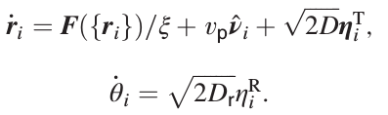

Slide 2
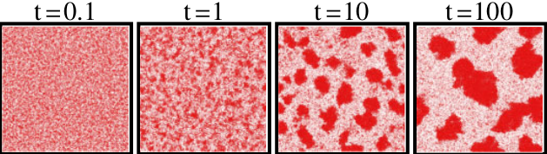
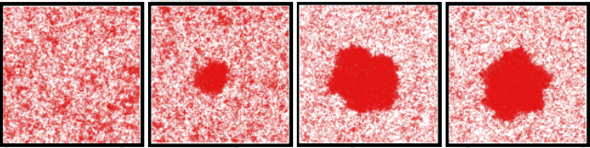
Phase separation of active particles
Separation can happen without attraction force
takes time
“effective attraction”
Time scales in the system:
1. diffusion time ~ σ²/D
2. rotational diffusion time ~ 1/D_{r}
3. active ballistic motion ~ σ/v_{p}
Separation happens if active ballistic motion time >> rotational diffusion time,i.e.
1/D_{r/} >> σ/v_{p}
Separation can be:
nucleation
spinodal decomposition
has a theory: Phys. Rev. Lett. 111 145702 (2013)

Slide 3
Can CNT apply?
analog to liquid/vapor phase separation of passive particles
chemical potential can be well mapped
Phys. Rev. Lett. 111 145702 (2013)
non-equilibrium
different mechanism
no well-defined pressure
no well-defined interfacial energy
  negative mechanical interfacial energy
  Phys. Rev. Lett. 115 098301 (2015)

Slide 4
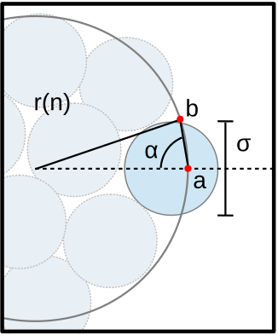
Yes, CNT applies
Key reasons
single reaction coordinate: nucleus size n
curvature-dependent evaporation rate
j_{out} ~ a - b/r
gives rise to an positive effective surface tension

Slide 5
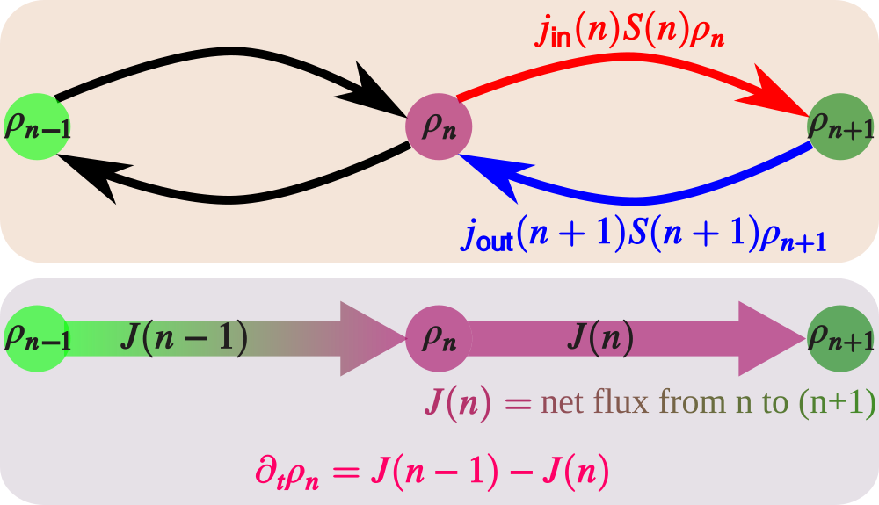
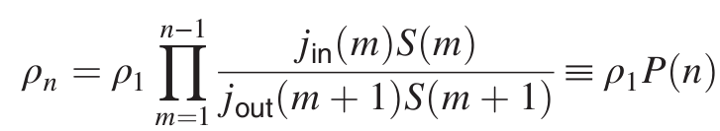
CNT master equation
At “equilibrium”, J = 0, we have

Slide 6



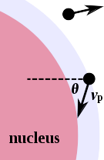
Absorption and evaporation rate
Mechanism:
v_{p} transports particles to the surface
Assumptions:
Large nucleus, i.e. flat surface
Pe >> 1, i.e. v_{p} dominates
Mechanism:
direction of v_{p} diffuses and kicks particles out
Assumptions:
Large nucleus, i.e. relatively flat surface
Pe >> 1, i.e. v_{p} dominates

Slide 7

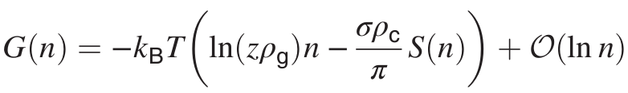

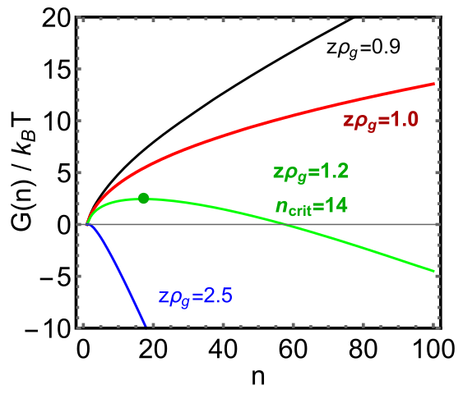

Steady-state cluster size distribution
bulk
surface
Separation happens if active ballistic motion time >> rotational diffusion time,i.e.
1/D_{r/} >> σ/v_{p}

Slide 8
 | CNT for passive system | CNT for active system
chemical potential | density | density, v_{p}, D_{r}
surface tension | excess free energy to create surface | curvature-dependent flux ~ a – b/r
barrier mechanism | competition of bulk and surface terms | competition of absorption and evaporation (time scale separation)
has free-energy? | yes | no, but effectively yes
can predict spinodal line? | no | yes, but wrong
works for any dimension? | yes | principally yes

Slide 9
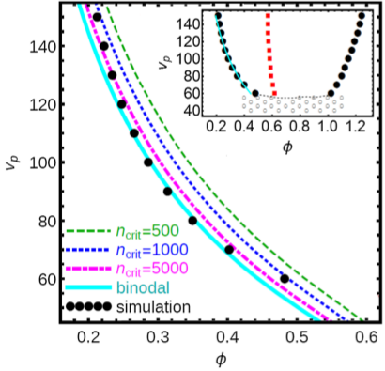
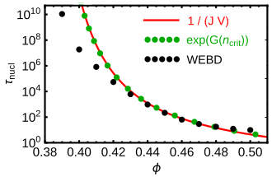
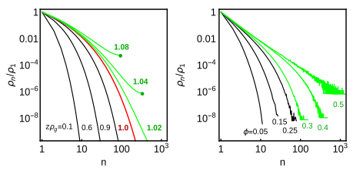
Prediction and verification
theory
simulation
theory
simulation

Slide 10
Outlook
CNT for nucleation under shear
Surface premelting of crystal with purely repulsive active particles
  crystal has been observed

