Slide 1
PSRS: Personalized Smartphone Recommendation System
Han Liang, Uiuc

Slide 2
1. Introduction of PSRS
Personalized Smartphone Recommendation System
Programming Language: Python
The goal of this project is to build a personalized smartphone recommendation system (PSRS) based on customers' shopping behavior for smartphones.
Code repository: https://github.com/fengxiaoshui/psrs

Slide 3
2. Tutorial
The data set of shopping behavior is stored in the file: shopping.csv
The main file: psrs.py
Please run following command to start the program:
python psrs.py

Slide 4
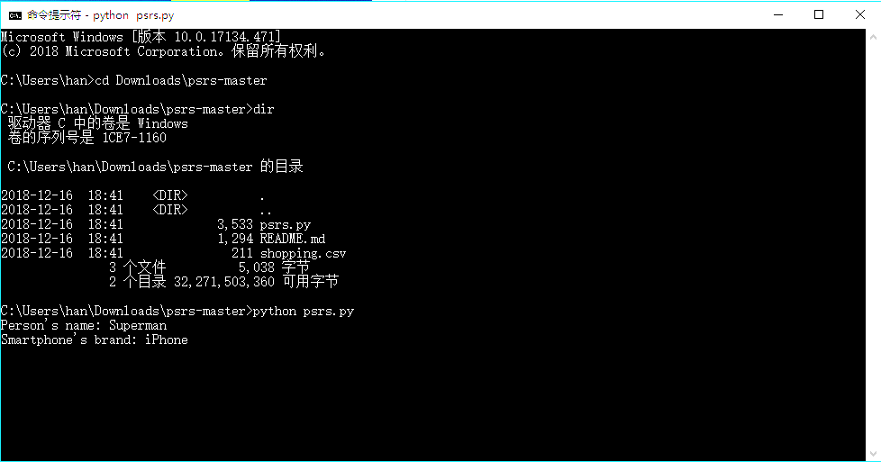
3. Example
Step 1: Type in
python psrs.py
Step 2: Type in a person’s name
For example: Superman
Step 3: Type in a smartphone brand
For example: iPhone

Slide 5
3. Example
Step 4: PSRS returns 4 lists
1) A customer similarity list:
Customers on this list are ranked by the similarity of shopping behavior between them and Superman.
In this example, the most similar customer is Bumblebee. The similarity value between Superman and Bumblebee is 0.4

Slide 6
3. Example
Step 4: PSRS returns 4 lists
2) A smartphone similarity list:
Smartphones on this list are ranked by the similarity of buyers between them and iPhone.
In this example, the most similar smartphone is Samsung. The similarity value between iPhone and Samsung is 0.326631.

Slide 7
3. Example
Step 4: PSRS returns 4 lists
3) A smartphone recommendation list:
Each smartphone brand has a recommendation value. The higher value means the higher probability that the customer may like the corresponding smartphone.
In this example, Superman is most likely to buy Xiaomi. It has the highest recommendation value of 4.059123.

Slide 8
3. Example
Step 4: PSRS returns 4 lists
4) A customer recommendation list:
Each customer has a recommendation value. The higher value means the higher probability that the smartphone may be liked by the corresponding customer.
In this example, iPhone is most likely to be bought by Megatron. It has the highest recommendation value of 3.829209.

Slide 9
Thanks!
Han Liang
UIUC

