Slide 1
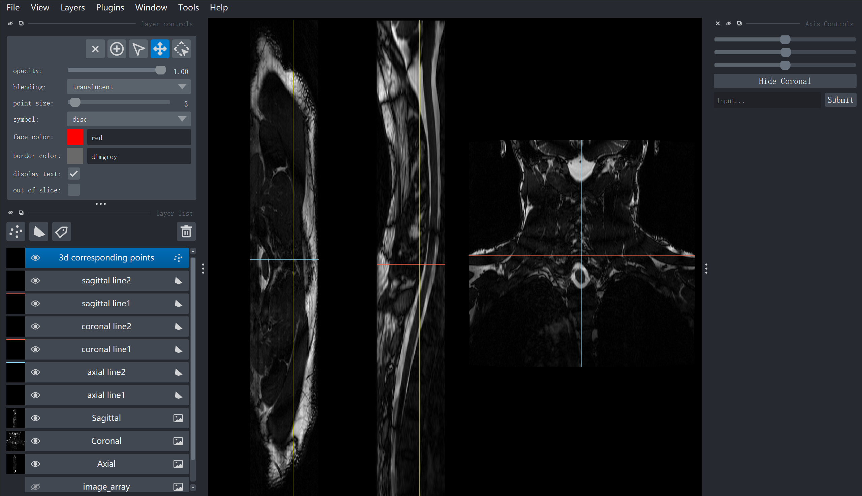
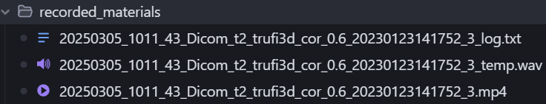
Add points of interest by clicking here first, then annotate the images (viewers). The annotation points will record their coordinates and timestamps.
Adjust the x, y, and z slice index by dragging the slider here.
x
y
z
Change the point size, symbol shape and color here
You can add text here, and its content along with the timestamp will be recorded.
VIDEO RECORDING OPERATIONS:
Press the "R" key to enter recording mode, during which all audio will be recorded. Press "R" again to exit recording mode. The recorded video and audio will be saved automatically as follows for example.
The lines can move as the x, y, z slicing index change
These are the viewers. You can toggle visibility by clicking here (for coronal view, you can click here as well).

Slide 2
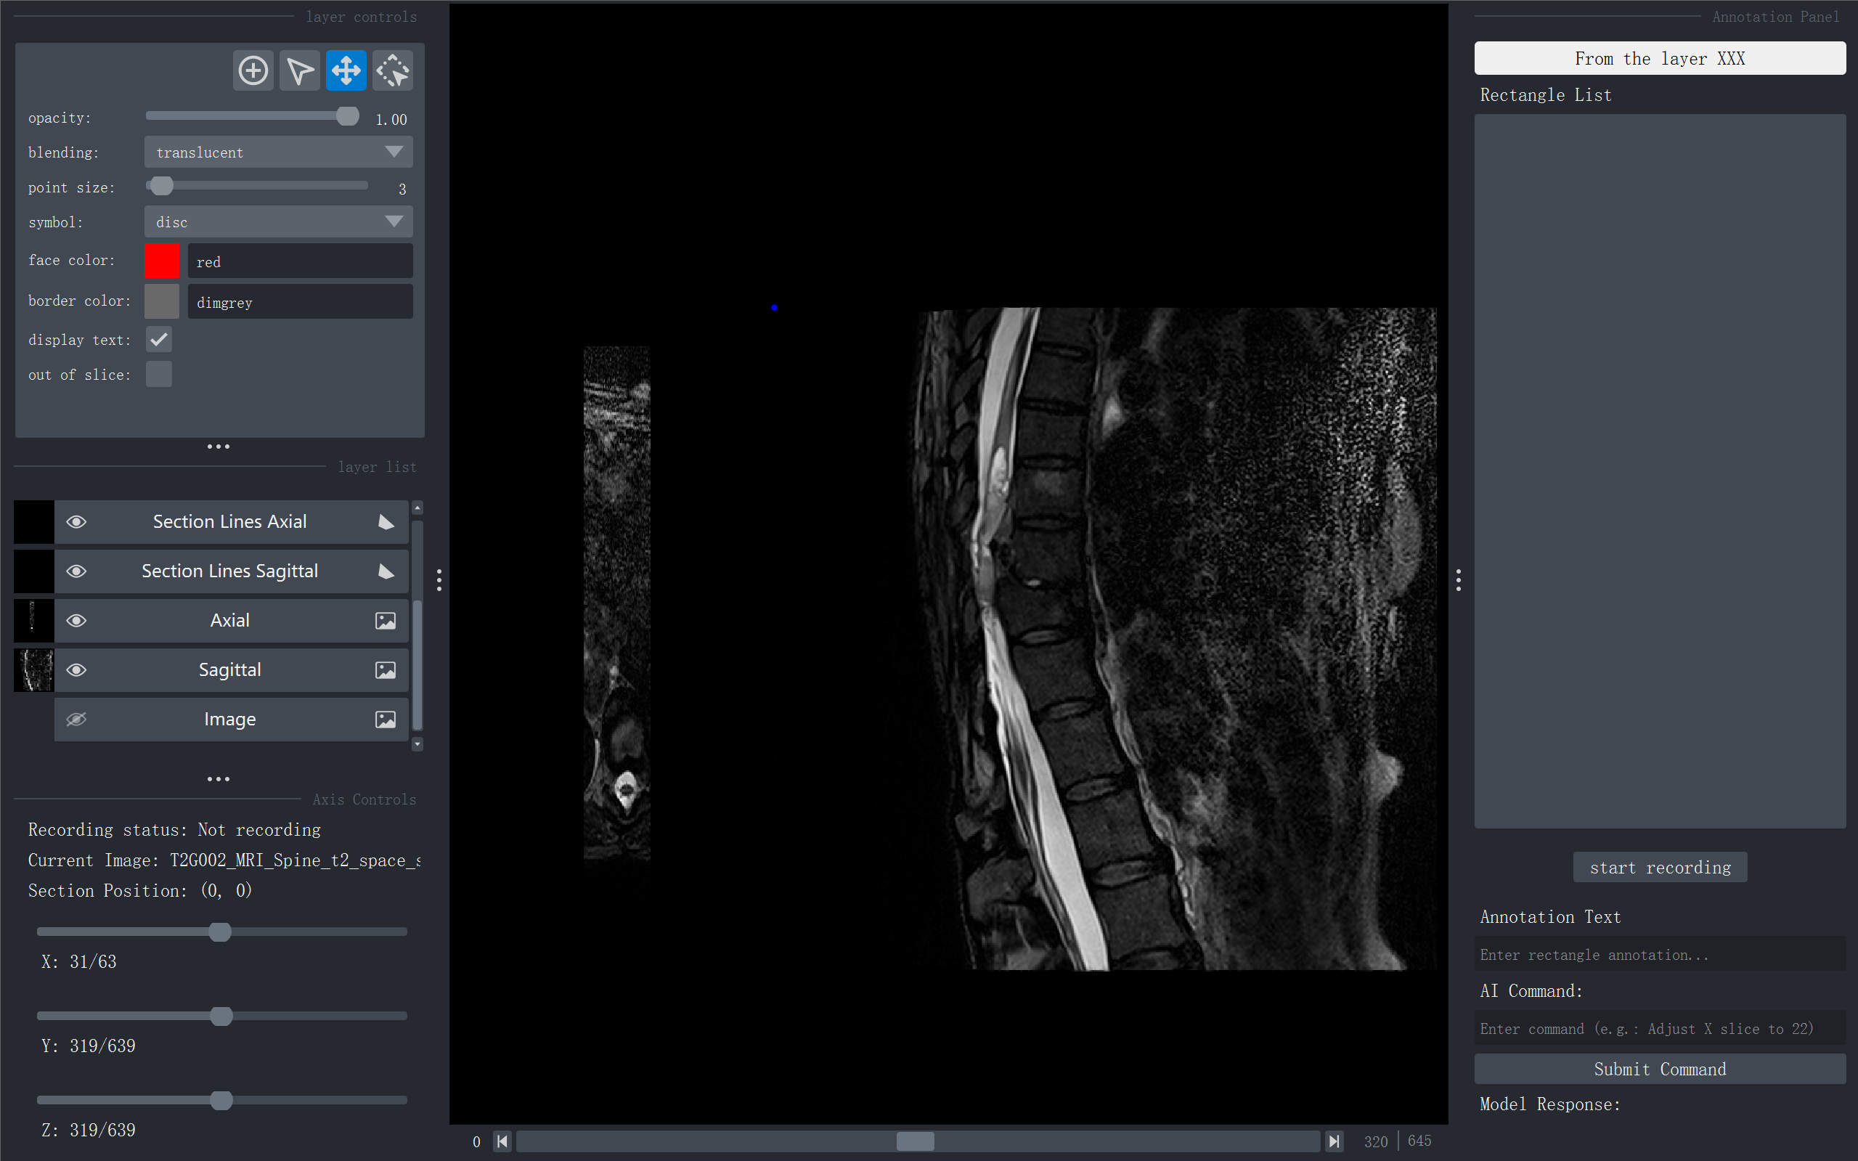

Add points of interest by clicking here first, then annotate the images (viewers). The annotation points will record their coordinates and timestamps.
Other functions
VIDEO RECORDING OPERATIONS:
Press the “M" key to enter recording mode, during which all audio will be recorded. Press “M" again to exit recording mode. The recorded video and audio will be saved automatically as follows for example.
Change the point size, symbol shape and color here
These are the viewers. You can toggle visibility by clicking here (for coronal view, you can click here as well).
Main view for the spin MRI image

Slide 3
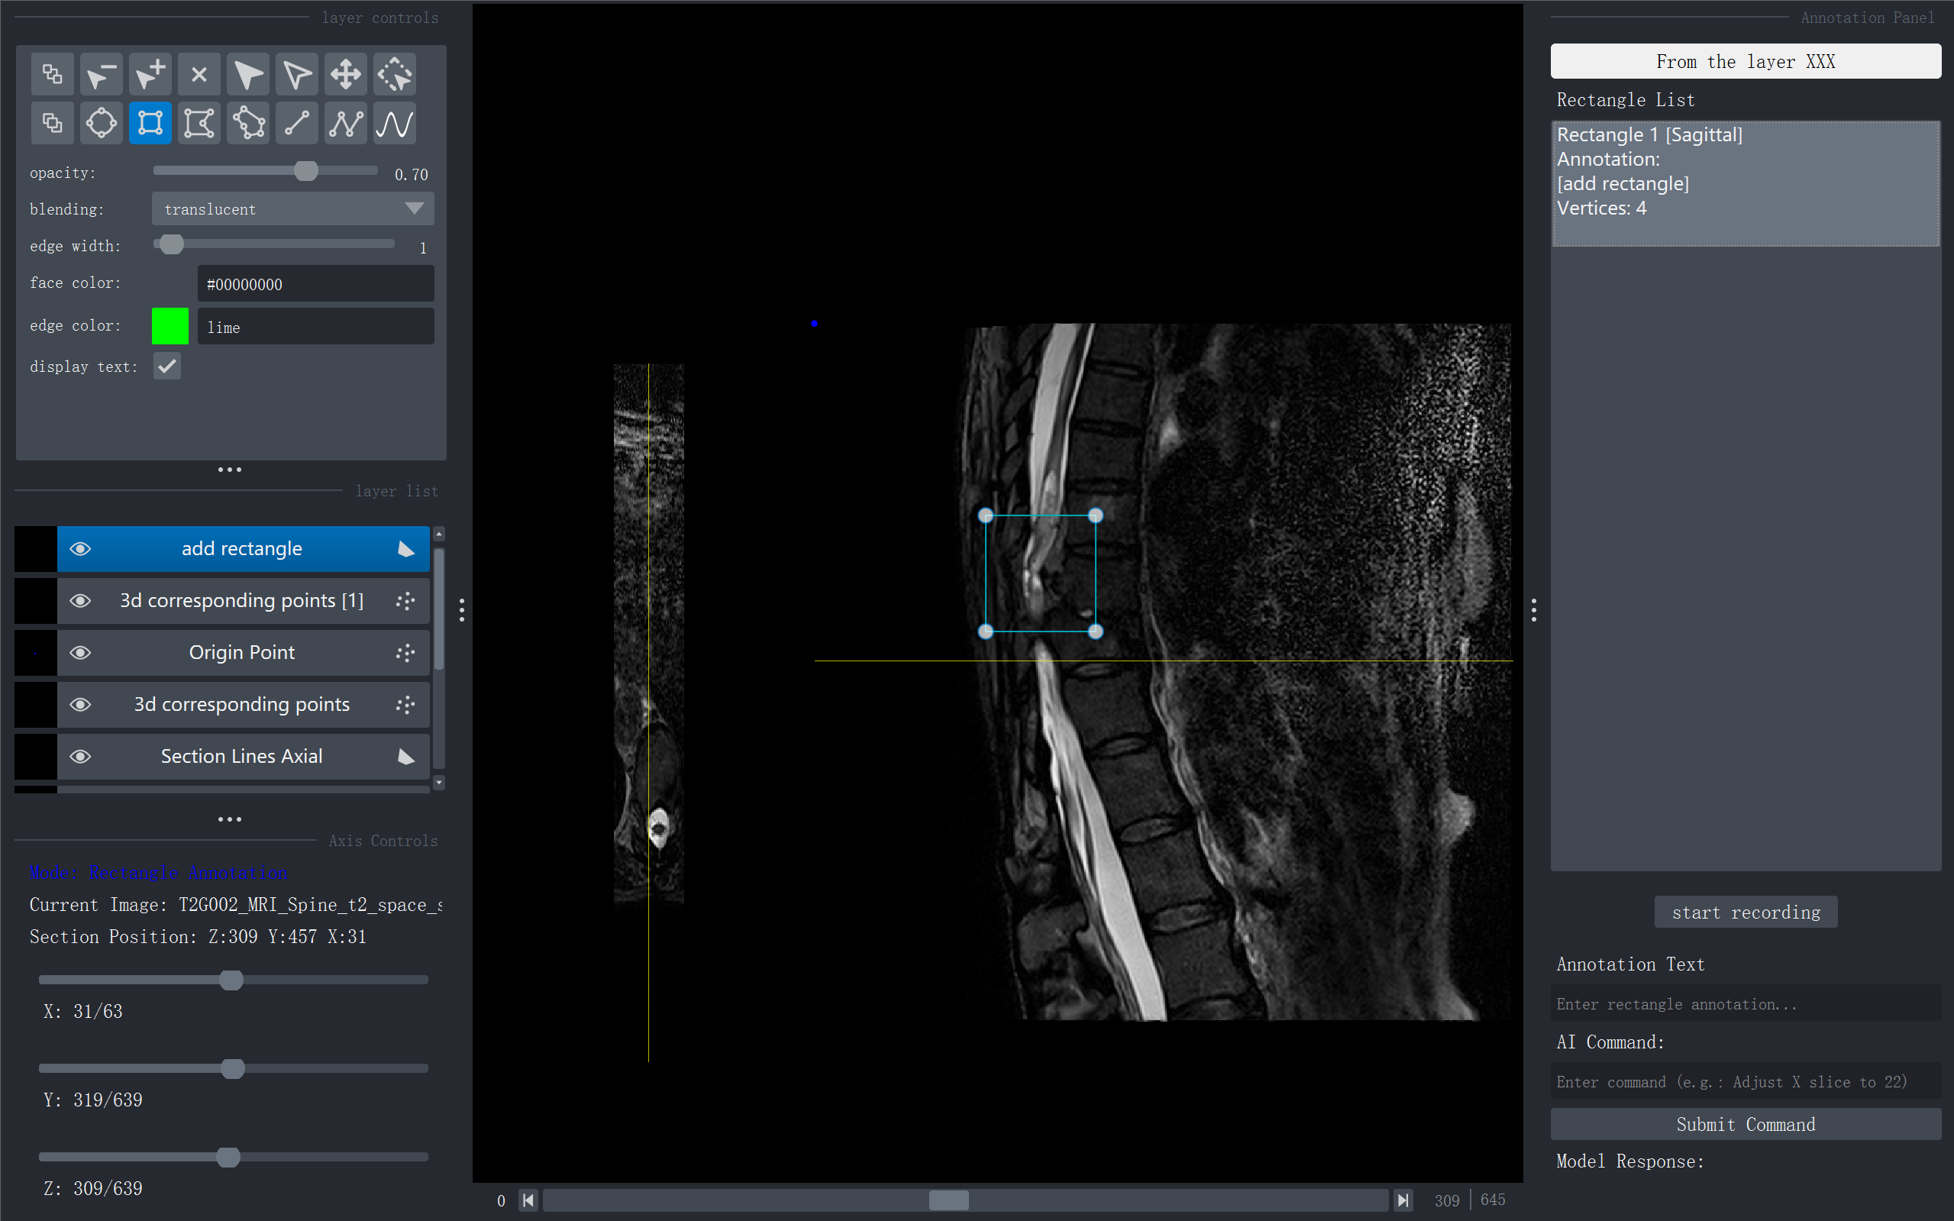
ANNOTATION MODE:
Press the “B" key to enter annotation mode. Press “B" again to exit annotation mode.
annotation rectangle will be saved the information here
Add annotation
The lines can move as the x, y, z slicing index change
Main view for the spin MRI image
AI command

