Slide 1
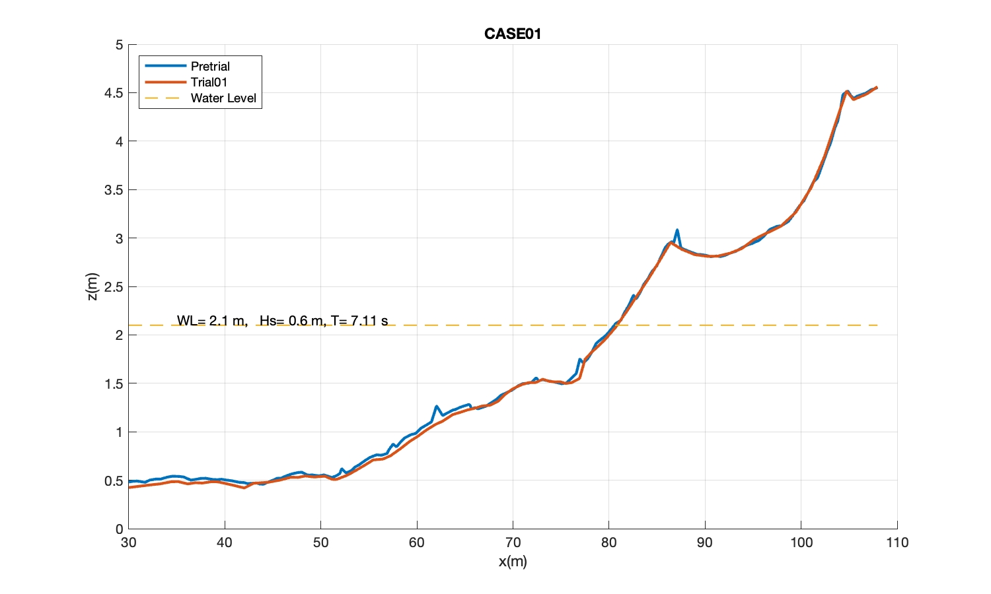
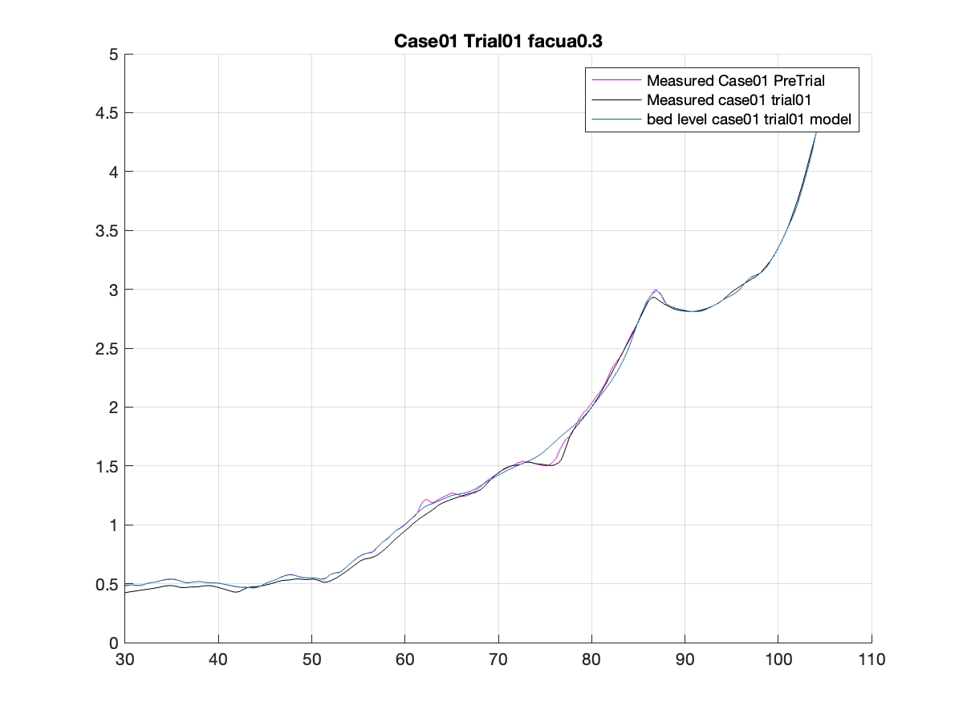
My plot
Your plot
The profile in your plot looks smoother than the raw data. Did you use any filtering?

Slide 2
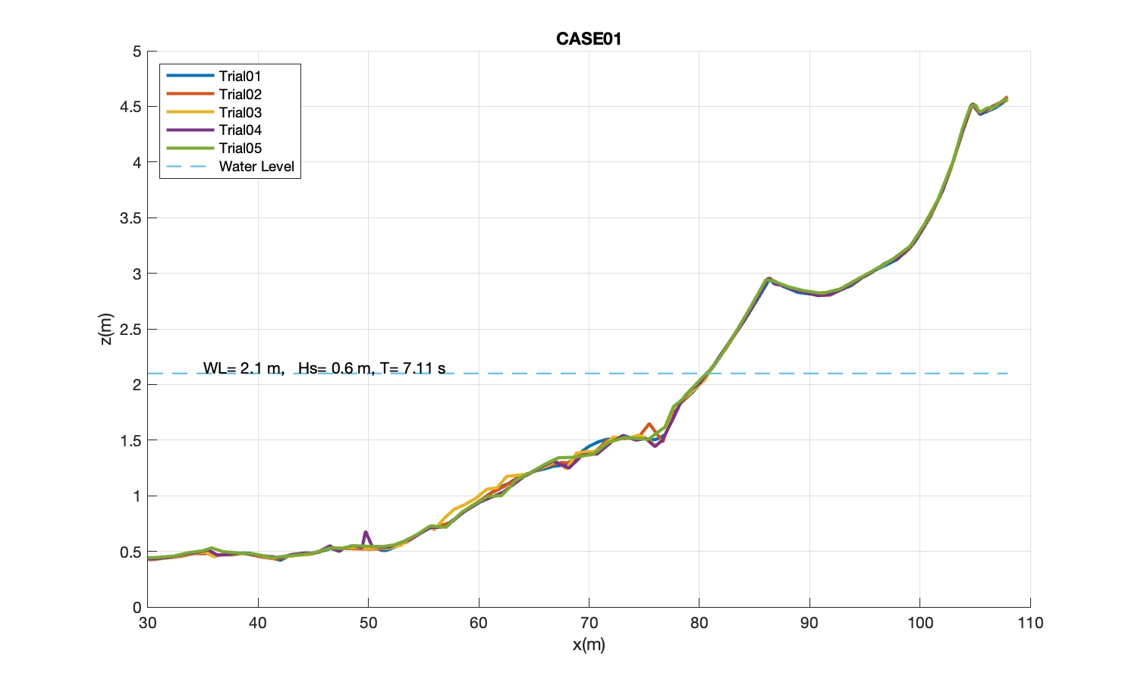
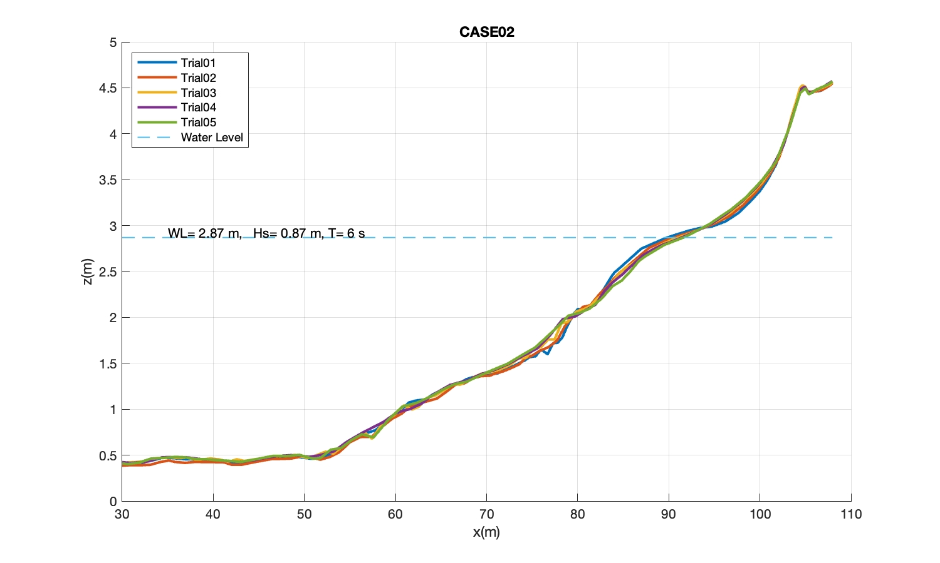
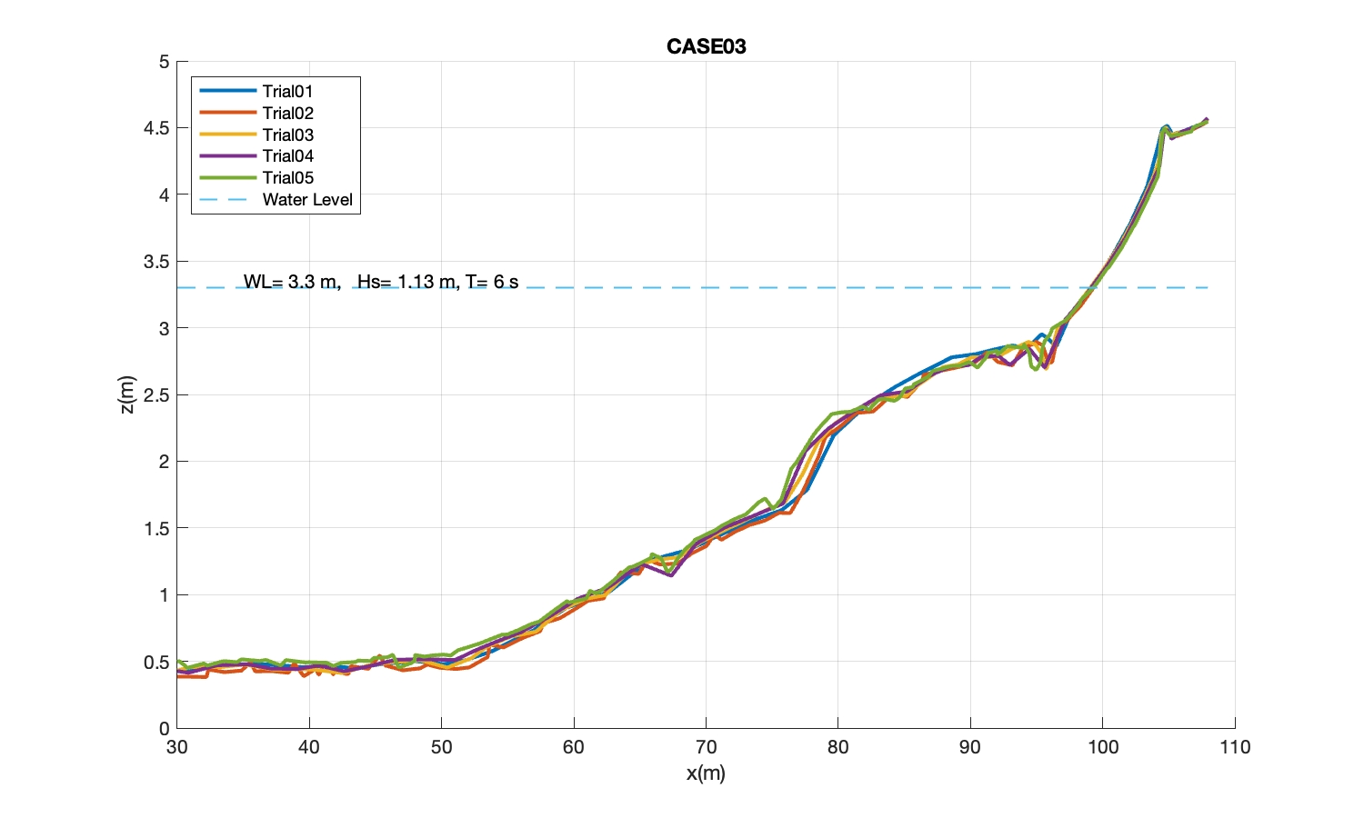
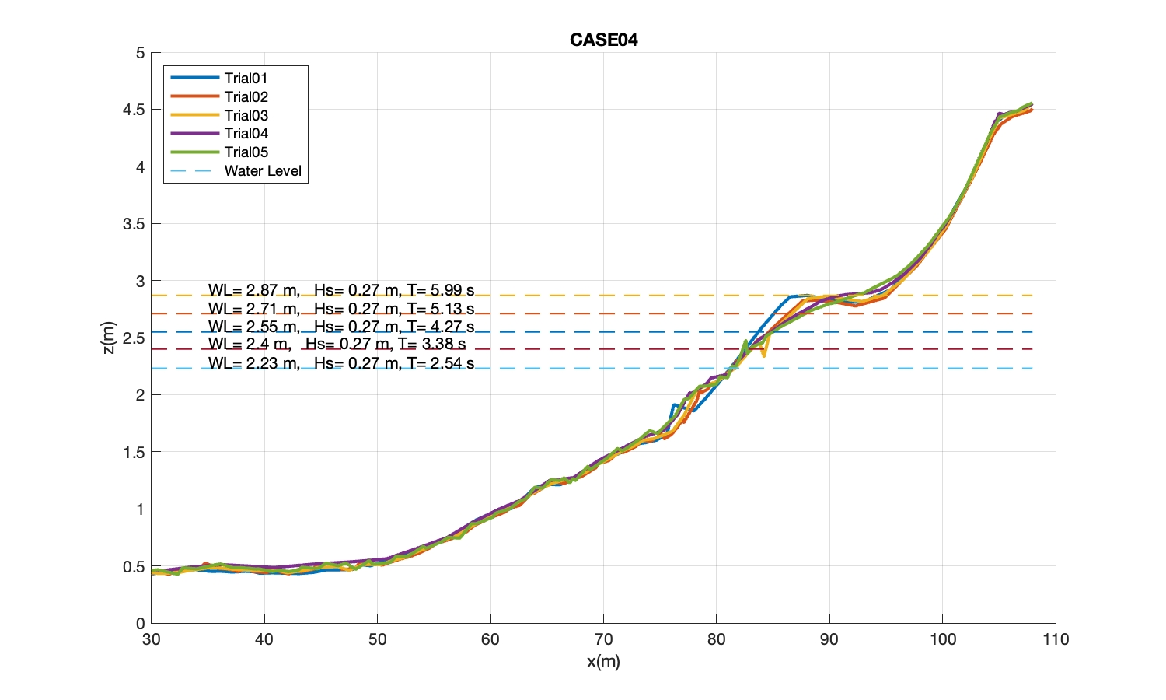
Is offshore domain flat bottom, 0.5 m?
2)Given that wave heights are different at the wave paddle, why Hs’s are the same in the five trials. Copy/paste errors?

Slide 3
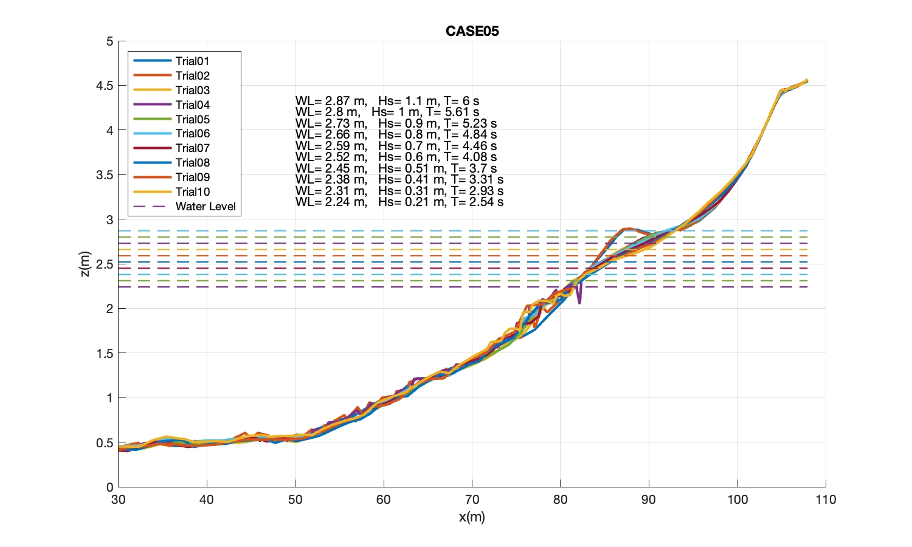
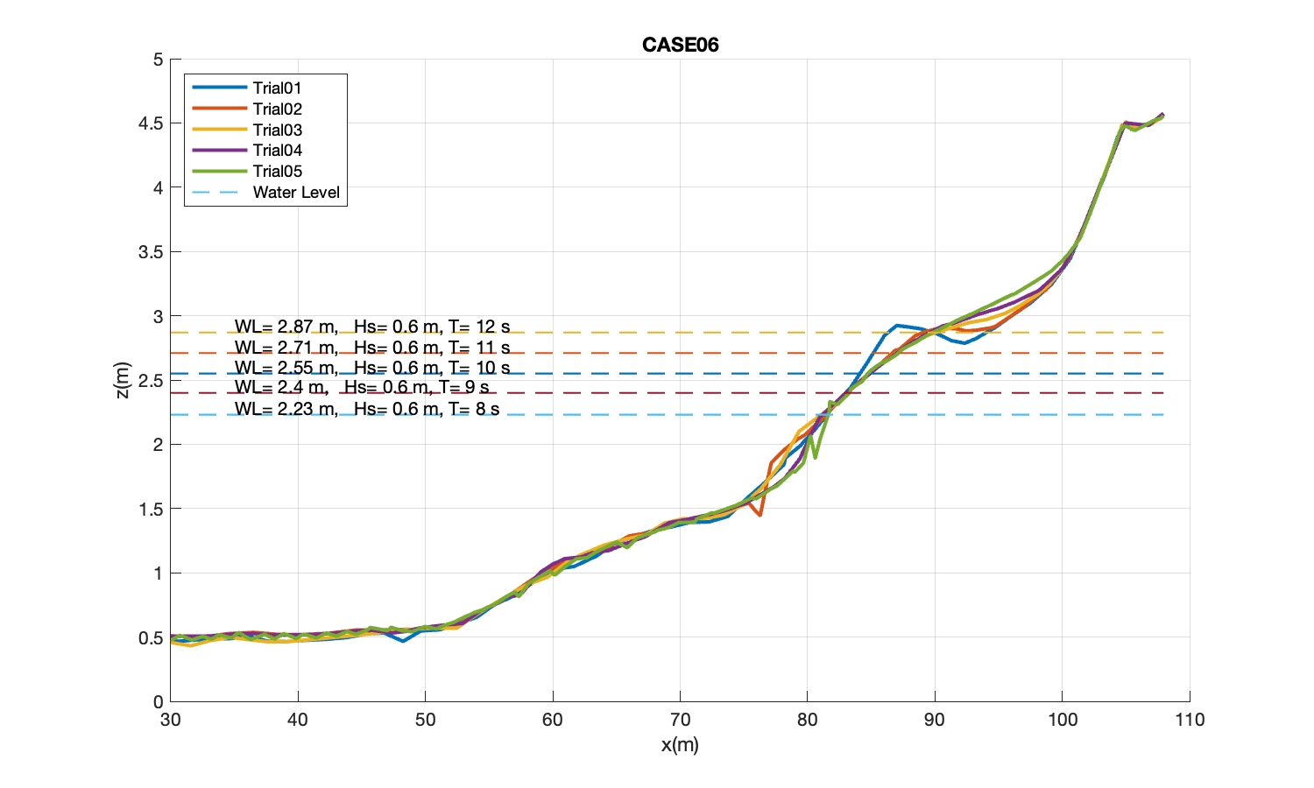
3) Please provide wave height inputs for CASE05 and CASE06. The wave heights here are from your column H, which may be the target wave heights at the paddle.
4)Do you have wave height measurements in the surfzone? Thanks.

