Slide 1
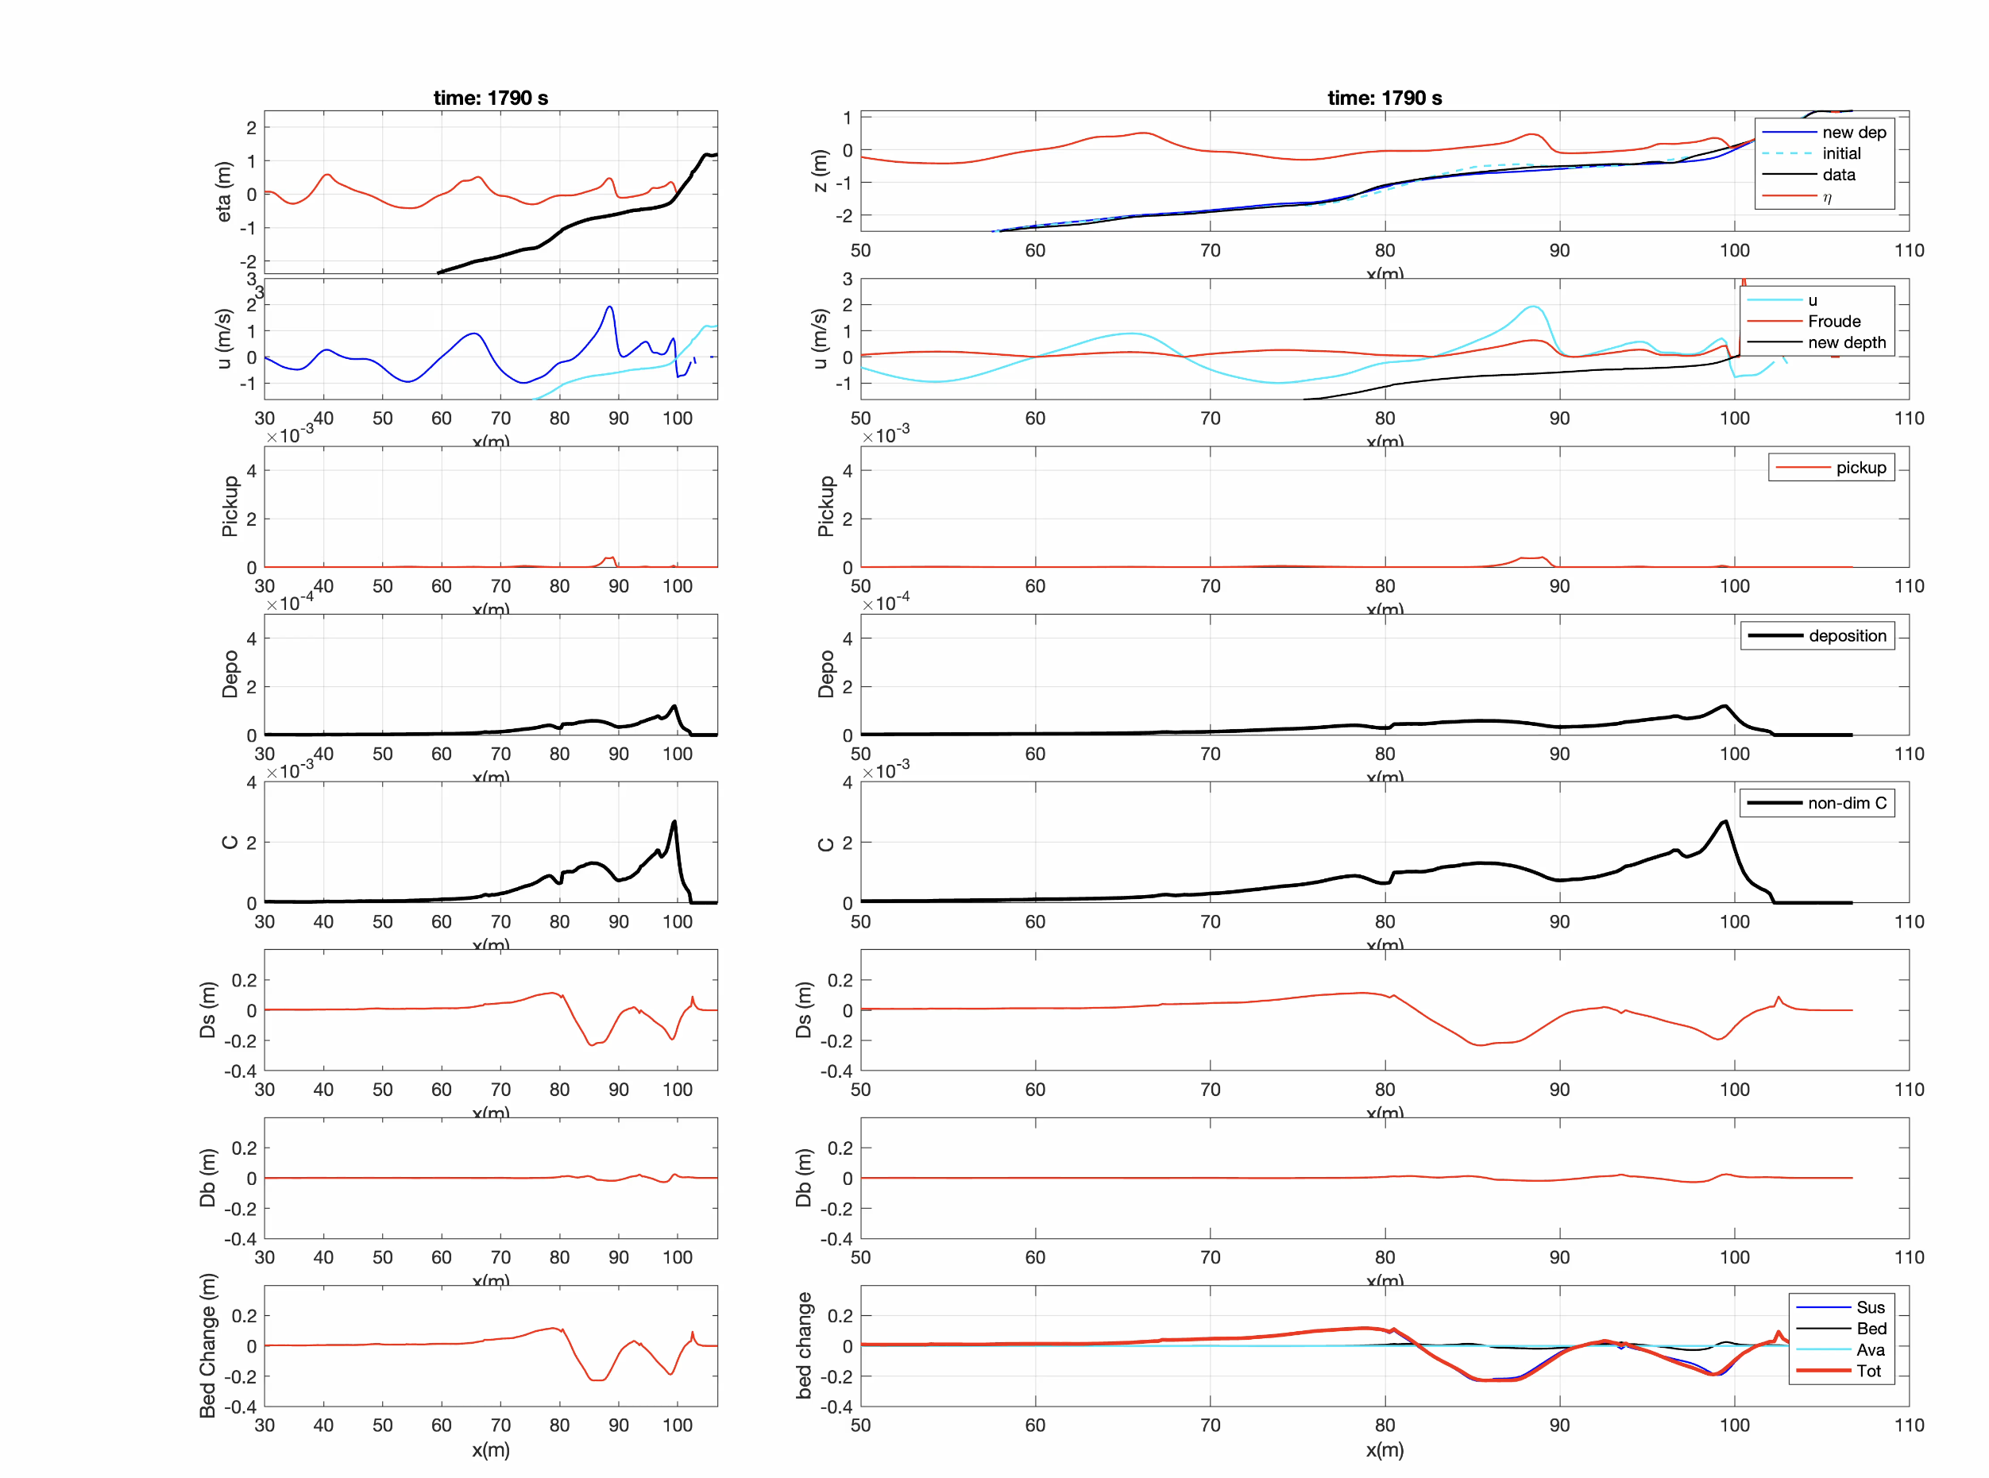
Surface and bed
Velocity and Froude number
Sediment pick
Sediment deposition
Sediment concentration
(relative conceentration)
Suspended-load-induced change
Bed-load-induced change
Total bed change

