Slide 1
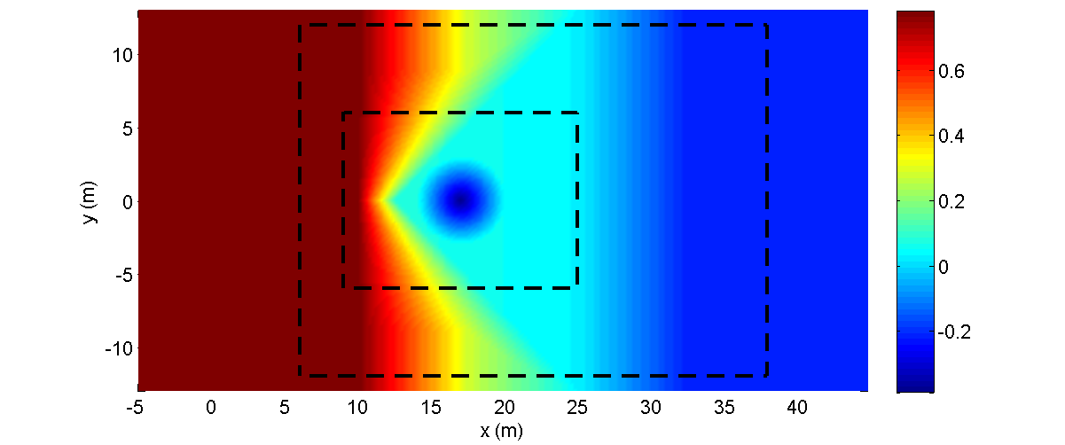
Solitary wave runup on a shelf with a conical island
(Case 1) With Two-Way Nesting (three level , ratio=2)
Initial location of solitary wave : x=5.0 (m)
x1=6.0 (m), y1=-12.0 (m)
Parent Grid - dx=0.2, dy=0.2
: Child Grid1 - dx=0.1, dy=0.1
x2=9.0 (m), y2=-6.0 (m)
Child Grid2 - dx=0.05, dy=0.05
※ For this experiment, numerical filter was applied on only surface elevation.

Slide 2
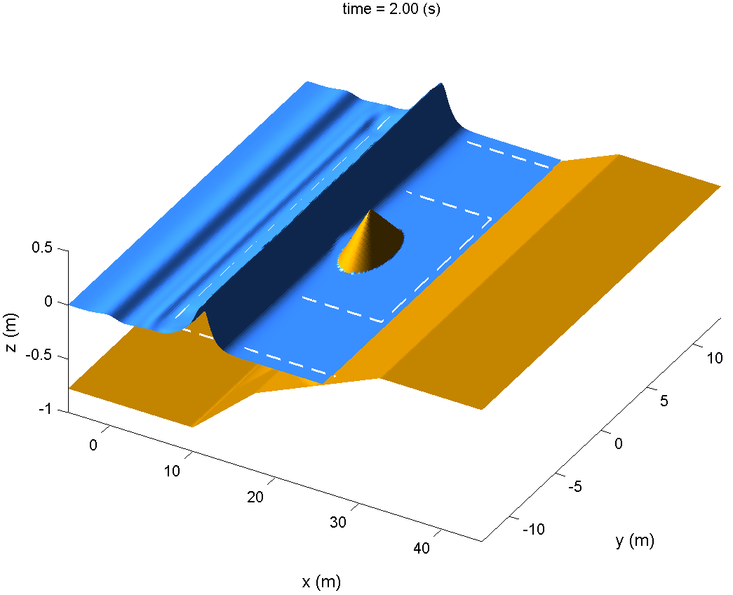
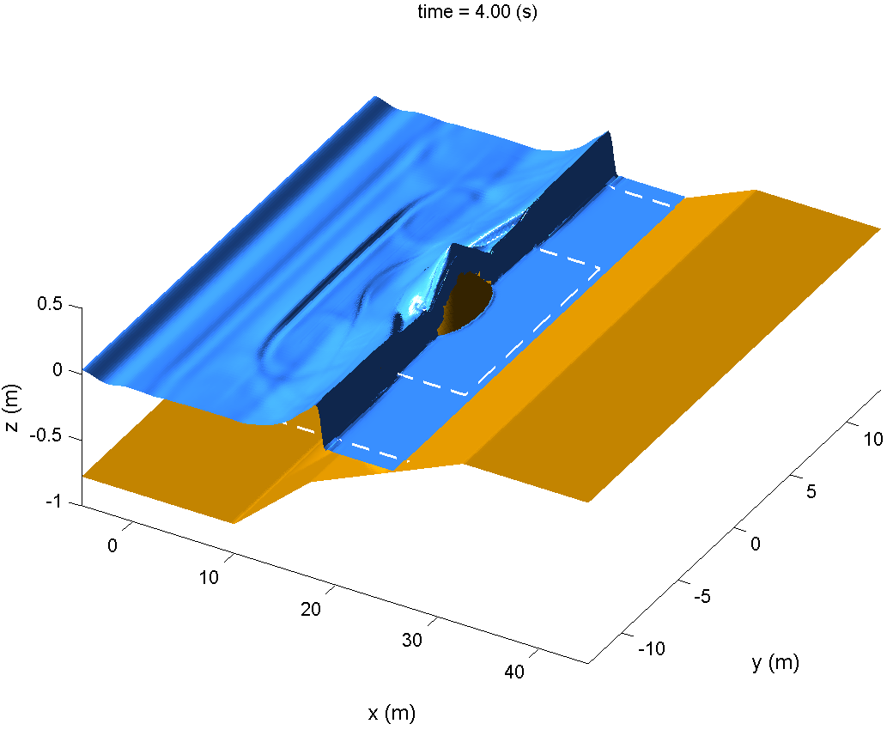
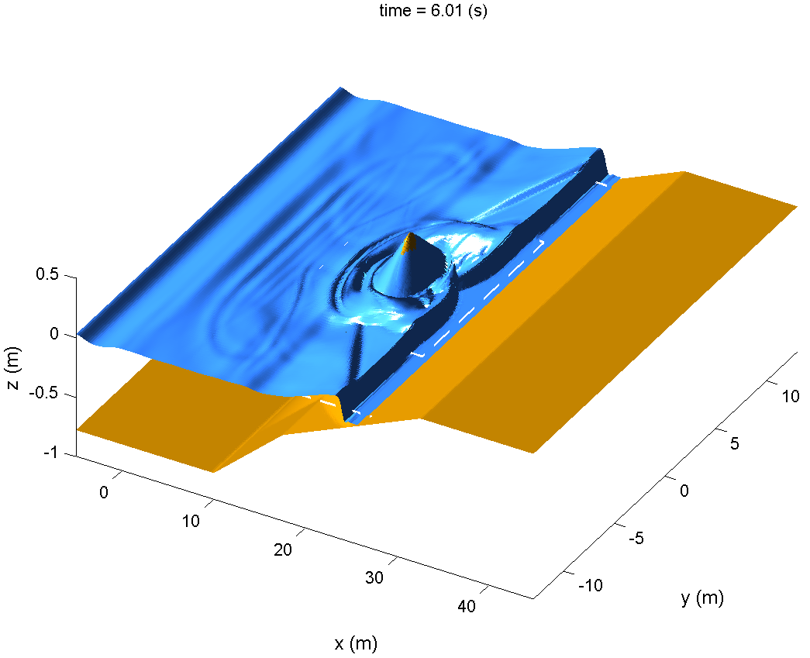
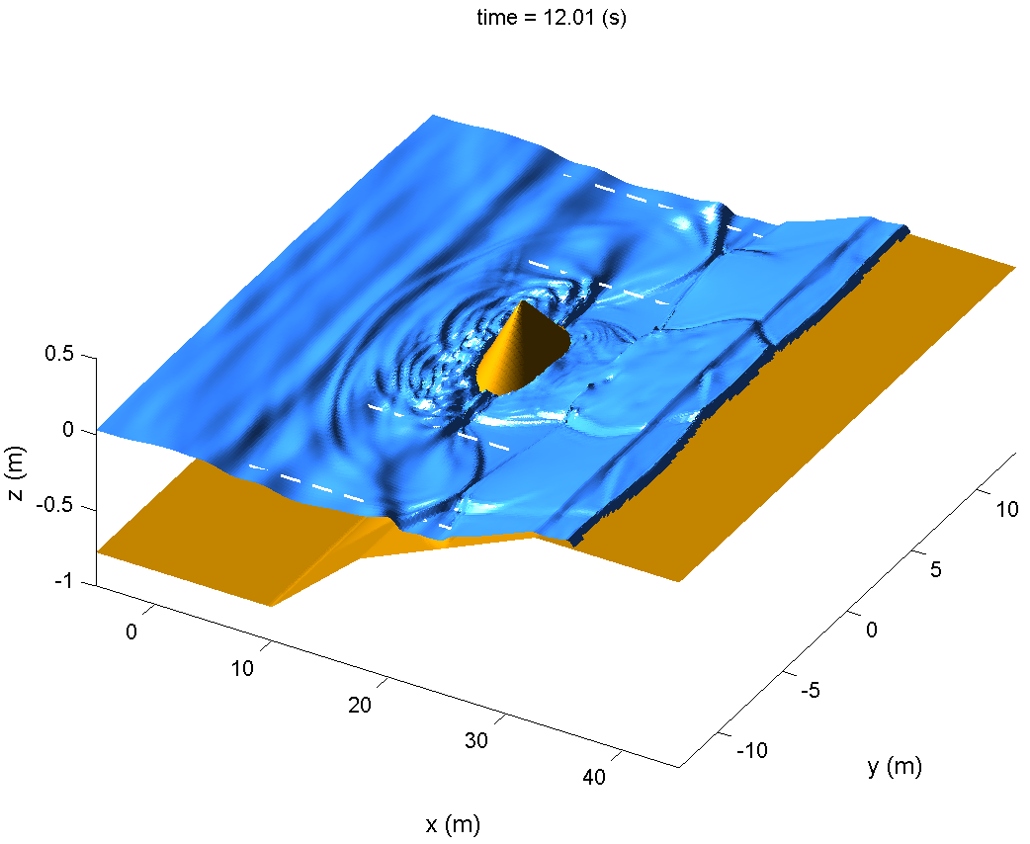

Slide 3
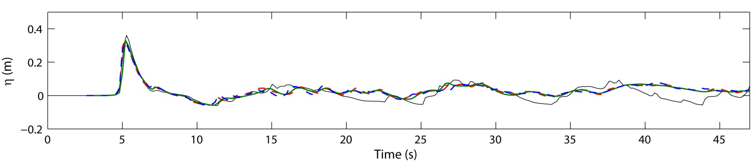
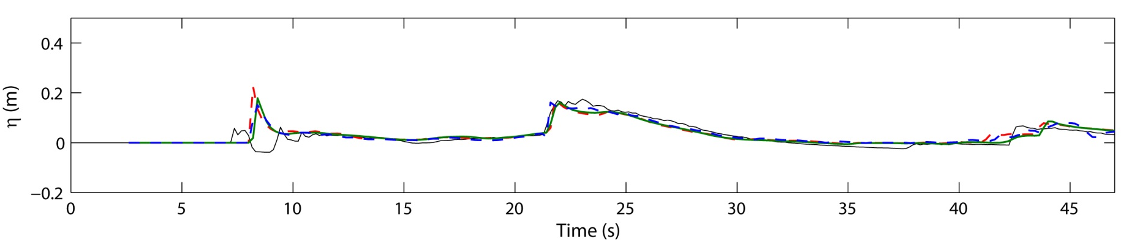
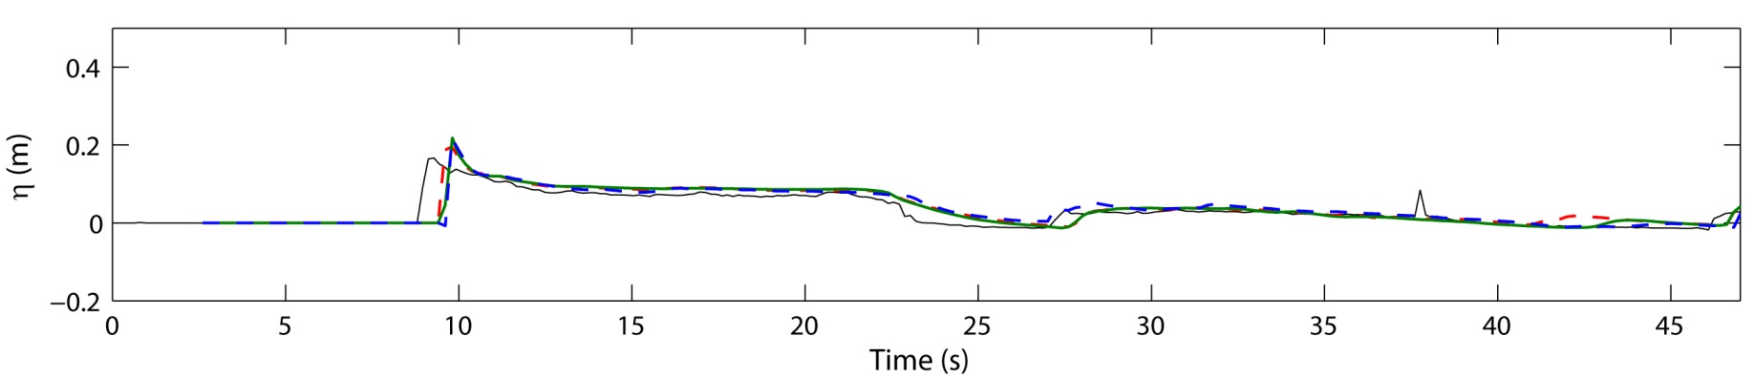
Comparison with experimental data G2, G3, G7
data
dx=0.1 without nesting
dx=0.2 without nesting
nesting
G2
(x,y)=(13,0)
G3
(x,y)=(21,0)
G7
(x,y)=(25,0)

Slide 4
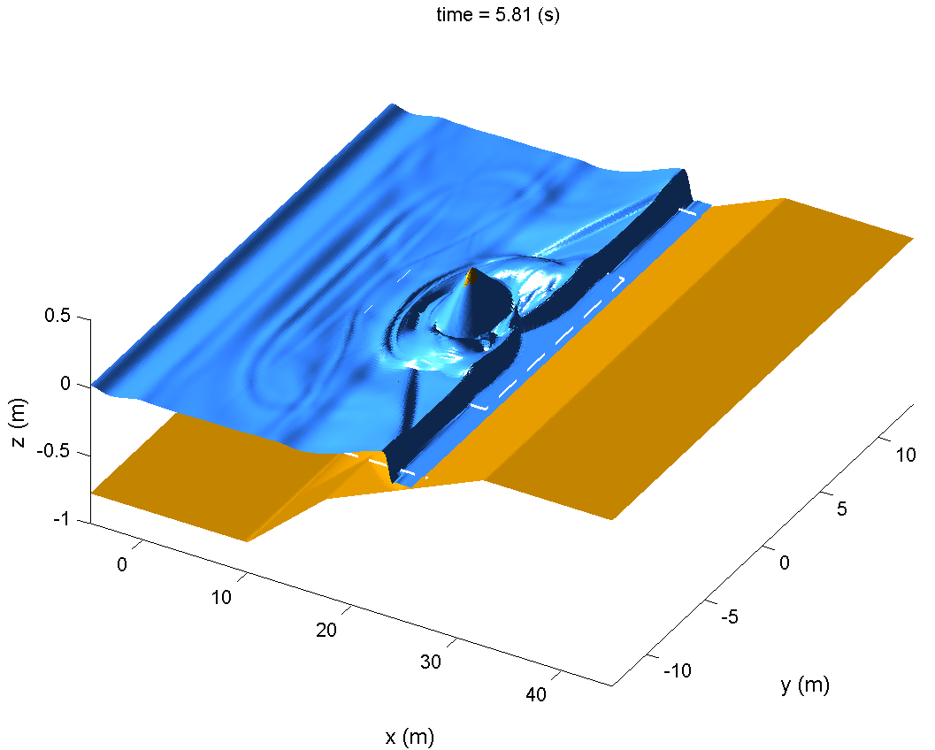
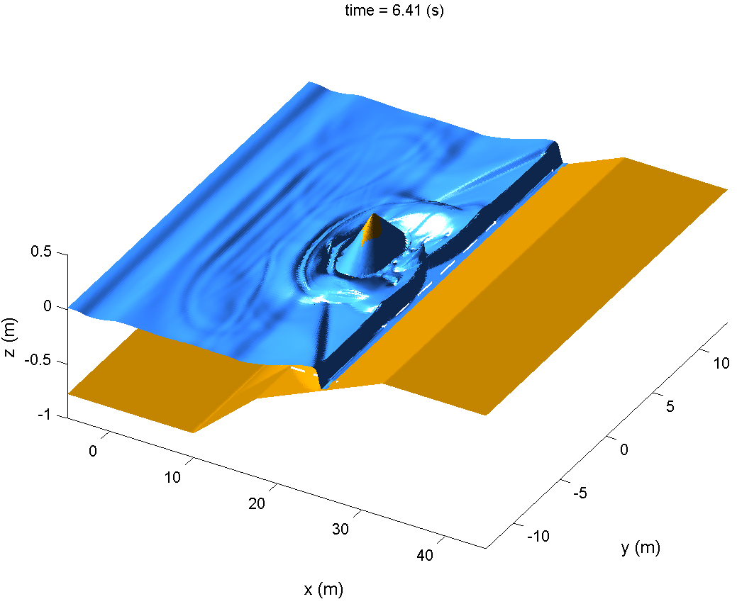
Comparison of the wave height behind the conical island
(next slide)

Slide 5
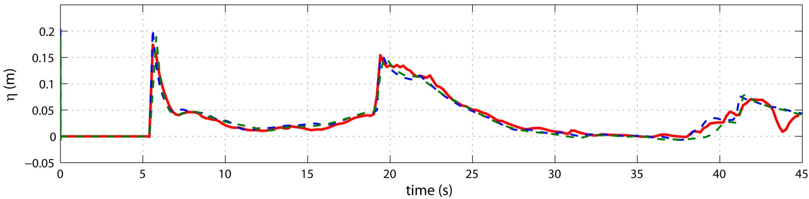
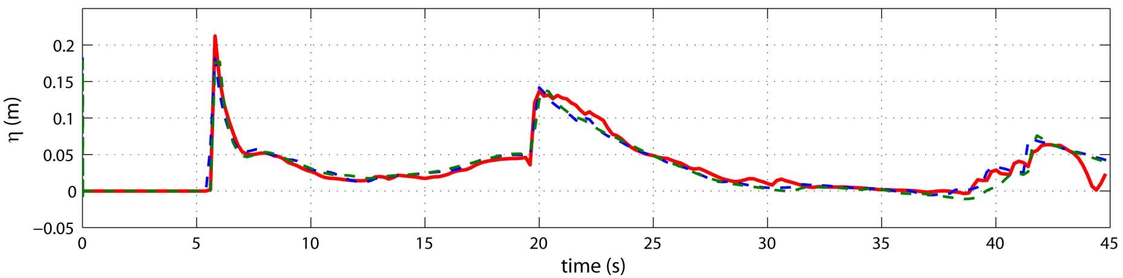
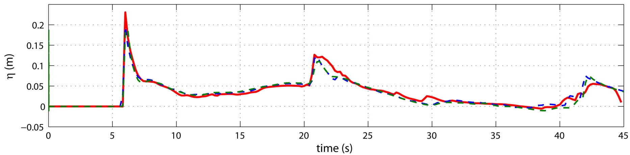
(x,y)=(21.4,0)
nesting
dx=0.1 without nesting
dx=0.2 without nesting
(x,y)=(21.8,0)
(x,y)=(22.4,0)

Slide 6
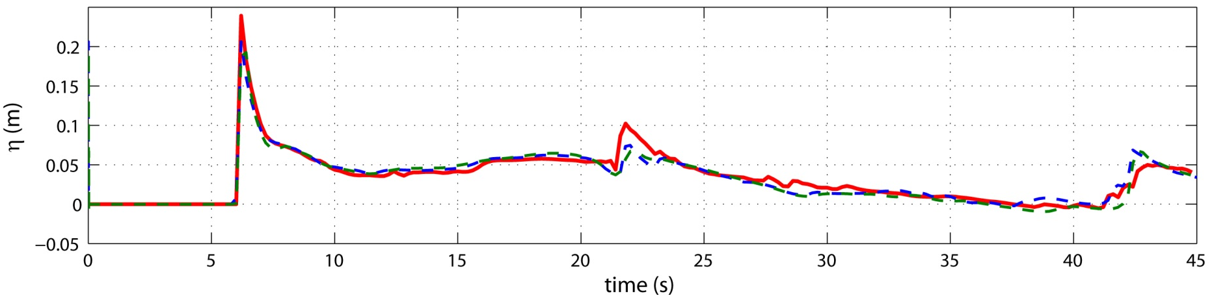
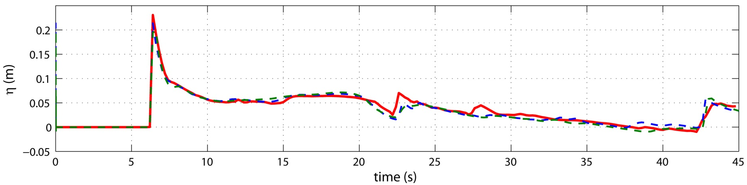
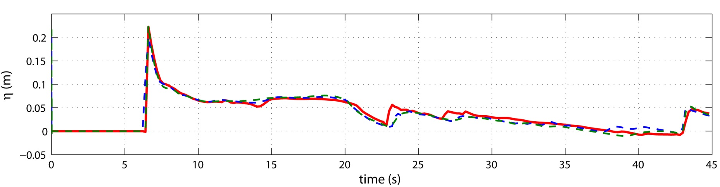
(x,y)=(23.0,0)
nesting
dx=0.1 without nesting
dx=0.2 without nesting
(x,y)=(23.6,0)
(x,y)=(24.0,0)

Slide 7
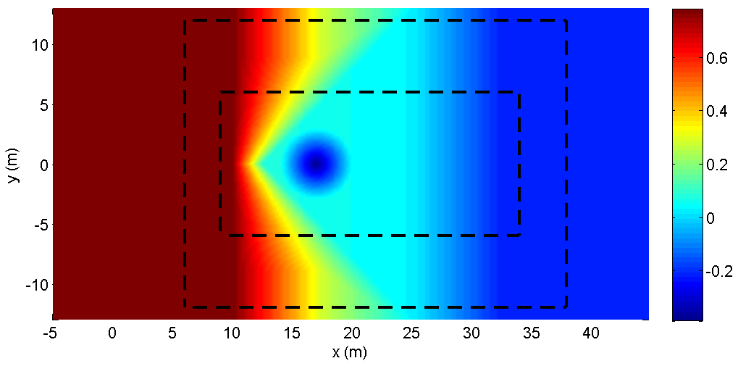
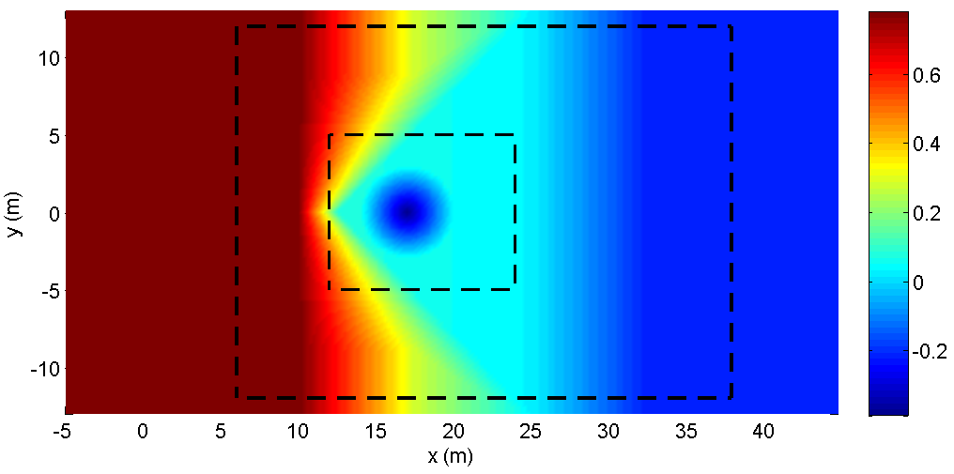
※ Blow-up cases
longer
shorter

