Slide 1
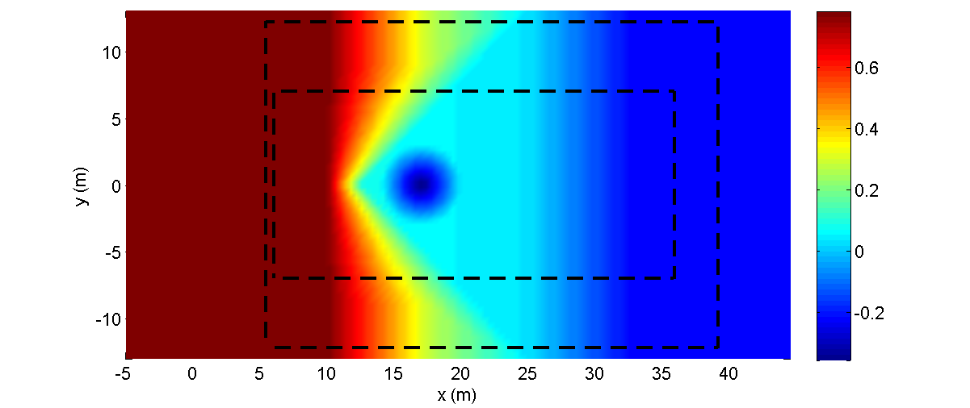
(Case 2) With Two-Way Nesting (three level , ratio=2)
Initial location of solitary wave : x=5.0 (m)
x1=5.4 (m), y1=-12.2 (m)
Parent Grid - dx=0.4, dy=0.4
: Child Grid1 - dx=0.2, dy=0.2
x2=6.0 (m), y2=-7.0 (m)
Child Grid2 - dx=0.1, dy=0.1
※ In this experiment, numerical filter was not applied.

Slide 2
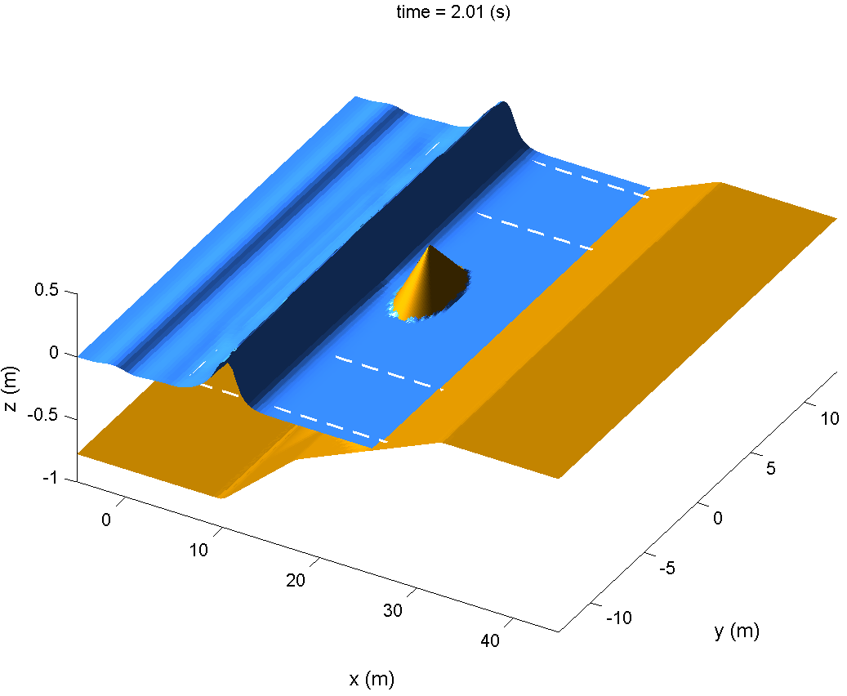
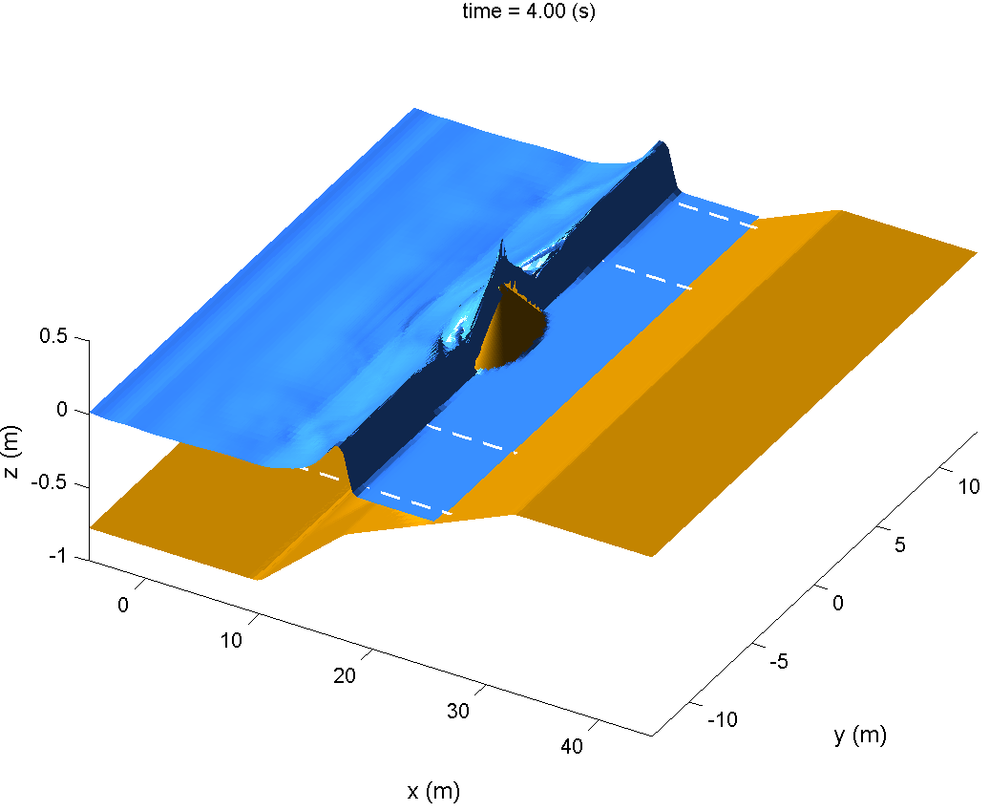
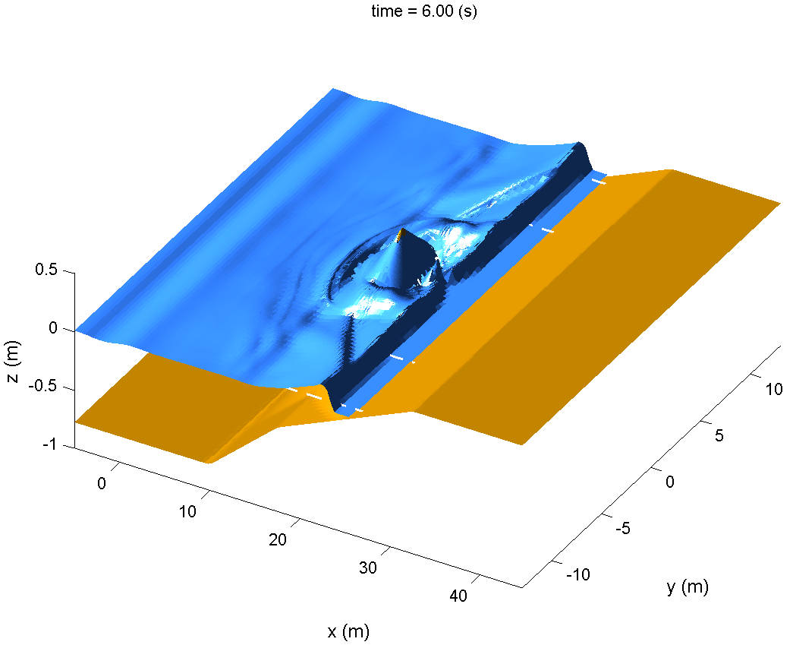
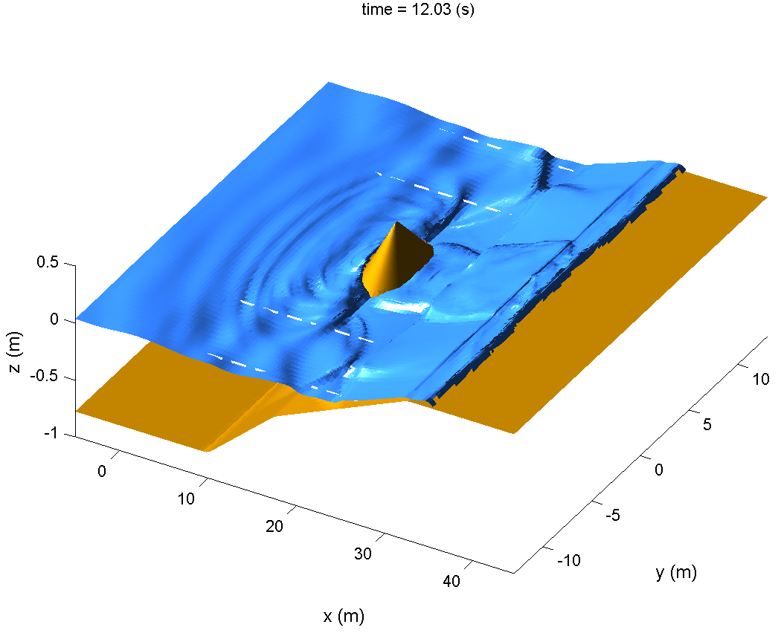

Slide 3
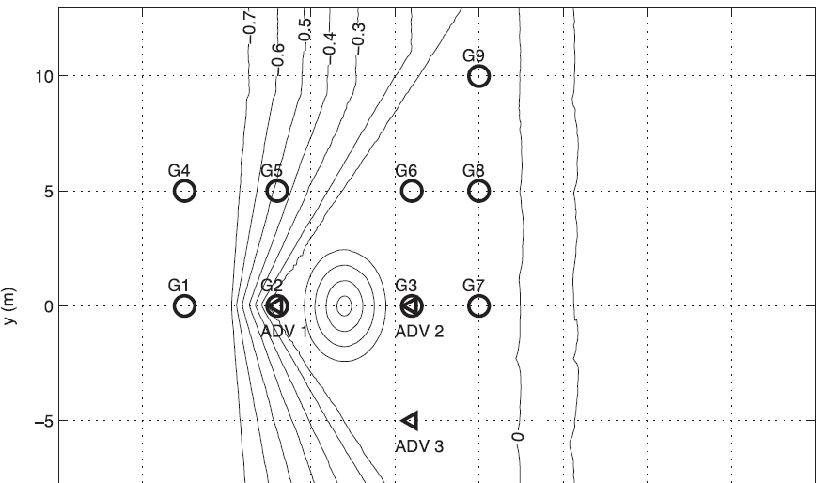
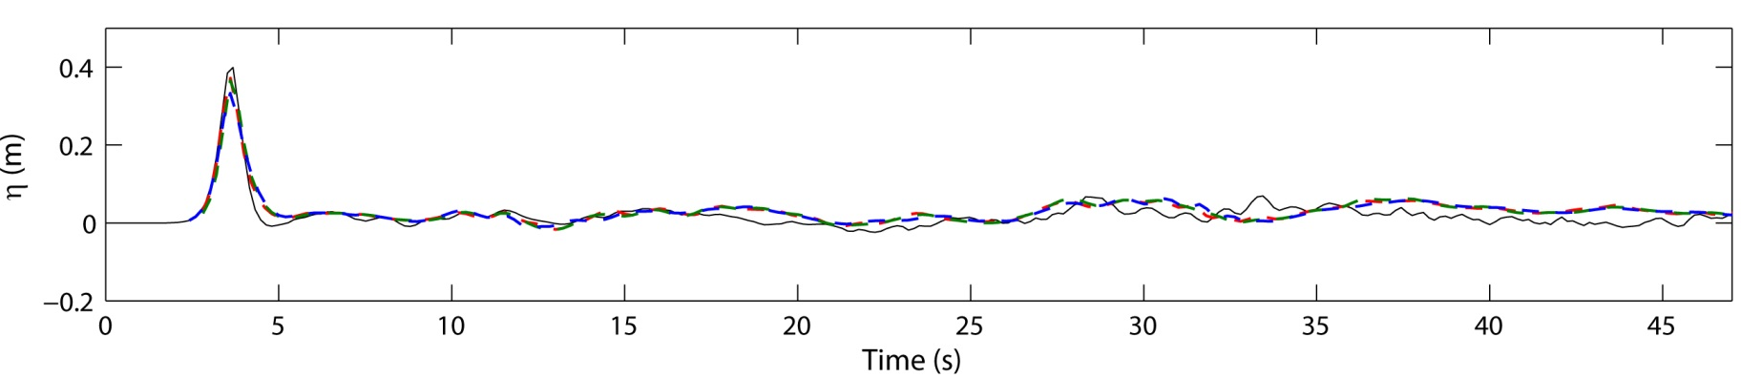
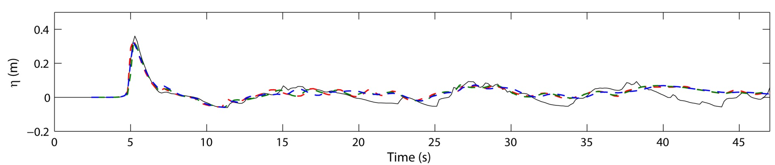
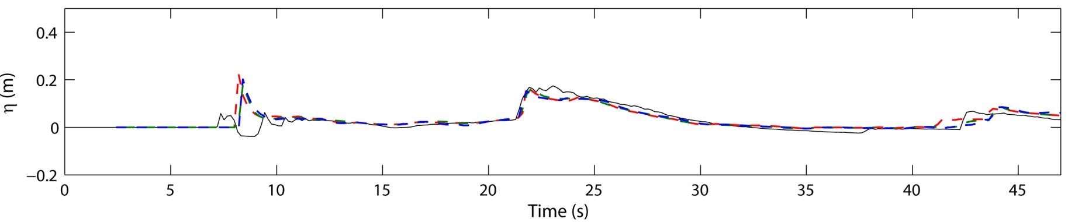
Comparison with experimental data
data
dx=0.1 without nesting
dx=0.2 without nesting
nesting
G1
(x,y)=(7.5,0)
G2
(x,y)=(13.0,0)
G3
(x,y)=(21.0,0)

Slide 4
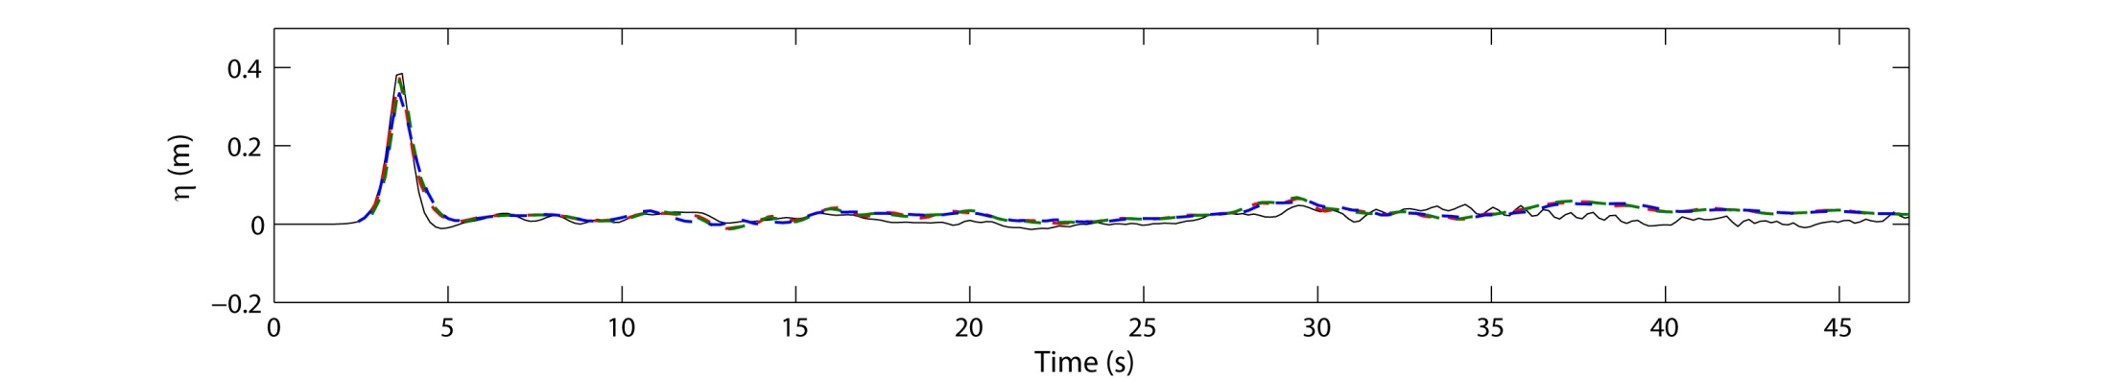
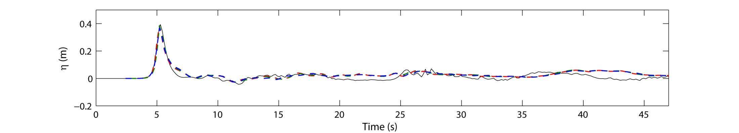
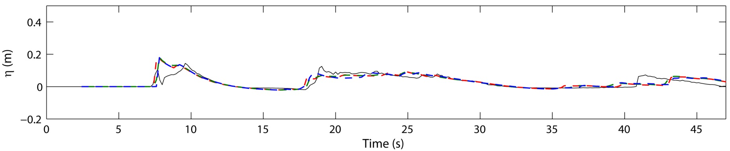
data
dx=0.1 without nesting
dx=0.2 without nesting
nesting
G4
(x,y)=(7.5,5)
G5
(x,y)=(13,5)
G6
(x,y)=(21,5)

Slide 5
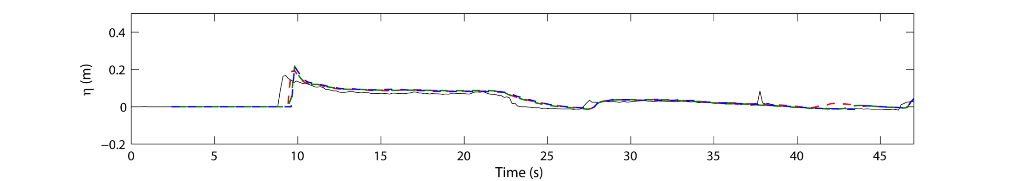
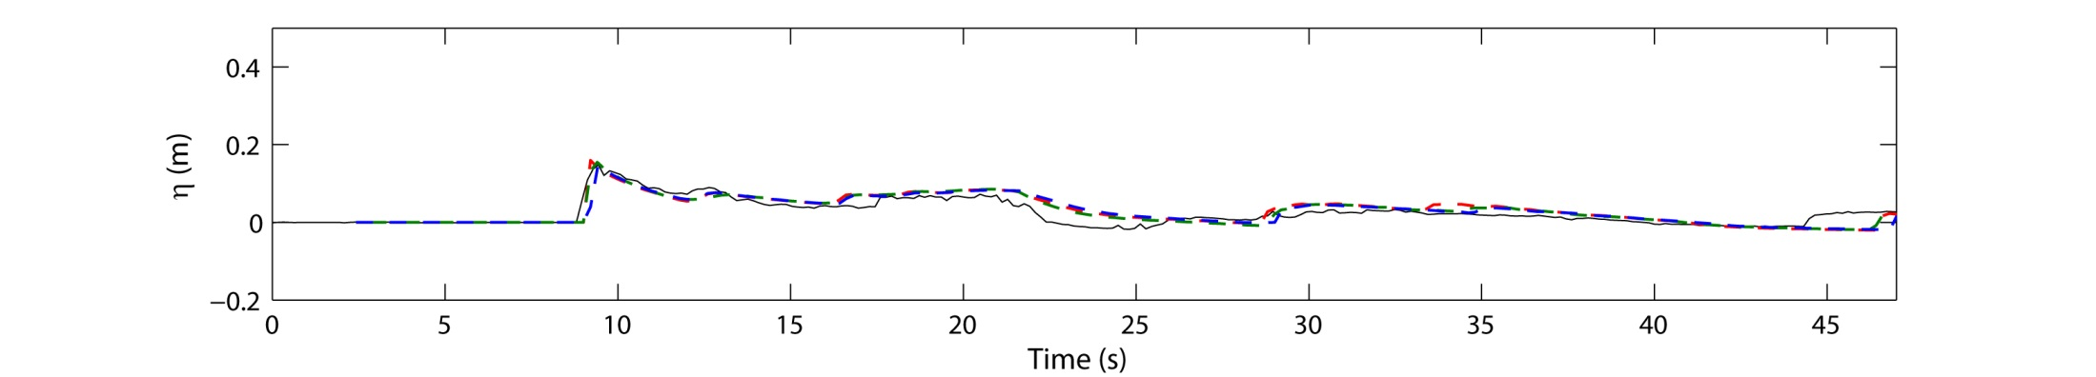
data
dx=0.1 without nesting
dx=0.2 without nesting
nesting
G7
(x,y)=(25,0)
G8
(x,y)=(25,5)

Slide 6
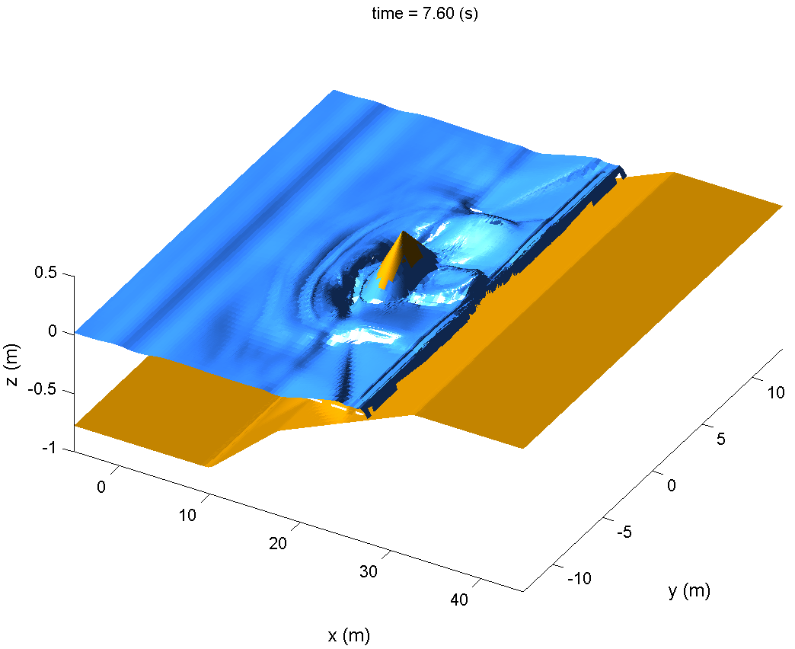
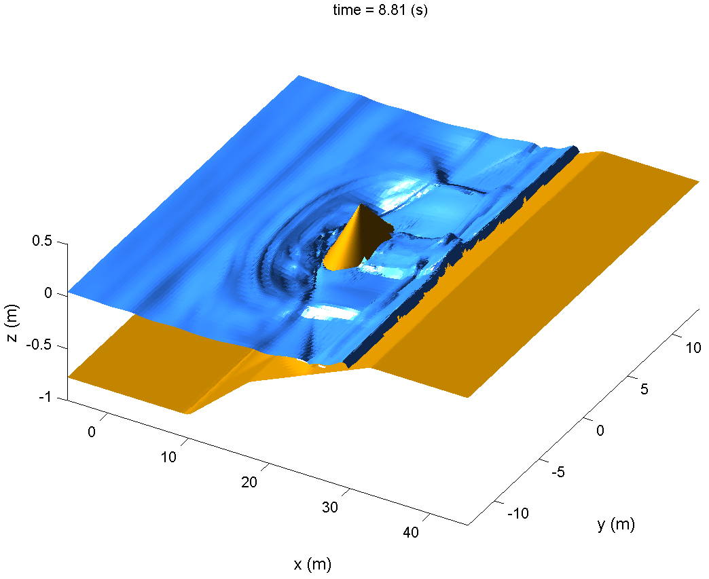
Comparison of the wave runup behind the conical island
(next slide)

Slide 7
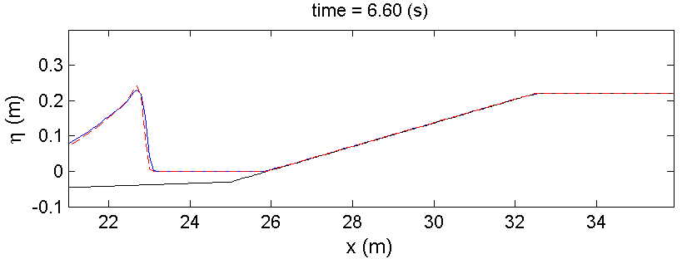
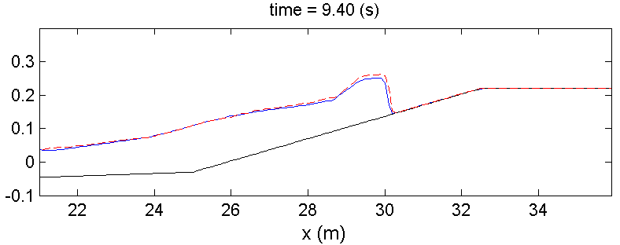
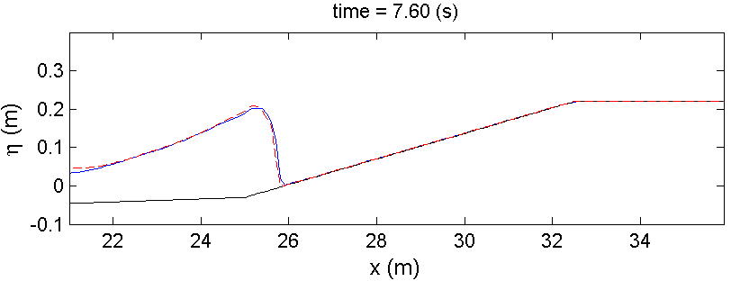
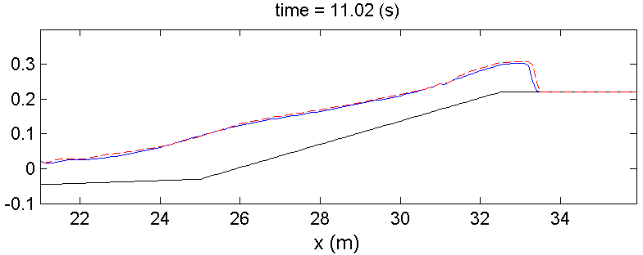
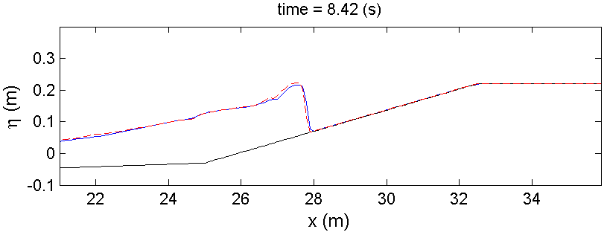
dx=0.1 without nesting
nesting

