Slide 1

MONGOOSE – 2DV CFD Model
Predicting surface waves, wave-structure interaction, wave-induced sediment transport and air bubbles
Fengyan Shi

Slide 2
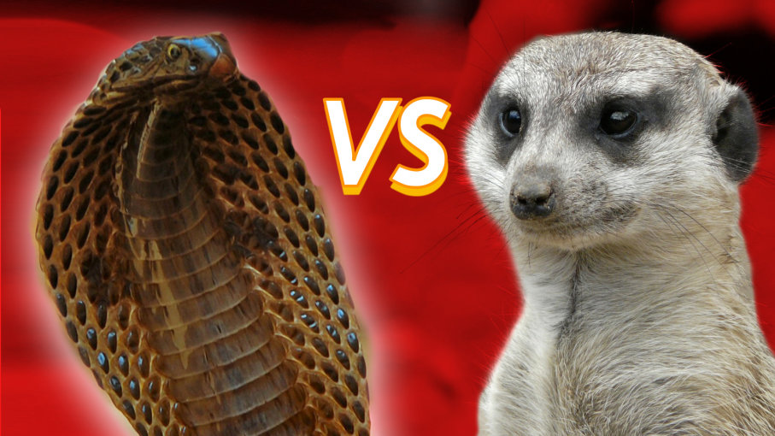
COBRAS (Cornell Breaking Wave and Structure)
RIPPLE (NASA)
MONGOOSE (Model of New Generation Ocean Wave and Ocean Structure Engineering)
COBRAS-UC (University of Cantabria Version)

Slide 3
Model features
FORTRAN serial code
VOF
Non-uniform structured grid
Multi-phase: water, air bubble, sediment, porous media
Turbulence models: k-epsilon, k-l mixing length model, multi-scale LES
Ocean and coastal engineering applications: surface wave, wave-solid/porous structure interaction, wave overtopping, sediment transport, air bubbles, pollutant transport

Slide 4
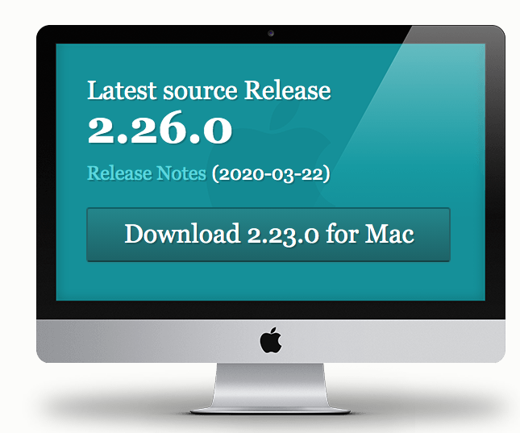
Preparation
Github
https://git-scm.com/downloads
Unix/Linux environment
For Windows 10 users:
set up a Linux subsystem
https://fengyanshi.github.io/build/html/windows.html
Install gfortran

Slide 5
Modeling procedures
Compile the code with a FORTRAN compiler
Modify input.txt
1) mesh generation
2) Obstacles generation
3) Porous structure generation
4) wave generation
5) turbulence model, boundary conditions
Run model
Post-processing model result

Slide 6
Compile the code
Modify Makefile
Use make
Copy exe file to the work directory

Slide 7
Input.txt
Name of your project
Numerical parameters
Fluid parameters
mesh generation
Obstacles
Free surface
Porous structure
Wave parameters
Output format
Other parameters, such as turbulence model

Slide 8
Numerical parameters
delt : Initial time step of calculation.
twfin
prtdt
sfdt
utot
Example:
0.01,150,0.5,0.05,1.0 = delt,twfin,prtdt,sfdt,utot

