Slide 1
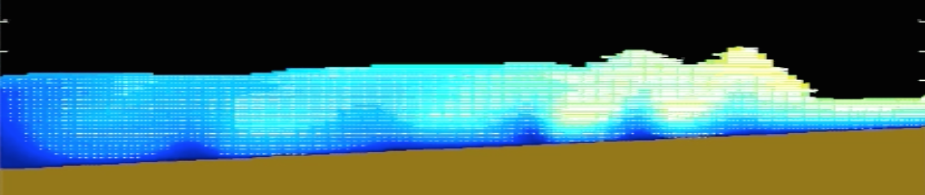
MONGOOSE – A 2DV CFD Model
A Model of New Generation Ocean Wave and Ocean Structure Engineering

Slide 2
Unix/Linux
Compiler
Make

Slide 3
JSOURCES
JSOURCES
h/4
~L/2
~L/20
ISOURCES
ISOURCEE

Slide 4
dxmn=1
0 m
300 m
800 m
XL(1)=0
NXL=400
NXR=400
XL(2)=800
Example for grid in x direction

Slide 5
Final structure
add
subtract

Slide 6
Final structure
add
subtract

Slide 7
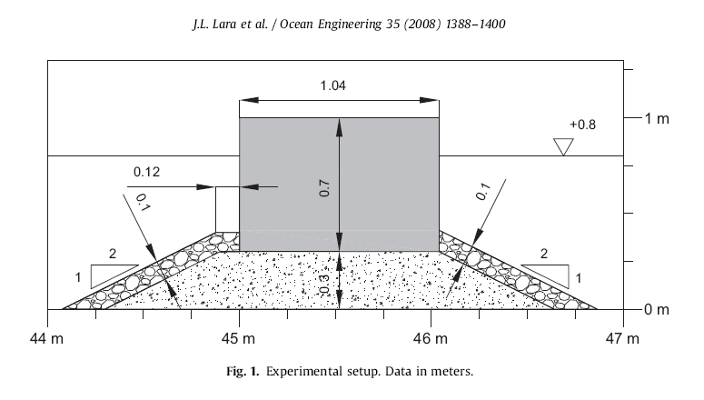
add
subtract

Slide 8
Porous I
add
subtract

Slide 9
Porous II
add
subtract

Slide 11
add
subtract
Solid structures

Slide 12
add
subtract
Solid structures

Slide 13
add
subtract
Solid structures

Slide 14
add
subtract
Porous structures

Slide 15
Final structure

Slide 16
F=0
F=1
(u,v), p
k,epsilon

