Slide 2
IBM force: SIB = (ub-U*)/dt -Sp
where
ub : target velocity
u0: velocity at boundary
ub
u0

Slide 3
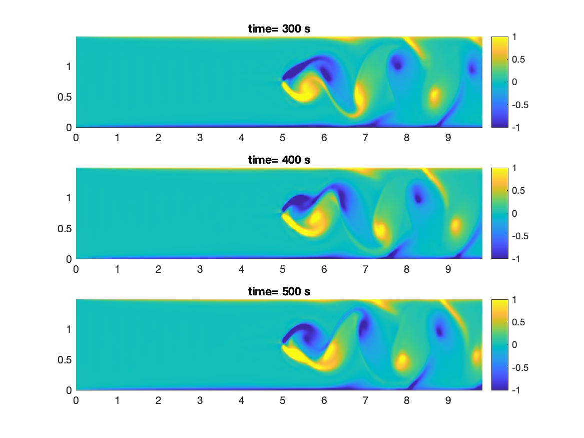
Preliminary result

Slide 4
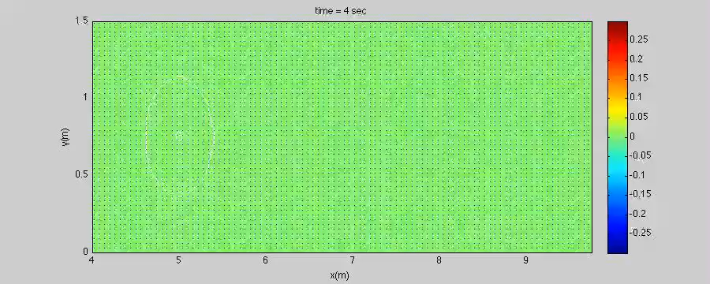
Preliminary result

Slide 5
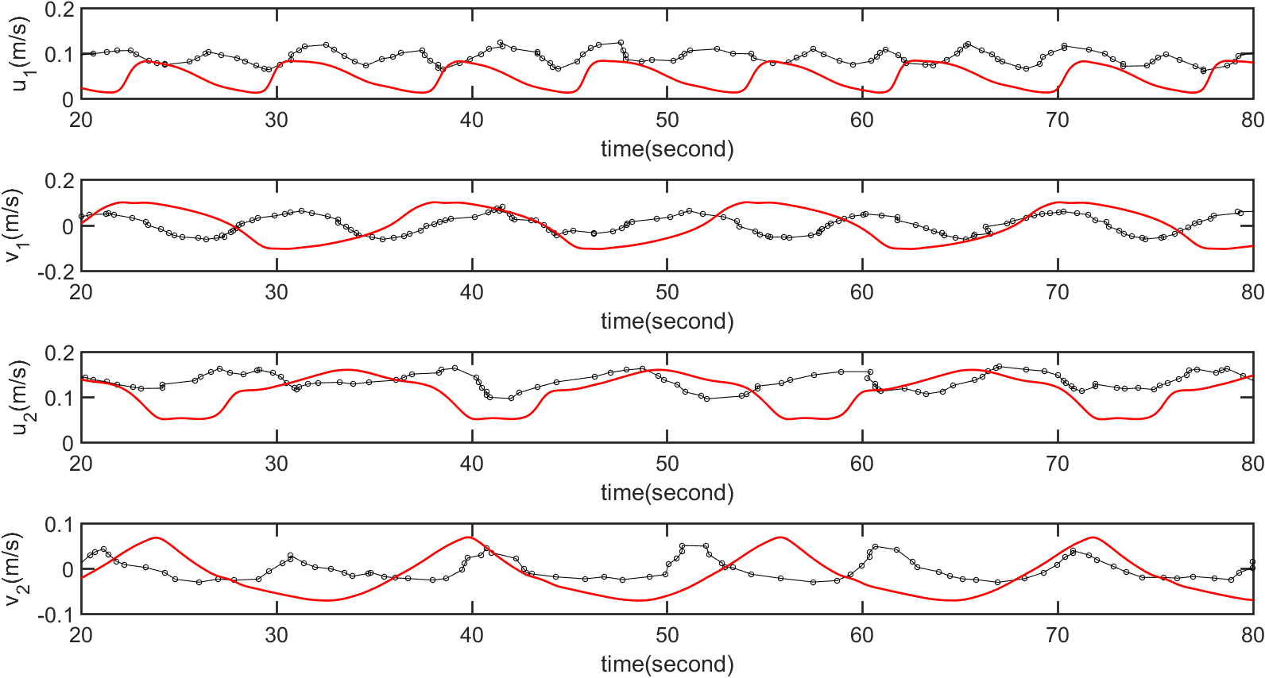

Slide 6
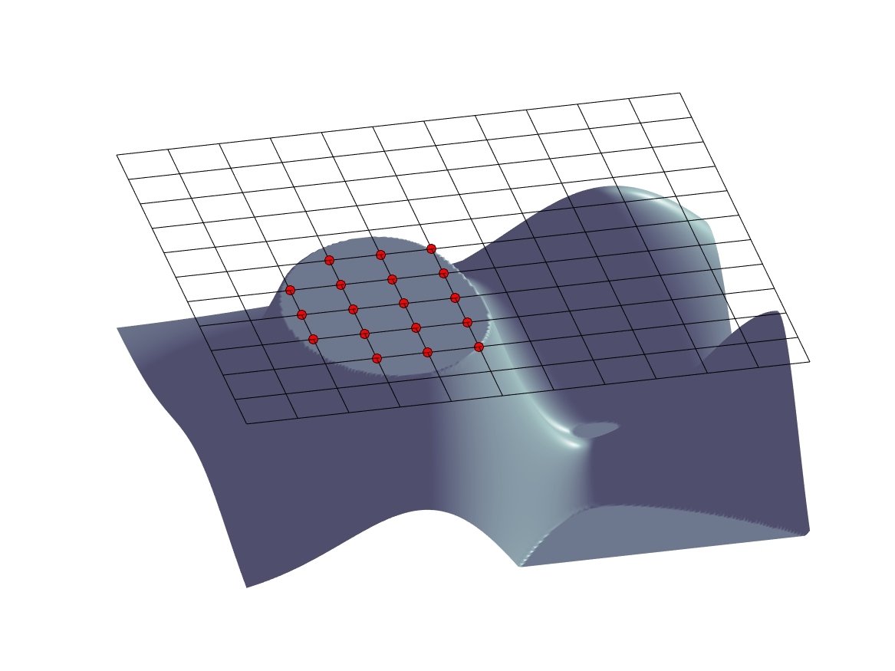
rx
ry

Slide 7
Wave surface
Z=0
Z_{s}
Z=-h
Z=-hL

