Slide 1
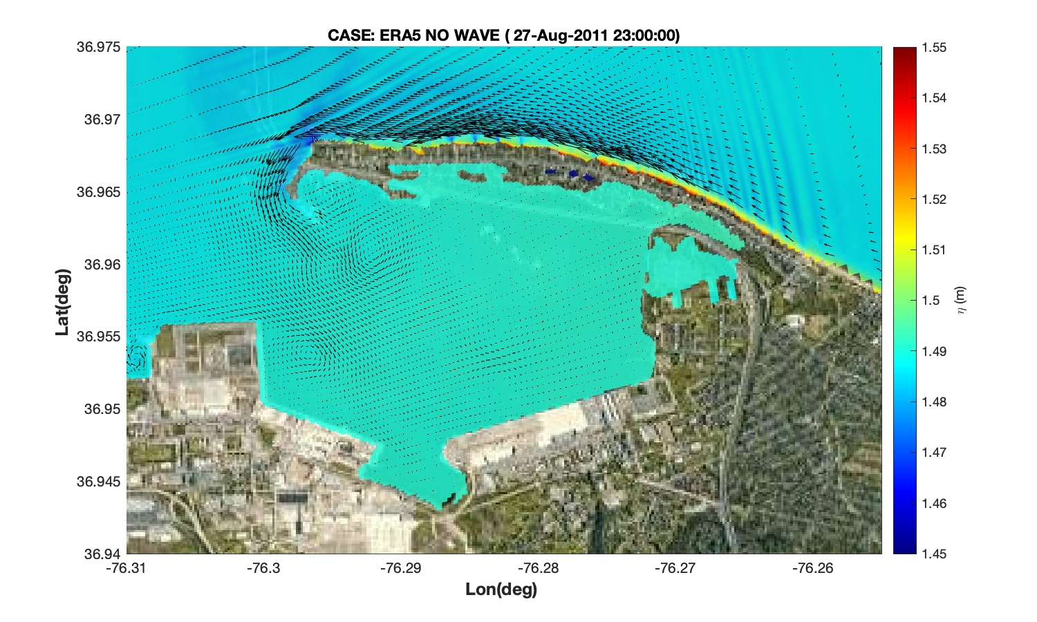
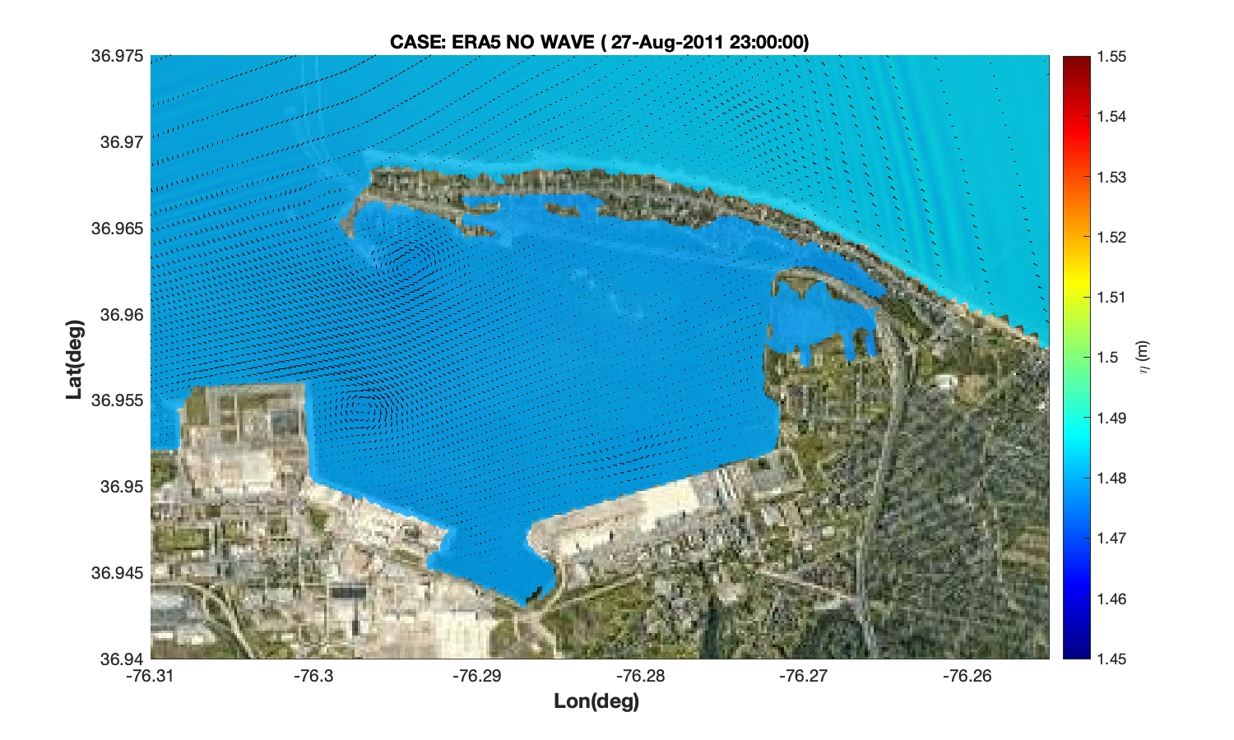
CASE: ERA5 WITH WAVE (27-Aug-2011 23:00:00)
CASE: ERA5 WITHOUT WAVE (27-Aug-2011 23:00:00)

