Slide 1
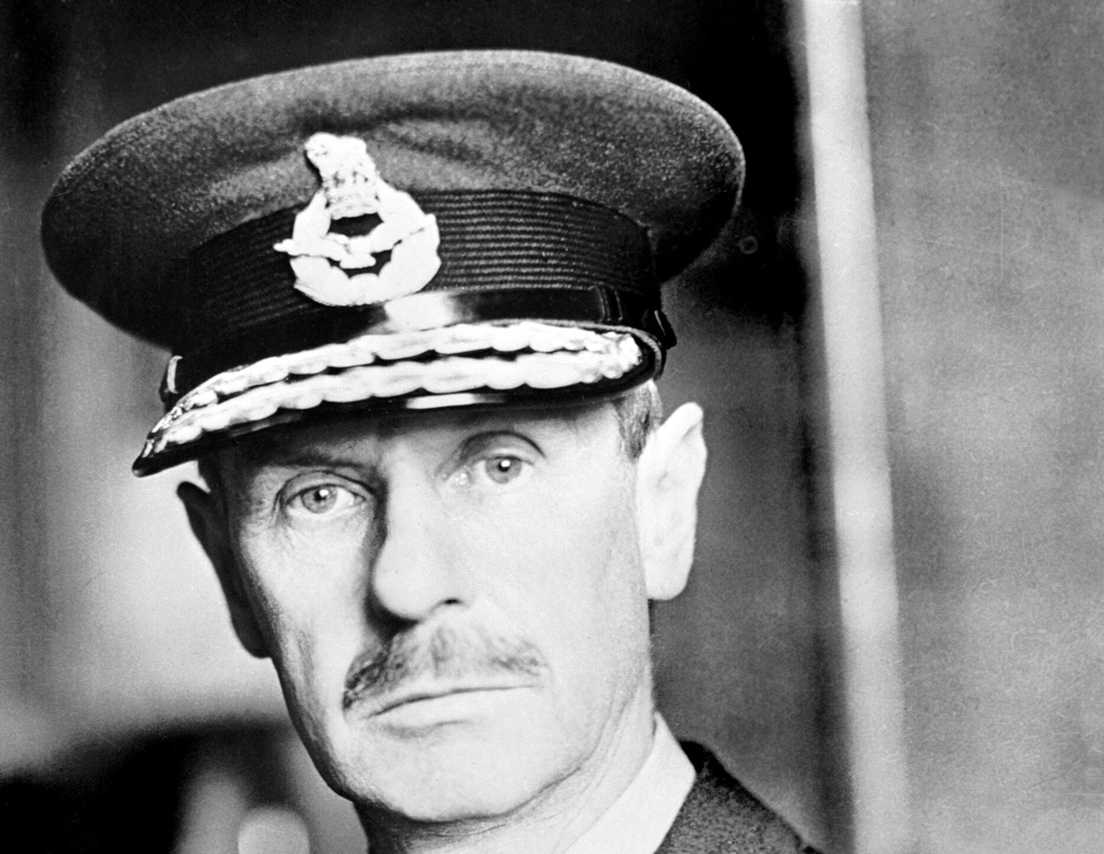
APSS1L01 group presentation
The Hong Kong Polytechnic University
Special edition: effective communication
Hugh Dowding and the Battle of Britain, 1940
The battle won by information
How Hugh Dowding's air defence network got each raid report to the right person in time, and what a student team can learn from it
By Group [number]: [member names]
Air Chief Marshal Sir Hugh Dowding, Commander-in-Chief of RAF Fighter Command
Imperial War Museums, D 1417 (public domain)
Notes:
[Speaker 1, about 20 seconds]
Good morning. Our leadership quality is effective communication. Our story is about a battle that was decided as much by information as by aircraft, and about the man who built the network that carried that information: Air Chief Marshal Hugh Dowding.

Slide 2
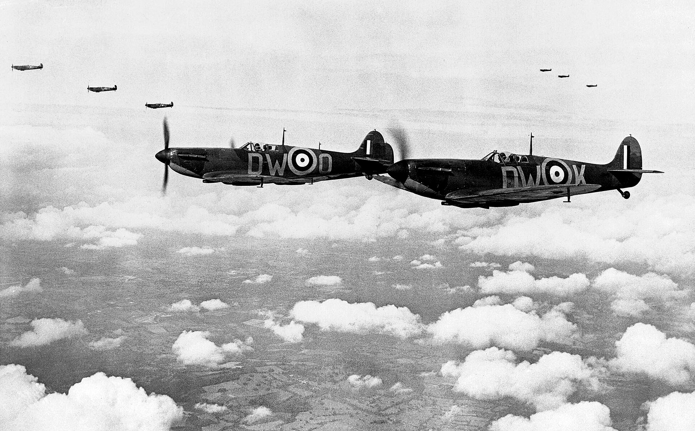
Opening
Britain stands alone
Summer 1940: France has fallen, and the German air force is just across the Channel
10 May
Germany attacks France, Belgium and the Netherlands.
22 June
France signs an armistice with Germany.
10 July
The Luftwaffe begins its attack on Britain. Germany cannot invade until it controls the air.
If you commanded Britain's fighters, where would you send them?
Spitfires of No. 610 Squadron from Biggin Hill in “vic” formation, 24 July 1940
Imperial War Museums, CH 740 (public domain)
Friends of the Battle of Britain Monument (n.d.)
Notes:
[Speaker 1, about 1 minute]
Imagine it is July 1940, and you command Britain's fighters. Germany has defeated France in six weeks, and on 22 June France signed an armistice. The German army stands on the French coast, and Britain is almost alone.
But Germany cannot simply sail across the Channel. Before any invasion, its air force must destroy the Royal Air Force. On 10 July, the attack begins. You can see the defenders here: Spitfires of No. 610 Squadron, photographed two weeks later.
Now, a question for you. German raids can come from anywhere along the coast. Where would you send these fighters?
Keep your answer in mind. It is exactly the problem Dowding faced.

Slide 3
Tomorrow's Leaders
Part 1 of 4
Part 1
1
The story
How did Britain meet every raid in time, with no fighters to spare?
Notes:
[Speaker 1, about 10 seconds]
Part 1, the story. One question runs through it: how did Britain meet every raid in time, with no fighters to spare?

Slide 4
Part 1: The story
750 British fighters, 2,250 German aircraft
Strength on 10 August 1940, counting only aircraft ready to fly
Fighter against fighter, the two sides were close. But Britain's fighters also had to find and stop more than 1,300 bombers.
German figures are “over” these numbers. Britain had 1,100 serviceable fighters, but trained pilots for only about 750.
A squadron sent to the wrong place could not reach the real raid in time.
Gleave (1991, p. 48)
Notes:
[Speaker 1, about 50 seconds]
First, the enemy, and it was a strong one. The Luftwaffe had just helped defeat Poland, Norway and France.
Look at the chart. On 10 August 1940, Germany had more than 1,300 bombers and more than 950 fighters ready to fly. Britain had 1,100 fighters ready to fly, but trained pilots for only about 750 of them.
So fighter against fighter, the two sides were close. The problem was the bombers. Britain's 750 fighters had to find and stop more than 1,300 bombers, while German fighters protected them.
So every squadron had to be in the right place. A squadron sent to the wrong place could not reach the real raid in time.

Slide 5
Part 1: The story
Twenty minutes to meet each raid
11 Group warned its controllers that raiders could be over London 20 minutes after the first radar plot
20 min
4 min
2 min
minutes of warning from a Kent radar station for a raid forming over France
minutes for the network to mark that raid on the operations room table
minutes, at times, for the 11 Group controller to decide
Every minute spent passing a report along was a minute less for the fighters to reach the raid.
“The Battle of Britain” (2015); Battle of Britain Bunker (n.d.)
Notes:
[Speaker 1, about 50 seconds]
And there was very little time.
A radar station in Kent could detect a raid forming over France about 20 minutes before it reached London. 11 Group, which defended London and the south-east, warned its controllers about exactly this.
Out of those 20 minutes, the network needed about 4 to put the raid on the operations room table. And at times the controller had about 2 minutes to decide.
So every minute spent passing a report along was a minute less for the fighters to reach the raid.

Slide 6
Part 1: The story
Seeing the raid was not enough
A radar operator sees 100 aircraft crossing the Channel. What happens next?
Option A
Option B
Phone the nearest airfield
Report to headquarters
A few fighters take off alone. Nobody else knows where the raid is going, and other airfields wait for orders.
Each level studies the report and passes an order down. The order reaches the pilots after the bombs have fallen.
The hard part was not seeing the raid. It was getting the right report to the right person in time.
Thought experiment based on the timings on slide 5.
Notes:
[Speaker 2, about 1 minute]
Let's try a thought experiment. You are a radar operator. On your screen, 100 aircraft are crossing the Channel. What do you do?
Option A: you phone the nearest airfield. A few fighters take off on their own. Nobody else knows where the raid is going, and the other airfields sit and wait.
Option B: you report to headquarters. Each level studies the report and passes an order down. By the time the order reaches the pilots, the bombs have already fallen.
Both options fail. So seeing the raid was only the start. The hard part was getting the right report to the right person in time. Britain solved this problem with a network built for exactly this job. Who built it?

Slide 7
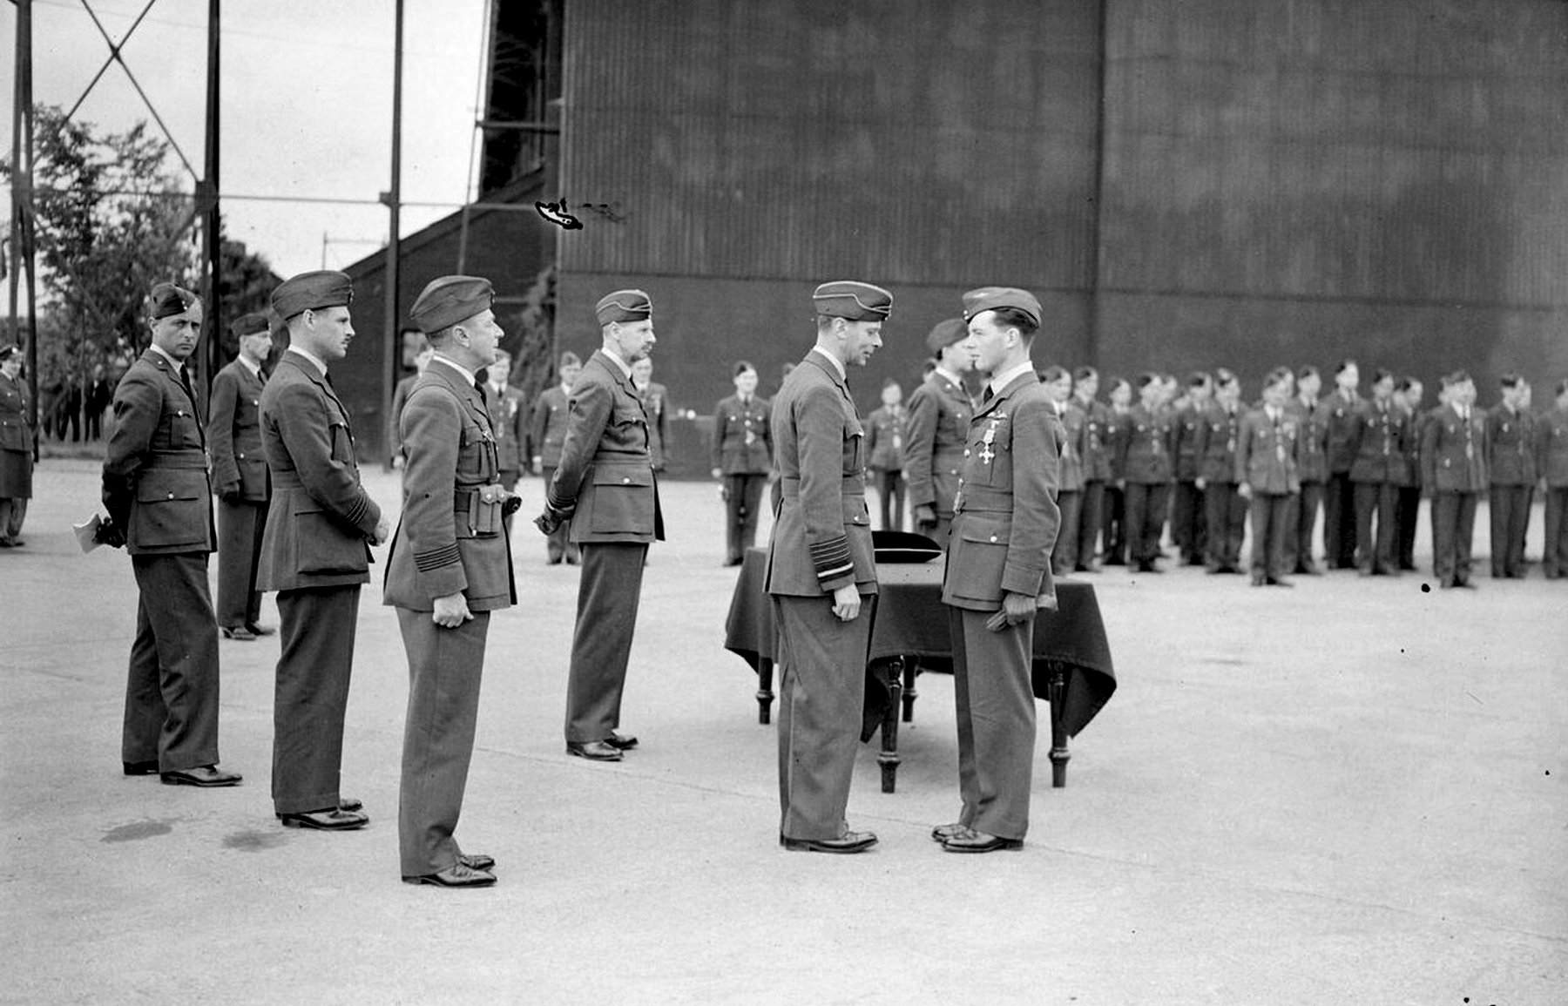
Part 1: The story
The man who built the network
Air Chief Marshal Hugh Dowding, head of RAF Fighter Command from 1936 to 1940
1935
As the RAF's head of research, he backs radar after a successful test near Daventry.
1936
He becomes the first head of Fighter Command, at Bentley Priory near London.
1936 to 1940
He links radar stations, observers, operations rooms and pilots into one network.
His idea, in our words: send each squadron to a raid that someone has already reported, instead of sending it to search the sky.
Dowding (centre, hands behind his back) as King George VI decorates a pilot at Hornchurch, 27 June 1940
Imperial War Museums, CH 442 (public domain)
Bournemouth University (n.d.); Royal Air Force Museum (n.d.-a); Imperial War Museums (n.d.-c)
Notes:
[Speaker 2, about 1 minute]
Hugh Dowding. In this photo from June 1940, he is the man in the centre with his hands behind his back, while the King decorates one of his pilots.
Dowding had one clear idea. In our words: send each squadron to a raid that someone has already reported, instead of sending it to search the sky.
In 1935, as the RAF's head of research, he backed radar after a successful test near Daventry. In 1936, he became the first head of Fighter Command. And over the next four years, he linked radar stations, observers, operations rooms and pilots into one network.
Let's follow a raid through that network, in four steps. Each step solves a problem left by the one before.

Slide 8
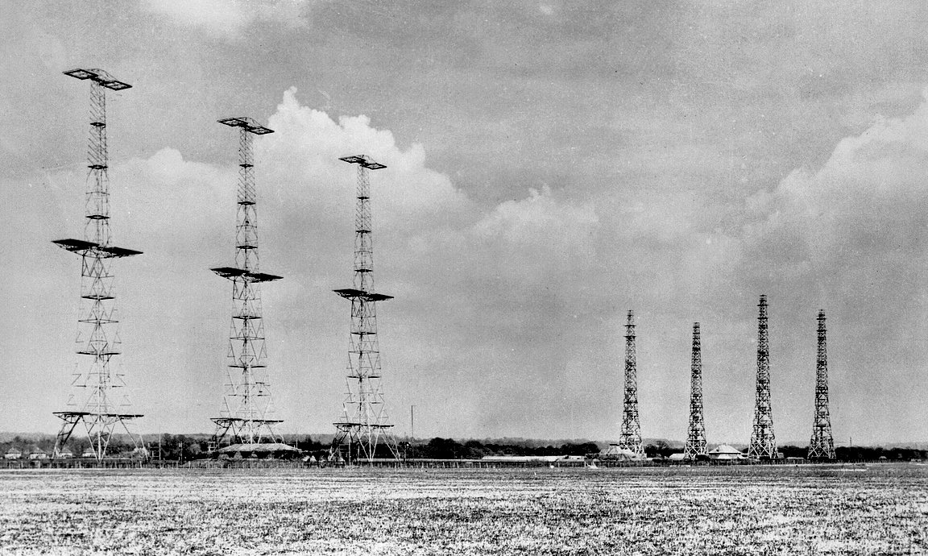
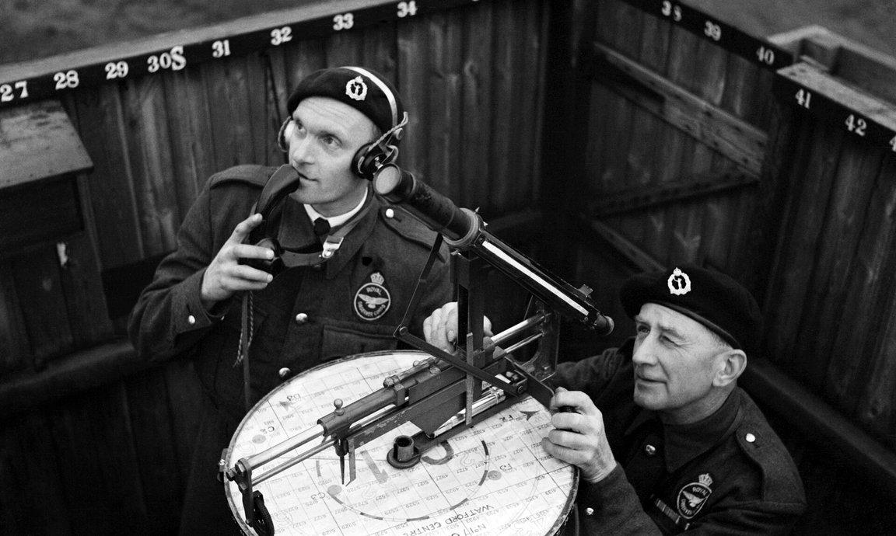
Part 1: The story
Step 1: Report
Radar stations faced out to sea, so volunteers watched the land
Chain Home radar
About 20 stations on the coast. They could not track aircraft over land, and their plots were not always accurate.
Observer Corps
About 30,000 volunteers at about 1,000 posts. They spotted aircraft by eye and reported them by telephone.
Chain Home radar station at Poling, Sussex, photographed in 1945
Imperial War Museums, CH 15173 (public domain)
An observer reports by chest telephone at Kings Langley, 1941 to 1945
Imperial War Museums, CH 8215 (public domain)
Next problem Several radar plots often described the same raid, and some disagreed about its position or strength.
Historic England (2020); Royal Air Force Museum (n.d.-b); Imperial War Museums (n.d.-b)
Notes:
[Speaker 2, about 1 minute]
Step 1: report.
On the left is a Chain Home radar station. About 20 of them stood along the coast. But radar had a weakness: the stations faced out to sea. Once the raid crossed the coast, radar could not track it.
So what did Dowding do? He used people. In the middle is the Observer Corps: about 30,000 volunteers at about 1,000 posts across the country. When a raid crossed the coast, they spotted it by eye and reported it by telephone.
But the radar plots had a problem of their own, shown at the bottom. Several plots often described the same raid, and some disagreed about where it was or how big it was. If every plot went straight to a commander, he would see far more raids than really existed.

Slide 9
Part 1: The story
Step 2: Filter
In the Filter Room, staff compared the radar plots and kept one track per raid
Command table
At the same time
Chain Home radar
Plots of raids over the sea
Filter Room
One track per raid
Each filtered track went by telephone to the Command, Group and Sector tables at the same moment, so every level saw the same raid.
Group tables
Observer Corps
Reports of raids over land
Observer Centres
Plot reports for their area
Sector tables
Next problem Commanders at three levels had to read the same table quickly and know how old each plot was.
Dowding (1946); Imperial War Museums (n.d.-c)
Notes:
[Speaker 2, about 1 minute]
Step 2: filter.
Radar reports went first to the Filter Room at Fighter Command headquarters. There, staff compared the plots, removed the duplicates and kept one track for each raid. Observer reports went to Observer Centres, which plotted them for their own area.
This is the step that Option B lacked. In Dowding's own account, each filtered track went by telephone to the Command, Group and Sector tables at the same time. Command, Group and Sector all saw the same raid in the same place at the same moment. Nobody waited for an order to be passed down.
But now three levels of commanders had to read the same table quickly, and they had to know how old each plot was.

Slide 10
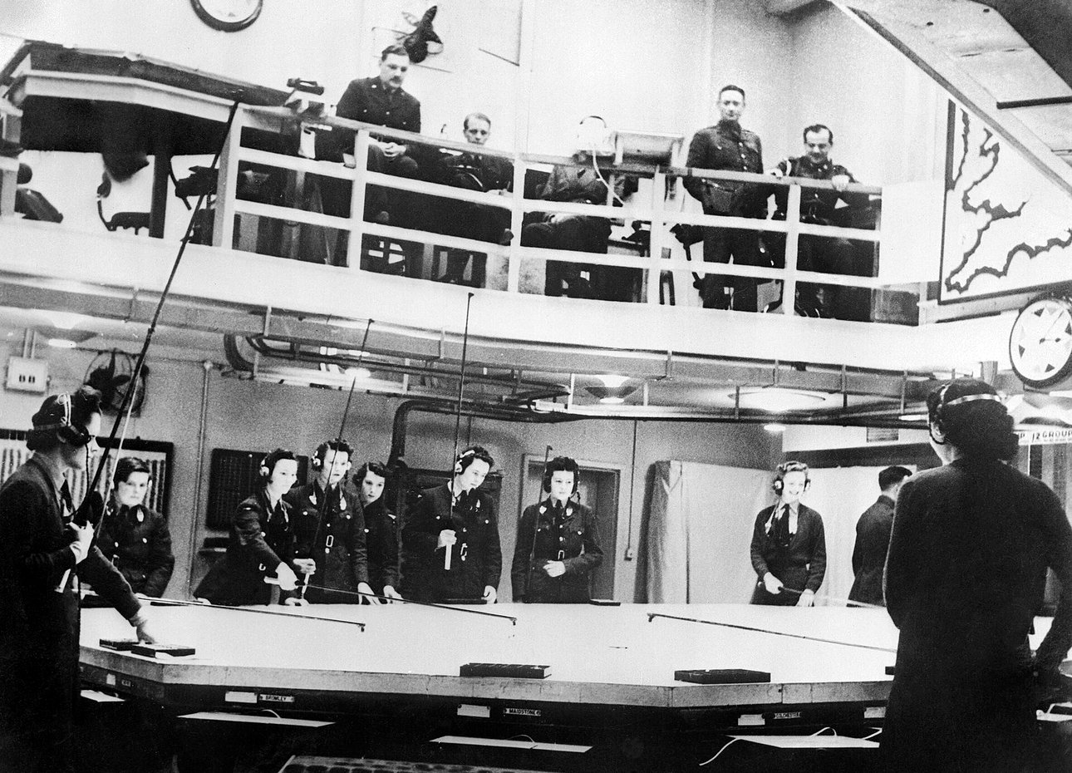
Part 1: The story
Step 3: Display
Every operations table used the same symbols
Sector clock
Its red, yellow and blue segments each span 5 minutes. Plotters used markers of the same colours, so a controller could see how old each plot was.
Raid 12
30+
Raid block
A block on the table showed the raid's name and estimated strength, and an arrow showed its direction.
A Readiness
B Left ground
Tote board
A board showed the state of each squadron, such as “at readiness” or “left ground”.
The operations room at Fighter Command headquarters, Bentley Priory (date not recorded)
Imperial War Museums, C 1869 (public domain)
Next problem A pilot in a cockpit needed his orders in a few words.
Royal Air Force Museum (n.d.-c); Imperial War Museums (2020, n.d.-c)
Notes:
[Speaker 2, about 1 minute]
Step 3: display.
This photo shows the operations room at Fighter Command headquarters, with plotters around the map table and officers above.
The sector clock had red, yellow and blue segments, each 5 minutes long. Plotters used markers of the same colour, so a controller could see at once how old each plot was.
A raid block showed the raid's name and its estimated strength, and an arrow showed its direction. The tote board showed the state of each squadron, such as "at readiness" or "left ground".
A plotter at headquarters and a controller at a sector station read their own tables in the same way. One last problem remained: the pilot. A pilot in a cockpit needed his orders in a few words.

Slide 11
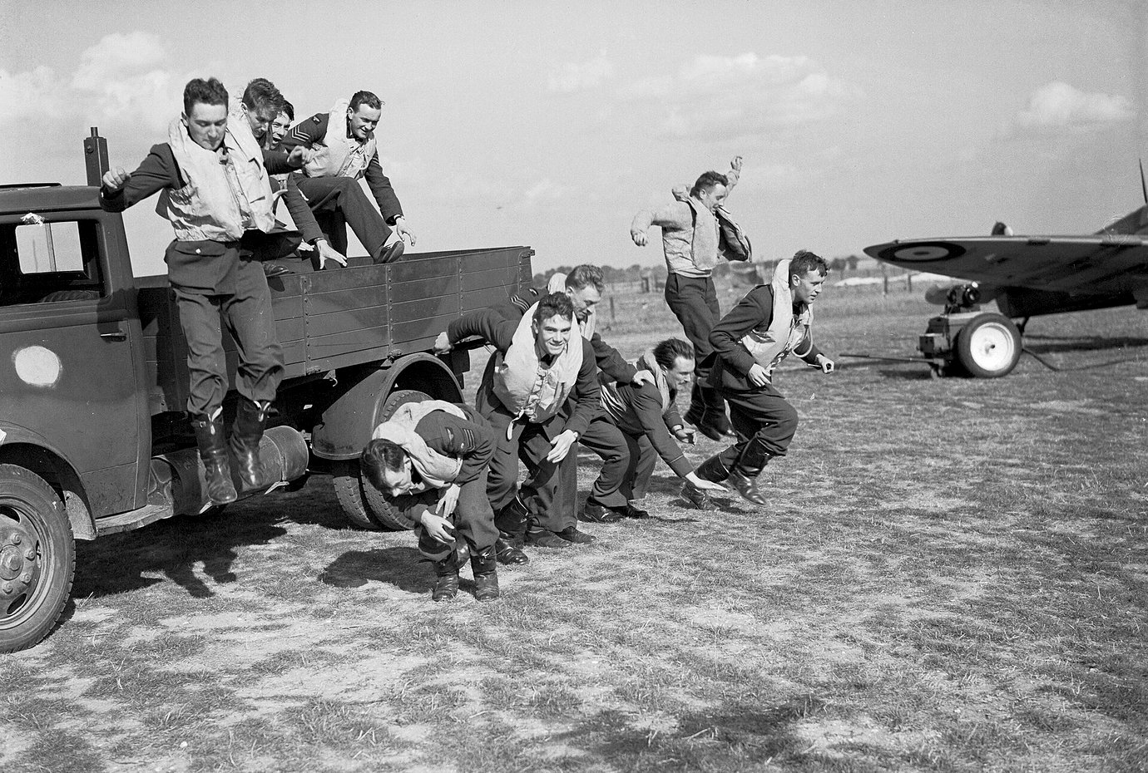
Part 1: The story
Step 4: Order
A sector controller gave each squadron its course and height by radio, in a few code words
Code word | Meaning
Scramble | Take off
Vector 230 | Fly a course of 230 degrees
Angels 20 | Fly at 20,000 feet
Pancake | Land
Group decided which sector met each raid and with how many fighters. The sector controller directed the pilots.
Pilots of No. 19 Squadron stage a “scramble” for the camera at Fowlmere, September 1940
Imperial War Museums, CH 1398 (public domain)
Dowding (1946)
Notes:
[Speaker 3, about 1 minute]
Step 4: order.
Group decided which sector met each raid and with how many fighters. Then the sector controller spoke to the pilots by radio, in the code words Dowding lists in his despatch.
"Scramble" meant take off. "Vector 230" meant fly a course of 230 degrees. "Angels 20" meant fly at 20,000 feet. "Pancake" meant land. A whole order took only a few words.
The photo shows pilots of No. 19 Squadron running to their aircraft. It was staged for the camera, but a real scramble looked much like this.
So: report, filter, display, order. That is the path from a radar plot over France to a squadron climbing to meet the raid.

Slide 12
Part 1: The story
“We had nothing like it”
Adolf Galland, a German fighter commander in 1940, on the British network
“From the first the British had an extraordinary advantage, never to be balanced out at any time during the whole war, which was their radar and fighter control network and organisation. It was for us a very bitter surprise. We had nothing like it.”
Galland (as cited in Wood, 1991)
Notes:
[Speaker 3, about 45 seconds]
How well did it work? Let's ask the enemy.
Adolf Galland was a German fighter commander in 1940. He later wrote that the British had "an extraordinary advantage", which was "their radar and fighter control network and organisation". And then: "We had nothing like it."

Slide 13
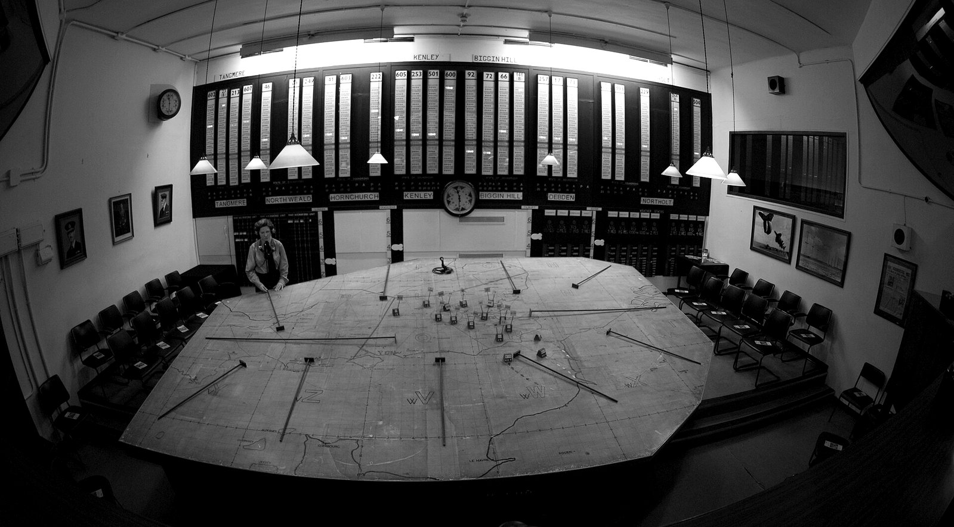
Part 1: The story
No reserves, so every order had to be right
15 September 1940: Churchill watches the plotting table at No. 11 Group, Uxbridge
“I now asked, ‘What other reserves have we?’
‘There are none,’ said Air Vice Marshal Park.”
Winston Churchill, recalling the visit. Park commanded No. 11 Group.
The preserved No. 11 Group operations room at Uxbridge, photographed in 2010
Photo: Danielstirland, CC0, via Wikimedia Commons
A squadron sent to the wrong place could not be replaced. Germany lost about 56 to 60 aircraft that day, and on 17 September Hitler postponed the invasion.
Churchill (as cited in Glines, 1990); Price (2003)
Notes:
[Speaker 4, about 1 minute]
15 September 1940. Churchill visits the No. 11 Group operations room at Uxbridge and watches the plotters move marker after marker across the table as German raids come in. He later wrote: "I now asked, 'What other reserves have we?' 'There are none,' said Air Vice Marshal Park."
Park had committed every squadron he had. With no reserves left, a squadron sent to the wrong place could not be replaced. Every order had to send a squadron to a real raid. This is the moment the network was built for.
Germany lost about 56 to 60 aircraft that day. Two days later, Hitler postponed the invasion of Britain until further notice.

Slide 14
Part 1: The story
Right information, right person, in time
Our definition: the right information reaches the right person in time, in a form they can act on
The right information, to the right person
In a form that person can act on
In time
Keyton (2011): communication is “transmitting information and common understanding from one person to another”.
Spitzberg (2013): competence is an impression of effectiveness and appropriateness, formed by the people you communicate with.
Neither scholar mentions time.
In the network
One filtered track per raid reached every operations table.
In the network
“Vector 230, Angels 20” told a pilot where to fly, in a few words.
In the network
A raid could reach London about 20 minutes after radar first detected it.
Keyton (2011, as cited in Lunenburg, 2010); Spitzberg (2013); “The Battle of Britain” (2015)
Notes:
[Speaker 4, about 1.25 minutes]
So what is effective communication? Our definition: effective communication gets the right information to the right person in time, in a form that person can act on.
Each part of this definition comes from somewhere.
"The right information, to the right person" comes from Keyton, as cited in Lunenburg: communication is "transmitting information and common understanding from one person to another". In the network, one filtered track per raid reached every operations table.
"In a form that person can act on" comes from Spitzberg, who describes competence as an impression of effectiveness and appropriateness. "Vector 230, Angels 20" told a pilot where to fly, in a few words.
"In time" comes from the story itself. Neither scholar mentions time, but a raid could reach London about 20 minutes after radar first detected it.
So the two scholars agree that a message must reach the other person. They differ in focus: Keyton looks at what is transmitted, while Spitzberg looks at how the receiver judges it.

Slide 15
Tomorrow's Leaders
Part 2 of 4
Part 2
2
Two theories
Why did the network work?
Notes:
[Speaker 4, about 10 seconds]
Part 2. Two theories help us answer one question: why did the network work?

Slide 16
Part 2: Two theories
Theory 1: The 7 Cs
Murphy, Hildebrandt and Thomas (1997) list seven qualities of a good message; we phrase each as a question
Clarity
Correctness
Conciseness
Concreteness
What is the one main point?
Are the facts and tone right?
Can it be said in fewer words?
Is it backed by specific facts?
Completeness
Consideration
Courtesy
Best suited to one message from one sender
Does the reader have all they need to act?
Is it written from the reader's side?
Is it respectful, even when firm?
Murphy et al. (1997)
Notes:
[Speaker 4, about 1 minute]
Our first theory is the 7 Cs of communication, from the business communication textbook by Murphy, Hildebrandt and Thomas. They list seven qualities of a good message. We have turned each one into a question a sender can ask.
Clarity: what is the one main point? Correctness: are the facts and tone right? Conciseness: can it be said in fewer words? Concreteness: is it backed by specific facts? Completeness: does the reader have all they need to act? Consideration: is it written from the reader's side? Courtesy: is it respectful, even when firm?
The 7 Cs work best on a single message from one sender. In Part 3 we test one of Dowding's radio orders against them.

Slide 17
Part 2: Two theories
Theory 2: Shannon and Weaver
A message travels from a source to a destination, and noise can distort it on the way
Information source
Transmitter
Channel
Receiver
Destination
Noise source
Weaver's three levels of communication problems
A. Technical
Can the symbols be sent accurately?
B. Semantic
Do the symbols carry the intended meaning?
C. Effectiveness
Does the meaning change behaviour as intended?
Shannon & Weaver (1949)
Notes:
[Speaker 5, about 1.25 minutes]
Our second theory comes from engineering. In 1949, Claude Shannon and Warren Weaver described communication as a chain.
An information source creates a message. A transmitter turns it into a signal. The signal travels through a channel. A receiver turns it back into a message, and the message reaches its destination. On the way, a noise source can distort the signal.
Weaver added three levels of problems. Level A, technical: can the symbols be sent accurately? Level B, semantic: do the symbols carry the intended meaning? Level C, effectiveness: does the meaning change behaviour as intended?
Shannon developed it while working on telephone systems, so it fits a network built from telephone lines and radios.

Slide 18
Part 2: Two theories
Comparing the two theories
The 7 Cs apply to one message, while Shannon and Weaver's model follows a message through a network
 | 7 Cs | Shannon and Weaver
Focus | The quality of one message | The path of a message, and where noise enters
Strength | A quick checklist anyone can apply | Shows where a message can be lost or distorted
Weakness | A checklist rather than a tested theory | One-way: no feedback, and nothing on the relationship between people
Culture | Assumes meaning is in the explicit words, which suits low-context cultures | Also assumes meaning travels in the message, not in the context
Murphy et al. (1997); Shannon & Weaver (1949); Craig (1999); Hall (1976); Cardon (2008)
Notes:
[Speaker 5, about 1.25 minutes]
Let's compare the two theories.
The 7 Cs check the quality of one message, and anyone can use them quickly. Shannon and Weaver's model follows a message through a network and shows where it can be lost or distorted.
Weakness: the 7 Cs are a checklist rather than a tested theory. Shannon and Weaver's model is one-way. It has no feedback, and it says nothing about the relationship between people. Craig notes that this "transmission" view of communication is often criticised as too simple.
Culture: both theories assume that meaning sits in the explicit message. Hall called this low-context communication. Hong Kong is often described as more high-context than Britain. In high-context cultures, much of the meaning depends on the relationship and the situation. One caution: Cardon's 2008 review found that Hall's model has rarely been tested. So the 7 Cs help us check one order, and Shannon and Weaver help us check the whole network. Part 3 uses both.

Slide 19
Tomorrow's Leaders
Part 3 of 4
Part 3
3
The theories applied
How do the theories explain the network, and what do they miss?
Notes:
[Speaker 5, about 10 seconds]
Part 3. How do the theories explain the network, and what do they miss?

Slide 20
Part 3: The theories applied
The network, part by part
Each part of the model matches a part of the network, and the network added the feedback the model leaves out
Source
Transmitter
Channel
Noise
Receiver
Destination
Radar stations and observers
Filter Room and plotters turn reports into tracks and markers
Telephone lines and radio
Duplicate, conflicting and old plots
Operations tables and pilots' radios
Controllers and pilots
Feedback, not in the original model: radio position fixes and pilots' reports
The network reduced all three of Weaver's problems but did not remove them: radar plots were not always accurate, and commanders still disagreed.
Shannon & Weaver (1949); Dowding (1946); Imperial War Museums (n.d.-c)
Notes:
[Speaker 5, about 1.25 minutes]
Let's put the network on Shannon and Weaver's model.
Read the top row against the bottom row. The source is the radar stations and observers. The transmitter is the Filter Room and the plotters. The noise is duplicate, conflicting and old plots. The destination is the controllers and the pilots.
Now look at the dashed line. The network also had feedback: radio stations fixed the position of the RAF's own fighters, and pilots reported what they saw. The original model has no feedback, so here the network went further than the theory.
The network reduced all three of Weaver's problems. Level A: the Filter Room removed duplicate and conflicting plots before they reached the tables. Level B: shared symbols and code words carried the same meaning to everyone. Level C: squadrons met the raids. But it did not remove the problems. Radar plots were not always accurate, and on the next slide two commanders disagree about what to do with the same reports.

Slide 21
Part 3: The theories applied
One radio order against the 7 Cs
An example order built from the code words in Dowding's despatch: “Scramble. Vector 230. Angels 20.”
19 of 21
Clarity
One action: take off and fly to the raid
Correctness
Course and height come from the filtered track
Conciseness
Five words
By the checklist, the order fails only on courtesy: it has no “please”. In a cockpit, a short order respects the pilot's time, so courtesy depends on a situation the checklist does not ask about.
Concreteness
An exact course and an exact height
Completeness
When, where and how high to fly
Consideration
Only words a pilot can act on while flying
Courtesy
No “please”: in combat, speed came first
Dowding (1946); Murphy et al. (1997). Scores are our group's judgment.
Notes:
[Speaker 6, about 1.25 minutes]
Now the 7 Cs. We built an example order from the code words in Dowding's despatch: "Scramble. Vector 230. Angels 20." Our group scored it from one to three dots. It is clear, correct, five words long, exact, complete, and written for a pilot who is flying.
Courtesy scores only one dot. There is no "please". In combat, speed came first.
So, by the checklist, the order scores 19 of 21. We gave courtesy one dot to show a weakness of the 7 Cs. In an office, an order with no "please" sounds rude. In a cockpit, a short order respects the pilot's time. The checklist does not ask about the situation, so the same five words could score one dot or three.

Slide 22
Part 3: The theories applied
Three limits of our analysis
The theories leave out disagreement, our story credits one man, and most of our sources are British
1
Same network, different tactics
Keith Park and Trafford Leigh-Mallory, two of Dowding's group commanders, received reports from the same network and still disagreed over how to use their squadrons.
If thousands of people ran the network, how much of its success belongs to Dowding?
2
Many people built the network
It built on First World War air defence and scientists' radar work, and thousands of plotters and observers ran it.
3
Our sources lean one way
Most of our sources are British or RAF institutions, and Galland gave his verdict after the war.
Imperial War Museums (n.d.-a, n.d.-c); Wood (1991)
Notes:
[Speaker 6, about 1.25 minutes]
Our analysis has three limits.
First, same network, different tactics. Keith Park and Trafford Leigh-Mallory, two of Dowding's group commanders, received reports from the same network and still disagreed over how to use their squadrons. Shannon and Weaver explain how information moved, but not how people agreed on what to do with it.
Second, many people built the network. It built on air defence from the First World War and on scientists' radar work, and thousands of plotters and observers ran it every day.
Third, most of our sources come from British or RAF institutions, and Galland wrote after the war.
Here's a question for you: if thousands of people ran the network, how much of its success belongs to Dowding?

Slide 23
Tomorrow's Leaders
Part 4 of 4
Part 4
4
Lessons for us
How can a student team get the right information to the right person in time?
Notes:
[Speaker 6, about 10 seconds]
Part 4. How can a student team get the right information to the right person in time?

Slide 24
Part 4: Lessons for us
Our group chats have the same problem
Amy posts in a five-person group chat: “Can someone do the theory part?” What happens next?
Option A
Option B
Nobody replies
Two members both start
Each member thinks someone else will do it. On Thursday, the theory part is still empty.
They write the same section twice, and nobody starts the comparison table.
Like the radar operator in 1940, Amy has the information. The hard part is getting it to the right person, in a form that person can act on.
Example from our own group work.
Notes:
[Speaker 6, about 1 minute]
Our group projects have the same problem as the radar operator.
Amy posts in a five-person group chat: "Can someone do the theory part?" What happens next?
Option A: nobody replies. Each member thinks someone else will do it, and on Thursday the theory part is still empty.
Option B: two members both start. They write the same section twice, and nobody starts the comparison table.
Like the radar operator in 1940, Amy has the information. The hard part is getting it to the right person, in a form that person can act on. Dowding's network gives us two lessons.

Slide 25
Part 4: Lessons for us
Lesson 1: Keep one shared tracker
Run a group project through the same four steps as Dowding's network
Step | In 1940 | In our project
Report | Radar and observers reported to one network | Post every update in one shared tracker, not in side chats
Filter | The Filter Room removed duplicate plots | One coordinator merges duplicate or conflicting updates twice a week
Display | The tote board used fixed words | Use four status words: Not started, Drafting, Ready for review, Done
Order | “Vector 230, Angels 20” | Write each request as owner, task and deadline: “Ming: theory slides, Thursday 8 pm”
Example tracker
Task | Owner | Status | Due
Story | Amy | Done | Tue
Theory slides | Ming | Drafting | Thu
Comparison table | Jason | Not started | Thu
Everyone can see that the comparison table has an owner but has not started.
Evidence In a flight simulation study, pairs who shared an understanding of the task and of each other worked together better and performed better.
For students Rotate the coordinator each week, so one person does not do all the filtering.
Mathieu et al. (2000); Dowding (1946)
Notes:
[Speaker 6, about 1.5 minutes]
Lesson 1: keep one shared tracker, and run it through the same four steps as Dowding's network.
Report: radar and observers reported to one network, so everyone posts updates in one shared tracker, not in side chats.
Filter: the Filter Room removed duplicate plots, so one coordinator merges duplicate or conflicting updates twice a week.
Display: the tote board used fixed words, so the tracker uses four status words: not started, drafting, ready for review, done.
Order: a controller said "Vector 230, Angels 20", so every request names an owner, a task and a deadline: "Ming: theory slides, Thursday 8 pm."
Look at the example tracker. Everyone can see that the comparison table has an owner, Jason, but has not started. Amy's problem from the last slide cannot happen.
Research supports the goal. In a flight simulation study, Mathieu and colleagues found that pairs who shared an understanding of the task and of each other worked together better and performed better. The study did not test trackers. The tracker is our way to build that shared understanding in a student team.
One tip for students: rotate the coordinator each week, so one person does not do all the filtering.

Slide 26
Part 4: Lessons for us
Lesson 2: Confirm what you heard
Dowding's network checked its information with feedback, which Shannon and Weaver's model leaves out
1
Listen
Read the whole request.
Amy's chat, with a paraphrase
Amy: Can you do the theory part?
Ming: So you need the two theory slides by Thursday, with APA citations?
Amy: Yes, and the comparison table too.
2
Paraphrase
Repeat it in your own words.
3
Check
Ask: “Did I get that right?”
4
Act
Start once the other person confirms.
Evidence In a study of 115 people, speakers felt more understood when the listener paraphrased and asked follow-up questions than when the listener gave advice or only short replies.
For students Use it for every request with a deadline. A paraphrase checks the request without saying the other person was unclear.
Adapted from Rogers & Farson (1957/2021); Weger et al. (2014)
Notes:
[Speaker 6, about 1.25 minutes]
Lesson 2: confirm what you heard.
Shannon and Weaver's model has no feedback, but Dowding's network did, through radio position fixes and pilots' reports. A team can add feedback in four steps, adapted from the active listening work of Carl Rogers and Richard Farson.
Listen to the whole request. Paraphrase it in your own words. Check: "Did I get that right?" And start once the other person confirms.
On the right is Amy's chat again. Ming's paraphrase makes Amy remember the comparison table, which Ming would otherwise have left out.
In a 2014 study of 115 people, Weger and colleagues found that speakers felt more understood when the listener paraphrased and asked follow-up questions than when the listener gave advice or only short replies. The study measured how understood people felt, not fewer mistakes, so our chat is an example, not proof.
Use this for every request with a deadline. A paraphrase checks the request without saying the other person was unclear.

Slide 27
Tomorrow's Leaders
Final edition
Germany had the aircraft. Britain had the network.
Questions for you
Where does information get lost in your group projects?
The network got the right information to the right person in time, which is our definition of effective communication.
Who in your team merges the updates, the way the Filter Room did?
Send every update to one shared tracker
Write each request as owner, task and deadline
Confirm what you heard before you act
Notes:
[Speaker 1, about 45 seconds, then Q&A]
Let's go back to our first question: if you commanded Britain's fighters, where would you send them? Dowding's answer was: only where the operations table showed a raid was going. On 15 September, Park had no squadron left in reserve, yet the Germans lost about 56 to 60 aircraft. Germany had more aircraft. Britain had a network that got the right information to the right person in time, and that is our definition of effective communication.
For our own teams, three habits: send every update to one shared tracker, write each request as owner, task and deadline, and confirm what you heard before you act.
Two questions for you. Where does information get lost in your group projects? And who in your team merges the updates, the way the Filter Room did?
Thank you. We're happy to take your questions.
Prepared answers for likely questions:
- "Did Britain win only because of the network?" No. The pilots' skill, aircraft production and German mistakes, such as the switch to London, also mattered. The network made the best use of a limited force.
- "Was the network Dowding's idea alone?" No. It built on First World War air defence and on radar science. Dowding's contribution was to organise these parts into one network and to insist that information was filtered and shared.
- "Why Shannon and Weaver, not a newer model?" Their model describes a message moving through a technical system, which is what the network was. Its missing feedback loop is also our Lesson 2.

Slide 28
References
References
Battle of Britain Bunker. (n.d.). Virtual bunker. Retrieved November 11, 2026, from https://battleofbritainbunker.co.uk/virtual-resources/
The Battle of Britain: A not so narrow margin. (2015). Air Power Review, 18(2). https://www.raf.mod.uk/what-we-do/centre-for-air-and-space-power-studies/aspr/apr-vol18-iss2-7-pdf/
Bournemouth University. (n.d.). The Daventry demonstration. Retrieved November 11, 2026, from https://histru.bournemouth.ac.uk/Oral_History/Talking_About_Technology/radar_research/the_daventry_demonstration.html
Bridge, P/O. (n.d.). The Royal Observer Corps, 1939-1945 [Photograph]. Imperial War Museums (CH 8215). Wikimedia Commons. https://commons.wikimedia.org/wiki/File:The_Royal_Observer_Corps,_1939-1945._CH8215.jpg
Cardon, P. W. (2008). A critique of Hall's contexting model: A meta-analysis of literature on intercultural business and technical communication. Journal of Business and Technical Communication, 22(4), 399–428. https://doi.org/10.1177/1050651908320361
Craig, R. T. (1999). Communication theory as a field. Communication Theory, 9(2), 119–161. https://doi.org/10.1111/j.1468-2885.1999.tb00355.x
Danielstirland. (2010). Plotting table [Photograph]. Wikimedia Commons. https://commons.wikimedia.org/wiki/File:Plotting_Table.jpg
Daventry, B. J. (1940). Supermarine Spitfire Mark IAs of No 610 Squadron, Royal Air Force based at Biggin Hill, Kent, flying in three 'vic' formations [Photograph]. Imperial War Museums (CH 740). Wikimedia Commons. https://commons.wikimedia.org/wiki/File:Supermarine_Spitfire_Mark_Is_of_No._610_Squadron_based_at_Biggin_Hill,_flying_in_%27vic%27_formation,_24_July_1940._CH740.jpg
Devon, S. A. (1940). Pilots of No 19 Squadron, Royal Air Force 'scramble' for the photographer, from the back of a lorry at Fowlmere [Photograph]. Imperial War Museums (CH 1398). Wikimedia Commons. https://commons.wikimedia.org/wiki/File:Pilots_of_No._19_Squadron_RAF_stage_a_mock_%27scramble%27_from_the_back_of_a_truck_at_Fowlmere_near_Duxford,_September_1940._CH1398.jpg
Dowding, H. C. T. (1946, September 10). The Battle of Britain [Despatch]. Supplement to The London Gazette, (37719), 4543–4571. https://www.thegazette.co.uk/London/issue/37719/supplement/4543
Notes:
References, continued.

Slide 29
References
References (continued)
Friends of the Battle of Britain Monument. (n.d.). Key facts about the Battle of Britain. Retrieved November 11, 2026, from https://bbm.org.uk/the-battle/battle-key-facts/
Gleave, T. (1991). August and September 1940. In H. Probert & S. Cox (Eds.), The battle re-thought: A symposium on the Battle of Britain. Airlife. https://www.rafmuseum.org.uk/documents/Research/RAF-Historical-Society-Journals/Bracknell-No-1-Battle-of-Britain.pdf
Glines, C. V. (1990, September). Their finest hour. Air Force Magazine. https://www.airandspaceforces.com/article/0990finest/
Hall, E. T. (1976). Beyond culture. Anchor Press/Doubleday.
Historic England. (2020). Chain Home transmitter tower, former RAF Stenigot (List entry 1259301). https://historicengland.org.uk/listing/the-list/list-entry/1259301
Imperial War Museums. (2020). Large print guide: Battle of Britain, Ops Block. https://www.iwm.org.uk/sites/default/files/files/2020-09/OPS_BLOCK_Largeprint.pdf
Imperial War Museums. (n.d.-a). Battle of Britain Big Wing: Was the Big Wing a bad idea? Retrieved November 11, 2026, from https://www.iwm.org.uk/history/battle-of-britain-big-wing-was-the-big-wing-a-bad-idea
Imperial War Museums. (n.d.-b). How the Observer Corps helped win the Battle of Britain. Retrieved November 11, 2026, from https://www.iwm.org.uk/history/battle-of-britain-observer-corps
Imperial War Museums. (n.d.-c). What was the Dowding System? Retrieved November 11, 2026, from https://www.iwm.org.uk/history/what-was-the-dowding-system
Lunenburg, F. C. (2010). Communication: The process, barriers, and improving effectiveness. Schooling, 1(1), 1–10.
Notes:
References, continued.

Slide 30
References
References (continued)
Mathieu, J. E., Heffner, T. S., Goodwin, G. F., Salas, E., & Cannon-Bowers, J. A. (2000). The influence of shared mental models on team process and performance. Journal of Applied Psychology, 85(2), 273–283. https://doi.org/10.1037/0021-9010.85.2.273
Ministry of Information. (n.d.). Air Chief Marshal Sir Hugh C T Dowding, Commander in Chief of RAF Fighter Command during the Battle of Britain [Photograph]. Imperial War Museums (D 1417). Wikimedia Commons. https://commons.wikimedia.org/wiki/File:Hugh_Dowding.jpg
Murphy, H. A., Hildebrandt, H. W., & Thomas, J. P. (1997). Effective business communications (7th ed.). Irwin/McGraw-Hill.
Price, A. (2003). Battle of Britain Day. Royal Air Force Historical Society Journal, (29). https://www.rafmuseum.org.uk/documents/Research/RAF-Historical-Society-Journals/Journal-29-Dr-Alfred-Price-on-Battle-of-Britain-Day.pdf
Rogers, C. R., & Farson, R. E. (2021). Active listening. Mockingbird Press. (Original work published 1957)
Royal Air Force Museum. (n.d.-a). Dowding: Architect of victory [Podcast transcript]. Retrieved November 11, 2026, from https://www.rafmuseum.org.uk/documents/podcasts/transcripts/Dowding-Architect-Of-Victory.pdf
Royal Air Force Museum. (n.d.-b). RADAR: The battle winner? Retrieved November 11, 2026, from https://www.rafmuseum.org.uk/research/online-exhibitions/history-of-the-battle-of-britain/radar-the-battle-winner/
Royal Air Force Museum. (n.d.-c). Sector room clock (replica) [Museum object 71142]. Retrieved November 11, 2026, from https://collections.rafmuseum.org.uk/collection/object/object-71142/
Royal Air Force official photographer. (1940). Flying Officer John Allen of No 54 Squadron receives the DFC from the King at Hornchurch [Photograph]. Imperial War Museums (CH 442). Wikimedia Commons. https://commons.wikimedia.org/wiki/File:Royal_Air_Force_1939-1945-_Fighter_Command_CH442.jpg
Royal Air Force official photographer. (1945). Chain Home radar installation at Poling, Sussex [Photograph]. Imperial War Museums (CH 15173). Wikimedia Commons. https://commons.wikimedia.org/wiki/File:Chain_Home_radar_installation_at_Poling,_Sussex,_1945._CH15173.jpg
Notes:
References, continued.

Slide 31
References
References (continued)
Royal Air Force official photographer. (n.d.). The Operations Room at Headquarters, Royal Air Force Fighter Command, at Bentley Priory [Photograph]. Imperial War Museums (C 1869). Wikimedia Commons. https://commons.wikimedia.org/wiki/File:The_Home_Front_in_Britain_during_the_Second_World_War_C1869.jpg
Shannon, C. E., & Weaver, W. (1949). The mathematical theory of communication. University of Illinois Press.
Spitzberg, B. H. (2013). (Re)Introducing communication competence to the health professions. Journal of Public Health Research, 2(3), Article e23. https://doi.org/10.4081/jphr.2013.e23
Weger, H., Jr., Castle Bell, G., Minei, E. M., & Robinson, M. C. (2014). The relative effectiveness of active listening in initial interactions. International Journal of Listening, 28(1), 13–31. https://doi.org/10.1080/10904018.2013.813234
Wood, D. (1991). The Dowding system. In H. Probert & S. Cox (Eds.), The battle re-thought: A symposium on the Battle of Britain. Airlife. https://www.rafmuseum.org.uk/documents/Research/RAF-Historical-Society-Journals/Bracknell-No-1-Battle-of-Britain.pdf
Notes:
References, continued.

