Slide 1

Modern software development technologies

Slide 2
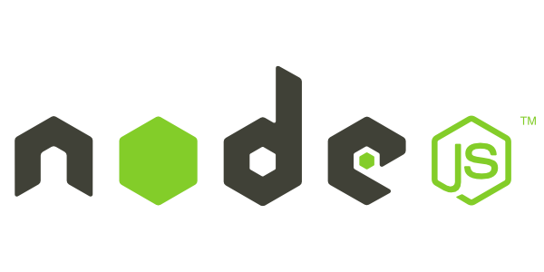

Slide 3
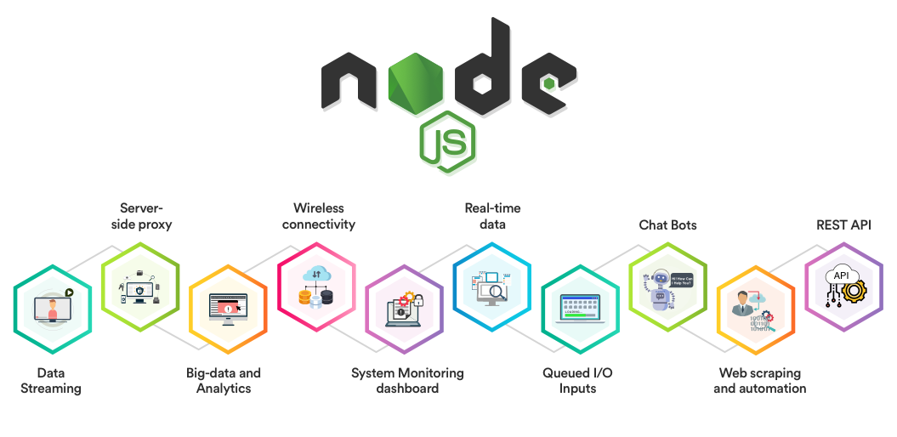

Slide 4
Node or Node.js is a software platform based on the V8 engine (which translates JavaScript into machine code) that transforms JavaScript from a highly specialized language into a general-purpose language.
Node.js adds the ability for JavaScript to
interact with I / O devices through its API (written in C ++),
connect other external libraries written in different languages,
providing calls to them from JavaScript code.

Slide 5
Node.js is a cross-platform runtime environment and library for running JavaScript applications outside the browser. It is used for creating server-side and networking web applications. It is open source and free to use.
Node.js can be used to build different types of applications such as command line application, web application, real-time chat application, REST API server etc. However, it is mainly used to build network programs like web servers, similar to PHP, Java, or ASP.NET.

Slide 6
Node.js is used mainly on the server, acting as a web server, but it is possible to develop on Node.js and desktop window applications and even program microcontrollers. At the core of Node.js is event-driven and asynchronous (or reactive) programming with non-blocking I / O.

Slide 7
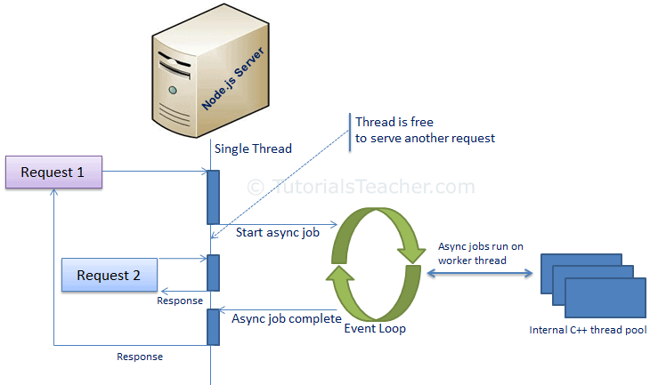
Node.js Process Model

Slide 8
Node.js runs in a single process and the application code runs in a single thread and thereby needs less resources than other platforms.
All the user requests to your web application will be handled by a single thread and all the I/O work or long running job is performed asynchronously for a particular request.
So, this single thread doesn't have to wait for the request to complete and is free to handle the next request. When asynchronous I/O work completes then it processes the request further and sends the response.

Slide 9
An event loop is constantly watching for the events to be raised for an asynchronous job and executing callback function when the job completes.
Internally, Node.js uses libev for the event loop which in turn uses internal C++ thread pool to provide asynchronous I/O.

Slide 10
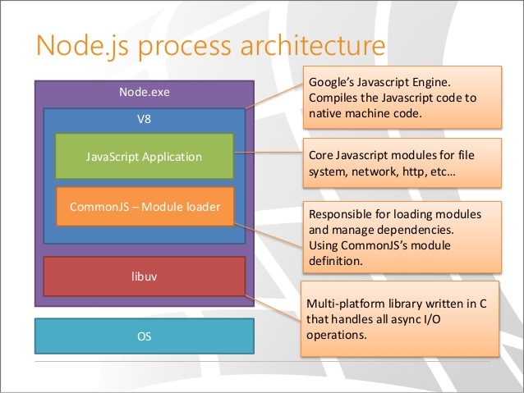

Slide 11
Modules
Each module in Node.js has its own context, so it cannot interfere with other modules or pollute global scope. Also, each module can be placed in a separate .js file under a separate folder.
Node.js implements CommonJS modules standard. CommonJS is a group of volunteers who define JavaScript standards for web server, desktop, and console application.
The core modules include bare minimum functionalities of Node.js. These core modules are compiled into its binary distribution and load automatically when Node.js process starts. However, you need to import the core module first in order to use it in your application.

Slide 12
Node.js includes three types of modules:
Core Modules
var module = require('module_name’);
Local Modules
var myLogModule = require('./Log.js');
Local modules are modules created locally in your Node.js application. These modules include different functionalities of your application in separate files and folders.
module.exports = log
Third Party Modules

Slide 13

Node Package Manager provides two main functionalities:
It provides online repositories for node.js packages/modules which are searchable on search.nodejs.org
It also provides command line utility to install Node.js packages, do version management and dependency management of Node.js packages.
NPM performs the operation in two modes: global and local. In the global mode, NPM performs operations which affect all the Node.js applications on the computer whereas in the local mode, NPM performs operations for the particular local directory which affects an application in that directory only.

Slide 14
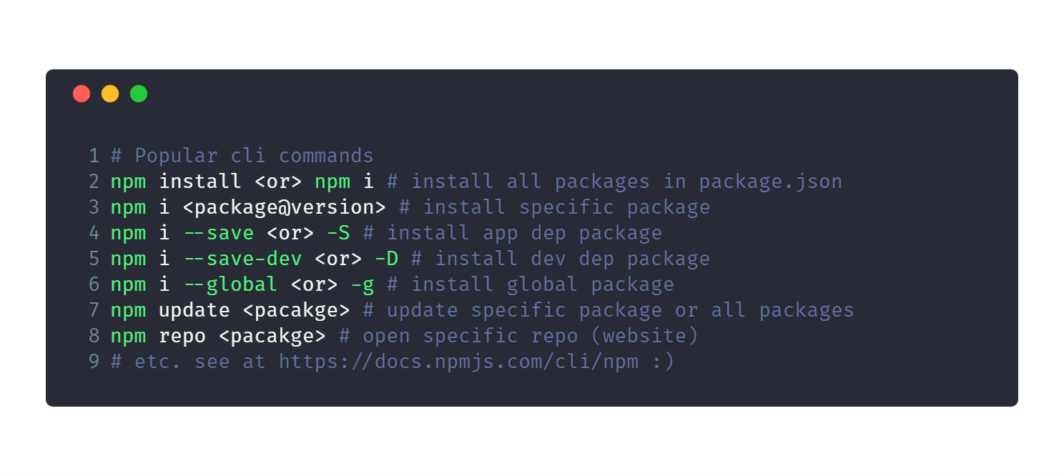

Slide 15
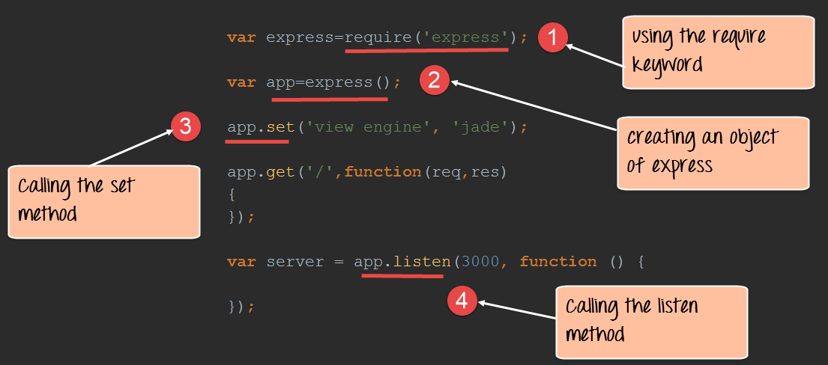

Slide 16
package.json
The "package.json" file is used to hold the metadata about a particular project. This information provides the Node package manager the necessary information to understand how the project should be handled along with its dependencies.
The package.json files contain information such as the project description, the version of the project in a particular distribution, license information, and configuration data.
The package.json file is normally located at the root directory of a Node.js project.

Slide 17
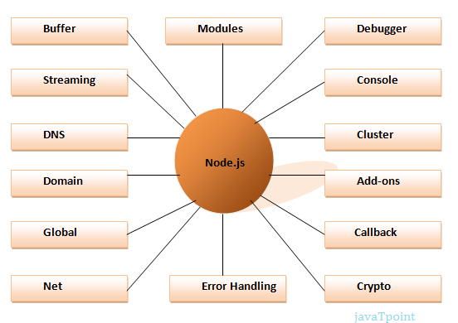

Slide 18
Node.js REPL
The term REPL stands for Read Eval Print and Loop. It specifies a computer environment like a window console or a Unix/Linux shell where you can enter the commands and the system responds with an output in an interactive mode.
You can start REPL by simply running "node" on the command prompt
Node.js Console
The Node.js console module provides a simple debugging console similar to JavaScript console mechanism provided by web browsers.
There are three console methods that are used to write any node.js stream

Slide 19
Node.js DNS
The Node.js DNS module contains methods to get information of given hostname.
Node.js Net
Node.js provides the ability to perform socket programming. We can create chat application or communicate client and server applications using socket programming in Node.js. The Node.js net module contains functions for creating both servers and clients.
Node.js Buffers
Node.js provides Buffer class to store raw data similar to an array of integers but corresponds to a raw memory allocation outside the V8 heap. Buffer class is used because pure JavaScript is not nice to binary data. So, when dealing with TCP streams or the file system, it's necessary to handle octet streams.

Slide 20
Node.js Process
Node.js provides the facility to get process information such as process id, architecture, platform, version, release, uptime, upu usage etc. It can also be used to kill process, set uid, set groups, unmask etc.
Node.js Crypto
The Node.js Crypto module supports cryptography. It provides cryptographic functionality that includes a set of wrappers for open SSL's hash HMAC, cipher, decipher, sign and verify functions.

Slide 21
Frameworks for Node.js
There are various third party open-source frameworks available in Node Package Manager which makes Node.js application development faster and easy.
Express.js
Express.js is a fast, robust and asynchronous Model-View-Controller framework for Node.js. It helps to direct server and routes. It helps to design various web applications and based on passing arguments to templates. It allows to dynamically render HTML Pages.

Slide 22
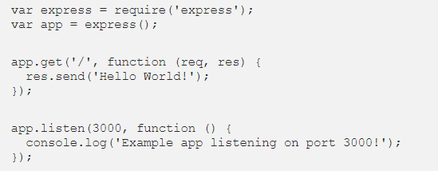
The first line declares a variable which will contain the module called express, grabbing it from the node_modules folder. The module is actually a function. Assigning the function call to another variable gives you access to a predefined set of tools which will in a great deal make your life much easier.
You could view the variable app as an object, whose methods you are using to build the actual program.
The listen method starts a server and listens on port 3000 for connections.
It responds with “Hello World!” for get requests to the root URL (/). For every other path, it will respond with a 404 Not Found.

Slide 23
Frameworks for Node.js
Nest.js
Nest.js is an adaptable and versatile REST API framework for building efficient and scalable Node.js server-side applications. It is shaped with TypeScript that helps to maintain compatibility with pure JavaScript and integrates modules of Object-Oriented Programming, Functional Programming, and Functional Reactive Programming.

Slide 24
Hapi.js
Hapi is an open-source, stable and constant Model-View-Controller MVC framework for structuring web applications and services. Hapi.js provides an effortless structuring of API (application programming interface) servers, websites, and HTTP(Hypertext Transfer Protocol) proxy applications. Because of its robust plugin system.
It enables you to add new features and fix bugs at a swift pace. Hapi.js provides you with the features of routing, input, output validation, and caching that assists in structuring REST APIs. It’s easy to build an API that serves clients’ needs for mobile and single-page applications.

Slide 25
Koa.JS
Koa.js is a Powerful HTTP middleware framework for node.js to create web applications and APIs more fun to draft. Its middleware stack runs in a stack-like method, enabling you to implement downstream then refine and manage the response upstream. This incorporates elements like content negotiation, normalization of node discrepancies, redirection, and more.

Slide 26
Useful Links
https://www.guru99.com/node-js-tutorial.html
https://nodejs.org/en/docs/guides/

Slide 27
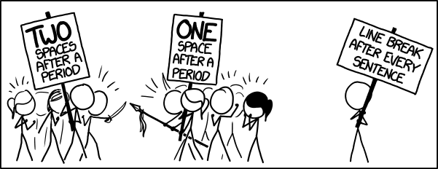
Linting

Slide 28
Linters
lint, or a linter, is a static code analysis tool used to flag programming
errors,
bugs,
stylistic errors,
mistrustful constructs.
The term originates from a Unix utility that examined C language source code.

Slide 29

SLint is a tool for identifying and reporting on patterns found in ECMAScript/JavaScript code, with the goal of making code more consistent and avoiding bugs.
ESLint is completely pluggable, every single rule is a plugin and you can add more at runtime.

Slide 30
Install and Use
install ESLint:
npm install eslint --save-dev
set up a configuration file:
npx eslint –init
run ESLint on any file or directory like this:
npx eslint yourfile.js

Slide 31
Configuration
Configuration Files - use a JavaScript, JSON or YAML file to specify configuration information for an entire directory and all of its subdirectories.
This can be
in the form of an .eslintrc.* file
an eslintConfig field in a package.json file

Slide 32
There are several things that can be configured:
Environments - which environments your script is designed to run in. Each environment brings with it a certain set of predefined global variables.
Parser - to specify the JavaScript language options you want to support.
Plugins may provide processors. Processors can extract JavaScript code from another kind of files
Globals - the additional global variables your script accesses during execution.
Rules - which rules are enabled and at what error level.

Slide 33
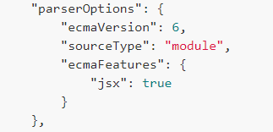
Specifying Parser Options
ESLint allows you to specify the JavaScript language options you want to support.
By default, ESLint expects ECMAScript 5 syntax.
You can override that setting to enable support for other ECMAScript versions as well as JSX by using parser options.

Slide 34
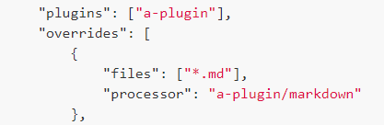
Configuring Plugins
ESLint supports the use of third-party plugins. Before using the plugin, you have to install it using npm.
Processors can extract JavaScript code from another kind of files, then lets ESLint lint the JavaScript code
Example:
Enable the processor that the plugin a-plugin provided, and specify processors for specific kinds of files

Slide 35

Specifying Environments
An environment defines global variables that are predefined.
enables the browser and Node.js environments

Slide 36
Configuring Rules
ESLint comes with a large number of rules. You can modify which rules your project uses either using configuration comments or configuration files. To change a rule setting, you must set the rule ID equal to one of these values:
"off" or 0 - turn the rule off
"warn" or 1 - turn the rule on as a warning (doesn't affect exit code)
"error" or 2 - turn the rule on as an error (exit code is 1 when triggered)

Slide 37
No rules are enabled by default.
The "extends": "eslint:recommended" property in a configuration file enables rules that report common problems
Rules in ESLint are grouped by category to help you understand their purpose.

Slide 38
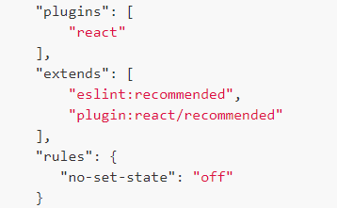
extend
A configuration file can extend the set of enabled rules from base configurations.
Using the configuration from a plugin
The extends property value can consist of:
“plugin:”
the package name (from which you can omit the prefix)
“/”
the configuration name

Slide 39
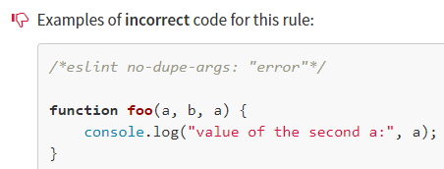
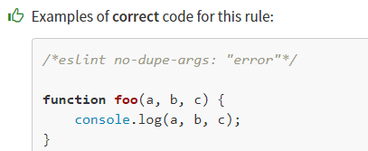
no-dupe-args
If more than one parameter has the same name in a function definition, the last occurrence "shadows" the preceding occurrences. A duplicated name might be a typing error.

Slide 40
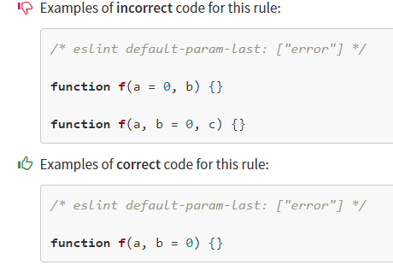
default-param-last
Putting default parameter at last allows function calls to omit optional tail arguments.

Slide 41
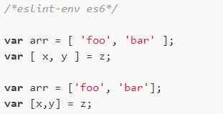
array-bracket-spacing
A number of style guides require or disallow spaces between array brackets and other tokens. This rule applies to both array literals and destructuring assignments
The --fix option on the command line can automatically fix some of the problems reported by this rule.

Slide 42
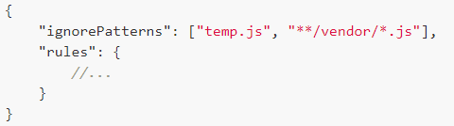
Ignoring Files and Directories
You can tell ESLint to ignore specific files and directories by ignorePatterns in your config files. Each value of ignorePatterns is the same pattern as each line of .eslintignore in the next section.

Slide 43
Disabling Rules with Inline Comments
To temporarily disable rule warnings in your file, use block comments

Slide 44
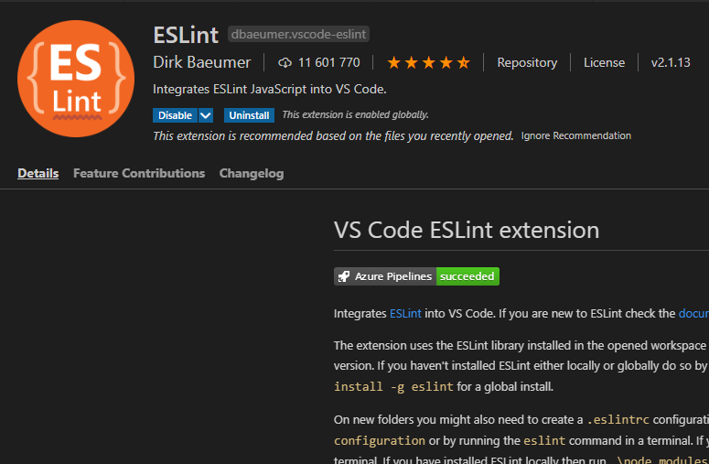
VS Code integration

Slide 45
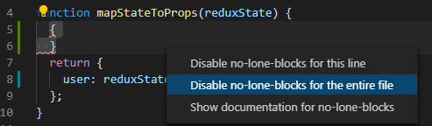
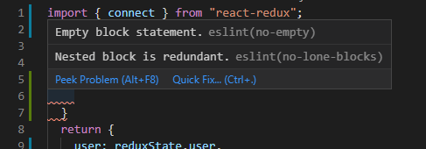
Errors detected by ESLint are marked with a red underline in the code editor
When you hover the cursor, a window appears where the error is described and links to possible solutions to the problem are posted

Slide 46

The check is initiated automatically when the file is opened in the code editor.
The detected errors are accumulated in a special window in the console area.

Slide 47
List of tools for static code analysis
https://en.wikipedia.org/wiki/List_of_tools_for_static_code_analysis

Slide 48
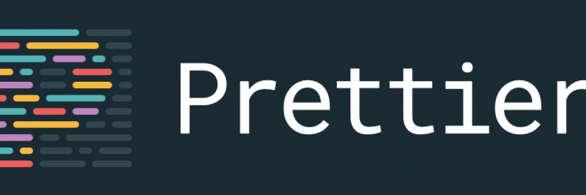
Prettier is an opinionated code formatter with support for:
JavaScript (including experimental features)
JSX
Angular
Vue
Flow
TypeScript
CSS, Less, and SCSS
HTML
JSON
GraphQL
Markdown, including GFM and MDX
YAML
It removes all original styling and ensures that all outputted code conforms to a consistent style.

Slide 49
Building and enforcing a style guide
Allows you to create a fully automatic and highly customizable guide style.
Thanks to the automatic change of the code, this approach will allow all project participants to accept it at once.
Helping Newcomers
it’s useful for people with very limited programming experience, and lets quicken the ramp up time from skilled engineers joining the company, as they likely used a different coding style before, and developers coming from a different programming language.

Slide 50
Writing code
With Prettier editor integration, you can just press that magic key binding and poof, the code is formatted
Clean up an existing codebase
It has the ability to convert an already existing codebase according to the new code style

Slide 51
npm install --save-dev --save-exact prettier
# or globally
npm install --global prettier
# Then test run it
npx prettier --write index/src.js
# or global
prettier --write index/src.js

Slide 52
Although Prettier comes with opinionated style, we can still change the formatting by creating a configuration file in our project.

Slide 53
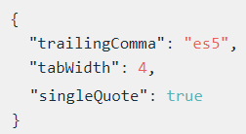
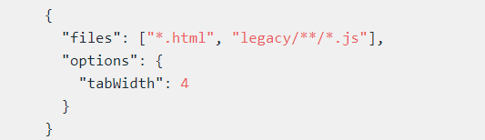
Overrides let you have different configuration for certain file extensions, folders and specific files.

Slide 54
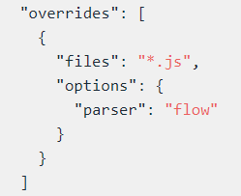
switch to the flow parser instead of the default babel for .js files

Slide 55
Use the prettier command to run Prettier from the command line.
prettier --check "src/**/*.js"
You can run Prettier programmatically with help API
const prettier = require("prettier");
prettier.format("foo ( );", { semi: false, parser: "babel" });

Slide 56
Plugins
Plugins are ways of adding new languages to Prettier. Prettier’s own implementations of all languages are expressed using the plugin API. The core prettier package contains JavaScript and other web-focused languages built in. For additional languages you’ll need to install a plugin.
Plugins are automatically loaded if you have them installed in the same node_modules directory where prettier is located.

Slide 57
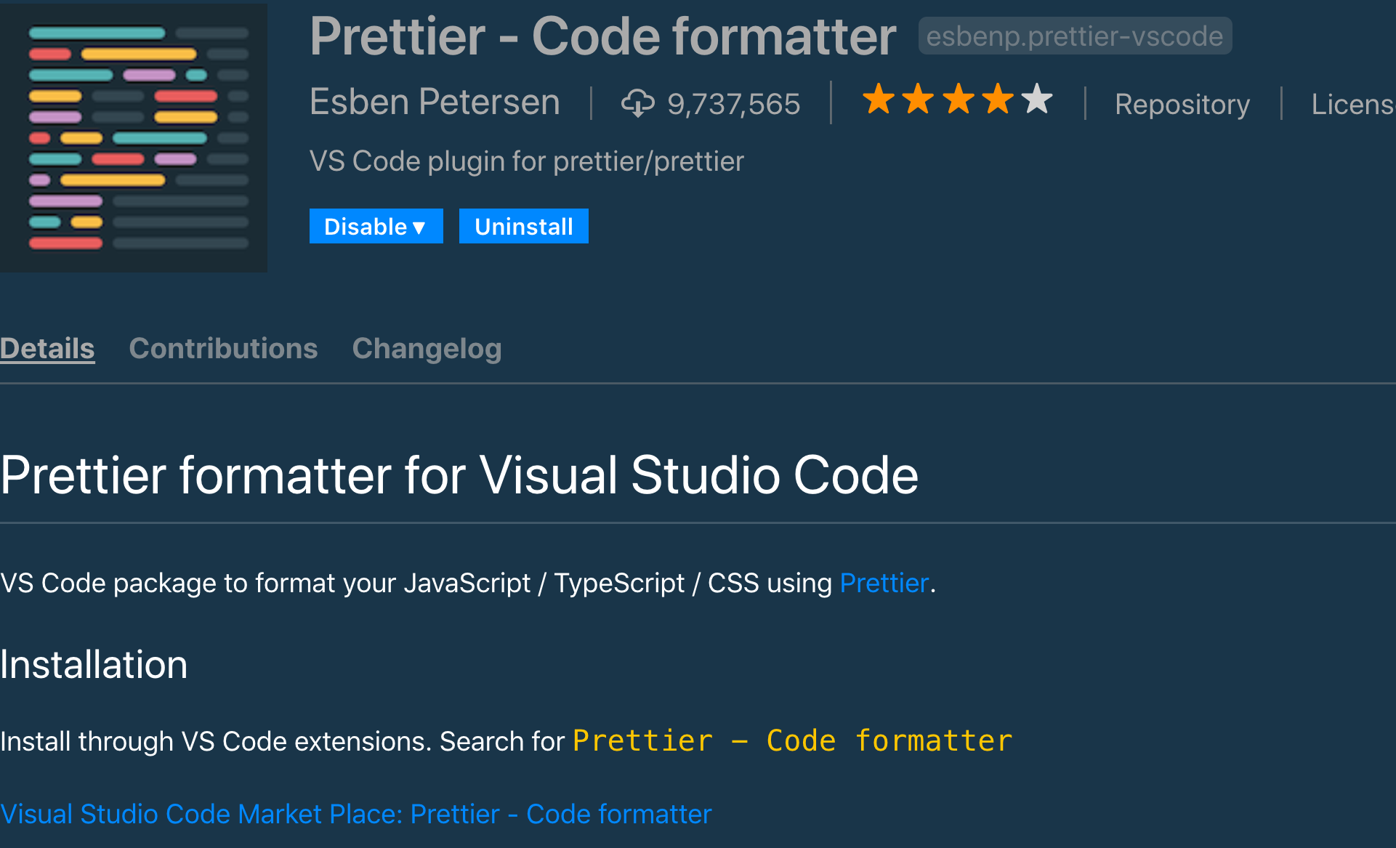
prettier-vscode can be installed using the extension sidebar – it’s called “Prettier - Code formatter.”

Slide 58
Working With ESLint
Linters usually contain not only code quality rules, but also stylistic rules.
In this case eslint works as usual.
Formatter using a set of linter styling rules and a custom set of rules transforms the code.

Slide 59
Most stylistic rules are unnecessary when using Prettier, but worse – they might conflict with Prettier!
Luckily it’s easy to turn off rules that conflict or are unnecessary with Prettier, by using these pre-made config package eslint-config-prettier
We have plugins that let you run Prettier as if it was a linter rule eslint-plugin-prettier
we have tools that runs prettier and then immediately for example eslint --fix on files prettier-eslint

Slide 60
Useful Links
https://marketplace.visualstudio.com/items?itemName=esbenp.prettier-vscode
https://prettier.io

Slide 61
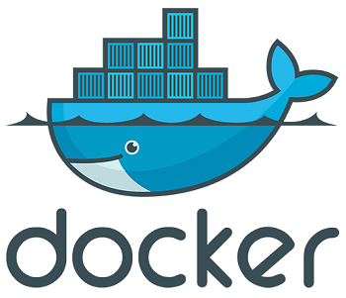

Slide 62
Docker provides the ability to package and run an application in a isolated environment called a container.
The isolation and security allow you to run many containers at the same time on a given host.
Containers are lightweight because they don’t need the extra load of a hypervisor, but run directly within the host machine’s kernel.
This means you can run more containers on a given hardware combination than if you were using virtual machines.
You can even run Docker containers within virtual machines.

Slide 63
Docker provides tooling and a platform to manage the lifecycle of your containers.
Develop your application and its supporting components using containers.
The container becomes the unit for distributing and testing your application.
When you’re ready, deploy your application into your production environment, as a container or an orchestrated service.

Slide 64
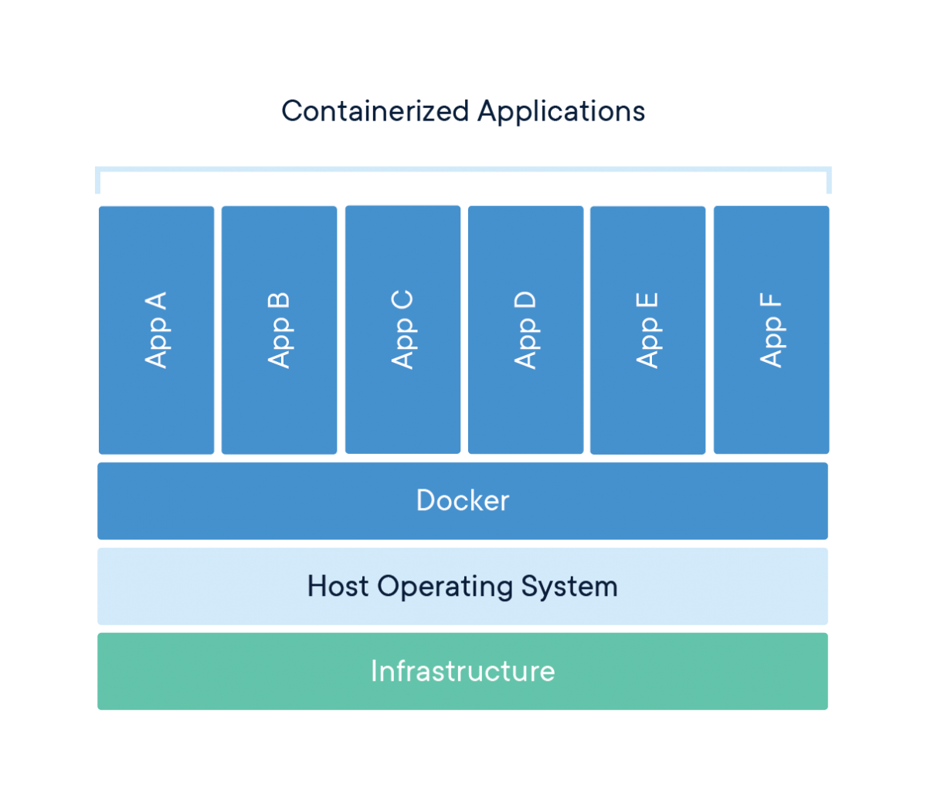

Slide 65
Packaging Software
A container is a standard unit of software that packages up code and all its dependencies so the application runs quickly and reliably from one computing environment to another.
A Docker container image is a lightweight, standalone, executable package of software that includes everything needed to run an application: code, runtime, system tools, system libraries and settings.
Container images become containers at runtime and in the case of Docker containers - images become containers when they run on Docker Engine. Available for both Linux and Windows-based applications, containerized software will always run the same, regardless of the infrastructure. Containers isolate software from its environment and ensure that it works uniformly despite differences for instance between development and staging.

Slide 66
The Docker daemon
The Docker daemon (dockerd) listens for Docker API requests and manages Docker objects such as images, containers, networks, and volumes. A daemon can also communicate with other daemons to manage Docker services.
The Docker client
The Docker client (docker) is the primary way that many Docker users interact with Docker. When you use commands such as docker run, the client sends these commands to dockerd, which carries them out. The docker command uses the Docker API. The Docker client can communicate with more than one daemon.
Docker registries
A Docker registry stores Docker images. Docker Hub is a public registry that anyone can use, and Docker is configured to look for images on Docker Hub by default. You can even run your own private registry.

Slide 67
IMAGES
An image is a read-only template with instructions for creating a Docker container.
Often, an image is based on another image, with some additional customization. For example, you may build an image which is based on the ubuntu image, but installs the Apache web server and your application, as well as the configuration details needed to make your application run.
You might create your own images or you might only use those created by others and published in a registry.
To build your own image, you create a Dockerfile with a simple syntax for defining the steps needed to create the image and run it. Each instruction in a Dockerfile creates a layer in the image. When you change the Dockerfile and rebuild the image, only those layers which have changed are rebuilt. This is part of what makes images so lightweight, small, and fast, when compared to other virtualization technologies.

Slide 68
CONTAINERS
A container is a runnable instance of an image. You can create, start, stop, move, or delete a container using the Docker API or CLI. You can connect a container to one or more networks, attach storage to it, or even create a new image based on its current state.
By default, a container is relatively well isolated from other containers and its host machine. You can control whether a container is isolated from other containers or from the host machine.
A container is defined by its image as well as any configuration options you provide to it when you create or start it. When a container is removed, any changes to its state that are not stored in persistent storage disappear.

Slide 69
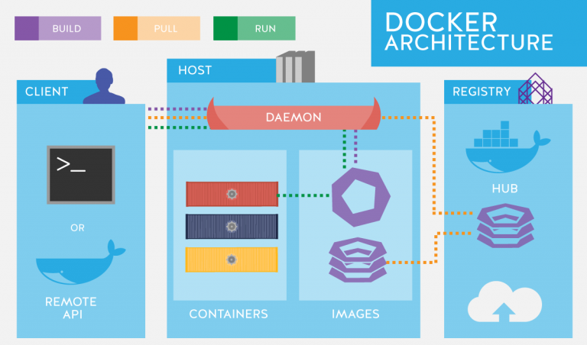
When you use the docker pull or docker run commands, the required images are pulled from your configured registry. When you use the docker push command, your image is pushed to your configured registry.

Slide 70
docker run -i -t ubuntu /bin/bash
If you do not have the ubuntu image locally, Docker pulls it from your configured registry.
Docker creates a new container.
Docker allocates a read-write filesystem to the container. This allows a running container to create or modify files and directories in its local filesystem.
Docker creates a network interface to connect the container to the default network. This includes assigning an IP address to the container.
Docker starts the container and executes /bin/bash. Because the container is running interactively and attached to your terminal (due to the -i and -t flags), you can provide input using your keyboard while the output is logged to your terminal.
When you type exit to terminate the /bin/bash command, the container stops but is not removed. You can start it again or remove it.

Slide 71
Docker File
A docker file is a text file that consists of all commands so that user can call on the command line to build an image. Use of base Docker image add and copy files, run commands and expose the ports.
The docker file can be considered as the source code and images to make compile for our container which is running code. The Dockerfile are portable files which can be shared, stored and updated as required.

Slide 72
instruction
FROM — This is used for to set the base image for the instructions. It is very important to mention this in the first line of docker file.
MAINTAINER — This instruction is used to indicate the author of the docker file and its non-executable in nature.
RUN — This instruction allows us to execute the command on top of the existing layer and create a new layer with the result of command execution.
CMD — This instruction doesn’t execute anything during the building of docker image. It Just specifies the commands that are used in the image.
LABEL — This Instruction is used to assign the metadata in the form key-value pairs. It is always best to use few LABEL instructions as possible.

Slide 73
instruction
EXPOSE — This instruction is used to listen on specific as required by application servers.
ENV — This instruction is used to set the environment variables in the Docker file for the container.
WORKDIR — This instruction is used to set the current working directory for the other instruction i.e. RUN, CMD, COPY, etc.
COPY — This instruction is used to copy the files and directory from specific folder to destination folder.

Slide 74
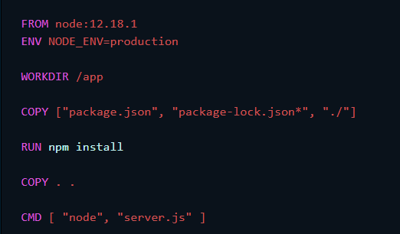
Example

Slide 75
The first thing we need to do is to add a line in our Dockerfile that tells Docker what base image we would like to use for our application.
The NODE_ENV environment variable specifies the environment in which an application is running (usually, development or production).
This instructs Docker to use this path as the default location for all subsequent commands.
Put our package.json and package-lock.json files into our images into our working directory /app
Node modules will be installed into the node_modules directory inside our image.
The COPY command takes all the files located in the current directory and copies them into the image
Now, all we have to do is to tell Docker what command we want to run when our image is run inside of a container.

Slide 76
docker run node-docker
To run an image inside of a container, we use the docker run command. The docker run command requires one parameter and that is the image name.

Slide 77
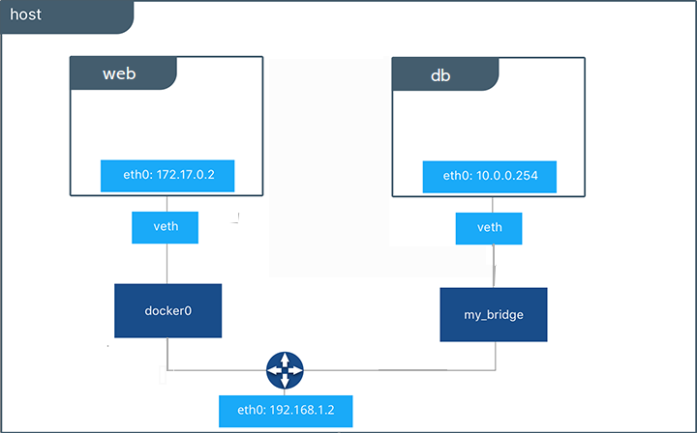
Docker Net
Docker Networking allows communication between Docker containers. Networked containers can run on the same host or on different hosts.

Slide 78
Docker Compose
Docker Compose is a tool which is used to define and running multiple-containers in Docker applications. Docker composes use to create a compose file to configure the application services. After that, a single command, we create and start all the services from our configuration.

Slide 79
Docker Compose builds a stack of applications to run a complete service.
The docker-compose.yml file is broken into sections, each section represents a single container which, when combined with the other containers, create the service.

Slide 80
Docker Compose process.
Define the app’s environment with a Dockerfile so that it can be reproduced anytime and anywhere.
Define the services in docker-compose.yml after that we can be run together in an isolated environment.
After that, using docker-compose up and Compose will start and run the app.

Slide 81
This Compose file is super convenient as we do not have to type all the parameters to pass to the docker run command. We can declaratively do that in the Compose file.

Slide 82
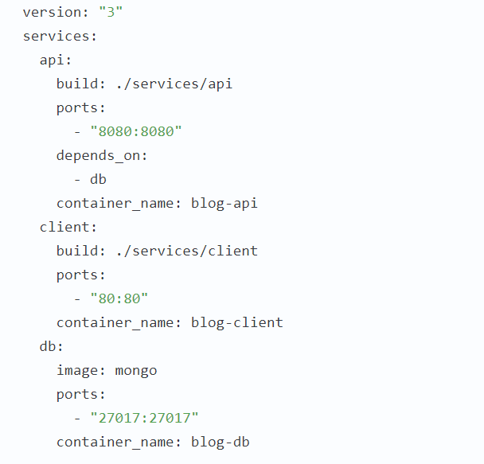

Slide 83
We have three services: client, api and db.
There is no dedicated Dockerfile for MongoDB - Docker will download the corresponding image from its hub and create a container from it.
This means that our database will be empty, but for a start, we are fine with that.
The api and client sections contain the build key, the value of which contains the path to the Dockerfiles of the corresponding services (to the root api and client directories).
The container ports assigned in the Dockerfiles will be exposed on the network hosted by Docker Compose. This will allow applications to interact.
When configuring the api service, the depends_on key is also used. It tells Docker to wait until the db container is fully started before starting this service.

Slide 84
https://docs.docker.com/compose/compose-file/
Complete example express, react
https://medium.com/better-programming/dockerizing-react-app-and-express-api-with-mongodb-f3a06bebf570

Slide 85
Swarm
Current versions of Docker include swarm mode for natively managing a cluster of Docker Engines called a swarm. Use the Docker CLI to create a swarm, deploy application services to a swarm, and manage swarm behave
The cluster management and orchestration features embedded in the Docker Engine are built using swarmkit. Swarmkit is a separate project which implements Docker’s orchestration layer and is used directly within Docker. or.

Slide 86
Key Feature Of Docker
Docker allows us to faster assemble applications from components and eliminates the errors which can come when we shipping the code. For example, we can have two Docker containers running two different versions of the same app on the same system.
Docker helps us to test the code before we deploy it to production as soon as possible.
Docker is simple to use. We can get started with Docker on a minimal Linux, Mac, or Windows system running with compatible Linux kernel directly or in a Virtual Machine with a Docker binary.
We can “dockerize” our application in fewer hours. Mostly Docker containers can be launch with in a minute.
Docker containers run everywhere. We can deploy containers on desktops, physical servers, virtual machines, into data centers, and up to public and private clouds. And, we can run exactly the same containers everywhere.

Slide 87
https://docs.docker.com/get-started/overview/
Example using docer composer for node.js
https://fireship.io/lessons/docker-basics-tutorial-nodejs/
https://docs.docker.com/get-started/nodejs/build-images/
Complete Node.js
https://github.com/docker/labs/tree/master/developer-tools/nodejs/porting/
https://habr.com/ru/company/ruvds/blog/439980/

Slide 88

JHipster

Slide 89
JHipster is a development platform to quickly generate, develop, and deploy modern web applications and microservice architectures.

Slide 90
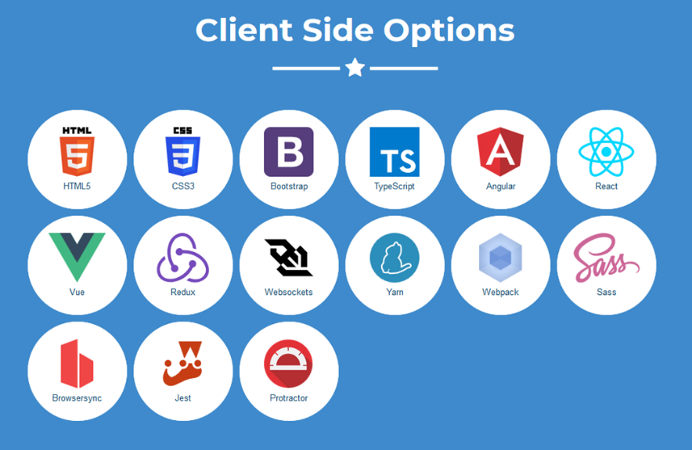
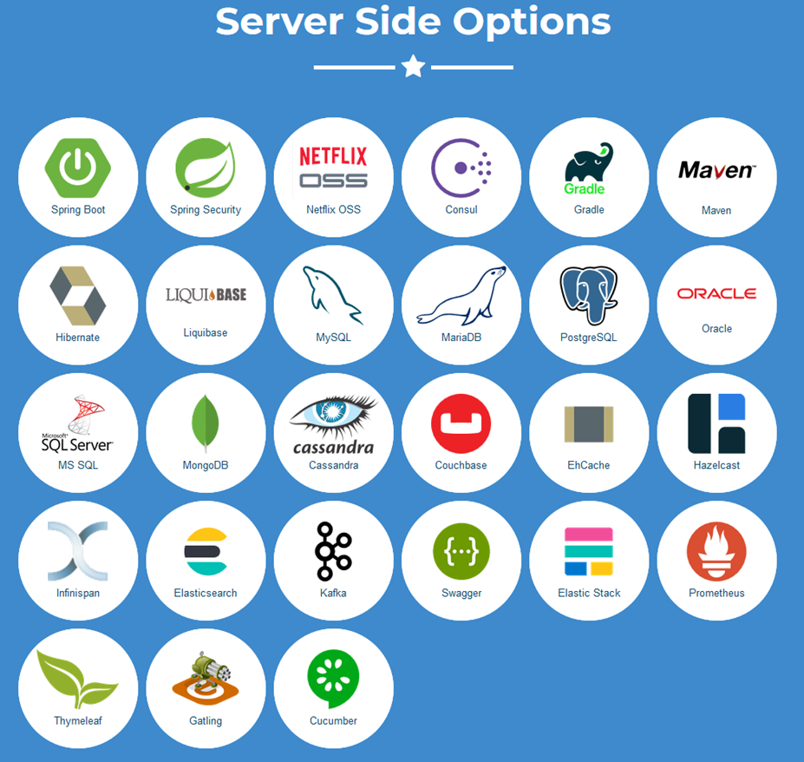
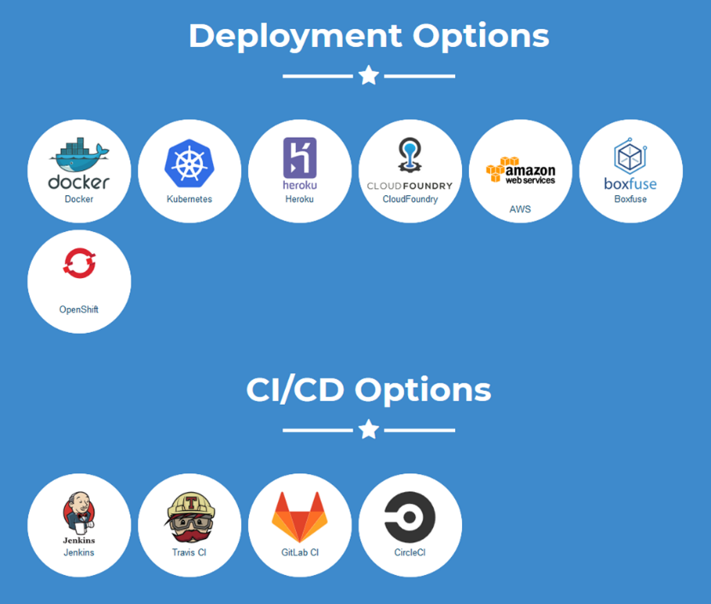

Slide 91
Scaffolding
Scaffolding generally refers to a quickly set up skeleton for an app.
Scaffolding, as used in computing, refers to one of two techniques: The first is a code generation technique related to database access in some model–view–controller frameworks; the second is a project generation technique supported by various tools.

Slide 92

What's Yeoman
Yeoman helps you to kickstart new projects, prescribing best practices and tools to help you stay productive.
To do so, we provide a generator ecosystem. A generator is basically a plugin that can be run with the `yo` command to scaffold complete projects or useful parts.

Slide 93
The Yeoman workflow is made up of three types of tools to enhance your productivity and satisfaction
when building a web app:
the scaffolding tool (yo),
the build tool (npm/Yarn, webpack, etc.), and
the package manager (npm/Yarn).

Slide 94
JHipster is a Yeoman generator. Yeoman is a code generator

Slide 95
Questions asked when generating an application
Which type of application would you like to create?
Your type of application depends on whether you wish to use a microservices architecture or not. A full explanation on microservices is available here, if unsure use the default “Monolithic application”.
You can either use:
Monolithic application: this a classical, one-size-fits-all application. It’s easier to use and develop, and is our recommended default.
Microservice application: in a microservices architecture, this is one of the services.
Microservice gateway: in a microservices architecture, this is an edge server that routes and secures requests.

Slide 96
Authentication
Answers to this question depend on previous answers. For example, if you selected the JHipster Registry above, you can only use JWT authentication.
Here are all the possible options:
JWT authentication: use a JSON Web Token (JWT), which is the default choice and what most people use.
OAuth 2.0 / OIDC Authentication: this uses an OpenID Connect server, like Keycloak or Okta, which handles authentication outside of the application. This is more secured than JWT, but it requires to set up an OpenID Connect server, so it’s a bit more complex. Please note that by default JHipster will synchronize the user data from the OpenID Connect server, and for this it will need a database.
HTTP Session Authentication: the classical session-based authentication mechanism, which is what people usually do with Spring Security.

Slide 97
Database
Which production database would you like to use?
This is the database you will use with your “production” profile. To configure it, please modify your src/main/resources/config/application-prod.yml file.
Which development database would you like to use?
This is the database you will use with your “development” profile. You can either use:
H2, running in-memory. This is the easiest way to use JHipster, but your data will be lost when you restart your server.
H2, with its data stored on disk. This is a better option than running in-memory, as you won’t lose your data upon application restart.
The same database as the one you chose for production: it’s a bit more complex to set up, but it should be better in the end to work on the same database as the one you will use in production. This is also the best way to use liquibase-hibernate as described in the development guide.
To configure it, please modify your src/main/resources/config/application-dev.yml file.

Slide 98
Management
Would you like to use Maven or Gradle?
Software project management tools. Based on the concept of a project object model, they can manage a project's build, reporting and documentation.
You can build your generated Java application either with Maven or Gradle. Maven is more stable and more mature. Gradle is more flexible, easier to extend, and more hype.

Slide 99
Other technologies
Which other technologies would you like to use?
API first development using swagger-codegen This option lets you do API-first development for your application by integrating the Swagger-Codegen into the build.
Search engine using ElasticSearch Elasticsearch will be configured using Spring Data Elasticsearch. You can find more information on our Elasticsearch guide.
Clustered HTTP sessions using Hazelcast By default, JHipster uses a HTTP session only for storing Spring Security’s authentication and authorisation information. You can choose to put more data in your HTTP sessions. Using HTTP sessions will cause issues if you are running in a cluster. If you want to replicate your sessions inside your cluster, choose this option to have Hazelcast configured.
WebSockets using Spring Websocket Websockets can be enabled using Spring Websocket. We also provide a complete sample to show you how to use the framework efficiently.
Asynchronous messages using Apache Kafka Use Apache Kafka as a publish/subscribe message broker.

Slide 100
Client
Which Framework would you like to use for the client?
The client-side framework to use.
You can either use:
Angular
React
Vue

Slide 101
Client customization
Would you like to use a Bootswatch theme?
The client theme to use.
You can use any themes from Bootswatch or keep the default one.
Would you like to use the Sass stylesheet preprocessor for your CSS?
Sass a great solution to simplify designing CSS. To be used efficiently, you will need to run a Webpack dev server, which will be configured automatically.
Would you like to enable internationalization support?
By default JHipster provides excellent internationalization support, both on the client side and on the server side. However, internationalization adds a little overhead, and is a little bit more complex to manage, so you can choose not to install this feature.
Please note that JHipster covers only UI internationalization. For data internationalization, you will need to code it yourself in JPA/Hibernate layer.

Slide 102
Testing
JHipster comes with a set of tests, and each generated application has:
Unit tests using JUnit 5.
Integration tests using the Spring Test Context framework.
UI tests with Jest.
Architecture tests with ArchUnit.
Which testing frameworks would you like to use?
By default JHipster provide Java unit/integration testing (using Spring’s JUnit support) and JavaScript unit testing (using Jest). As an option, you can also add support for:
Performance tests using Gatling
Behaviour tests using Cucumber
Angular integration tests with Protractor

Slide 103
Creating an entity
For each entity, you will need:
A database table
A Liquibase change set
A JPA Entity
A Spring Data JPA Repository
A Spring MVC REST Controller, which has the basic CRUD operations
An Angular router, a component and a service
An HTML view
Integration tests, to validate everything works as expected
Performance tests, to see if everything works smoothly
If you have several entities, you will likely want to have relationships between them. For this, you will need:
A database foreign key
Specific JavaScript and HTML code for managing this relationship

Slide 104
CLI command
The “entity” sub-generator will create all the necessary files, and provide a CRUD front-end for each entity.
The sub generator can be invoked by running
jhipster entity <entityName> --[options].
supported options:
--table-name <table_name> - By default JHipster will generate a table name based on your entity name, if you would like to have a different table name you can do so by passing this option.
--angular-suffix <suffix> - If you want all your Angular routes to have a custom suffix you can pass that using this option.
--client-root-folder <folder-name> - Use a root folder name for entities on the client side. By default it’s empty for monoliths and the name of the microservice for gateways.
--regenerate - This will regenerate an existing entity without asking any questions.
--skip-server - This will skip the server-side code and will generate only the client-side code.
--skip-client - This will skip the client-side code and will generate only the server-side code.
--skip-db-changelog - This will skip generation of database changelog (using Liquibase for SQL databases).
--db - Specify the database when skipping server side generation, has no effect otherwise.

Slide 105
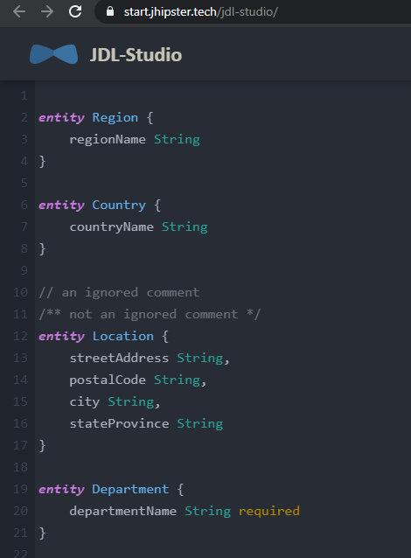
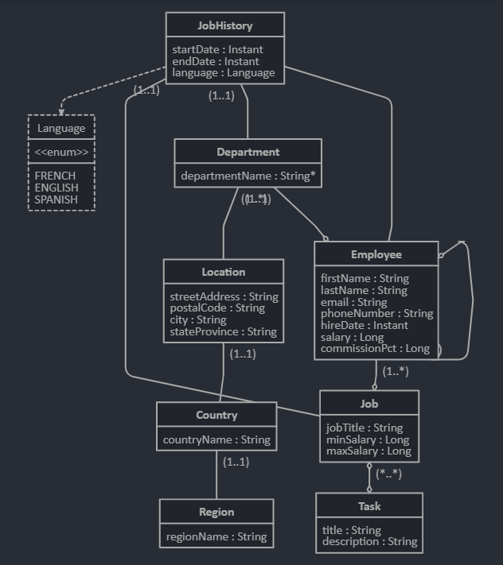
JDL Studio

Slide 106
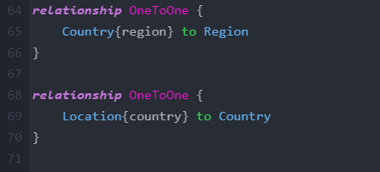
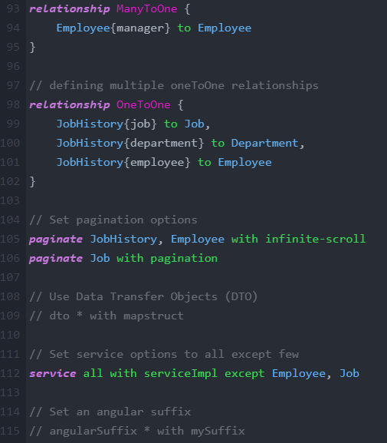
JDL Studio

Slide 107
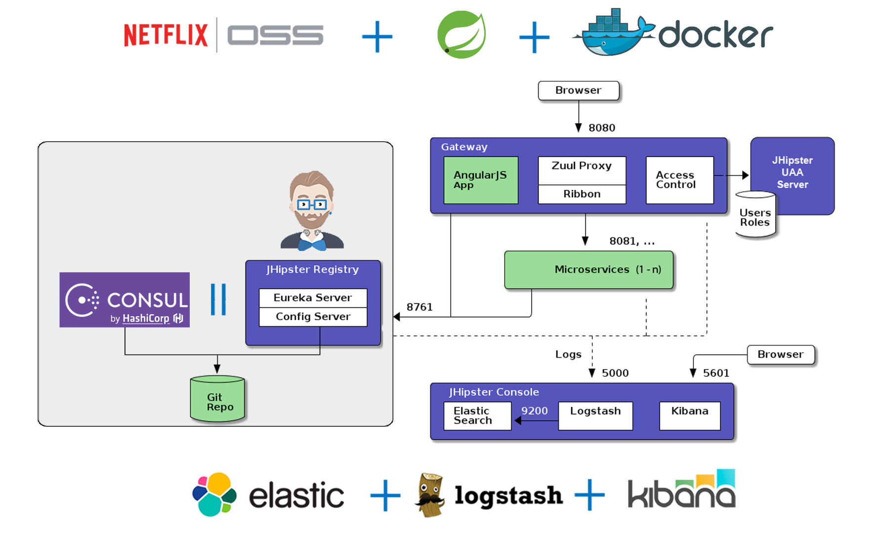
Doing microservices with JHipster

Slide 108
Microservices architecture overview
A gateway is a JHipster-generated application (using application type microservice gateway when you generate it) that handles Web traffic, and serves an Angular/React application. There can be several different gateways, if you want to follow the Backends for Frontends pattern, but that’s not mandatory.
Traefik is a modern HTTP reverse proxy and load balancer that can work with a gateway.
The JHipster Registry is a runtime application on which all applications registers and get their configuration from. It also provides runtime monitoring dashboards.
Consul is a service discovery service, as well as a key/value store. It can be used as an alternative to the JHipster Registry.
JHipster UAA is a JHipster-based User Authentication and Authorization system, which uses the OAuth2 protocol.
Microservices are JHipster-generated applications (using application type microservice application when you generate them), that handle REST requests. They are stateless, and several instances of them can be launched in parallel to handle heavy loads.
The JHipster Console is a monitoring & alerting console, based on the ELK stack.

Slide 109
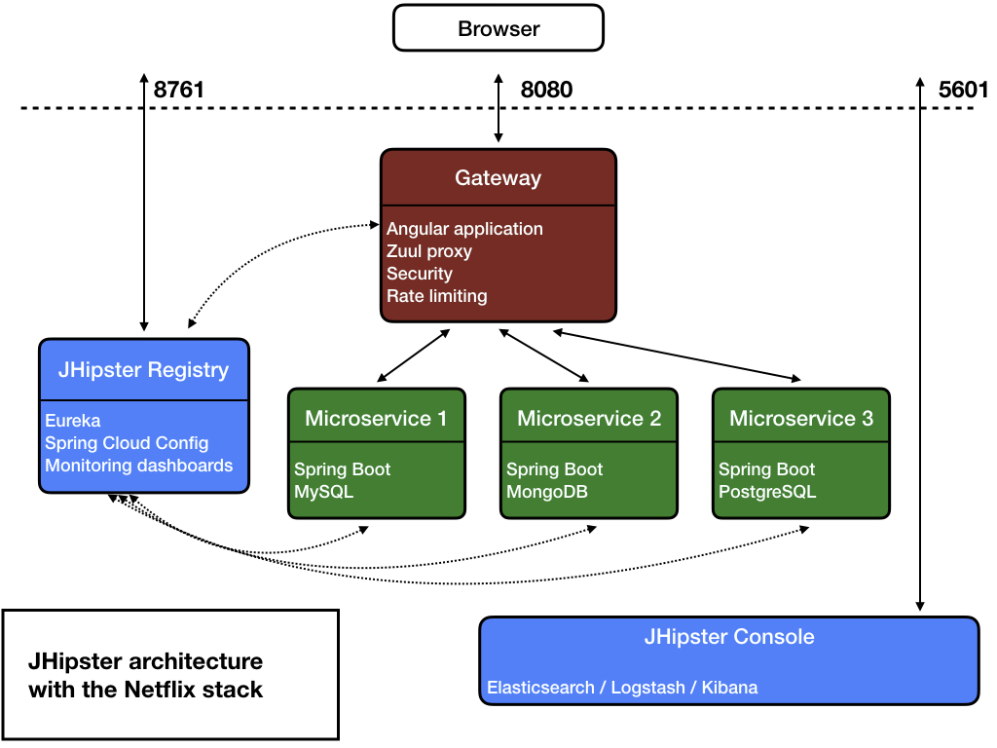
JHipster API Gateway

Slide 110
When the gateways and the microservices are launched, they will register themselves in the registry (using the eureka.client.serviceUrl.defaultZone key in the src/main/resources/config/application.yml file).
The gateway will automatically proxy all requests to the microservices, using their application name: for example, when microservices app1 is registered, it is available on the gateway on the /services/app1 URL.
For example, if your gateway is running on localhost:8080, you could point to http://localhost:8080/services/app1/api/foos to get the foos resource served by microservice app1. If you’re trying to do this with your Web browser, don’t forget REST resources are secured by default in JHipster, so you need to send the correct JWT header (see the point on security below), or remove the security on those URLs in the microservice’s MicroserviceSecurityConfiguration class.
If there are several instances of the same service running, the gateway will get those instances from the JHipster Registry, and will:
Load balance HTTP requests using Netflix Ribbon.
Provide a circuit breaker using Netflix Hystrix, so that not available instances are quickly and safely removed.
Each gateway has a specific “admin > gateway” menu, where opened HTTP routes and microservices instances can be monitored.

Slide 111
Security

Slide 112
JWT (JSON Web Token)
Tokens are generated by the gateway, and sent to the underlying microservices: as they share a common secret key, microservices are able to validate the token, and authenticate users using that token.
Those tokens are self-sufficient: they have both authentication and authorization information, so microservices do not need to query a database or an external system. This is important in order to ensure a scalable architecture.
For security to work, a JWT secret token must be shared between all applications.
For each application the default token is unique, and generated by JHipster. It is stored in the .yo-rc.json file.
Tokens are configured with the jhipster.security.authentication.jwt.secret key in the src/main/resources/config/application.yml file.
To share this key between all your applications, copy the key from your gateway to all the microservices, or share it using the JHipster Registry’s Spring Config Server or JHipster’s specific configuration of the Consul K/V store. This is one of the main reasons why people use those central configuration servers.
A good practice is to have a different key in development and production.

Slide 113
OpenID Connect
When selecting this option, you will use Keycloak by default, and you will probably want to run your complete microservice architecture using Docker Compose: be sure to read our Docker Compose documentation, and configure correctly your /etc/hosts for Keycloak.
When using OpenID Connect, the JHipster gateway will send OAuth2 tokens to microservices, which will accept those tokens as they are also connected to Keycloak.
Unlike JWT, those tokens are not self-sufficient, and should be stateful, which causes following issues:
A performance issue in microservices: as it is very common to look for the current user’s security information (otherwise we wouldn’t be using any security option from the beginning), each microservice will call the OpenID Connect server to get that data. So in a normal setup, those calls will be made by each microservice, each time they get a request, and this will quickly cause a performance issue.
If you have selected a caching option (here is the “Using a cache” documentation) when generating your JHipster microservice, a specific CachedUserInfoTokenServices Spring Bean will be generated, which will cache those calls. When properly tuned, this will remove the performance issue.
If you want more information on this “user info” request, it is configured using the standard Spring Boot configuration key security.oauth2.resource.userInfoUri in your src/main/resources/application.yml configuration file.

Slide 114
JHipster UAA
JHipster UAA is a user accounting and authorizing service for securing JHipster microservices using the OAuth2 authorization protocol.
To distinct JHipster UAA from other “UAA”s such as Cloudfoundry UAA, JHipster UAA is a fully configured OAuth2 authorization server with the users and roles endpoints inside, wrapped into a usual JHipster application.
This allows the developer to deeply configure every aspect of the user domain, without restricting on policies by other ready-to-use UAAs.

Slide 115
https://www.jhipster.tech/creating-an-app/

Slide 116
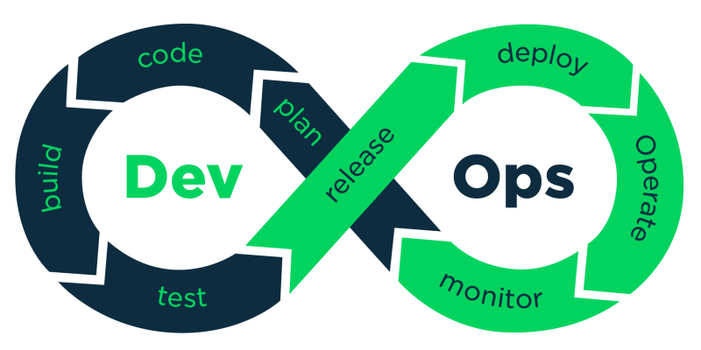
CI/CD

Slide 117
CI
Continuous Integration (CI) is a development practice that requires developers to integrate code into a shared repository several times a day. Each check-in is then verified by an automated build, allowing teams to detect problems early. By integrating regularly, you can detect errors quickly, and locate them more easily.
With CI, a developer practices integrating the code changes continuously with the rest of the team. The integration happens after a “git push,” usually to a master branch—more on this later. Then, in a dedicated server, an automated process builds the application and runs a set of tests to confirm that the newest code integrates with what’s currently in the master branch.

Slide 118
CD
Continuous delivery (CD) is a software engineering approach in which teams produce software in short cycles.
It aims at building, testing, and releasing software with greater speed and frequency.
The approach helps reduce the cost, time, and risk of delivering changes by allowing for more incremental updates to applications in production.
A straightforward and repeatable deployment process is important for continuous delivery.

Slide 119
Run tests locally
CI is used in combination with automated unit tests written through the practices of test-driven development. This is done by running and passing all unit tests in the developer's local environment before committing to the mainline. This helps avoid one developer's work-in-progress breaking another developer's copy. Where necessary, partially complete features can be disabled before committing, using feature toggles for instance.
Compile code in CI
A build server compiles the code periodically or even after every commit and reports the results to the developers. The use of build servers had been introduced outside the XP (extreme programming) community and many organisations have adopted CI without adopting all of XP.

Slide 120
Run tests in CI
In addition to automated unit tests, organisations using CI typically use a build server to implement continuous processes of applying quality control in general – small pieces of effort, applied frequently. In addition to running the unit and integration tests, such processes run additional static analyses, measure and profile performance, extract and format documentation from the source code and facilitate manual QA processes. On the popular Travis CI service for open-source, only 58.64% of CI jobs execute tests.^{[7]}
This continuous application of quality control aims to improve the quality of software, and to reduce the time taken to deliver it, by replacing the traditional practice of applying quality control after completing all development. This is very similar to the original idea of integrating more frequently to make integration easier, only applied to QA processes.
Deploy an artifact from CI
Now, CI is often intertwined with continuous delivery or continuous deployment in what is called CI/CD pipeline. "Continuous delivery" makes sure the software checked in on the mainline is always in a state that can be deployed to users and "continuous deployment" makes the deployment process fully automated.

Slide 121
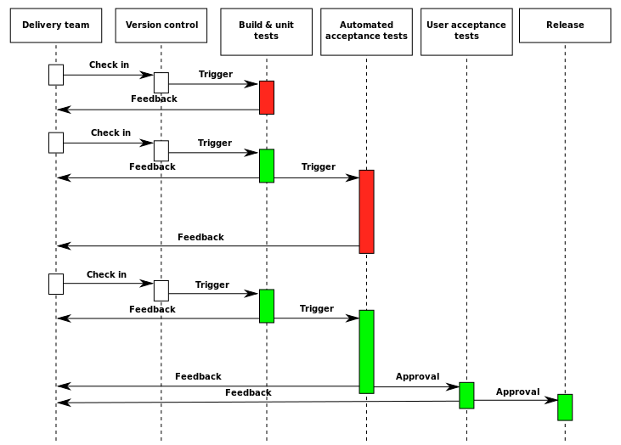

Slide 122

CI using GitHub Actions offers workflows that can build the code in your repository and run your tests. Workflows can run on GitHub-hosted virtual machines, or on machines that you host yourself.
You can configure your CI workflow to run when a GitHub event occurs (for example, when new code is pushed to your repository), on a set schedule, or when an external event occurs using the repository dispatch webhook.

Slide 123
GitHub runs your CI tests and provides the results of each test in the pull request, so you can see whether the change in your branch introduces an error. When all CI tests in a workflow pass, the changes you pushed are ready to be reviewed by a team member or merged. When a test fails, one of your changes may have caused the failure.
When you set up CI in your repository, GitHub analyzes the code in your repository and recommends CI workflows based on the language and framework in your repository. For example, if you use Node.js, GitHub will suggest a template file that installs your Node.js packages and runs your tests. You can use the CI workflow template suggested by GitHub, customize the suggested template, or create your own custom workflow file to run your CI tests.

Slide 124
In addition to helping you set up CI workflows for your project, you can use GitHub Actions to create workflows across the full software development life cycle. For example, you can use actions to deploy, package, or release your project.
If you enable email or web notifications for GitHub Actions, you'll receive a notification when any workflow runs that you've triggered have completed. The notification will include the workflow run's status (including successful, failed, neutral, and canceled runs). You can also choose to receive a notification only when a workflow run has failed.

Slide 125
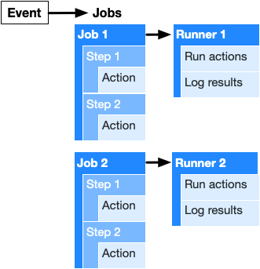

Slide 126
Workflows
The workflow is an automated procedure that you add to your repository. Workflows are made up of one or more jobs and can be scheduled or triggered by an event. The workflow can be used to build, test, package, release, or deploy a project on GitHub.
Events
An event is a specific activity that triggers a workflow. For example, activity can originate from GitHub when someone pushes a commit to a repository or when an issue or pull request is created. You can also use the repository dispatch webhook to trigger a workflow when an external event occurs. For a complete list of events that can be used to trigger workflows, see Events that trigger workflows.

Slide 127
Jobs
A job is a set of steps that execute on the same runner. By default, a workflow with multiple jobs will run those jobs in parallel. You can also configure a workflow to run jobs sequentially. For example, a workflow can have two sequential jobs that build and test code, where the test job is dependent on the status of the build job. If the build job fails, the test job will not run.
Steps
A step is an individual task that can run commands in a job. A step can be either an action or a shell command. Each step in a job executes on the same runner, allowing the actions in that job to share data with each other.

Slide 128
Actions
Actions are standalone commands that are combined into steps to create a job. Actions are the smallest portable building block of a workflow. You can create your own actions, or use actions created by the GitHub community. To use an action in a workflow, you must include it as a step.
Runners
A runner is a server that has the GitHub Actions runner application installed. You can use a runner hosted by GitHub, or you can host your own. A runner listens for available jobs, runs one job at a time, and reports the progress, logs, and results back to GitHub. For GitHub-hosted runners, each job in a workflow runs in a fresh virtual environment.

Slide 129
Workflow Configuration File
Lets create an workflow in your repository that automatically triggers a series of commands whenever code is pushed.
In the .github/workflows/ directory, create a new file called learn-github-actions.yml

Slide 130
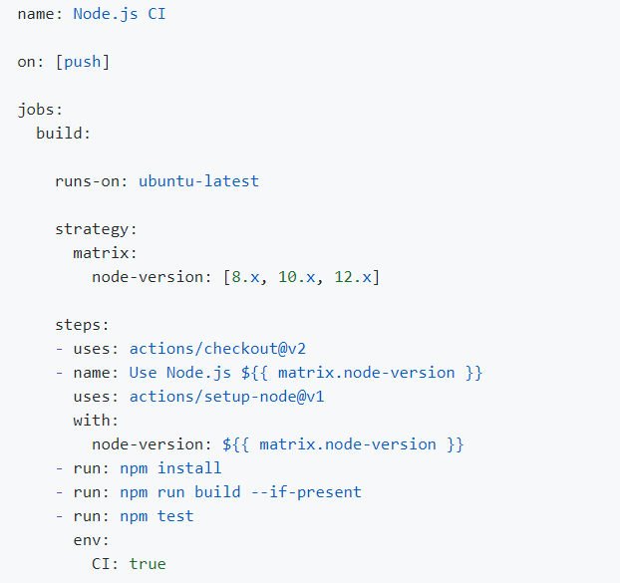

Slide 131
The starter workflow template configures jobs to run on Linux, using the GitHub-hosted ubuntu-latest runners. You can change the runs-on key to run your jobs on a different operating system.
The template includes a matrix strategy that builds and tests your code with three Node.js versions: 8.x, 10.x, and 12.x. The 'x' is a wildcard character that matches the latest minor and patch release available for a version. Each version of Node.js specified in the node-version array creates a job that runs the same steps.
Each job can access the value defined in the matrix node-version array using the matrix context. The setup-node action uses the context as the node-version input. The setup-node action configures each job with a different Node.js version before building and testing code.
GitHub-hosted runners have npm and Yarn dependency managers installed. You can use npm and Yarn to install dependencies in your workflow before building and testing your code.

Slide 132
You can use the same commands that you use locally to build and test your code. For example, if you run npm run build to run build steps defined in your package.json file and npm test to run your test suite, you would add those commands in your workflow file.

Slide 133
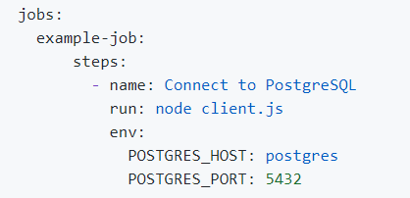
GitHub Actions include default environment variables for each workflow run. If you need to use custom environment variables, you can set these in your YAML workflow file.

Slide 134
You can save artifacts from your build and test steps to view after a job completes. For example, you may need to save log files, core dumps, test results, or screenshots.
This example shows you how to create a workflow for a Node.js project that builds the code in the src directory and runs the tests in the tests directory. You can assume that running npm test produces a code coverage report named code-coverage.html stored in the output/test/ directory
The workflow uploads the production artifacts in the dist directory, but excludes any markdown files. It also and uploads the code-coverage.html report as another artifact.

Slide 135
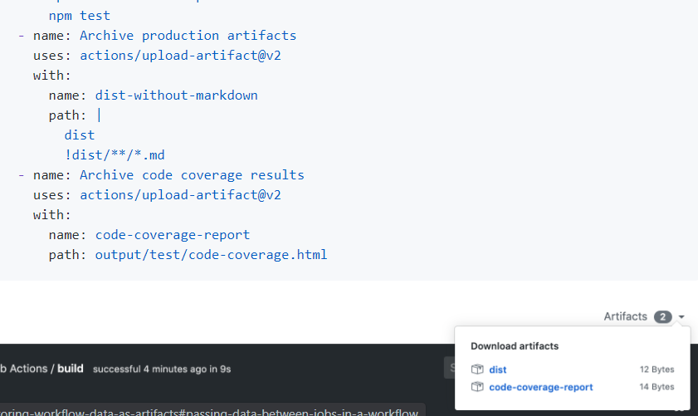

Slide 136
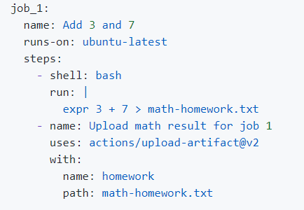
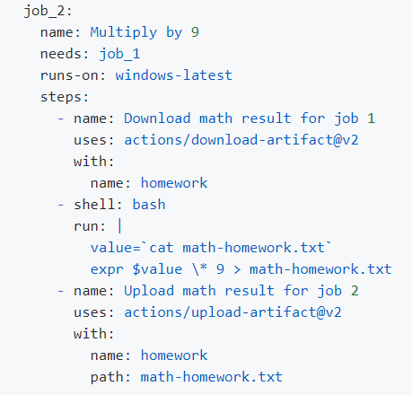
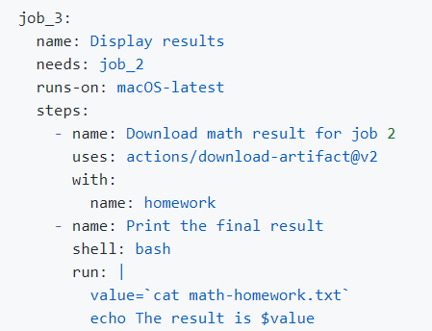
Passing data between jobs in a workflow

Slide 137
Job 1 performs these steps:
Performs a math calculation and saves the result to a text file called math-homework.txt.
Uses the upload-artifact action to upload the math-homework.txt file with the artifact name homework.
Job 2 uses the result in the previous job:
Downloads the homework artifact uploaded in the previous job. By default, the download-artifact action downloads artifacts to the workspace directory that the step is executing in. You can use the path input parameter to specify a different download directory.
Reads the value in the math-homework.txt file, performs a math calculation, and saves the result to math-homework.txt again, overwriting its contents.
Uploads the math-homework.txt file. This upload overwrites the previously uploaded artifact because they share the same name.

Slide 138
Job 3 displays the result uploaded in the previous job:
Downloads the homework artifact.
Prints the result of the math equation to the log.
The full math operation performed in this workflow example is (3 + 7) x 9 = 90.

Slide 139


Slide 140
Liquibase is an open-source solution for managing revisions of your database schema scripts. It works across various types of databases and supports various file formats for defining the DB structure. The feature that is probably most attractive in Liquibase is its ability to roll changes back and forward from a specific point — saving you from needing to know what was the last change/script you ran on a specific DB instance.

Slide 141
changelog files
Developers store database changes in text-based files on their local development machines and apply them to their local databases. These changelog files are stored in source control to enable collaboration. The changelog can be used to update all the different database environments that a team uses — from local development databases, to test, staging, and production. Changelog files can be arbitrarily nested for better management.

Slide 142
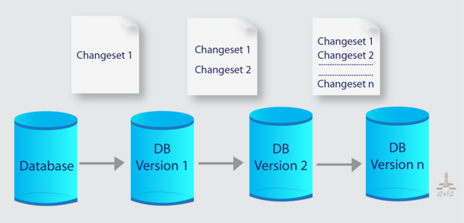
changesets
ChangeSets are the units of change that Liquibase is tracking.
ChangeSet is an analogue of a commit in version control systems.
Each changeSet is uniquely identified by the author, id, and filename attributes. When Liquibase runs, it queries the DATABASECHANGELOG table for the changeSets that are marked as executed and then executes all changeSets in the changelog file that have not yet been executed.

Slide 143
By analogy with a commit, changes that were made within a single changeSet can be rolled or rolled back to the database server.
Liquibase can automatically create a script to rollback most of the changeset.

Slide 144
Change types
Each changeset contains one or more Change Types that describe a type of change or action you want to apply to the database.
Liquibase supports both descriptive Change Types that generate SQL for supported databases and raw SQL. Generally, there should only be one Change Type per changeset to avoid failed auto-commit statements that can leave the database in an unexpected state.
createTable, dropTable, renameTable, addCheckConstrain, addForeignKeyConstraint, Inserst, Delete

Slide 145
Attributes

Slide 146

Preconditions
Preconditions can be applied to either the changelog as a whole or to individual changesets.
Preconditions control the execution of an update and can stop the update, skip a changeset, mark a changeset as run, or show a warning.

Slide 147
Contexts
Contexts can be applied to changeSets to control whether they are run in different environments. For example, some changeSets can be tagged as “production” and others as “test”. If no context is specified, the changeSet will run regardless of the execution context. Contexts can be specified as logical expressions in the changeSet to more precisely control execution.

Slide 148


Example

Slide 149


Add table

Slide 150


Add new field to DB

