Slide 1



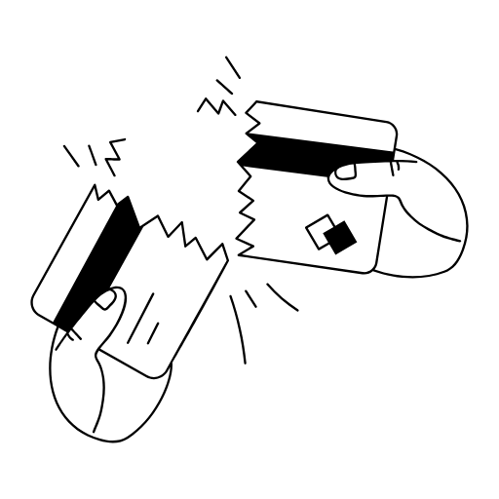
Harnessing Transformers for Fraud Detection
Tackling Imbalanced Data and Outperforming Baselines
Fengyuan Shen
Jinhu Sun
DS542 Deep Learning
December 6, 2024

Slide 2

Table of contents
01
02
03
04
Introduction
Methodology
Experiments and Results
Discussion and Conclusion

Slide 3
01
Introduction

Slide 4
Introduction
01. Overview
Financial fraud: A growing threat to global economic stability.
Challenges:
Highly imbalanced data: Fraudulent transactions make up only 0.172%.
Complex, non-linear patterns in transaction data.
02. Dataset Summary
Dataset: Credit Card Fraud Detection dataset (Kaggle).
Size: 284,807 transactions, 492 fraudulent.
Features:
PCA-transformed variables (V1–V28).
Time and Amount are raw features.
03. Objectives
Build an effective fraud detection model.
Improve recall for minority (fraudulent) class.
Balance minority class detection without sacrificing majority class performance.

Slide 5
02
Methodology

Slide 6
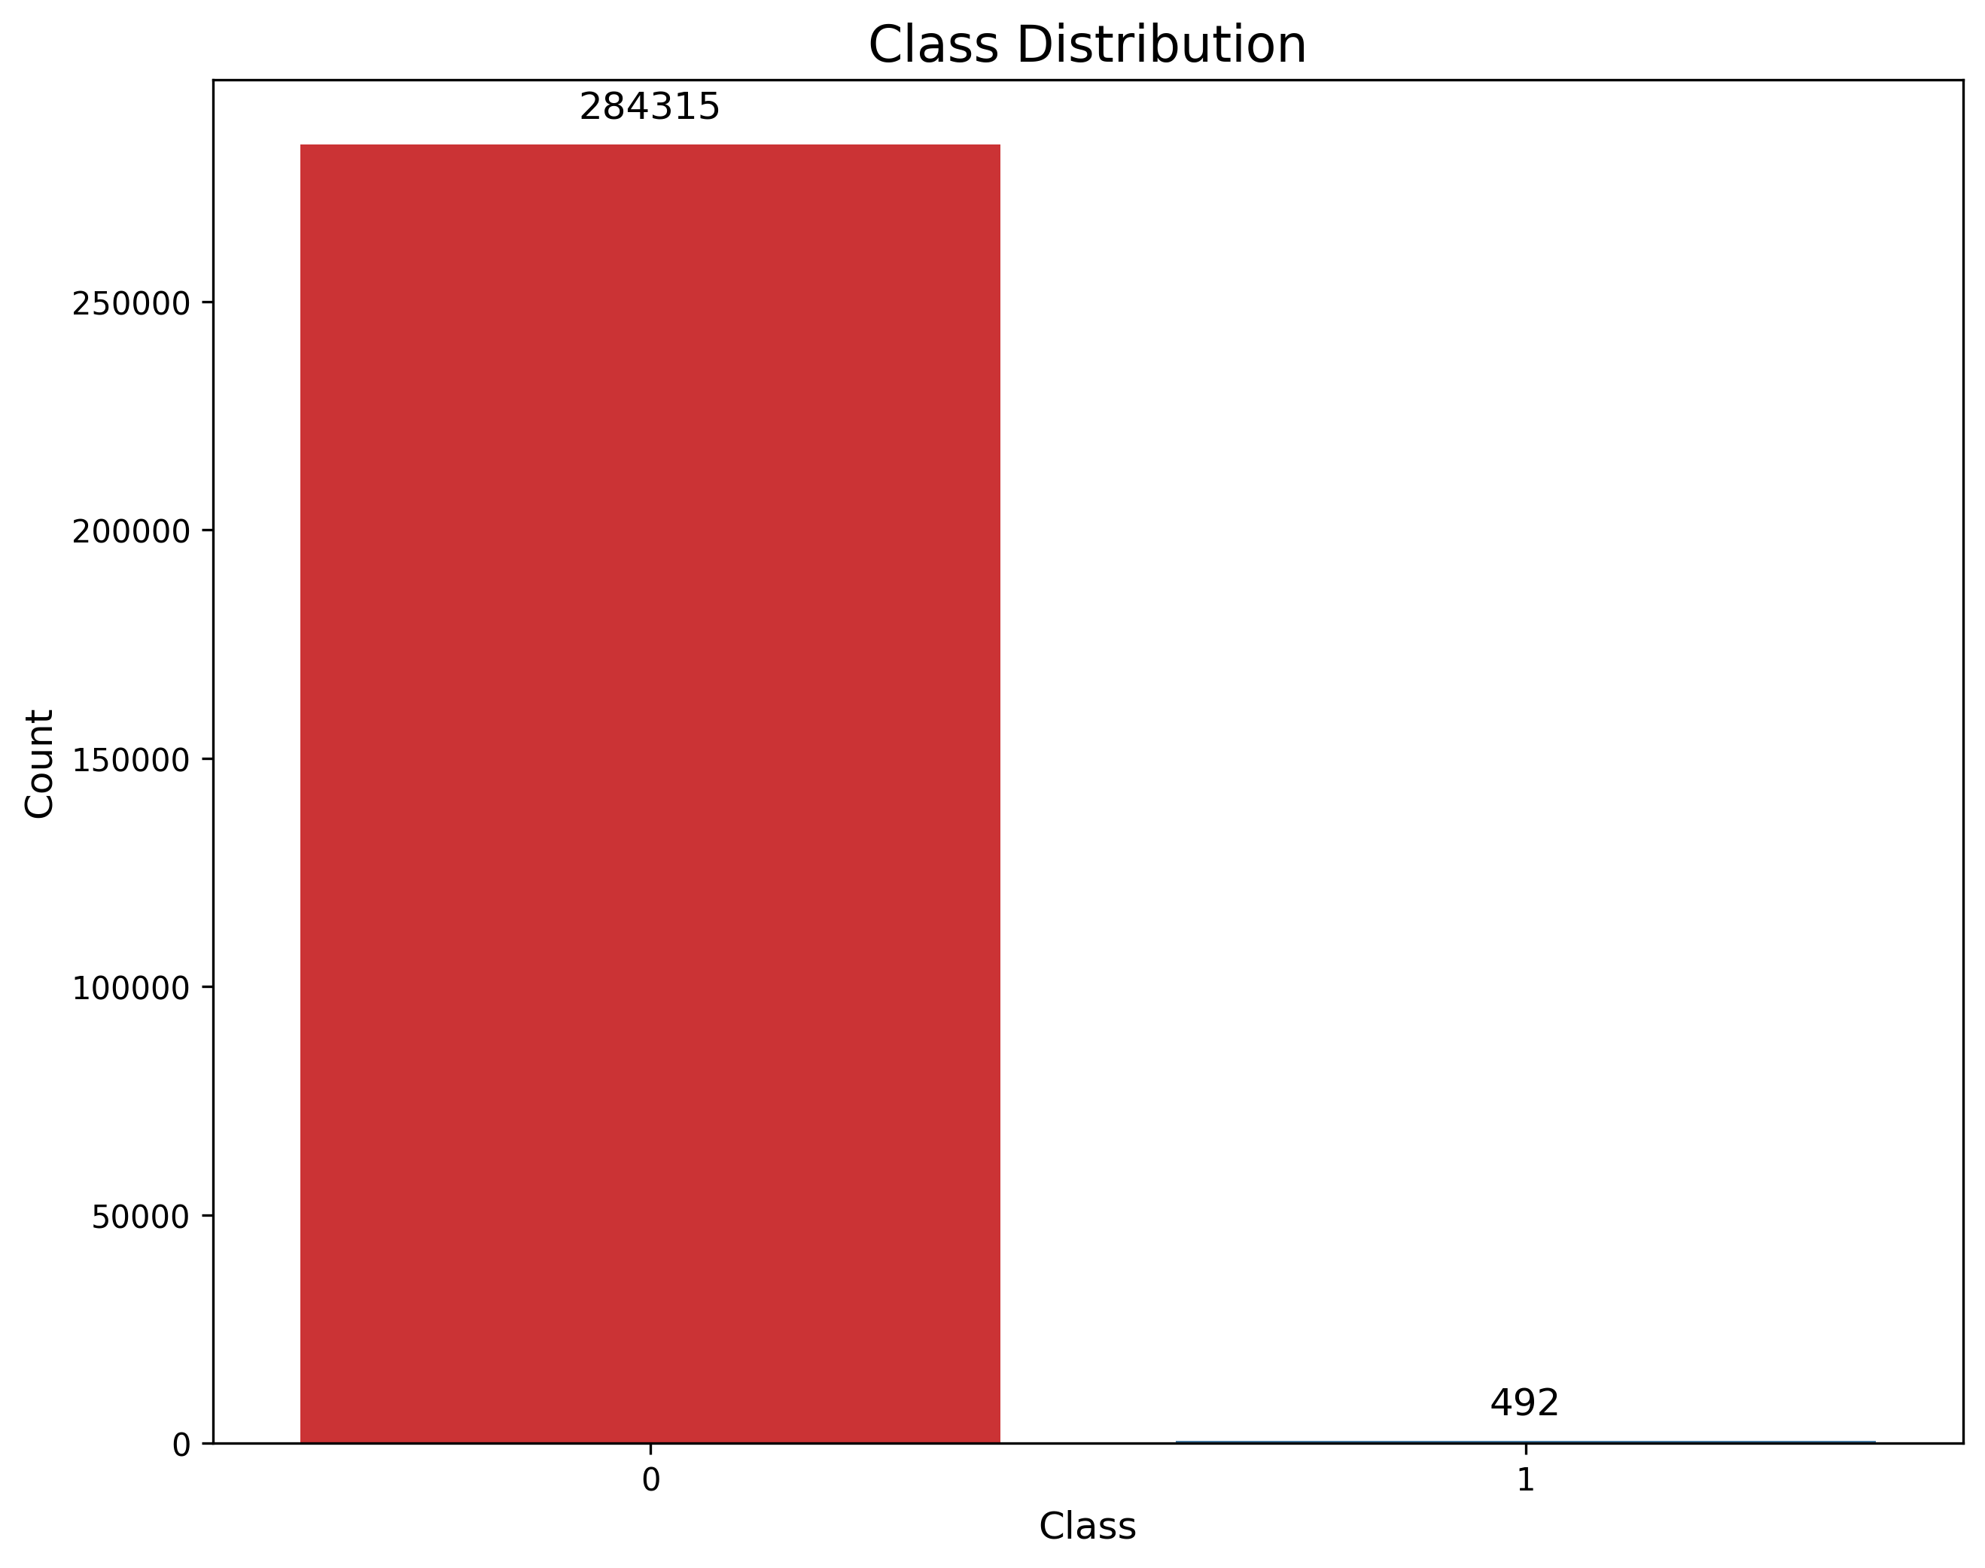
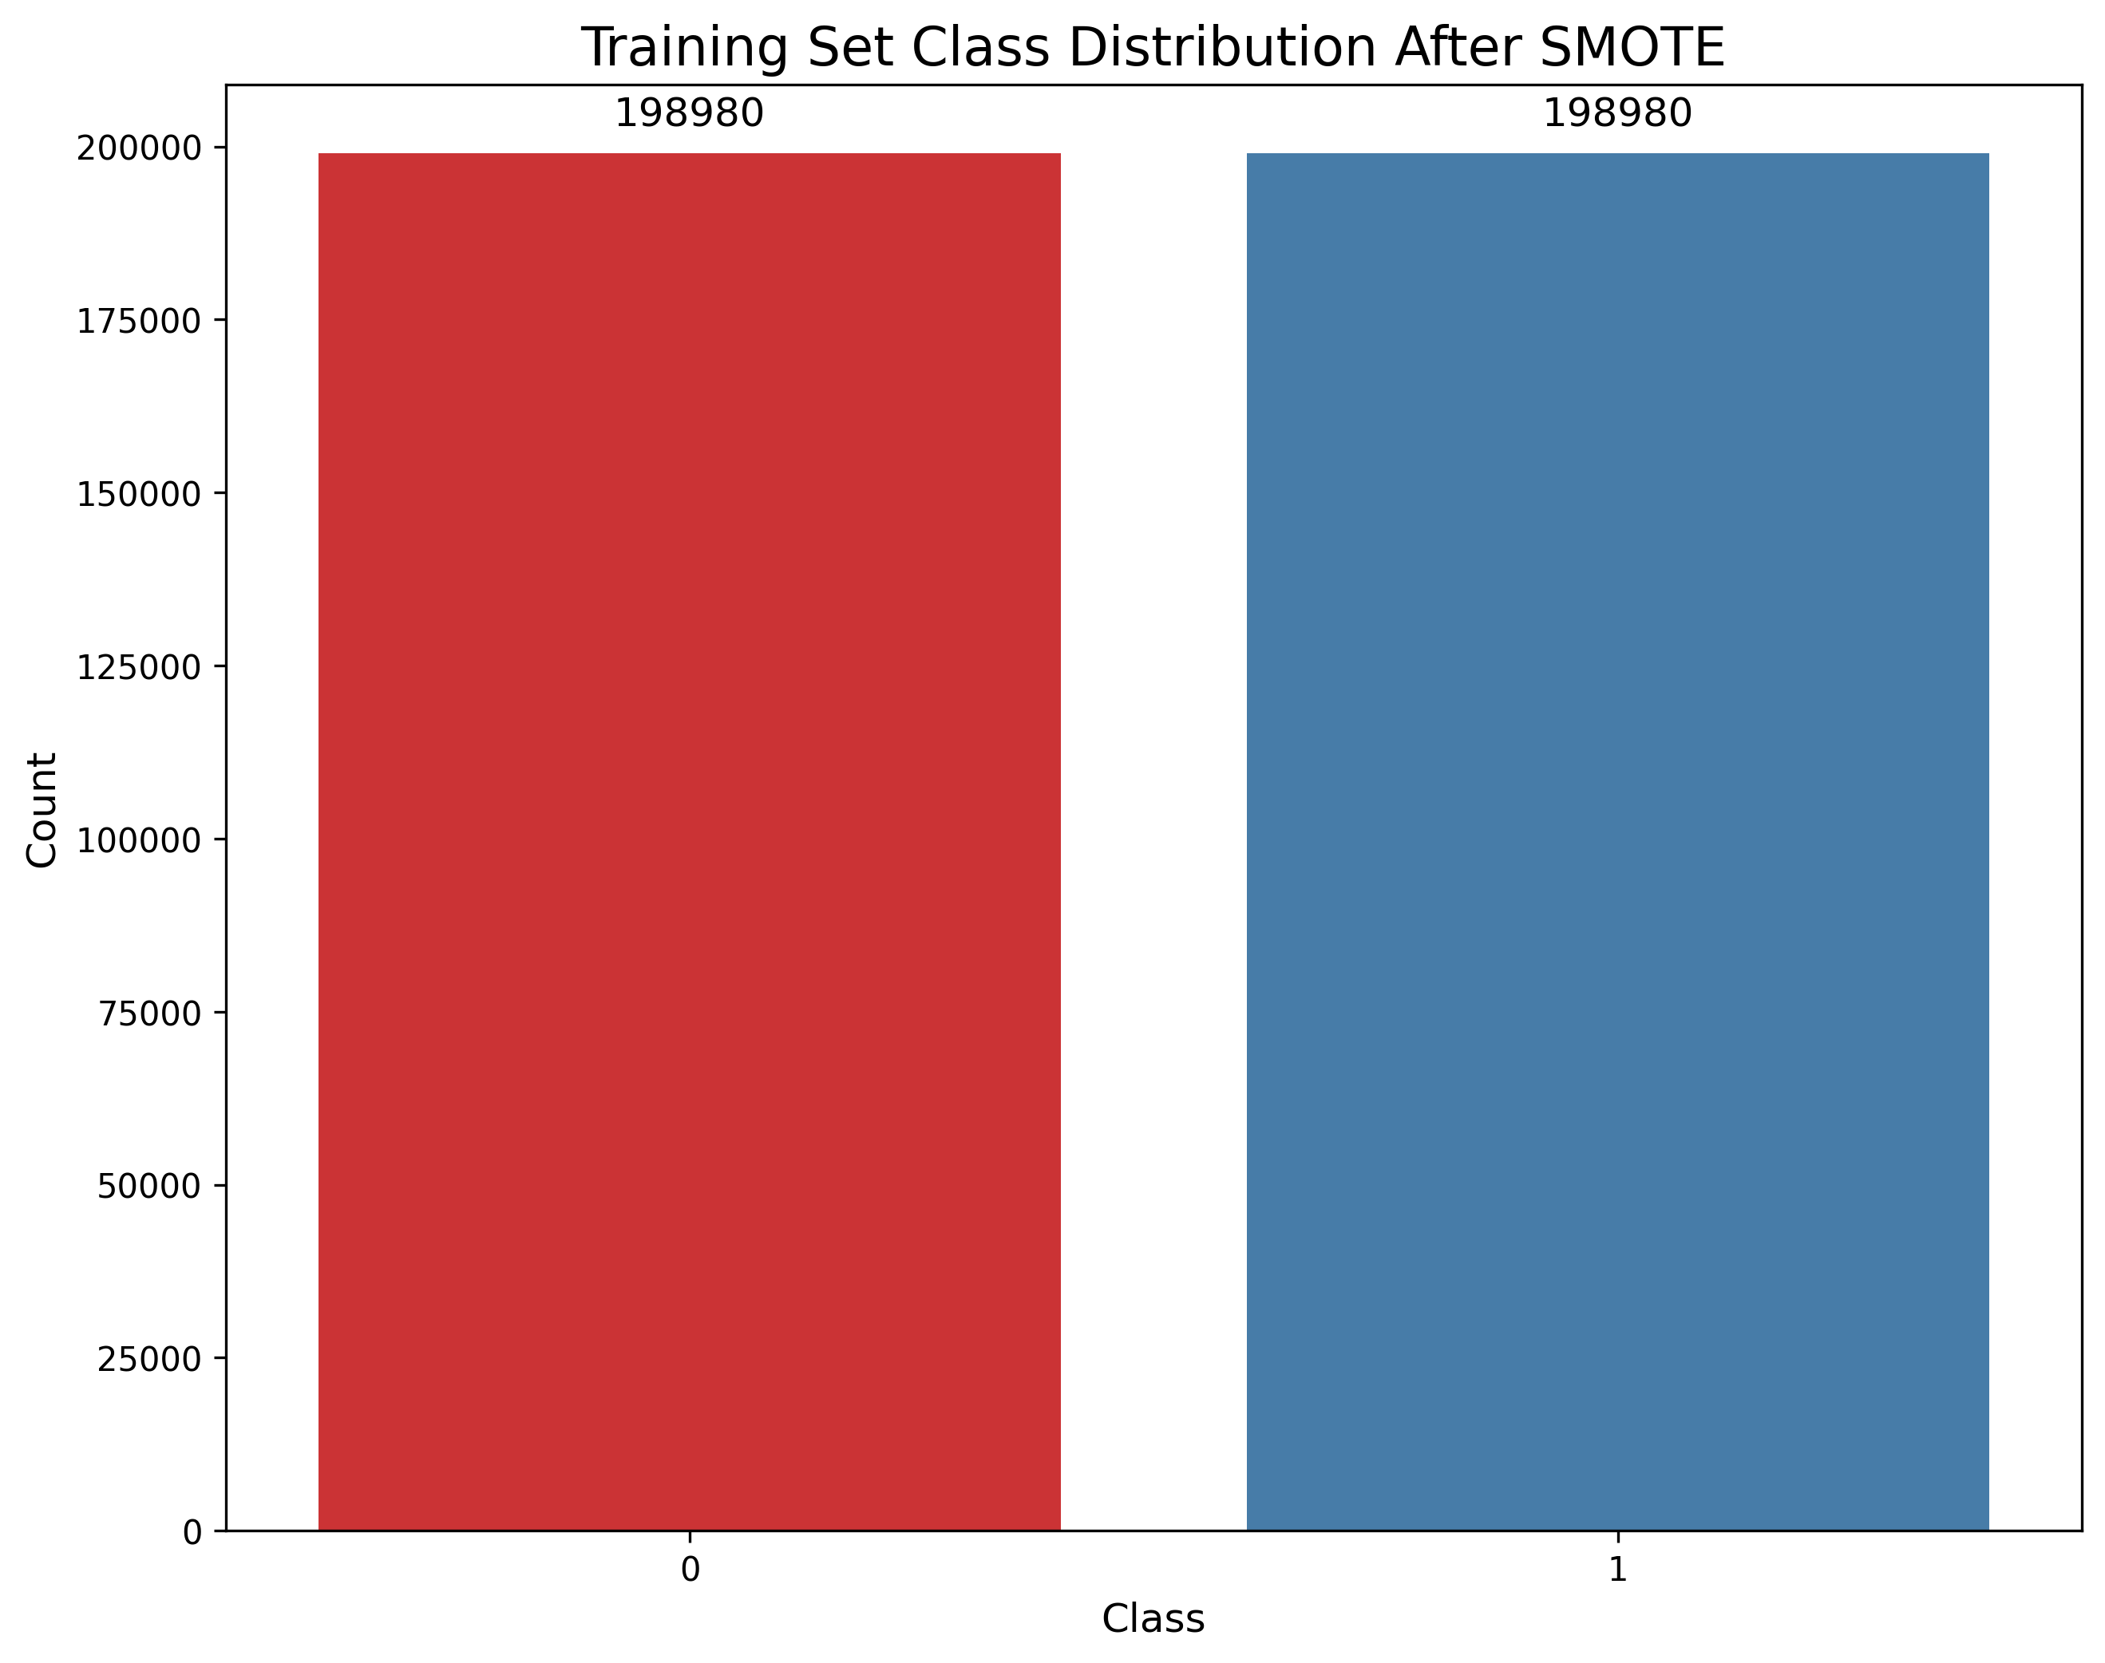
Methodology
01. Data Preprocessing
Training Set Splitting: 70:30, sorted by Time to mimic real-world fraud detection.
Standardization:
Both Time and Amount were standardized separately for training and testing datasets to prevent data leakage.
SMOTE for Imbalance Handling:
Balanced classes in training set (1:1 ratio).
Generate synthetic samples for the minority class by interpolating between existing samples.
Result: Improved minority class representation.

Slide 7
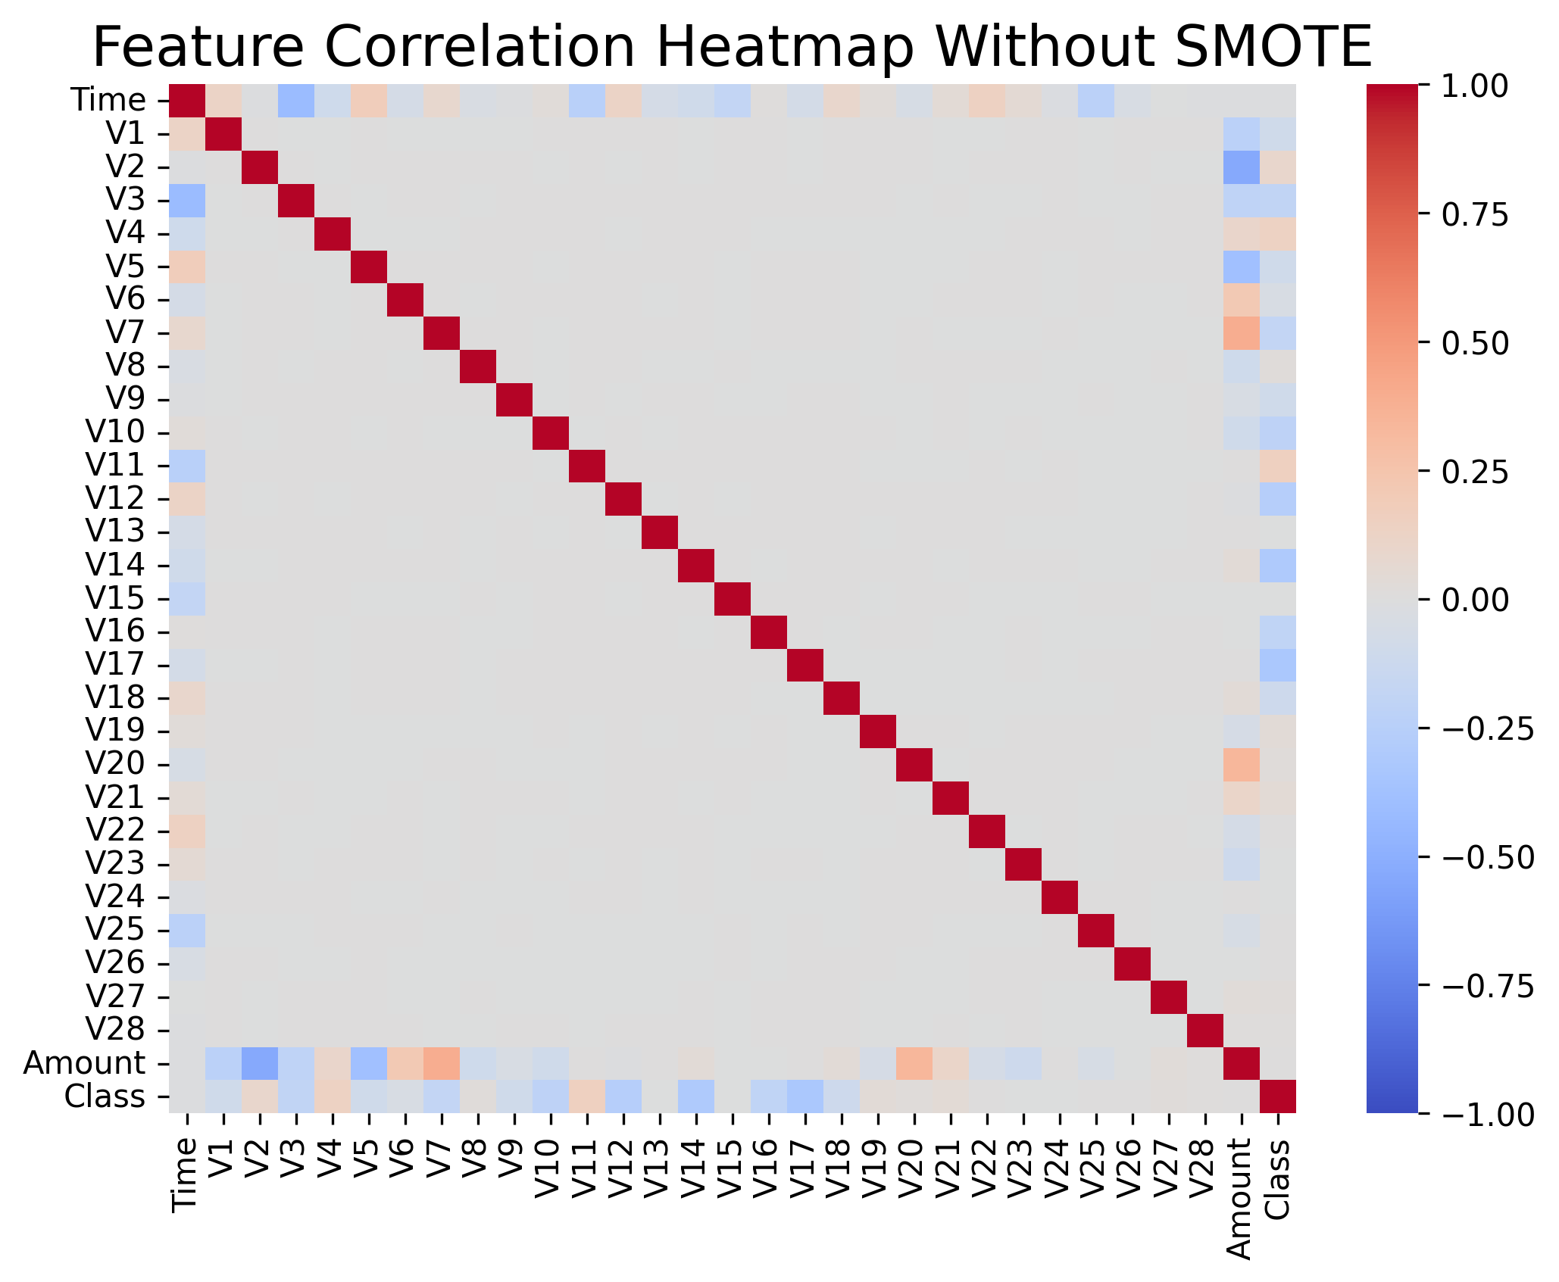
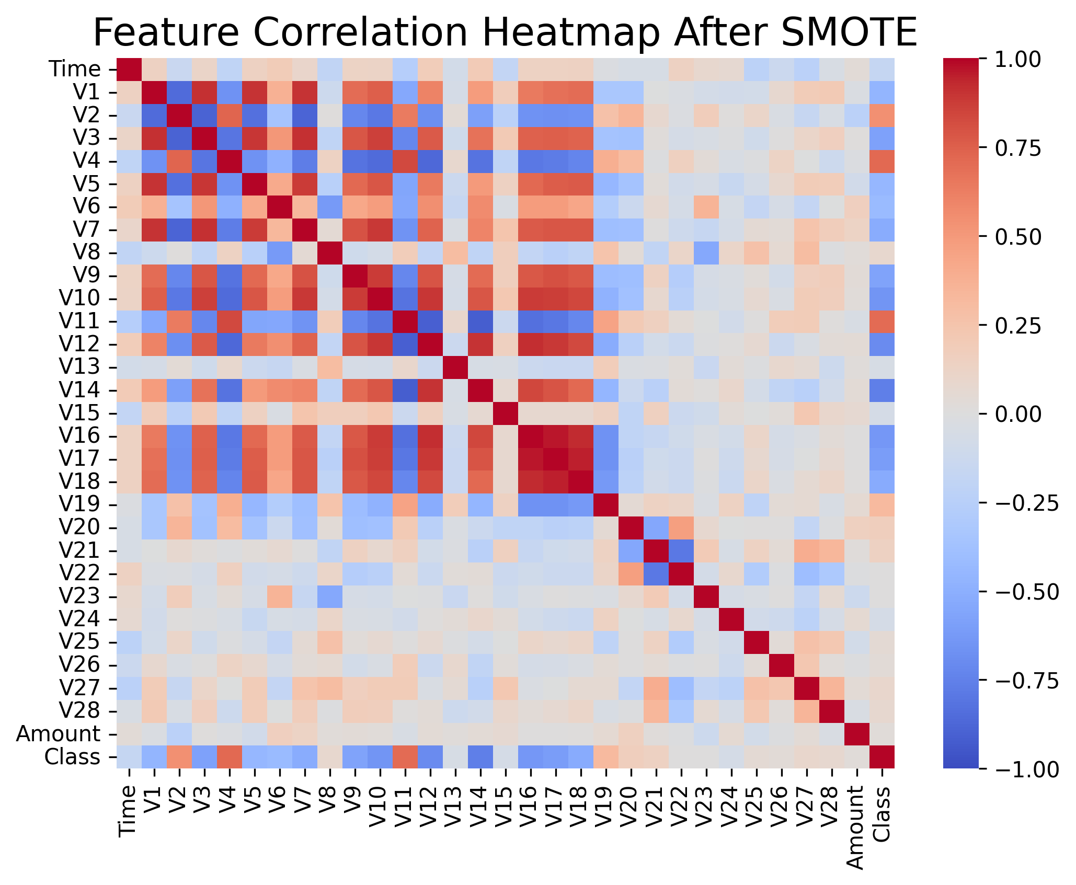
Methodology
02. Correlation Analysis
Purpose: To investigate the relationships between features and the target variable.
Challenge: In imbalanced datasets, correlation coefficients can be misleading due to the scarcity of minority class samples.
Impact of SMOTE:
SMOTE increases the proportion and diversity of minority class samples.
Enhanced correlations reveal more distinctive patterns between features and the target variable.
Results help models better discern key relationships for fraud detection.

Slide 8
Methodology
03. Model Comparison
Baseline Models:
Logistic Regression
Random Forest
Deep Learning Models:
Multi-Layer Perceptron (MLP).
LSTM for sequence modeling.
Transformer leveraging self-attention.
Model | Architecture | Key Layers | Loss | Optimizer | Learning Rate | Epochs
Logistic Regression | Single linear layer + sigmoid | Input dim -> 1 | BCE | Adam | 0.001 | 30
Random Forest | Ensemble of 100 trees | n_estimators = 100 | N/A | N/A | N/A | N/A
MLP | Fully connected network | fc1: 128; fc2: 64 | BCE | Adam | 0.001 | 30
LSTM | 2-layer LSTM + linear output | hidden_dim: 64; num_layers: 2 | BCE or Focal | Adam | 0.001 | 30
Transformer | 2-layer encoder; multi-head attention | d_model: 256; heads: 4 | BCE or Focal | AdamW | 0.001 | 30

Slide 9
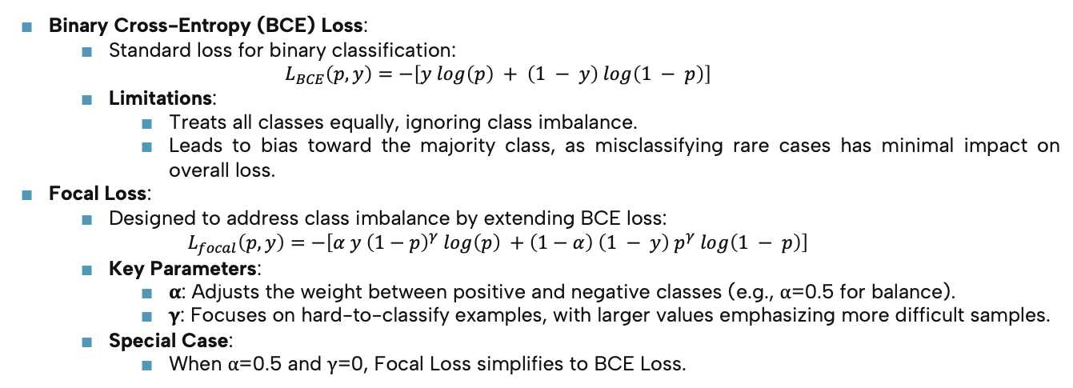
Methodology
04. Loss Functions
Binary Cross-Entropy (BCE) Loss:
Standard loss for binary classification:
$$L_{BCE}\left(p,y\right)=−\left[y log\left(p\right) + \left(1 − y\right) log\left(1 − p\right)\right]$$
Limitations:
Treats all classes equally, ignoring class imbalance.
Leads to bias toward the majority class, as misclassifying rare cases has minimal impact on overall loss.
Focal Loss:
Designed to address class imbalance by extending BCE loss:
$$L_{focal}\left(p,y\right)=−\left[α y {\left(1−p\right)}^{γ} log\left(p\right) +\left(1−α\right) \left(1 − y\right) p^{γ} log\left(1 − p\right)\right]$$
Key Parameters:
α: Adjusts the weight between positive and negative classes (e.g., α=0.5 for balance).
γ: Focuses on hard-to-classify examples, with larger values emphasizing more difficult samples.
Special Case:
When α=0.5 and γ=0, Focal Loss simplifies to BCE Loss.

Slide 10
Methodology
05. Innovation: Transformer with Focal Loss
Why Transformer:
Captures both local and global patterns efficiently.
Why Focal Loss:
Focuses on hard-to-classify fraud cases.
Reduces the dominance of majority class.
Result: Enhanced recall for fraudulent transactions.
06. Evaluation Metrics
Recall：
Definition: Measures the proportion of actual fraud cases correctly identified.
Importance: Prioritizes identifying rare fraudulent transactions over overall accuracy.
ROC AUC Score：
Definition: Evaluates the model’s ability to rank positive instances (fraud) higher than negative ones (non-fraud) across varying classification thresholds.
Benefits: Provides a holistic view of the model's discriminative power.

Slide 11
03
Experiments and Results

Slide 12
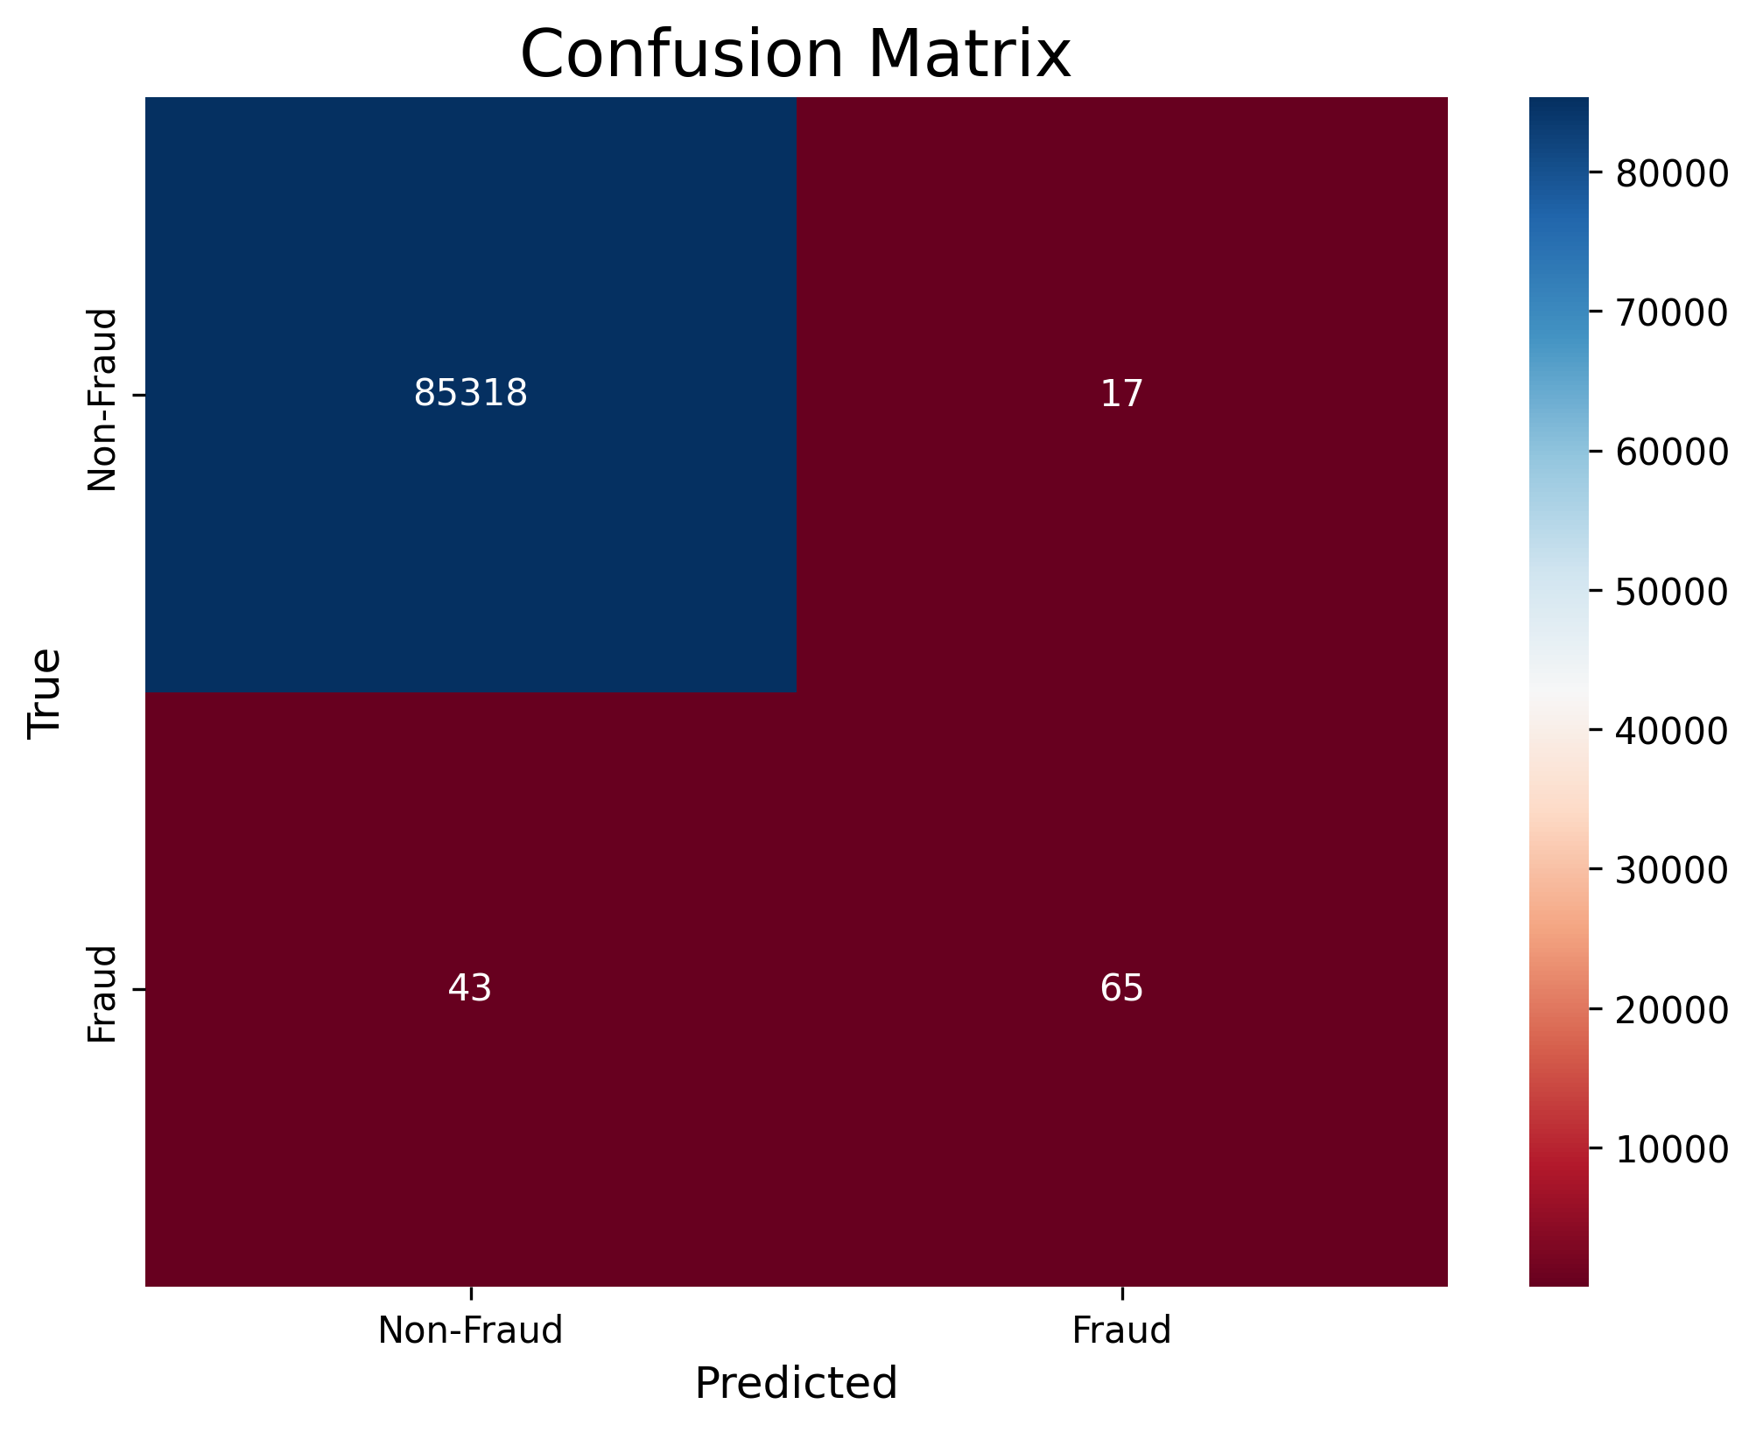
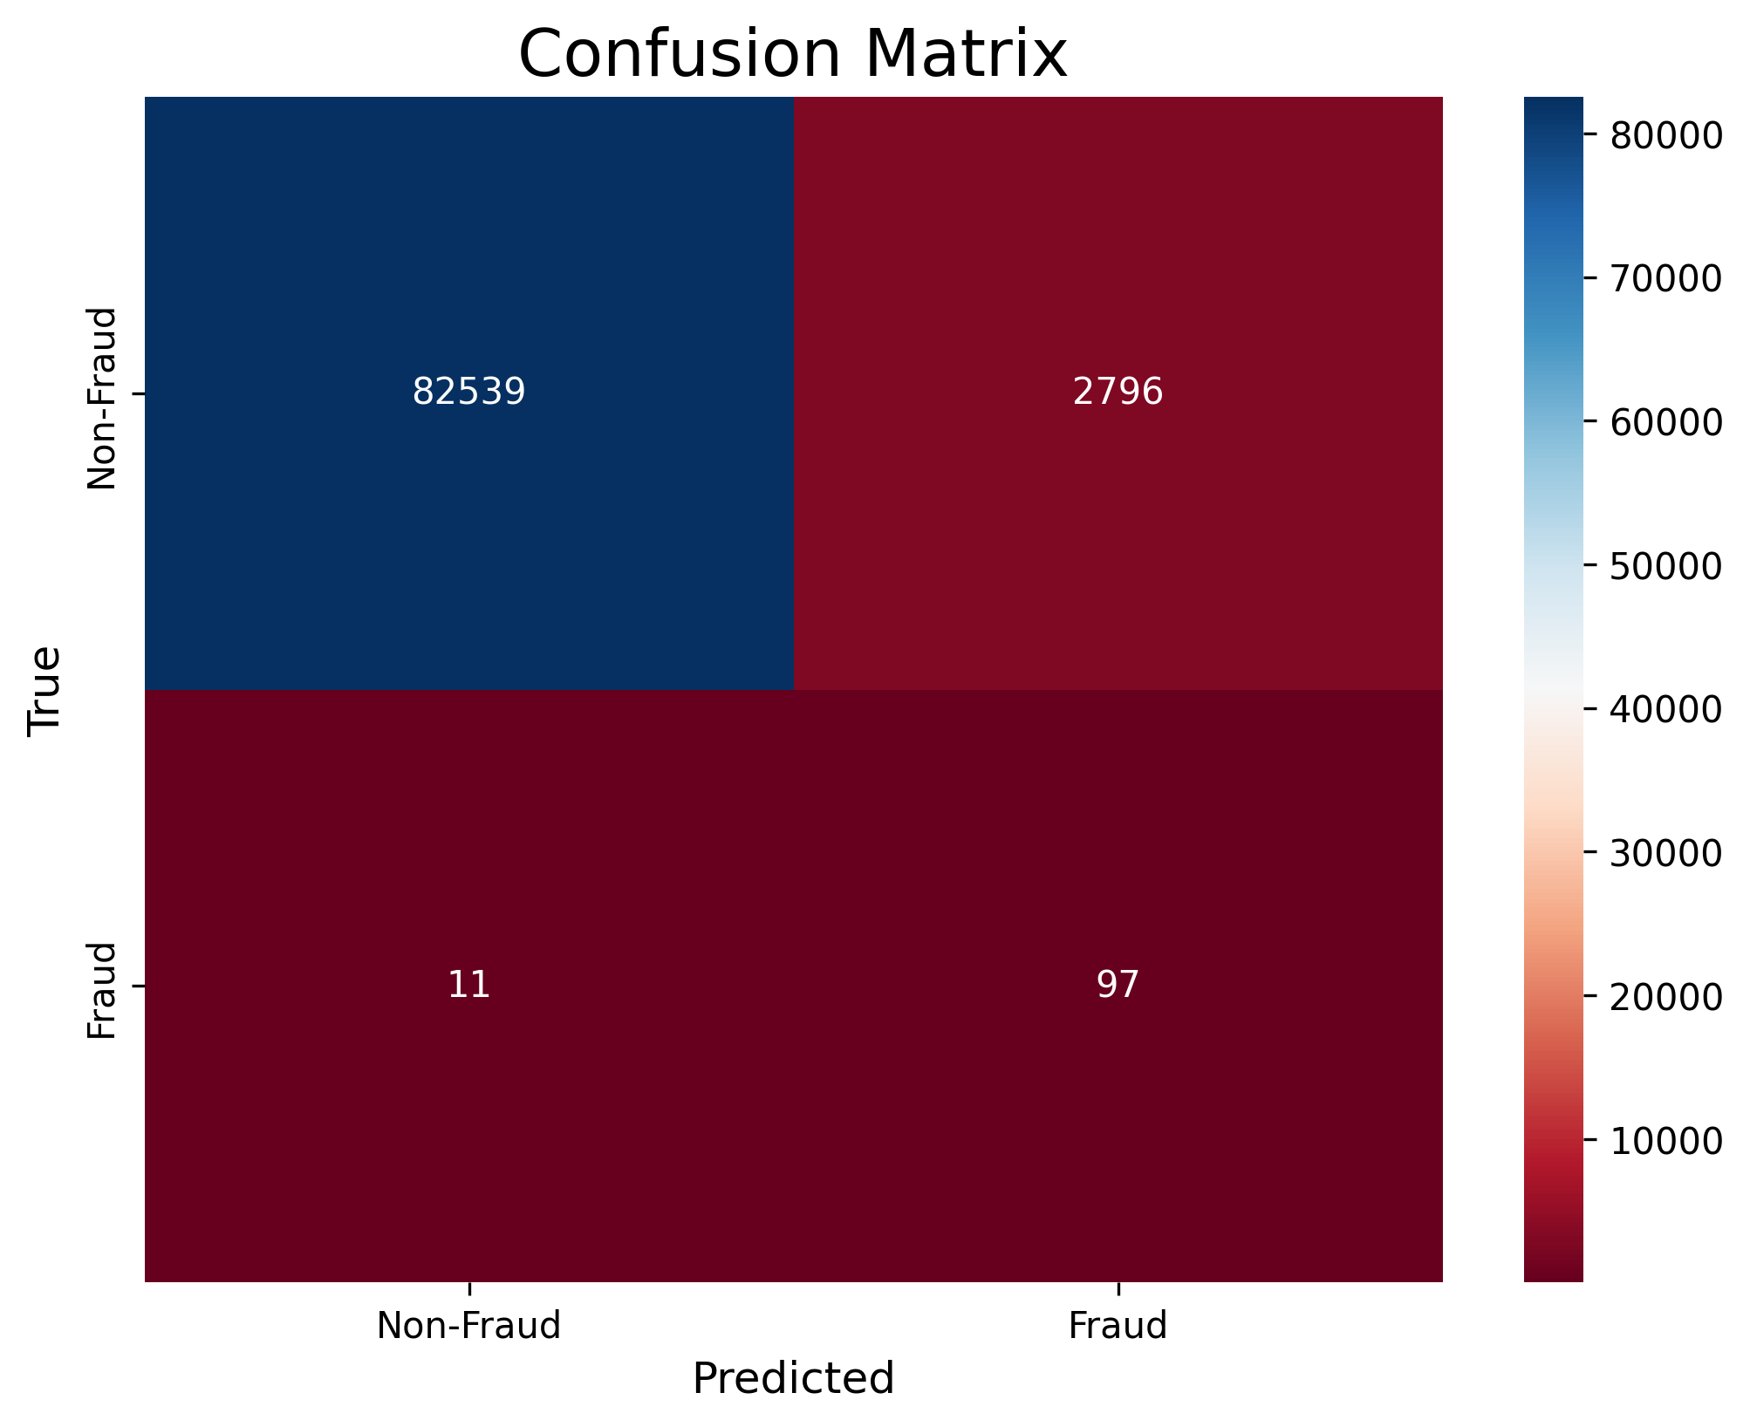
Experiments and Results
01. Effect of SMOTE on Logistic Regression
Goal: Highlight the impact of addressing class imbalance.
Findings:
Without SMOTE: High accuracy but poor fraud detection (Recall = 0.60, ROC AUC = 0.80).
With SMOTE: Significant improvement in fraud recall (Recall = 0.90, ROC AUC = 0.93).
Trade-off: Increased false positives for non-fraud cases.
Logistic Regression Without SMOTE
Logistic Regression With SMOTE

Slide 13
Experiments and Results
02. Model Performance Comparison
Models Evaluated: Logistic Regression, Random Forest, MLP, LSTM, Transformer.
Key Results:
Logistic Regression (after SMOTE): High fraud recall (0.90).
Transformer: Achieved balance with fraud recall (0.89) and overall performance (ROC AUC = 0.91).
Insight: Transformer effectively captures nuanced patterns but trades off some non-fraud accuracy.
Model | Recall (Fraud) | Recall (Non-Fraud) | ROC AUC Score
Logistic Regression | 0.90 | 0.97 | 0.93
Random Forest | 0.76 | 1.00 | 0.88
MLP | 0.79 | 1.00 | 0.89
LSTM | 0.77 | 1.00 | 0.88
Transformer | 0.89 | 0.94 | 0.91
Performance of Various Models (Trained with BCELoss and SMOTE)

Slide 14
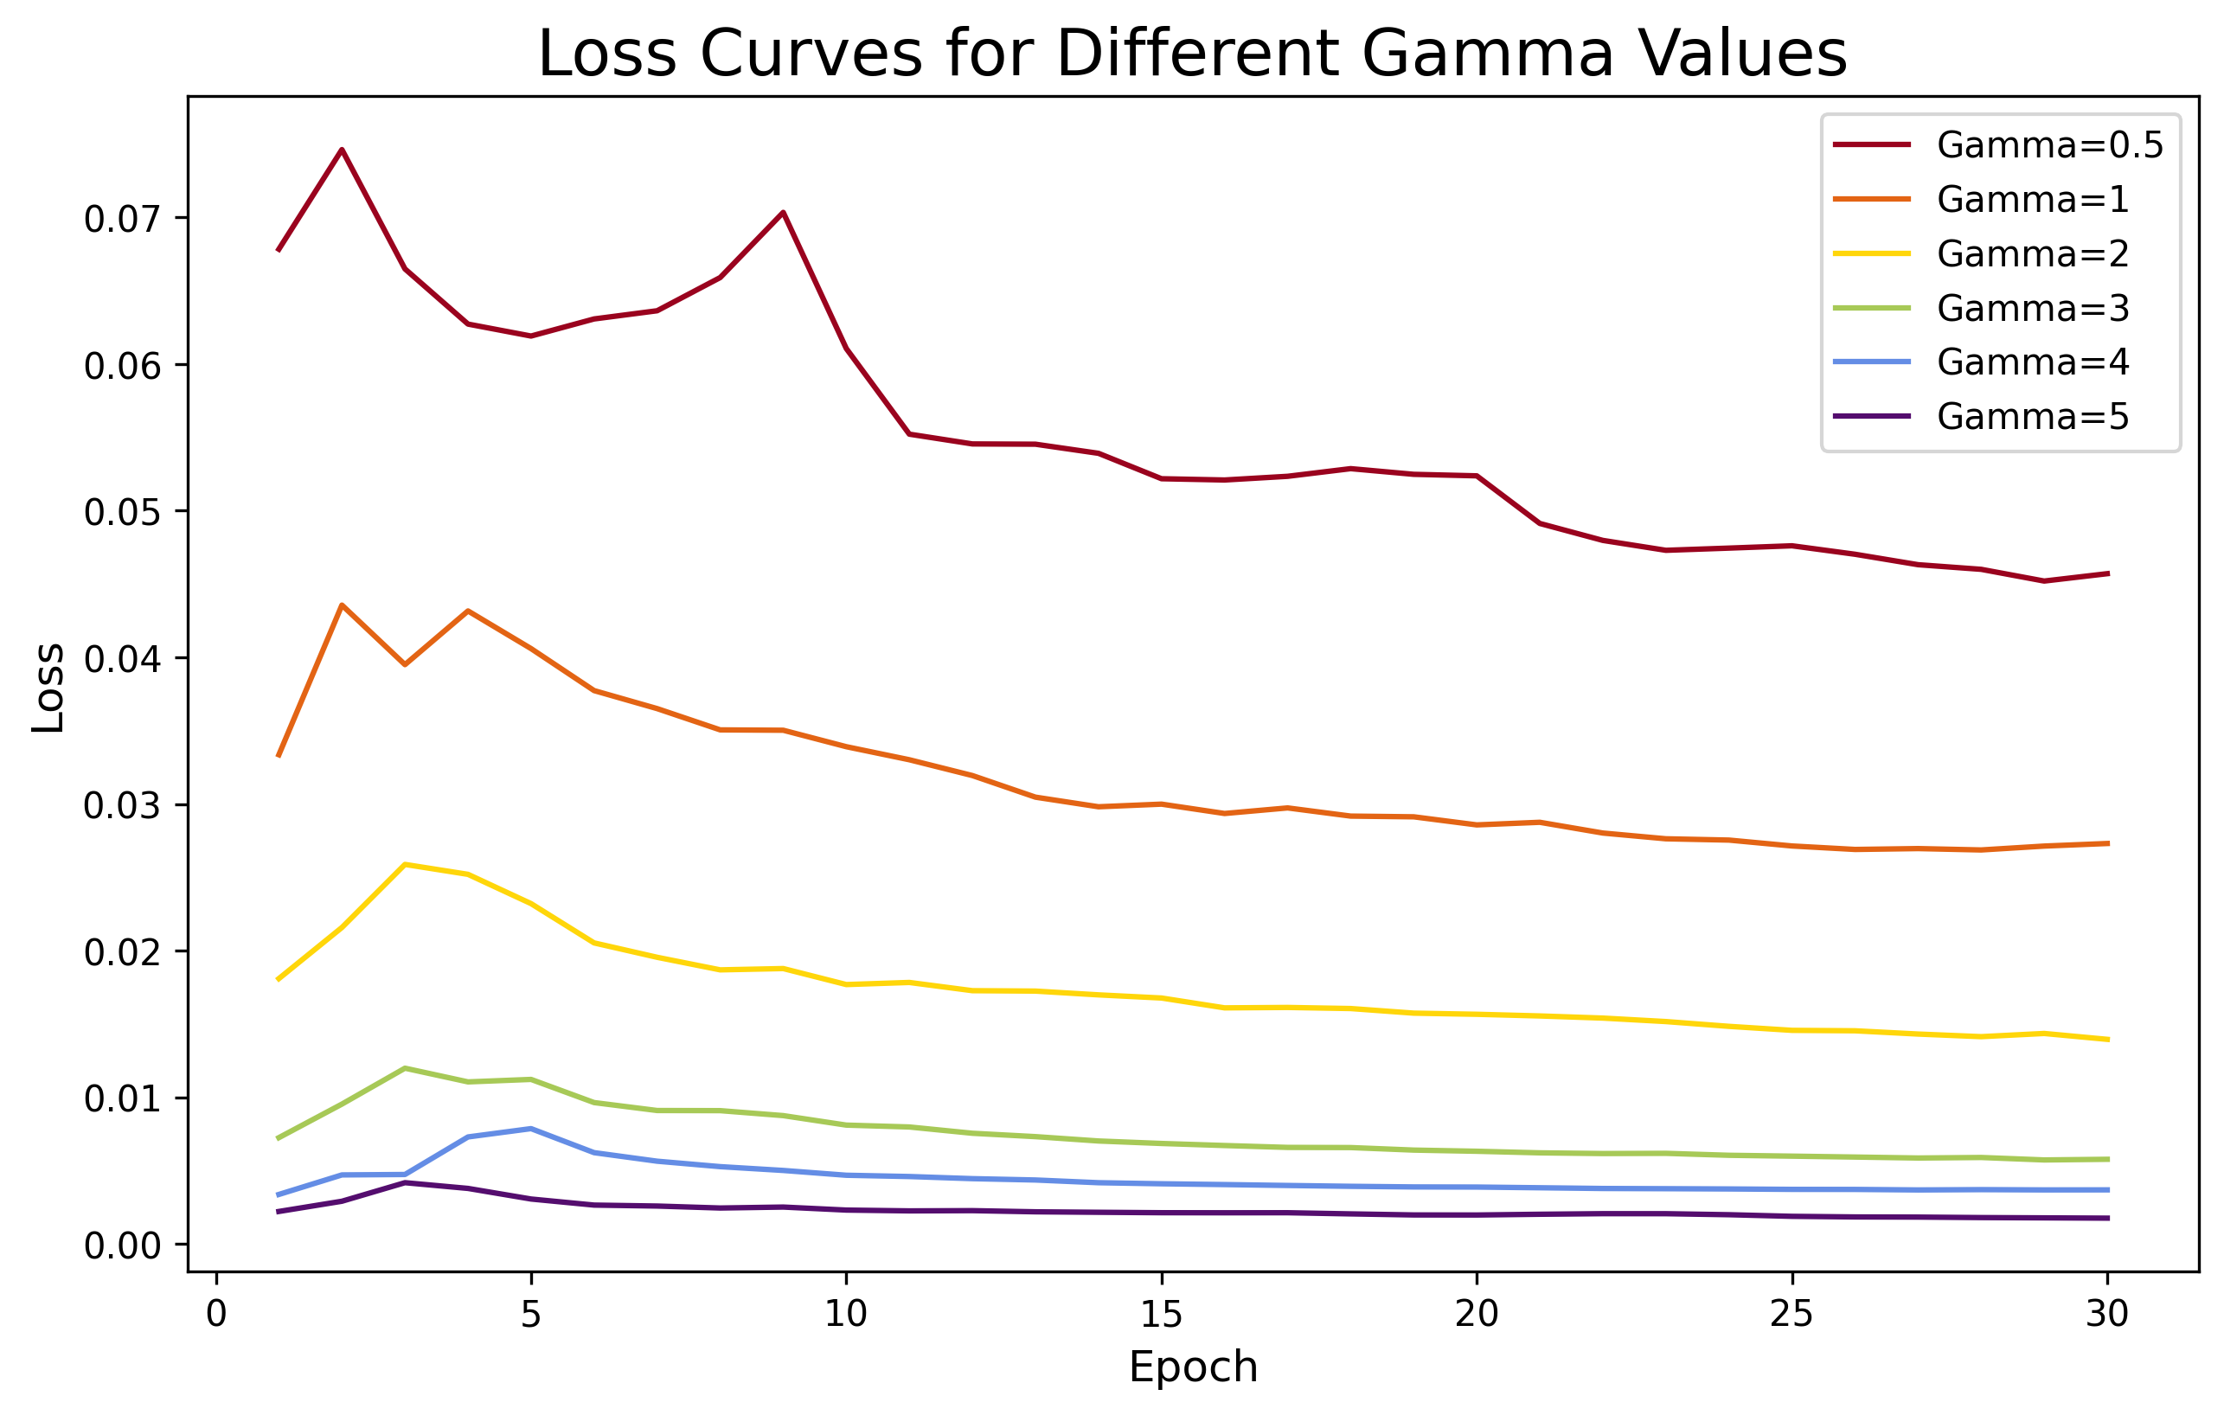
Experiments and Results
03. Impact of Focal Loss on Transformer
Experiment: Tuning γ (Focal Loss) to improve fraud detection.
Key Findings:
γ=2: Optimal trade-off between fraud recall (0.917) and non-fraud performance (0.931).
Lower γ (e.g., 0.5): Focuses aggressively on hard samples but sacrifices non-fraud accuracy.
Comparison: Achieved similar ROC AUC to Logistic Regression while exceeding its fraud recall.
γ | Recall (Fraud) | Recall (Non-Fraud) | ROC AUC Score
0.5 | 0.935 | 0.851 | 0.893
1 | 0.880 | 0.951 | 0.915
2 | 0.917 | 0.931 | 0.924
3 | 0.880 | 0.971 | 0.925
4 | 0.889 | 0.950 | 0.920
5 | 0.926 | 0.898 | 0.912
Transformer Performance Under Focal Loss with Varying γ

Slide 15
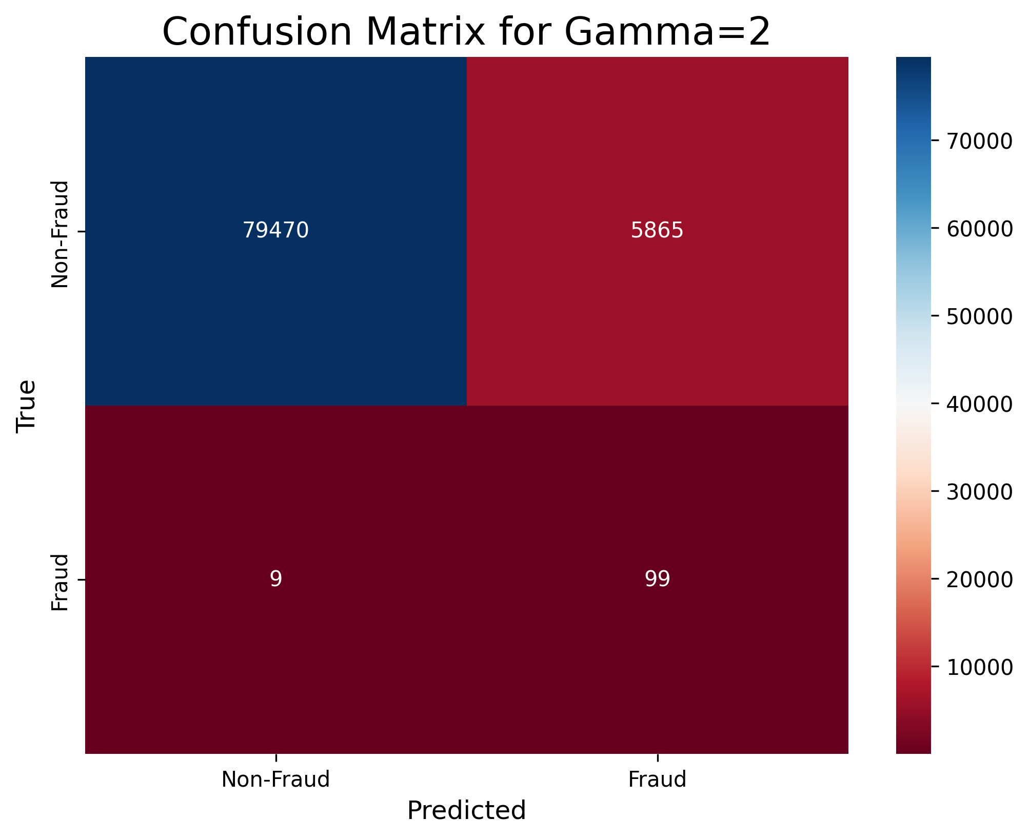

Experiments and Results
04. Transformer vs. LSTM (γ=2)
Transformer: Fraud Recall = 0.917, ROC AUC = 0.92.
LSTM: Fraud Recall = 0.75, ROC AUC = 0.875.
Insight:
Transformer’s attention mechanism better captures complex patterns and reweights features effectively, outperforming LSTM in both recall and overall performance.
Transformer With γ=2
LSTM With γ=2

Slide 16
04
Discussion and Conclusion

Slide 17
Discussion and Conclusion
01. Discussion: Transformer vs. Logistic Regression
Logistic Regression:
Surprising effectiveness after SMOTE.
Fraud Recall = 0.90, ROC AUC = 0.93.
Transformer:
Fraud Recall = 0.917, ROC AUC = 0.92 (with γ=2).
More powerful at capturing nuanced patterns but requires careful tuning.
Transformer With γ=2
Logistic Regression With SMOTE

Slide 18

Discussion and Conclusion
02. Conclusion and Insights
Key Achievements:
Demonstrated the potential of Transformer with Focal Loss to surpass Logistic Regression for fraud detection.
Balanced improvements in minority-class recall and overall performance.
Takeaways:
Complex models require thoughtful parameter tuning and preprocessing.
Simpler models like Logistic Regression can still be competitive when data is properly balanced.
03. Limitations and Future Work
Limitations:
Validation Strategy: The absence of a separate validation set may risk overfitting.
Future Directions:
Employ Time Series Split CV to better evaluate model generalization.
Investigate model interpretability tools (e.g., SHAP) to assist fraud analysts in understanding predictions.

Slide 19
Thanks!

