Slide 1
Search
Radix search trie (RST)
R-way trie (RT)
De la Briandias trie (DLB)

Slide 2
Binary search tree (BST)
Left branch is less than
Right branch is larger than
Create a tree with 0, 1, 2, 3 (in order)

Slide 3
Create BST
0
0
1
<
<
2
1
<
<
3
2
<
<
3
Can we do better?

Slide 4
Radix search trie
Using a pair <Key,Value> instead of only Value (BST)
Key is parsed along the tree edges
Value is stored at a node
Assume each Value is linked with only one Key
Create a tree with 0, 1, 2, 3 (in order)

Slide 5
Create RST
“binary” or 2-way tree
each node links to 2 children
Key
Value
Consider a lower case alphabet string:
each node (character) links to (followed by) 26 children (characters)
26-way tree
000
0
0
1
001
1
010
2
0
1
011
3
0
1
0
1
Binary representation
Worst case bounds by binary representation length (log n), not by n as in BST
Can we apply to string?

Slide 6
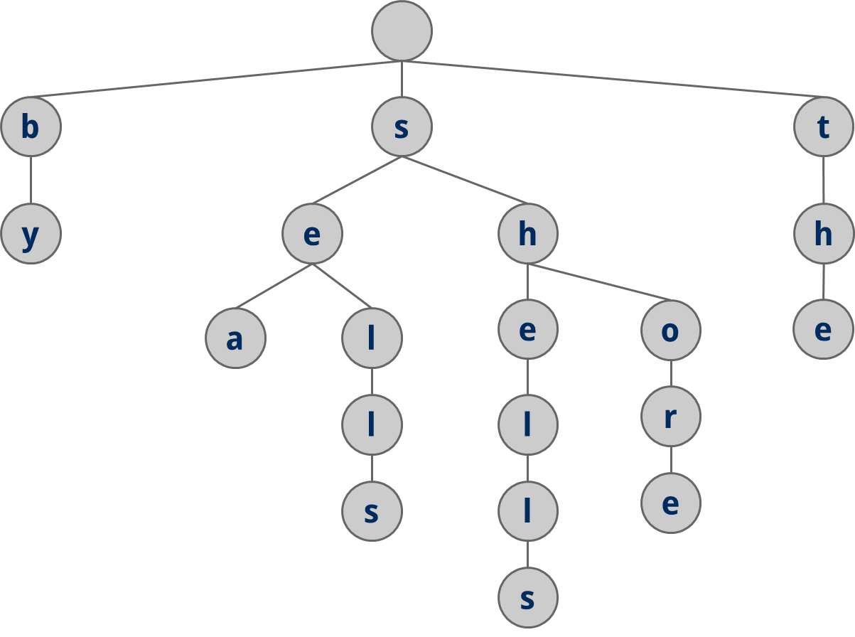
R-way trie (lecture example)
she, sells, sea, shells, by, the, sea, shore (Keys are on nodes, not on edges)
Worst case bounds by the character length of the string
false
false
false
false
false
true
false
false
How can we indicate “she” is a complete word?
true
false
true
true
Using a flag variable in each node?
false
false
false
false
true
true
true

Slide 7
Create R-way trie
shells, she
Special node (starting of any string)
s
h
e
l
l
s
s
false
h
false
Is this approach good?
e
false
true
l
false
l
false
s
true

Slide 8
The ugly truth
she, sea
s
false
?
?
1 link for letter “e”
1 link for letter “h”
a
c
e
h
1 node = 26 links + 1 flag variable
The same prefix? Impossible combinations?
Can we do it better?

Slide 9
De la Briandais (DLB)
Replace the fixed link array by a flexible linked list
s
a
b
c
d
e
f
g
h
i
j
k
l
m
n
o
p
q
r
s
t
u
v
w
x
y
z
head
Linked-list
next
next
next
s
e
h

Slide 10
Trade off
Save a lot of space, especially when the real case has sparse strings
Increase searching time. Why?
R-way trie: Directly go to a child in the array
DLB: linearly go the child in the linked list
s
e
h

Slide 11
Create a DLB
shells, she, sea, seat
s
h
e
l
l
s
false
s
s
e
a
t
false
false
h
e
false
e
a
true
true
false
l
true
t
false
l
true
s

Slide 12
Delete a word in DLB
shells
If the path does not belong to other words, remove.
Otherwise, leave it alone.
sea
false
s
false
false
h
e
A true node
stop
true
e
false
a
true
Change to false, has a child
stop
False, no children
delete
false
l
true
t
False, no children
delete
false
l
Change to false
no children: delete
s
false
true

Slide 13
Exercises (on paper)
RST:
Create a tree for: 2, 3, 4, 6
Delete values: 4, 6
DLB:
Create a tree for: baby, bad, bank, box, dad, dance
Delete words: bad, bank, dance

Slide 14
Exercises RST (creation)
0
1
1
0
1
0
1
0
0
2
3
4
6

Slide 15
Exercises RST (deletion)
0
1
0
1
2
3

Slide 16
Exercise DLB (creation)
b
d
a
a
o
b
d
n
x
d
n
true
true
true
c
true
y
k
true
e
true

Slide 17
Exercise DLB (deletion)
b
d
a
a
o
d
b
x
true
true
true
y

